Slide 1

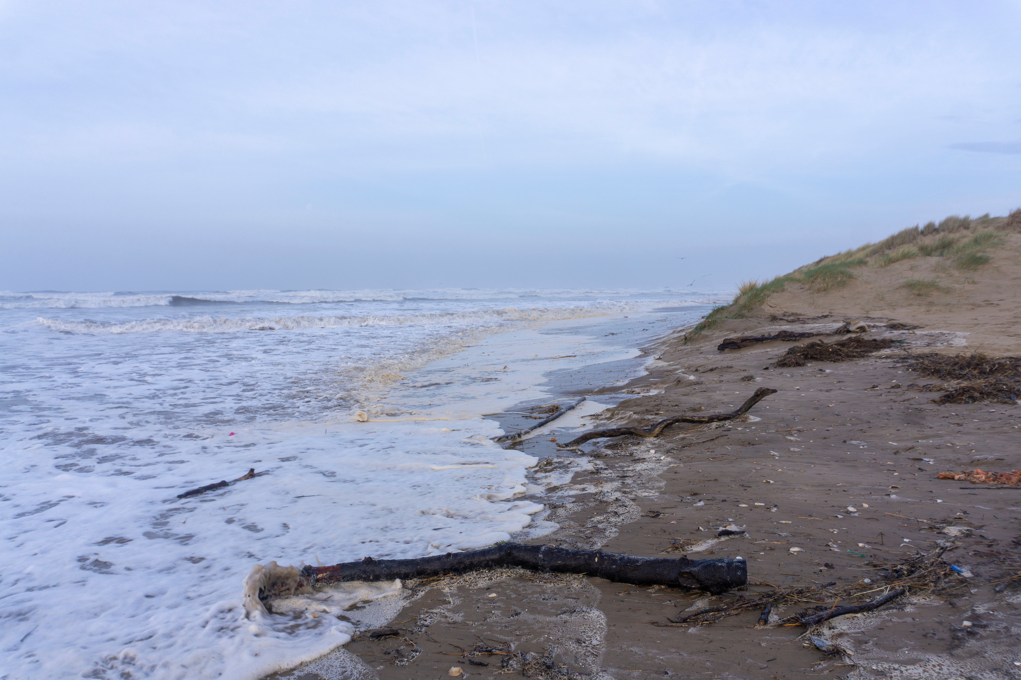


EROSION
Explore the impact of climate change on our coastlines...

Slide 2
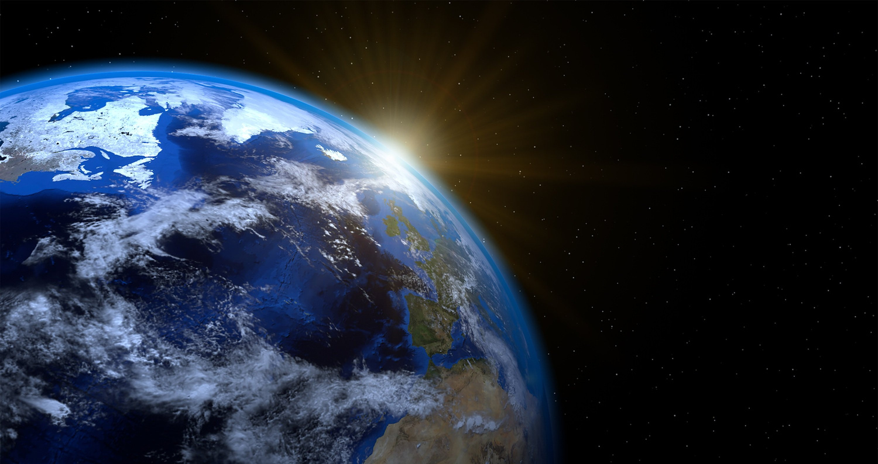
LEARNING OUTCOMES
By the end of this presentation you will have learned:
What erosion is
How erosion is affecting our coastline
The features of erosion
How we currently slow erosion

Slide 3
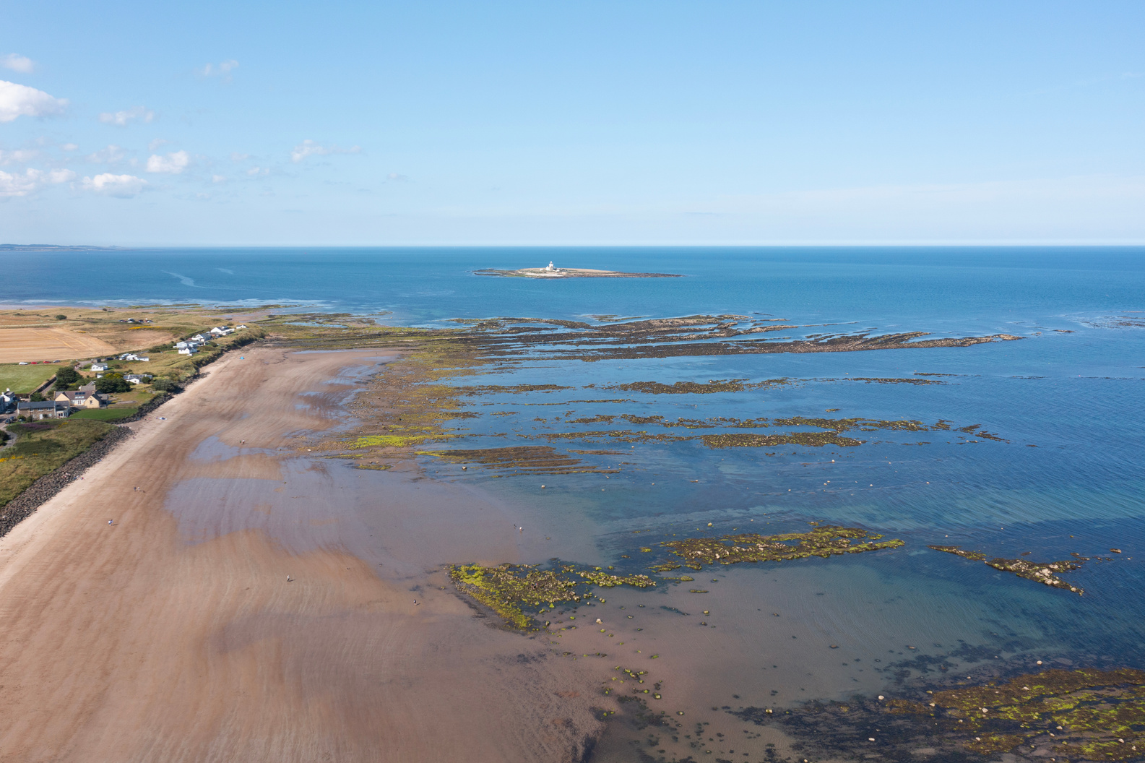
GETTING TO KNOW THE COAST
List some features you might find at the coast:
Cliffs
Beaches
River mouths
Mudflats
Rocky shore
Harbours

Slide 4
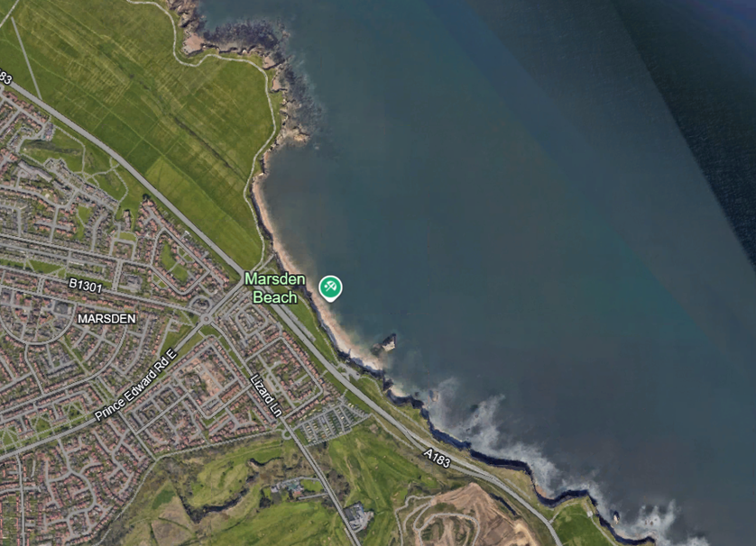
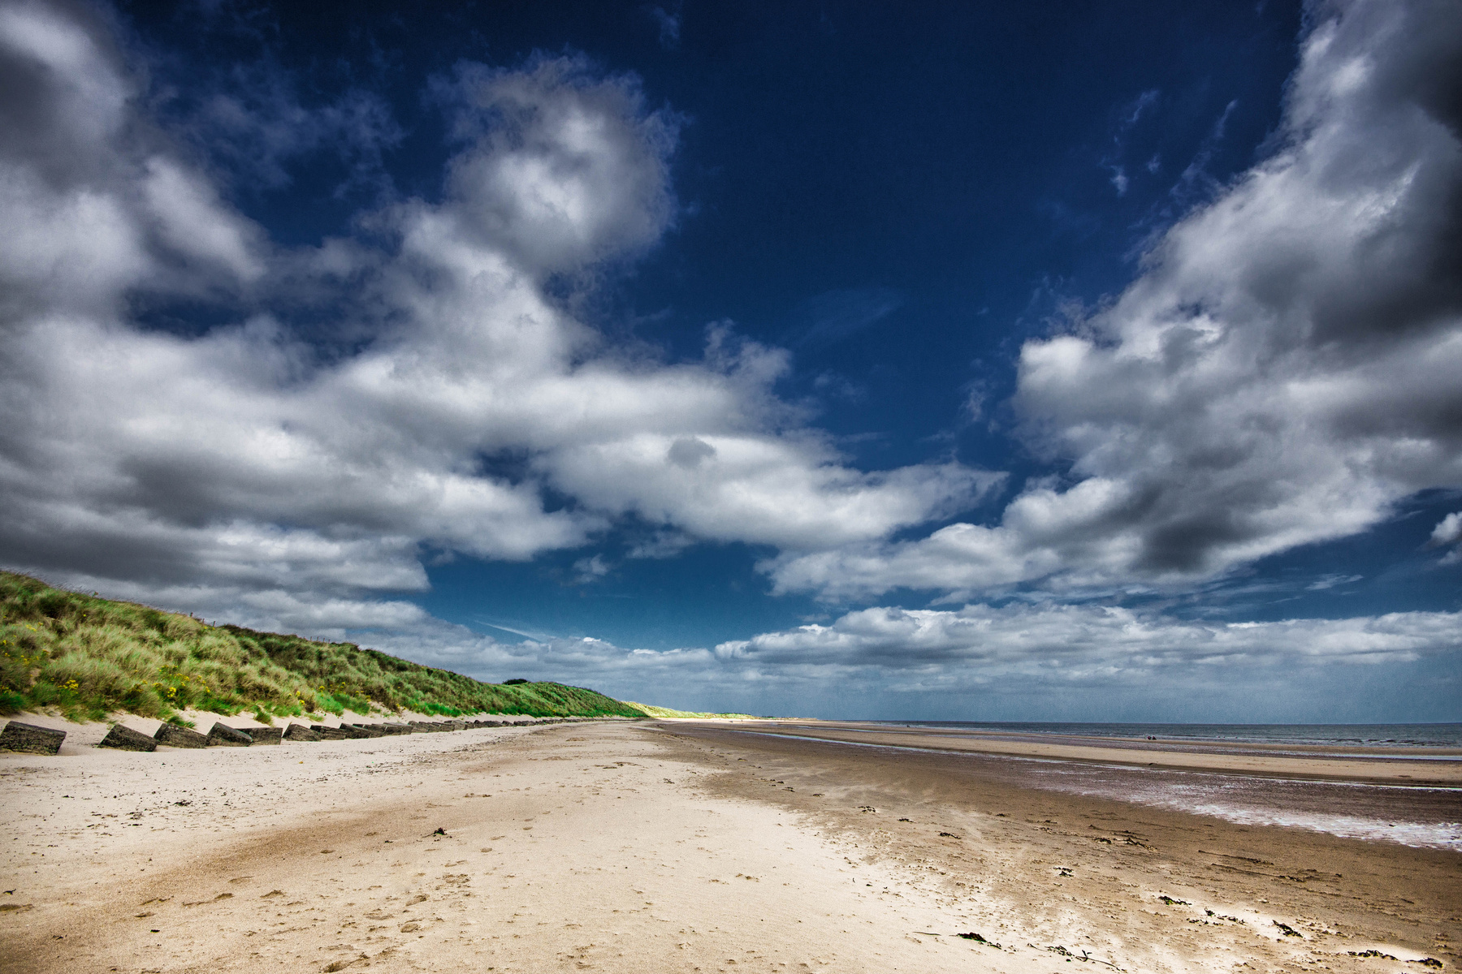
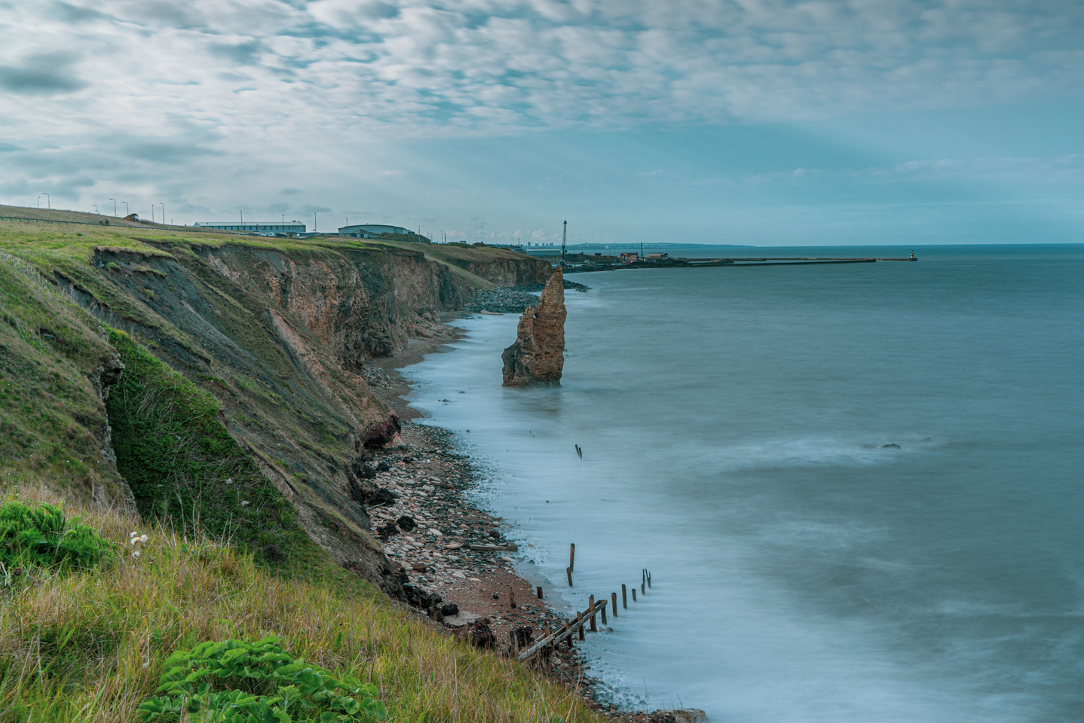
GETTING TO KNOW THE COAST
Coasts are always changing, but what does a typical coast look like?
There are different types of coastlines, and they are shaped by how water moves in the area, nearby rivers, and the kind of rock found there.

Slide 5
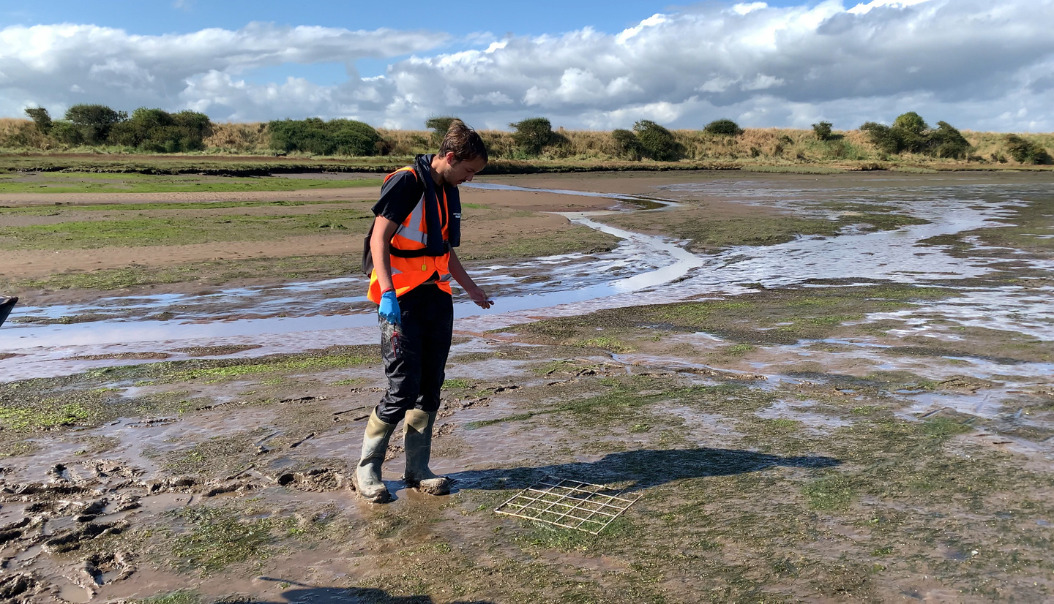
ESTUARIES
Where rivers meet the sea, you might find estuaries, where fresh water mixes with salt water, and where quite often you might find marsh areas and a lot of mud!
This mud is washed downstream in the river to settle at the river mouth.

Slide 6
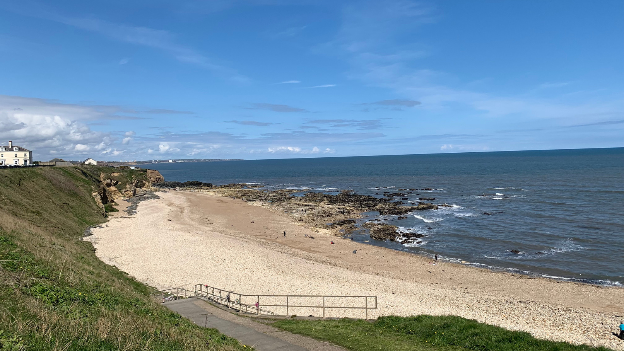
DEPOSITION
In areas where the coast is sheltered from the open ocean, the water is calmer and the waves slower, and so sand can be ‘deposited’ (dropped) here to form long, sandy or stony beaches. On these beaches you might even find mounds of sand called dunes!
Bays are an excellent example of these sheltered areas...

Slide 7
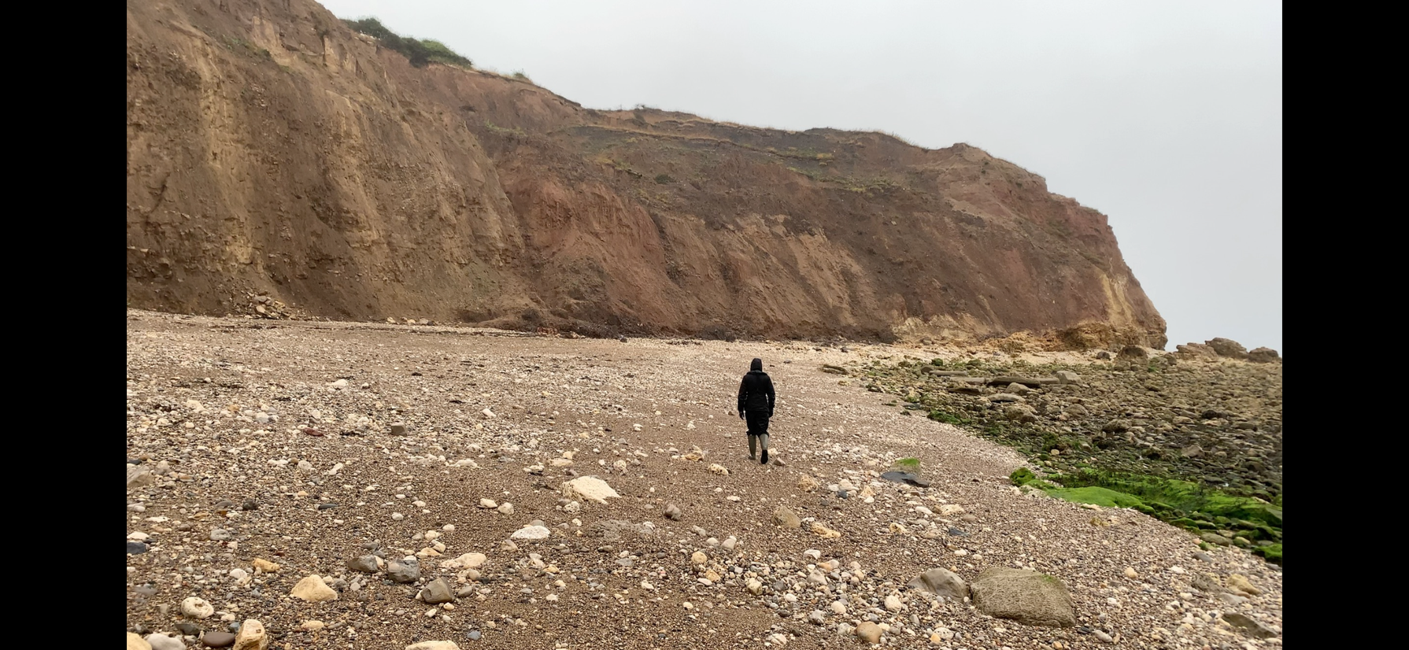
HEADLANDS
In areas with harder rock, such as volcanic rock, parts of the coast might jut out into the sea. That is because the harder rock takes longer to ‘erode’.
What do you think ‘erode’ means?
Headlands are an excellent example of harder rock jutting out into the sea...

Slide 8
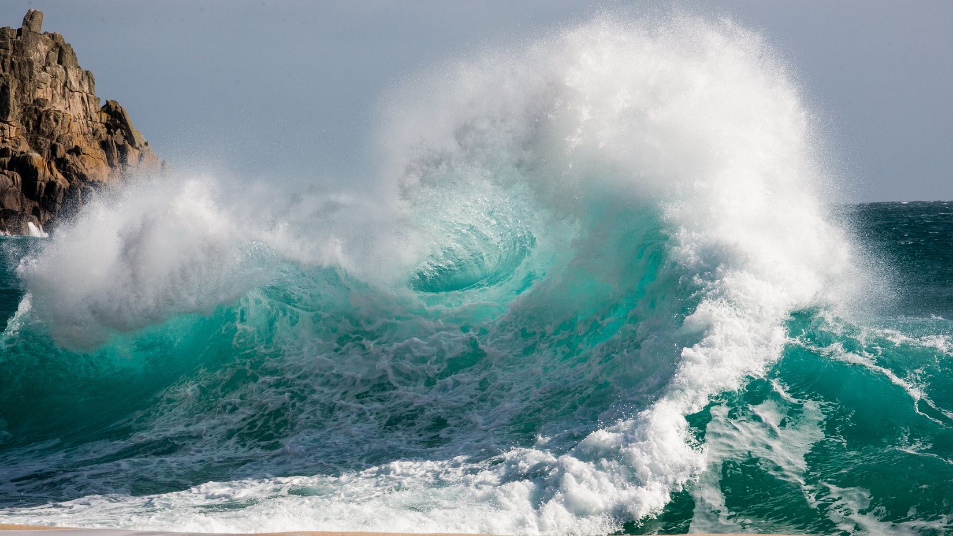
EROSION
Our coasts are always changing, because the sea is always moving! Our coasts might move back inland (eroding) or they might move outwards through deposition, with new beaches forming.
Climate change is causing us trouble however, as it is increasing the speed at which our coast erodes.

Slide 9
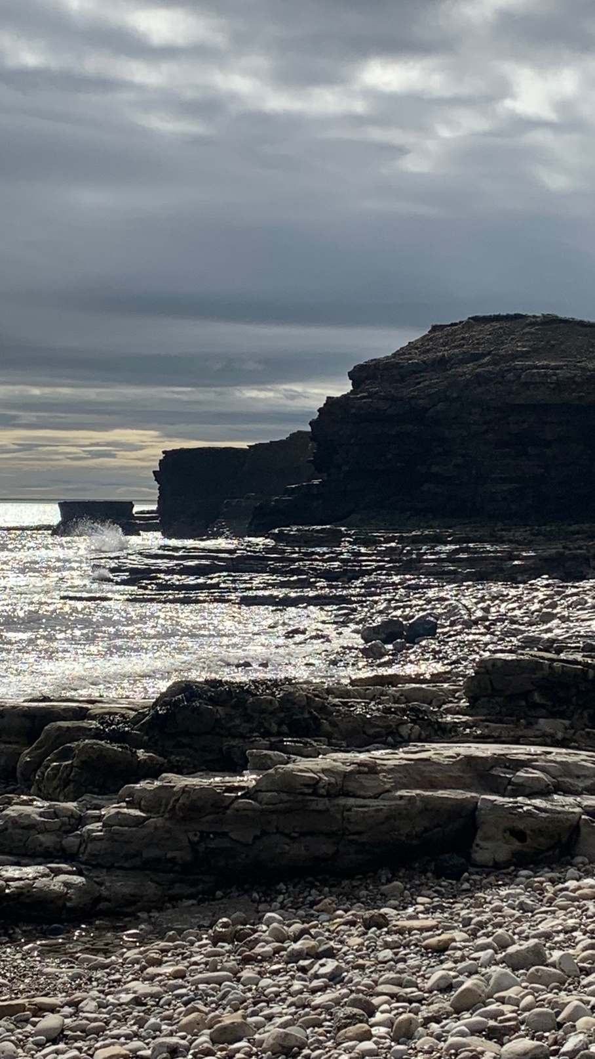
EROSION
Erosion is the breaking up of coastal rock over time, as sea waves crash against the rock. The water breaks off small pieces of rock, and over time this makes the coastline move further and further inland.

Slide 10
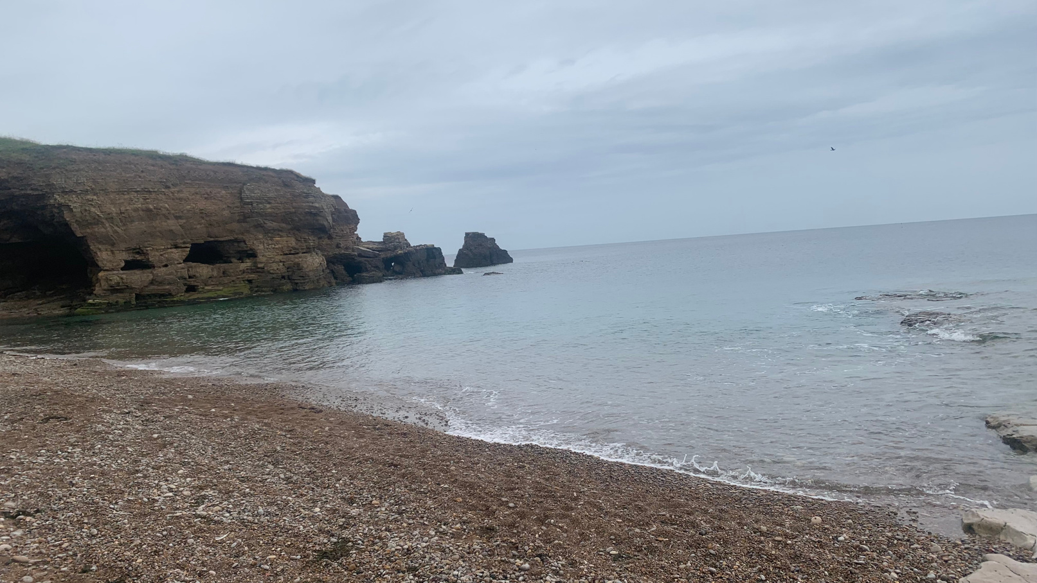
EROSION
The process of erosion follows a similar pattern that repeats again and again, year after year.
As rocks erode, we get coastal features, many of which you may recognise!

Slide 11
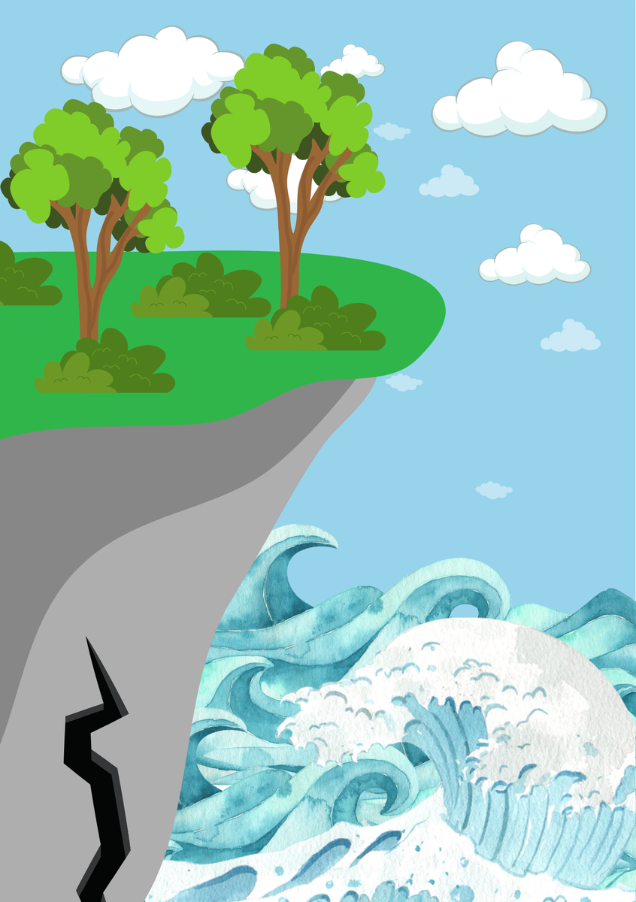
FEATURES OF EROSION
The process starts with a crack forming in the rock...

Slide 12
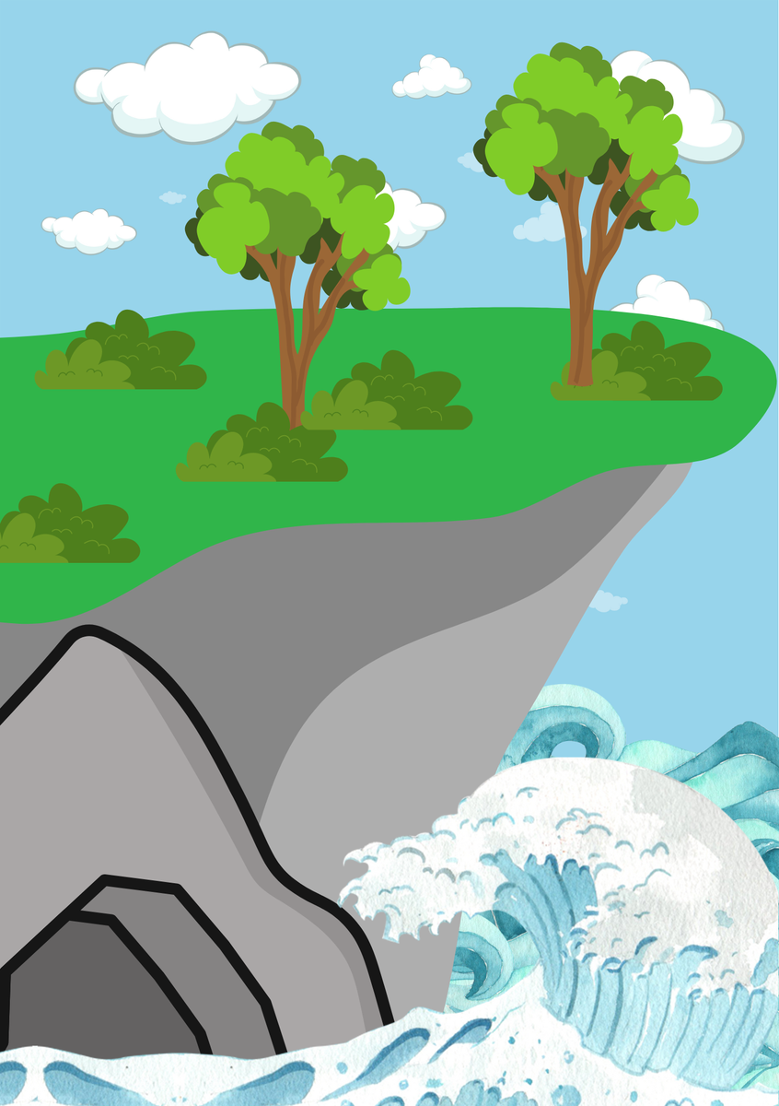
FEATURES OF EROSION
The waves crashing against the crack widen it over time, until it becomes a cave!

Slide 13
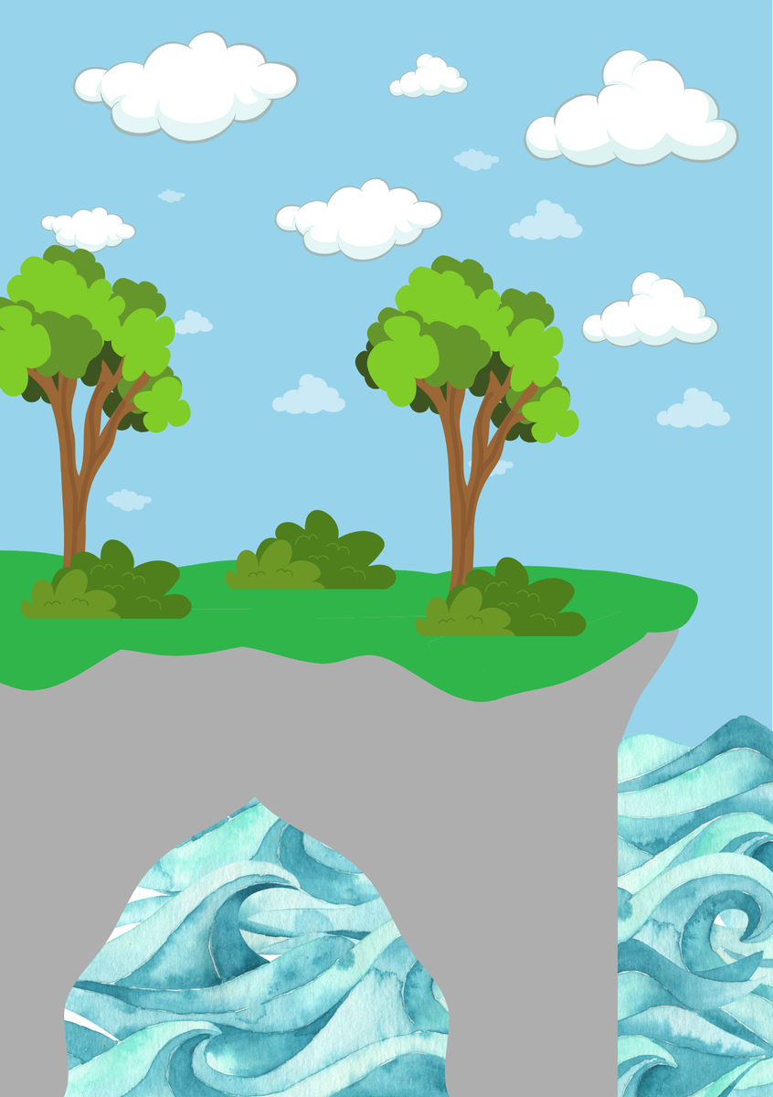
FEATURES OF EROSION
Eventually, if the cave is in a headland, the waves can erode the back of the cave and form an arch...

Slide 14
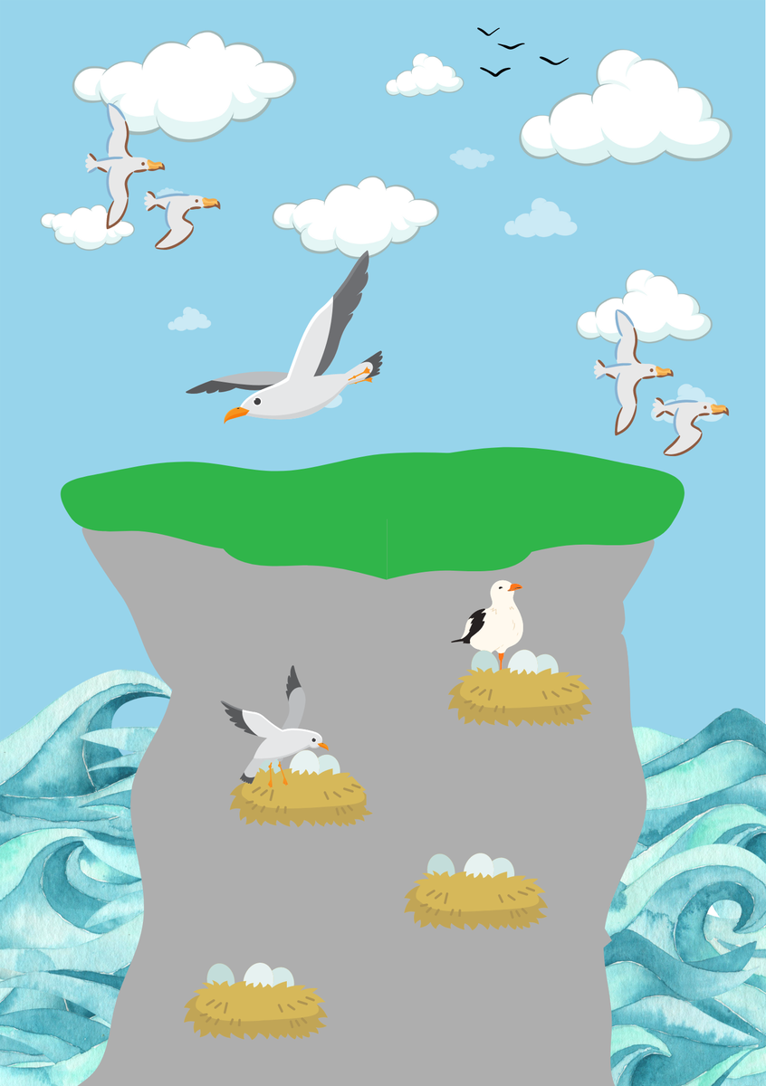
FEATURES OF EROSION
This arch collapses eventually, leaving a stack...

Slide 15
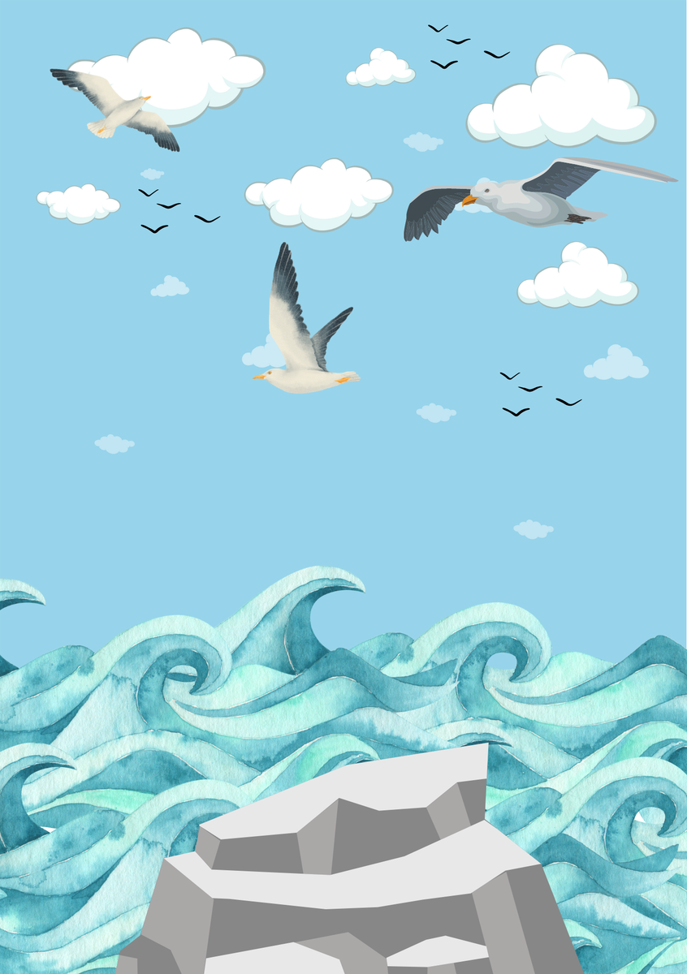
FEATURES OF EROSION
The stack eventually collapses into a stump, and the stump slowly erodes away until nothing is left. Then, the whole process starts all over again!

Slide 16
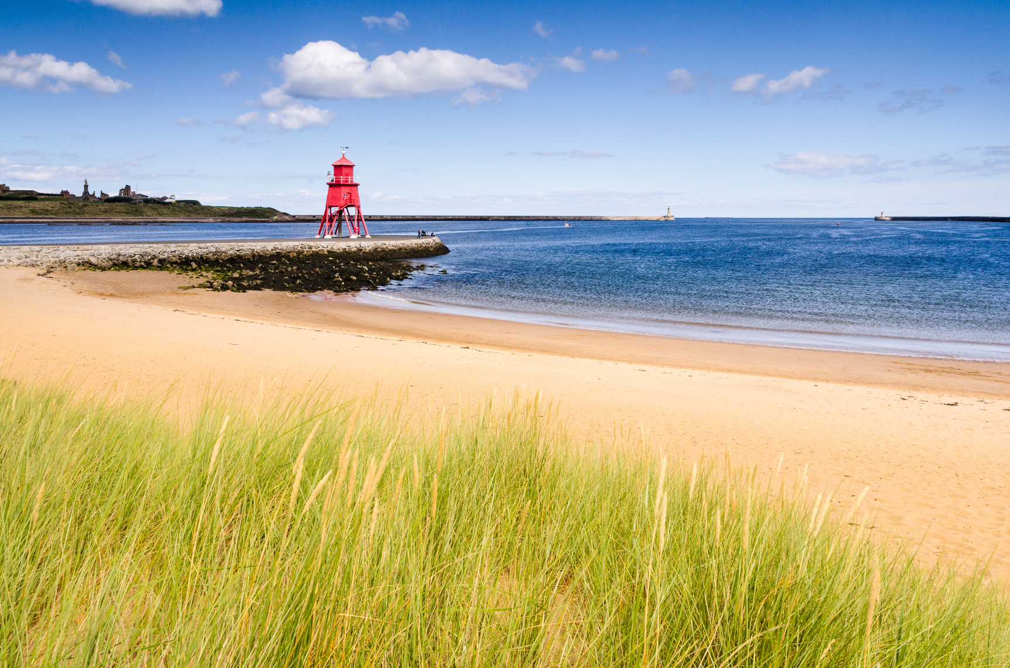
THE PROBLEM
Climate change is causing bigger storms, and the sea level is rising. This means our coasts are eroding faster than before. Lots of businesses, homes, roads, and other important places are built near the coast. So, faster erosion is a big problem!

Slide 17
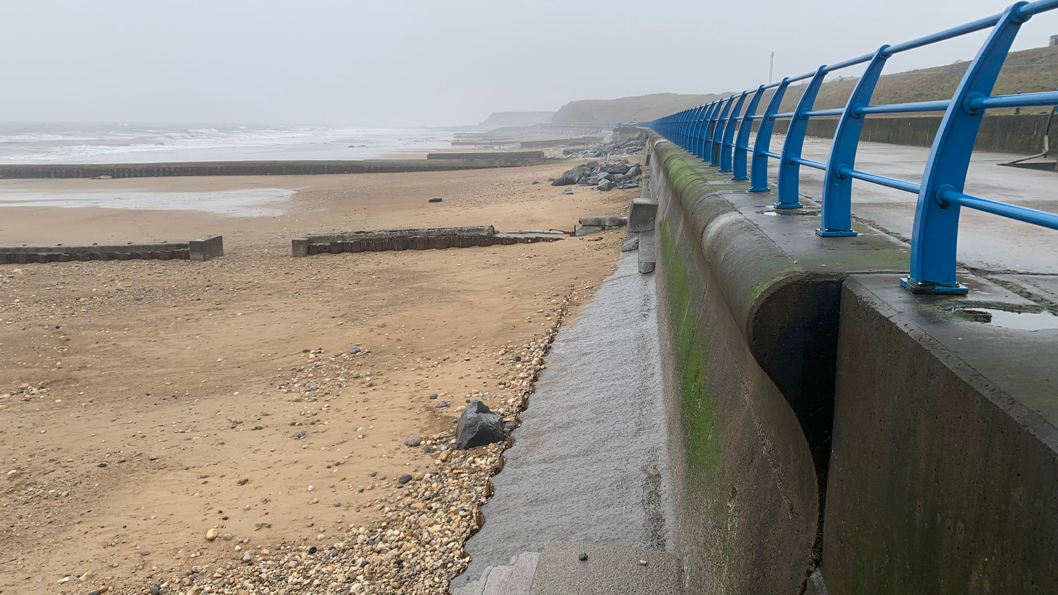
THE SOLUTION
There are a few ways we can slow down erosion thankfully! We can:
Build sea defences like sea walls (this is called hard engineering)
Rebuild things away from the coast (like moving roads backwards inland)
Use nature to help reduce wave energy before the waves reach the shore (this is called soft engineering)

Slide 18
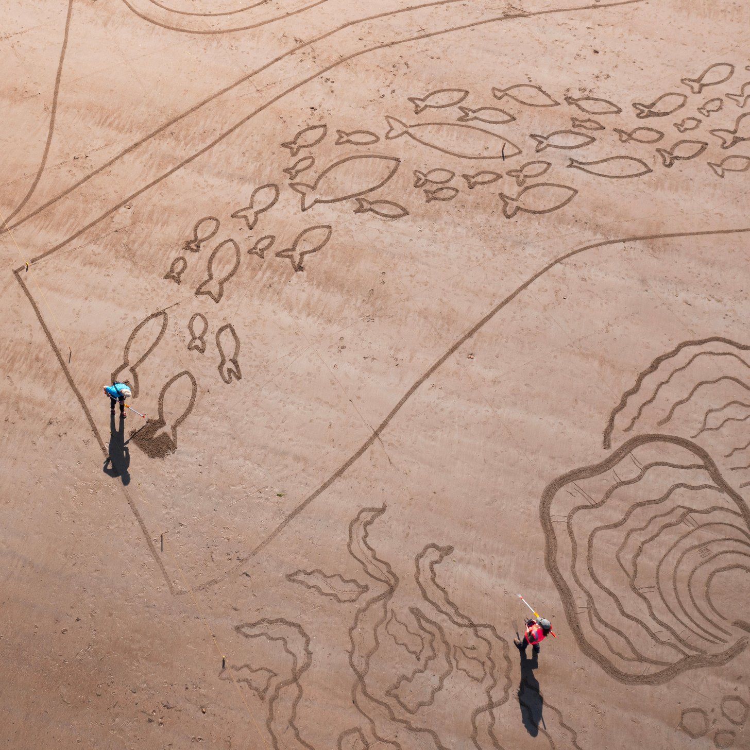
ACTIVITY TIME
You can now take the quiz and complete the activity in the accompanying PDF.
Notes:
07854109229 Beverley Walton

Slide 19
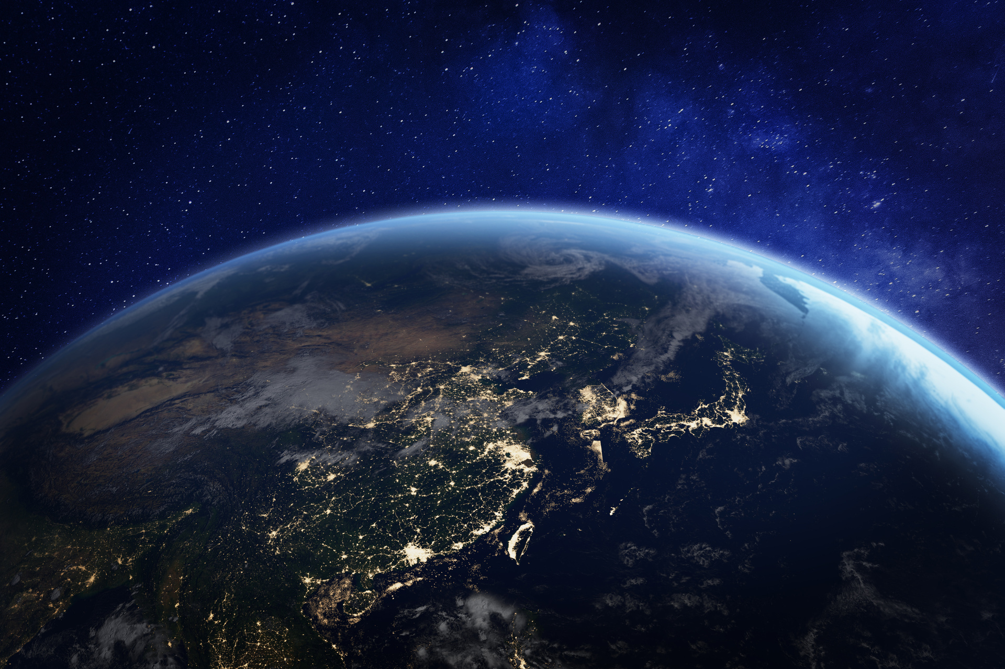
QUIZ TIME!
EROSION

Slide 20
WHAT IS EROSION ?

Slide 21
WHAT IS EROSION?
Wearing away of the rocks through the action of the waves on the coastline.

Slide 22
NAME THIS FEATURE...

Slide 23
NAME THIS FEATURE...
CRACK

Slide 24
NAME THIS FEATURE...

Slide 25
NAME THIS FEATURE...
CAVE

Slide 26
NAME THIS FEATURE...

Slide 27
NAME THIS FEATURE...
ARCH

Slide 28
NAME THIS FEATURE...

Slide 29
NAME THIS FEATURE...
STACK

Slide 30
NAME THIS FEATURE...

Slide 31
NAME THIS FEATURE...
STUMP

Slide 32
CLIMATE CHANGE IS:
A) SPEEDING UP EROSION
B) SLOWING DOWN EROSION
C) STOPPING EROSION

Slide 33
CLIMATE CHANGE IS:
A) SPEEDING UP EROSION

Slide 34


To find out more about Stronger Shores follow the link in the QR code to visit our StoryMap, or go to:
https://storymaps.arcgis.com/stories/7da0c07ee3d245c9b273c6538bf0e1db

