Slide 1

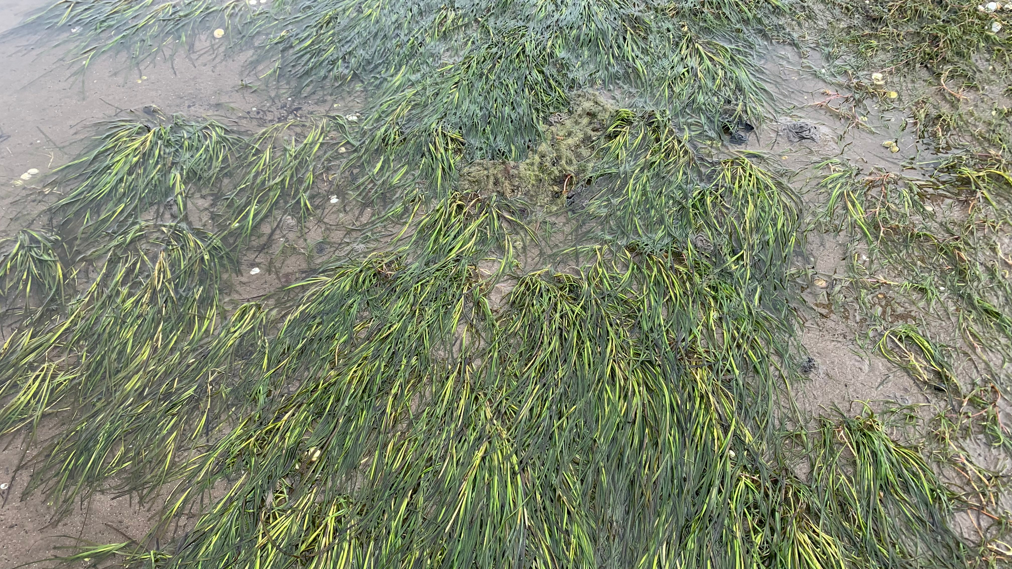
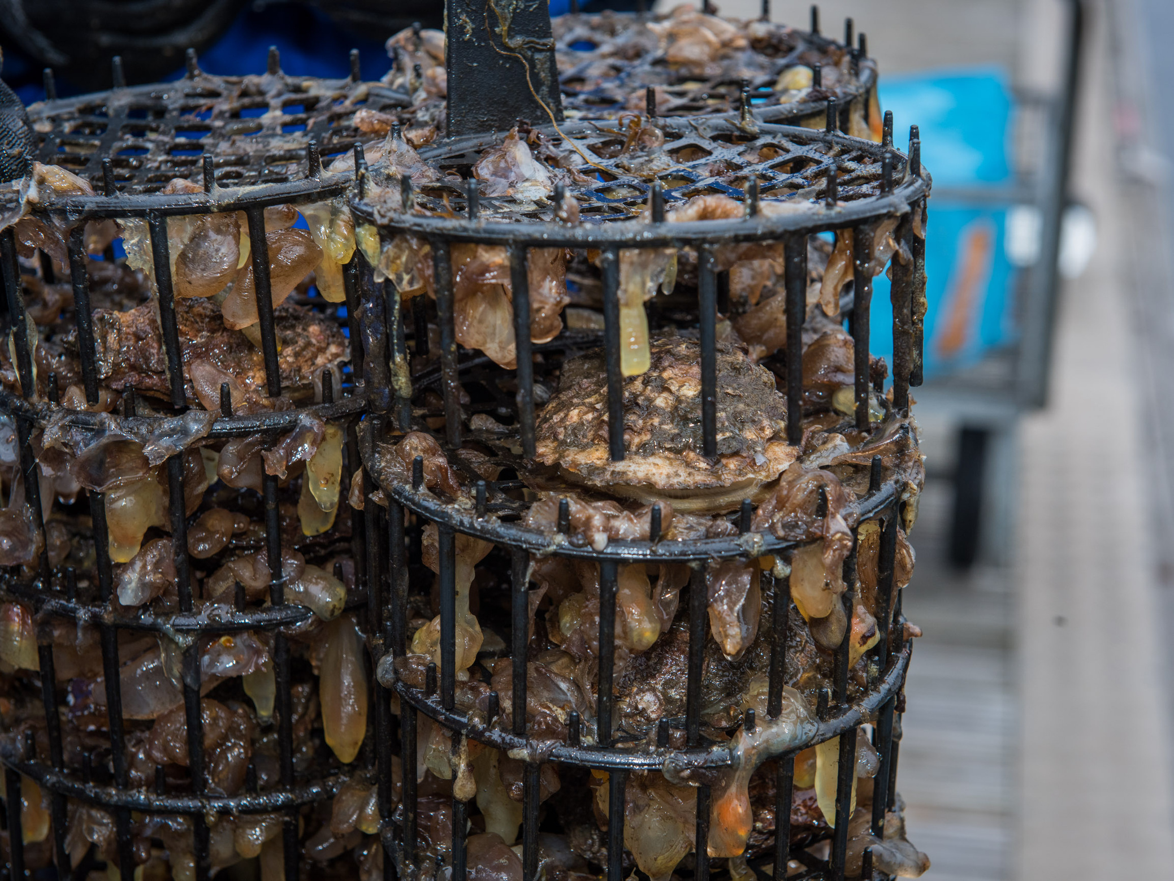

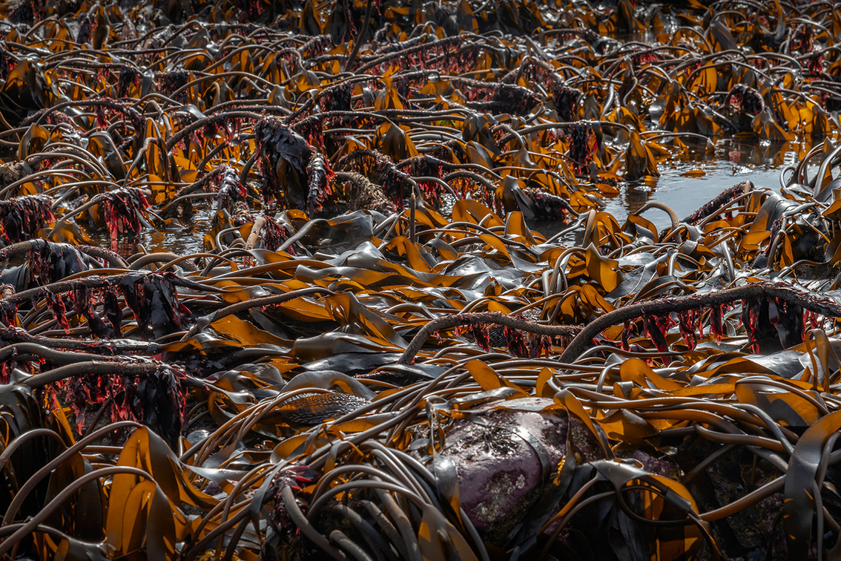

COASTAL DEFENCE
Explore how nature can protect our coasts...

Slide 2
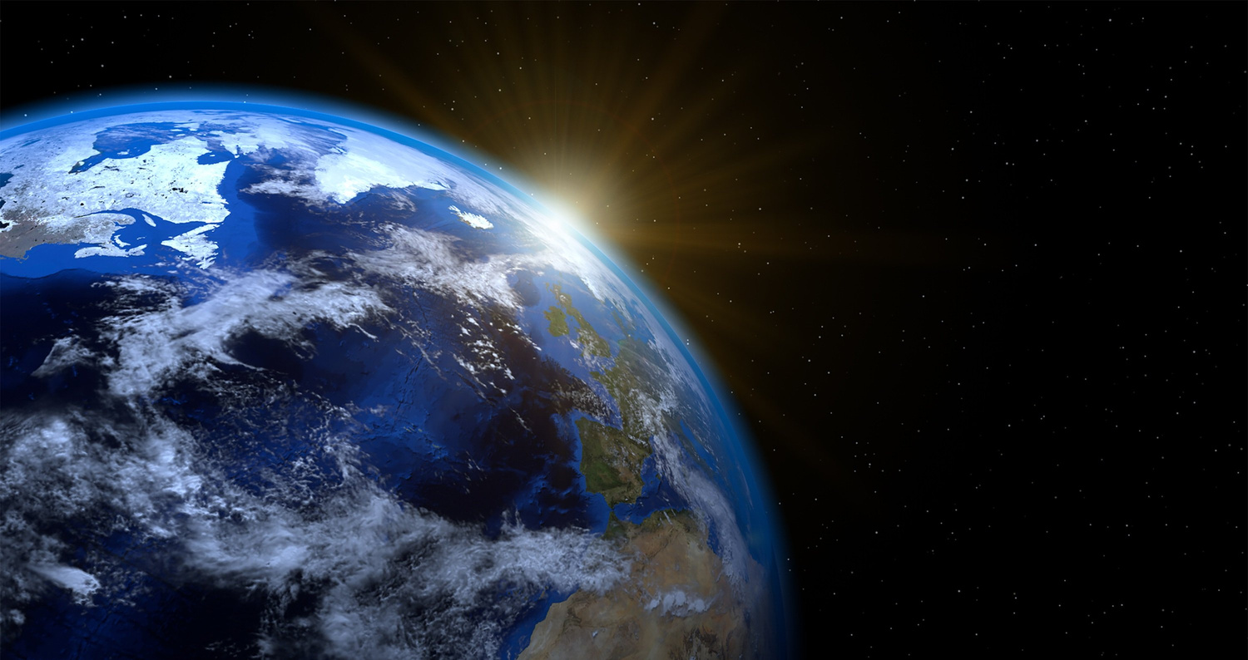
LEARNING OUTCOMES
By the end of this presentation you will have learned:
That marine habitats provide various benefits to both humans, and the coastal environment.
The difference between a plant, and algae.
That oysters can help to filter water to clean it.
That seagrass roots help to bind the sediment it grows in.

Slide 3
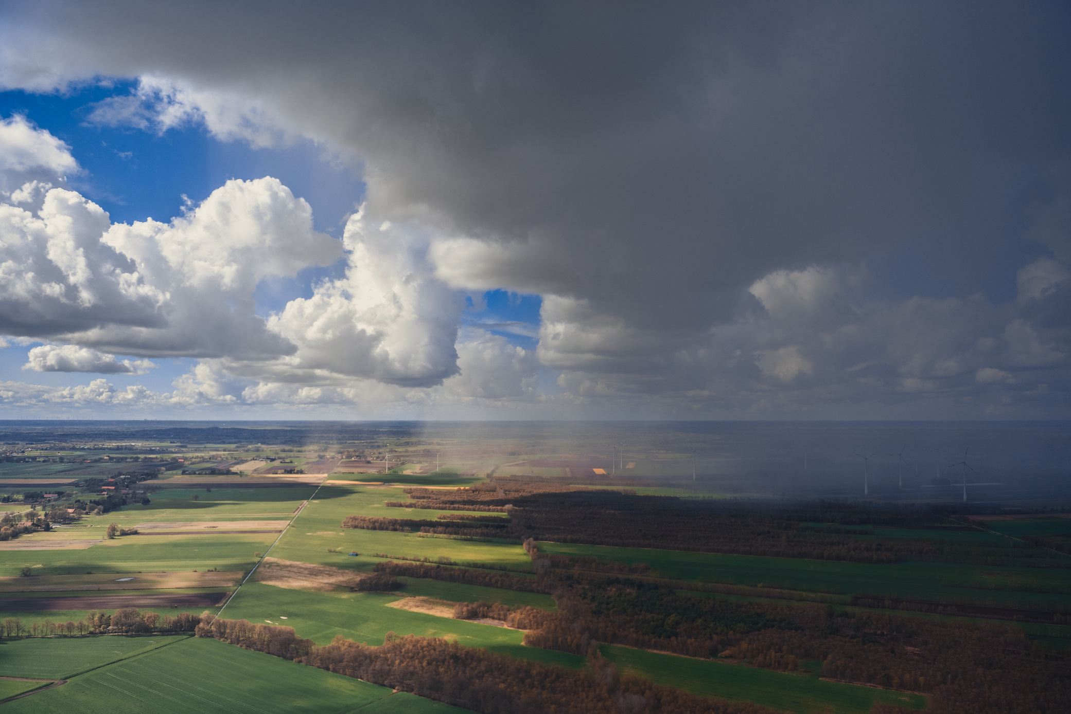
WHAT IS STRONGER SHORES?
Stronger Shores is a scientific project that is exploring the benefits of kelp, seagrass and oysters - from protecting our coasts from erosion to providing habitats for marine life, and everything in between...

Slide 4
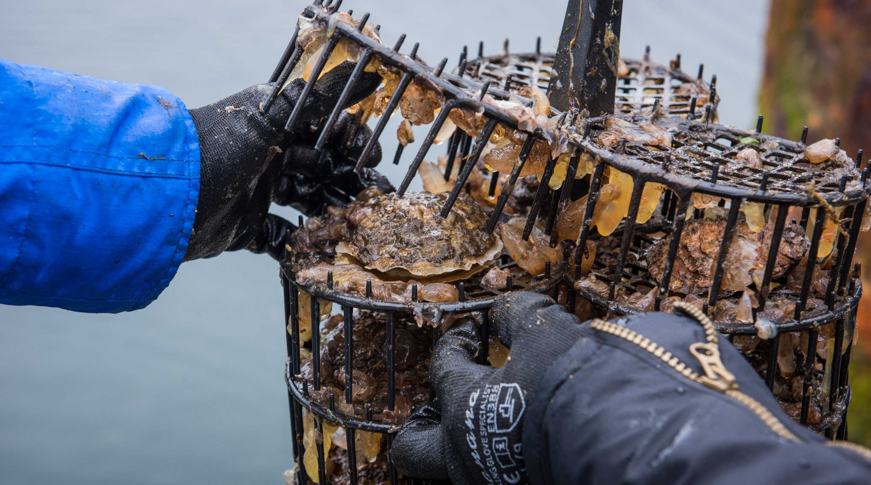
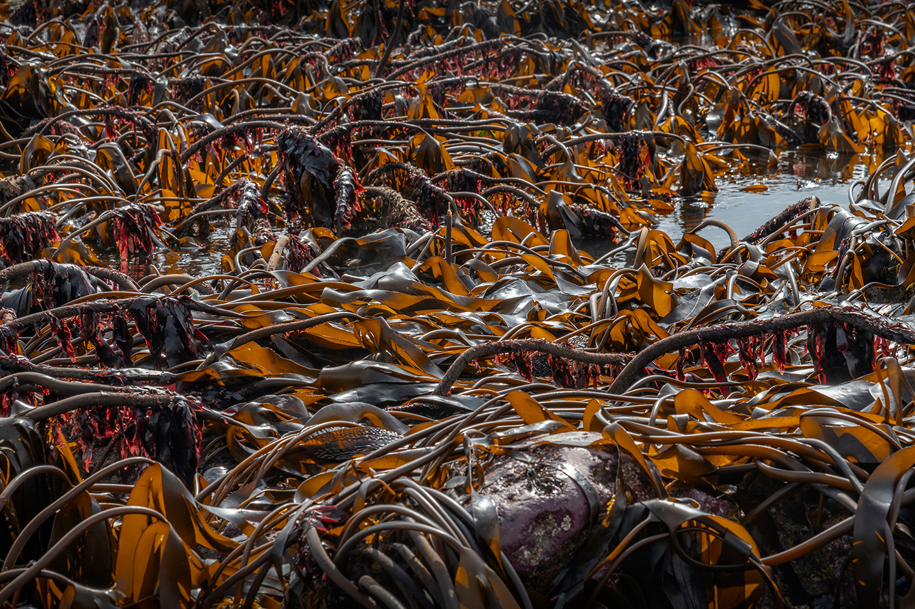
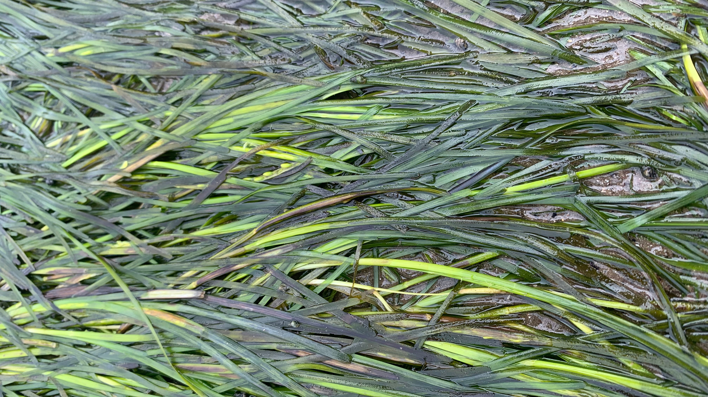
THE SPECIES
SEAGRASS
OYSTERS
KELP

Slide 5
KELP
Kelp is not in fact an animal or a plant, but an algae, a different ‘kingdom’ much like mushrooms are ‘fungi’!
Kelp is actually edible and is considered a very environmentally friendly crop to grow. It doesn’t need fresh water or fertiliser, as it gets everything it needs—water and nutrients—from the surrounding seawater.

Slide 6
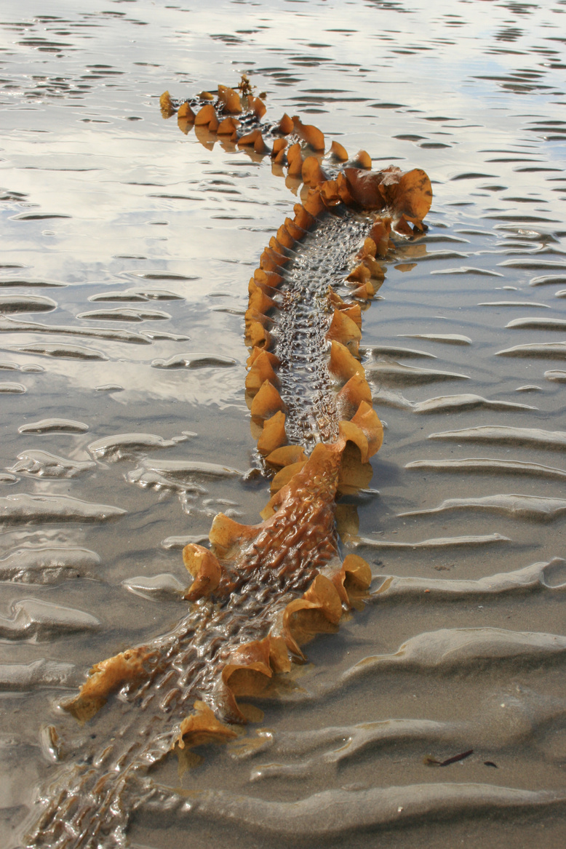
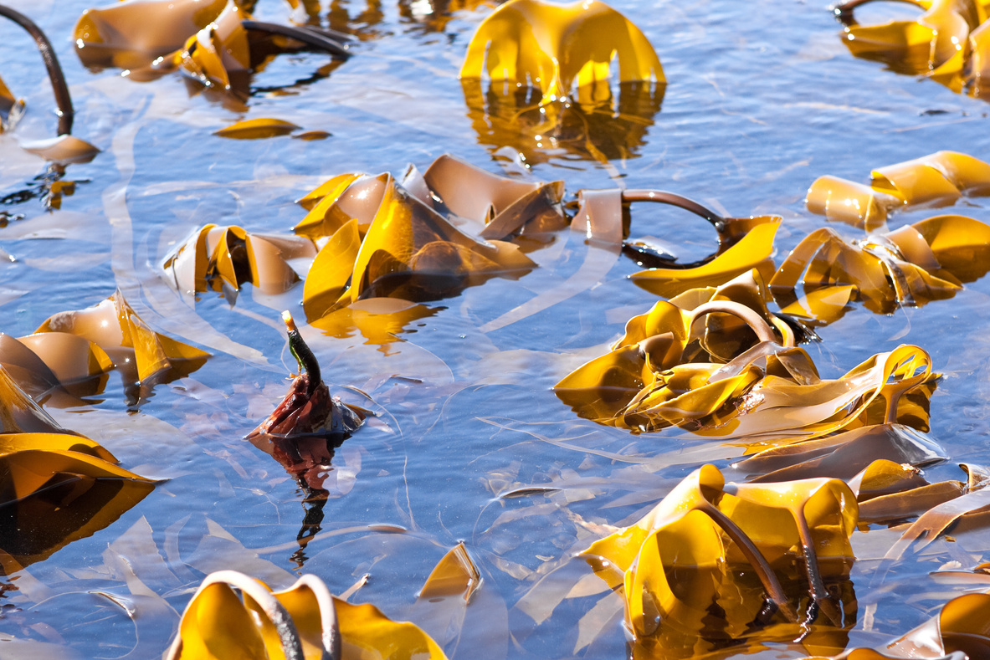
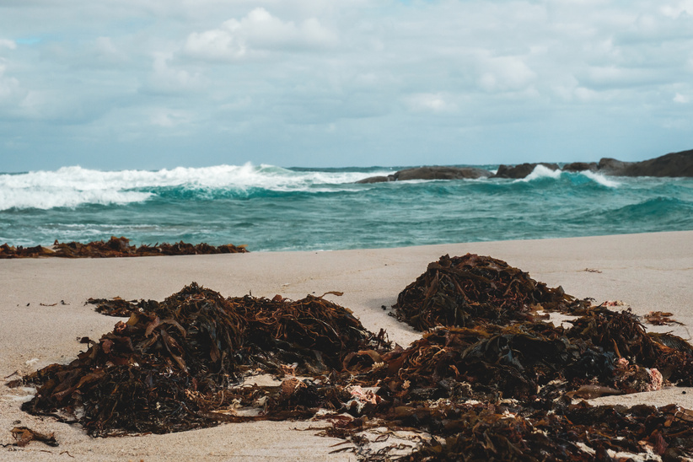
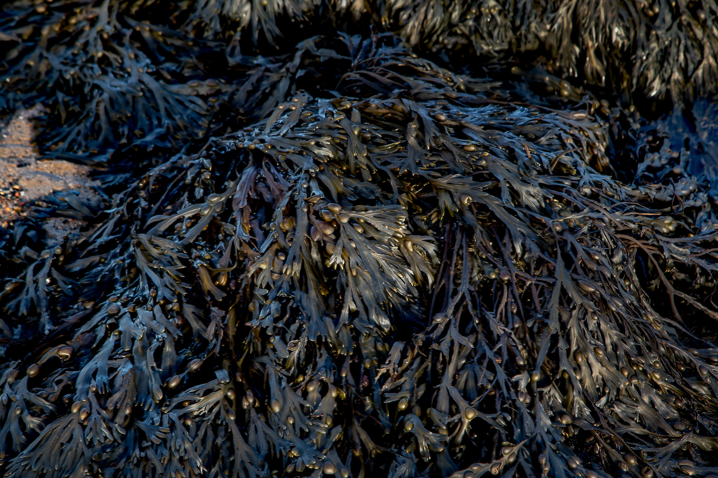
KELP
There are many types of seaweed. Kelp is the term given to describe any of the larger brown seaweeds that grow in cool waters (such as those around the UK).

Slide 7
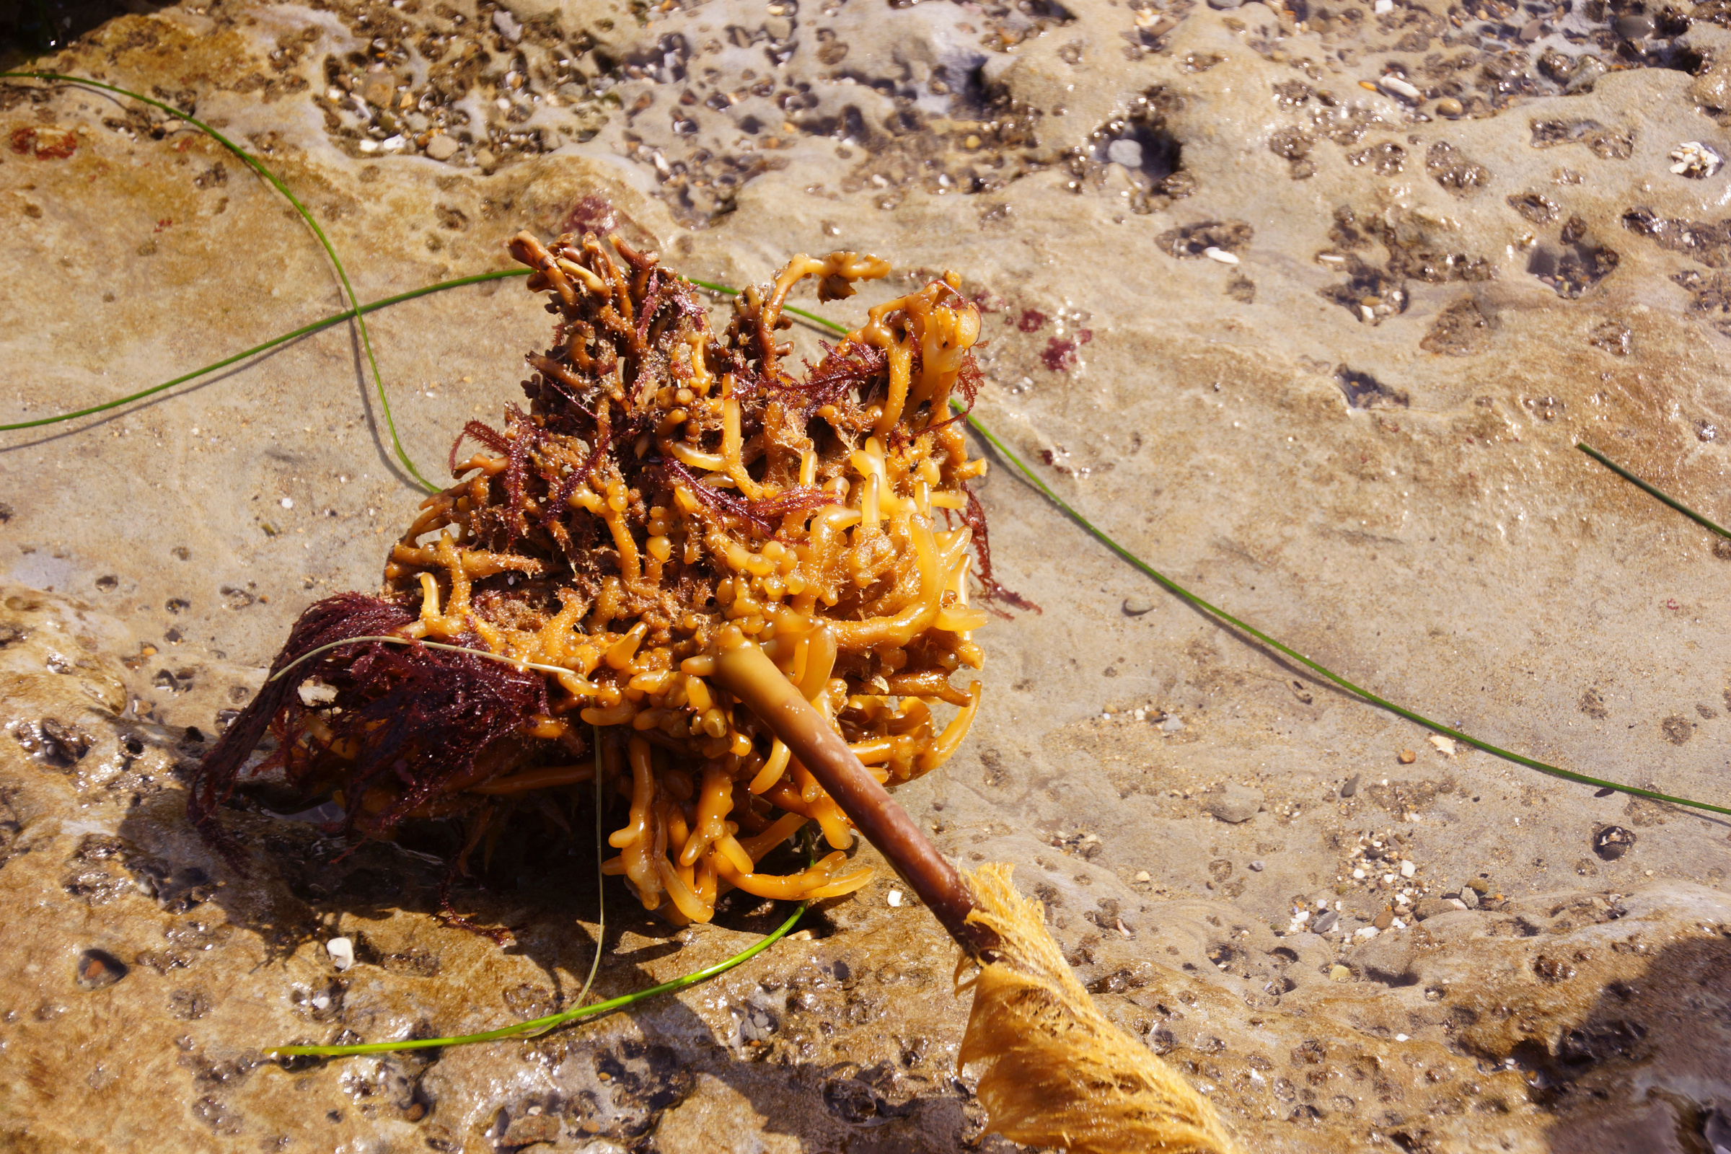
KELP
Why is kelp not a plant?
Roots vs Holdfast:
Plants have roots to take up nutrients and water from the soil. Kelp have a holdfast, this attaches them to the rocks that they grow on, however, the kelp is submerged in water, and so the whole structure can take up nutrients and water!

Slide 8
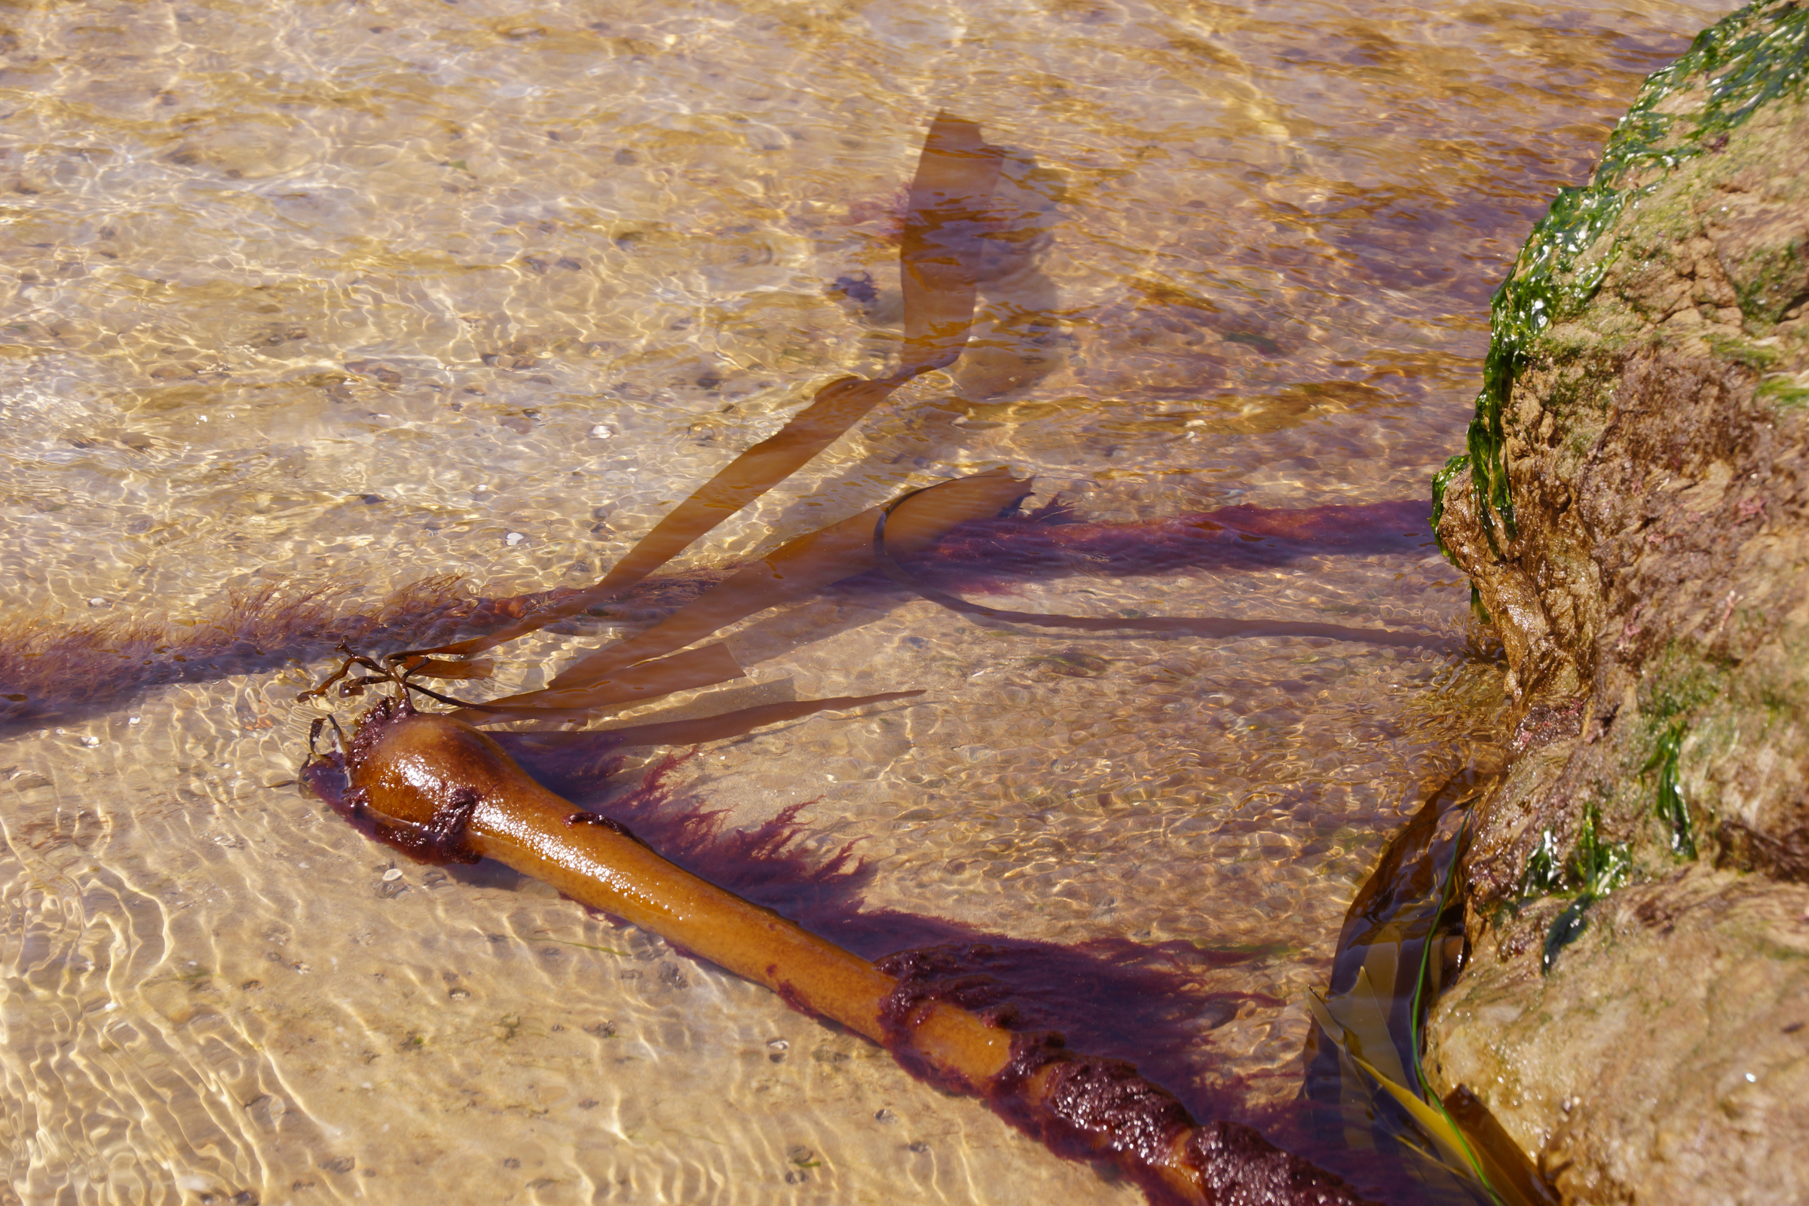
KELP
Why is kelp not a plant?
2. Stem vs. stipe
Plant stems have internal parts that are designed to carry the nutrients and water from the roots to the leaves. The stipe, what looks like the kelp stem, is there to provide support to hold up the kelp’s ‘blades’.

Slide 9
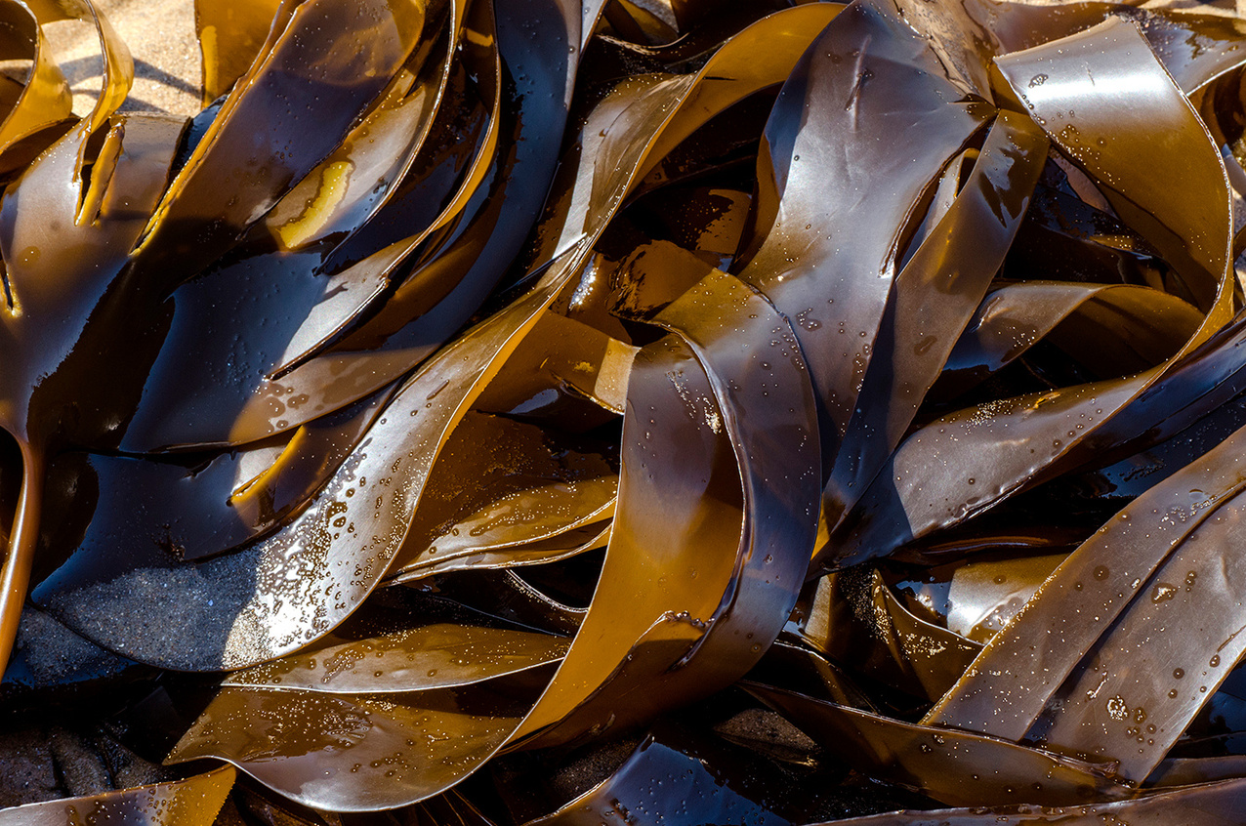
KELP
Why is kelp not a plant?
3. Leaves vs. Blades
What looks to some like leaves on the kelp, is in fact known as blades, with these designed to take up nutrients from the water, as well as to capture sunlight to photosynthesise.

Slide 10
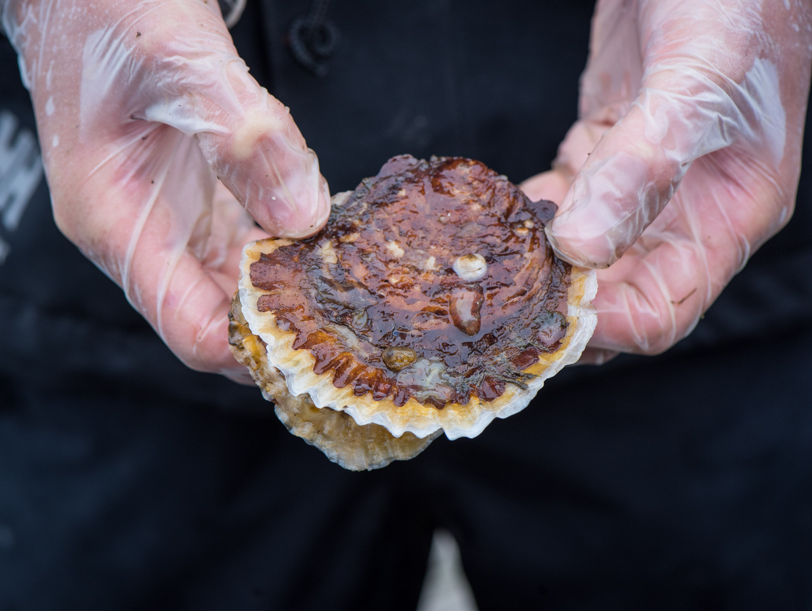
OYSTERS
Oysters are animals that grow a shell around them in order to protect themselves from any predators.
Oysters are filter feeders. This means they pull in water and pass it through their gills. Any tiny bits of food floating in the water get trapped and eaten by the oyster, and the clean water is pushed back out.

Slide 11
OYSTERS
By filtering the water, the oysters help to clean it, which is massively beneficial for both humans, and the surrounding marine life.
Filtering the water clears it, allowing in more light, which is beneficial for kelp and other marine life that requires sunlight.

Slide 12
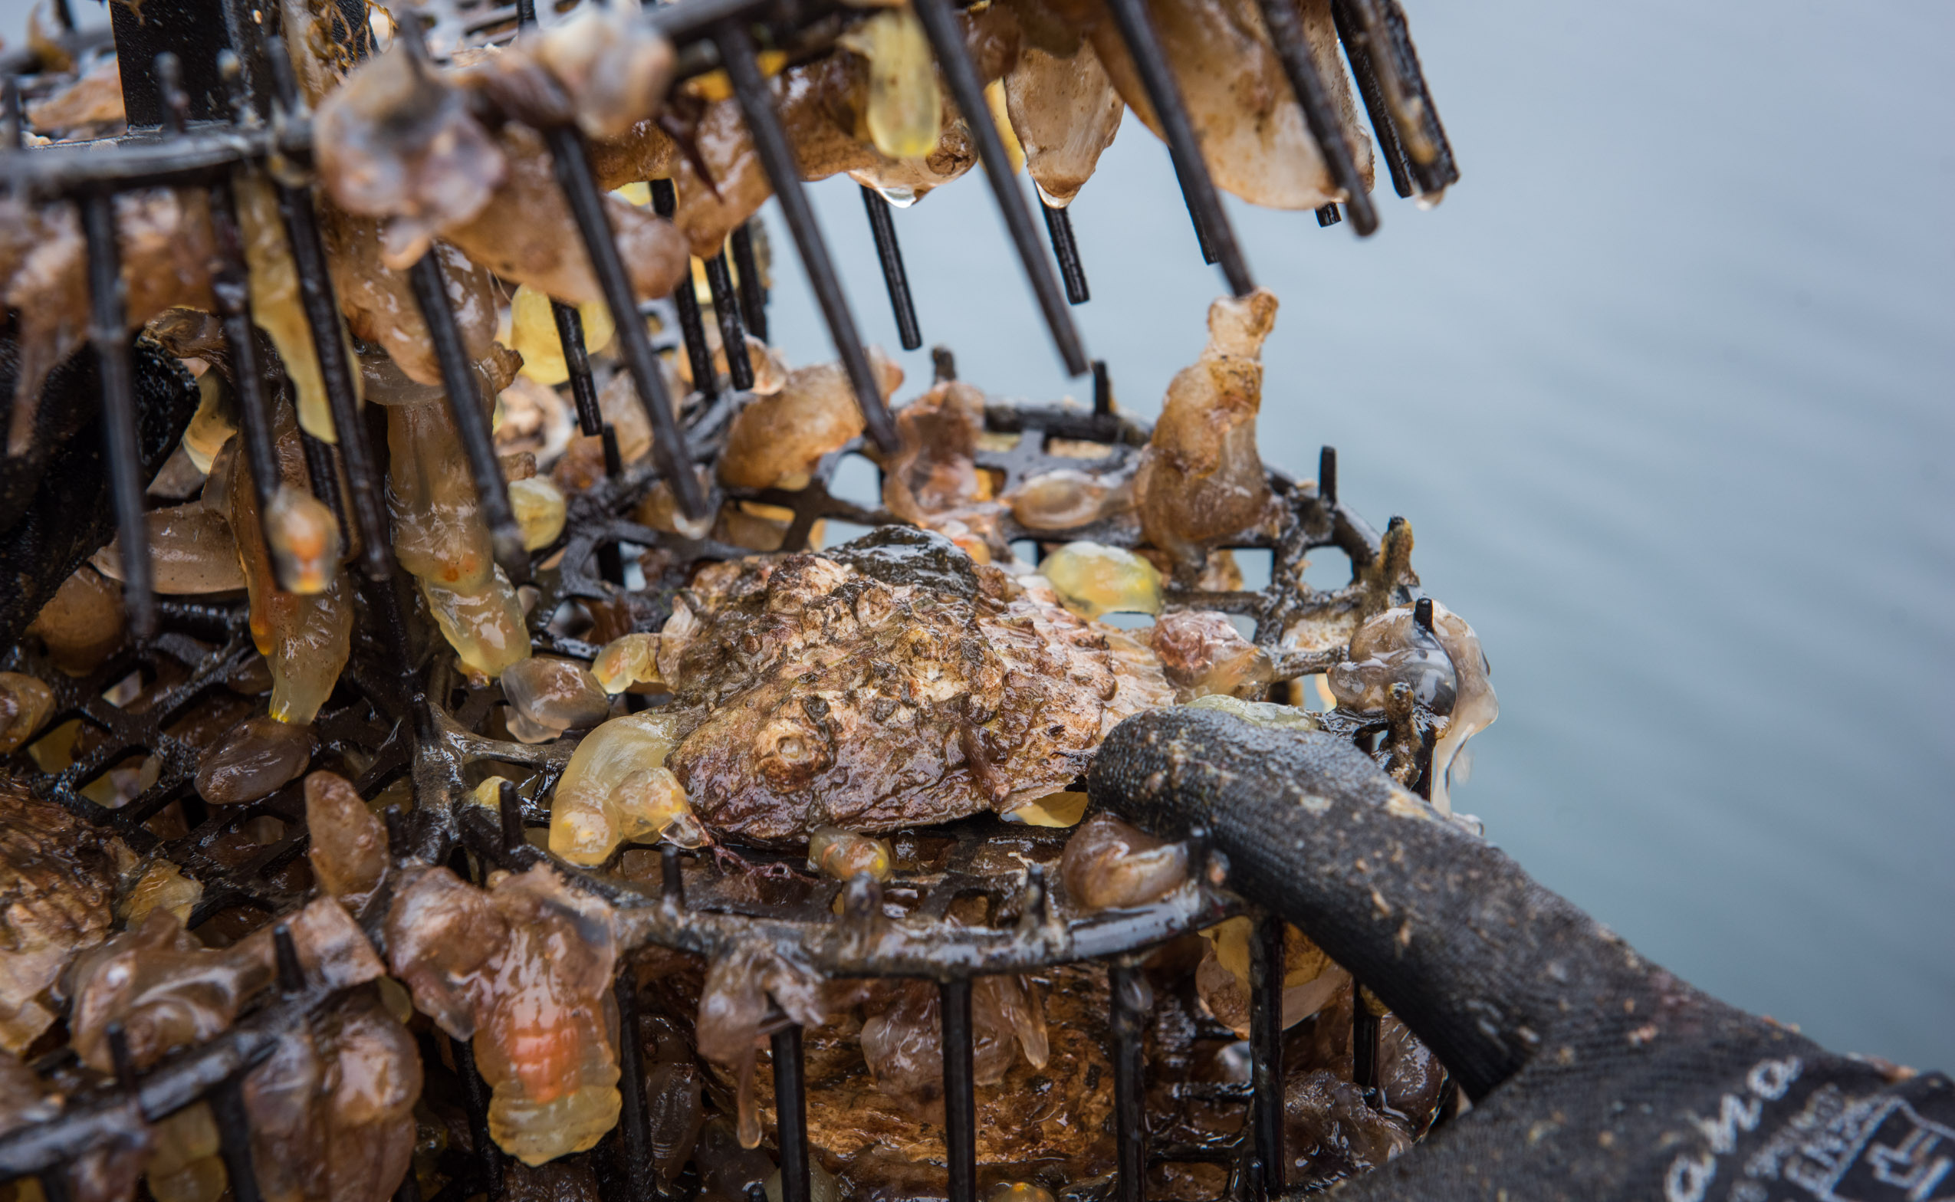
OYSTERS
Oysters also grow in reefs, attaching to each other to create hard structures on the sea bed.
This is very important, as by doing this they create a habitat for marine life to grow on top of them, spaces for fish to live within them, and surfaces for marine life to lay eggs on them.
These oyster reefs therefore help to bring lots and lots of life to an area!

Slide 13
SEAGRASS
Seagrass is our final species. It is the only true flowering marine plant in the world!
Seagrass can be found in flat, sheltered areas, growing in muddy or coarse ‘sediment’ - sediment is the material that settles on the seabed (it can be sand, gravel, mud etc.)

Slide 14
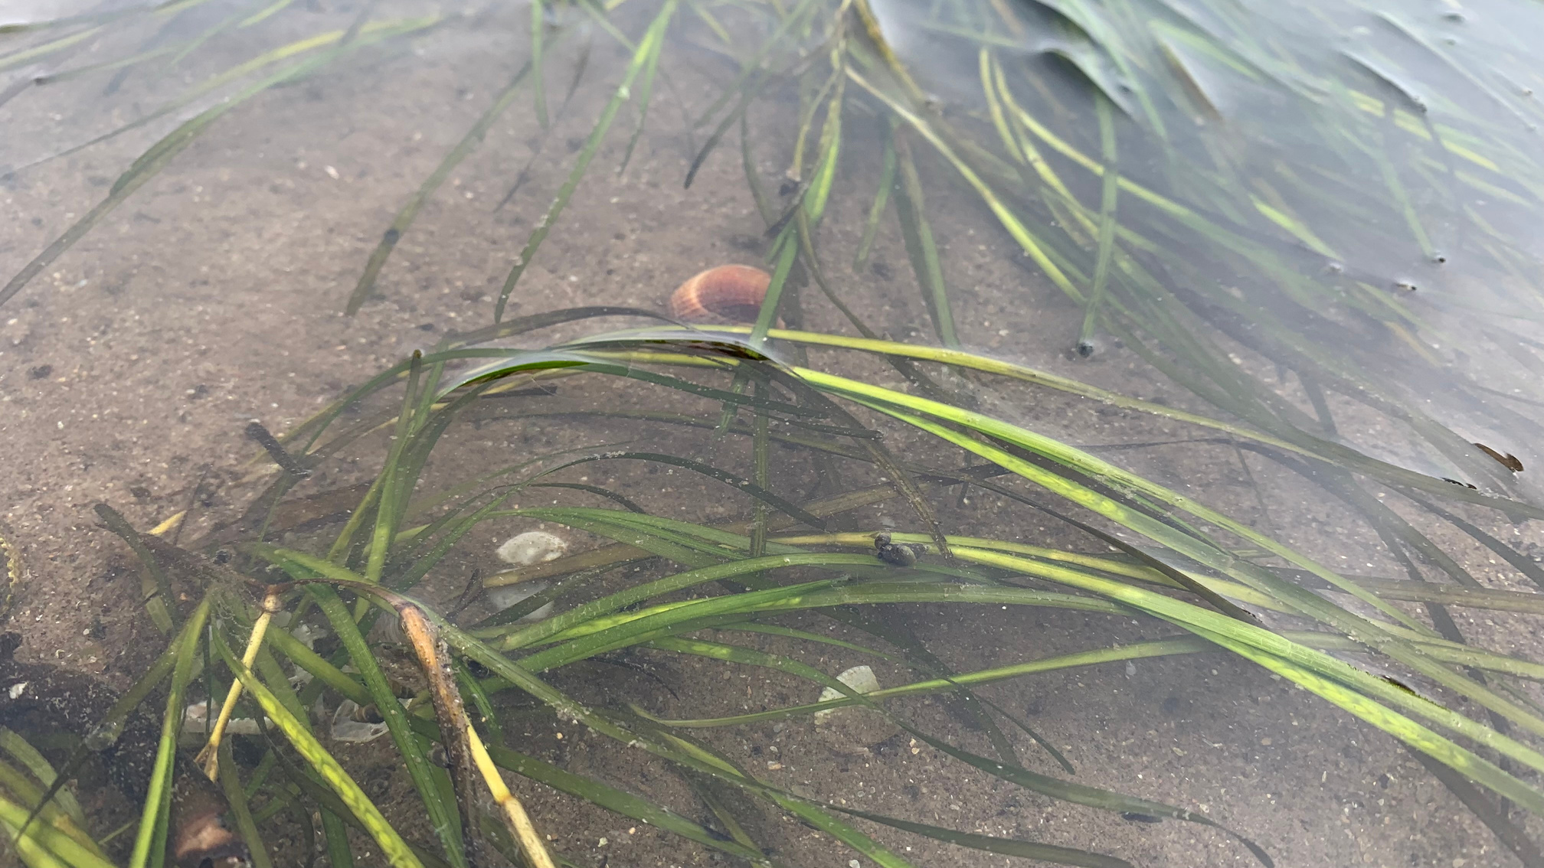
SEAGRASS
This marine plant produces seeds every year, which are washed around in the surf, and settle on the seabed to grow and create new plants.

Slide 15
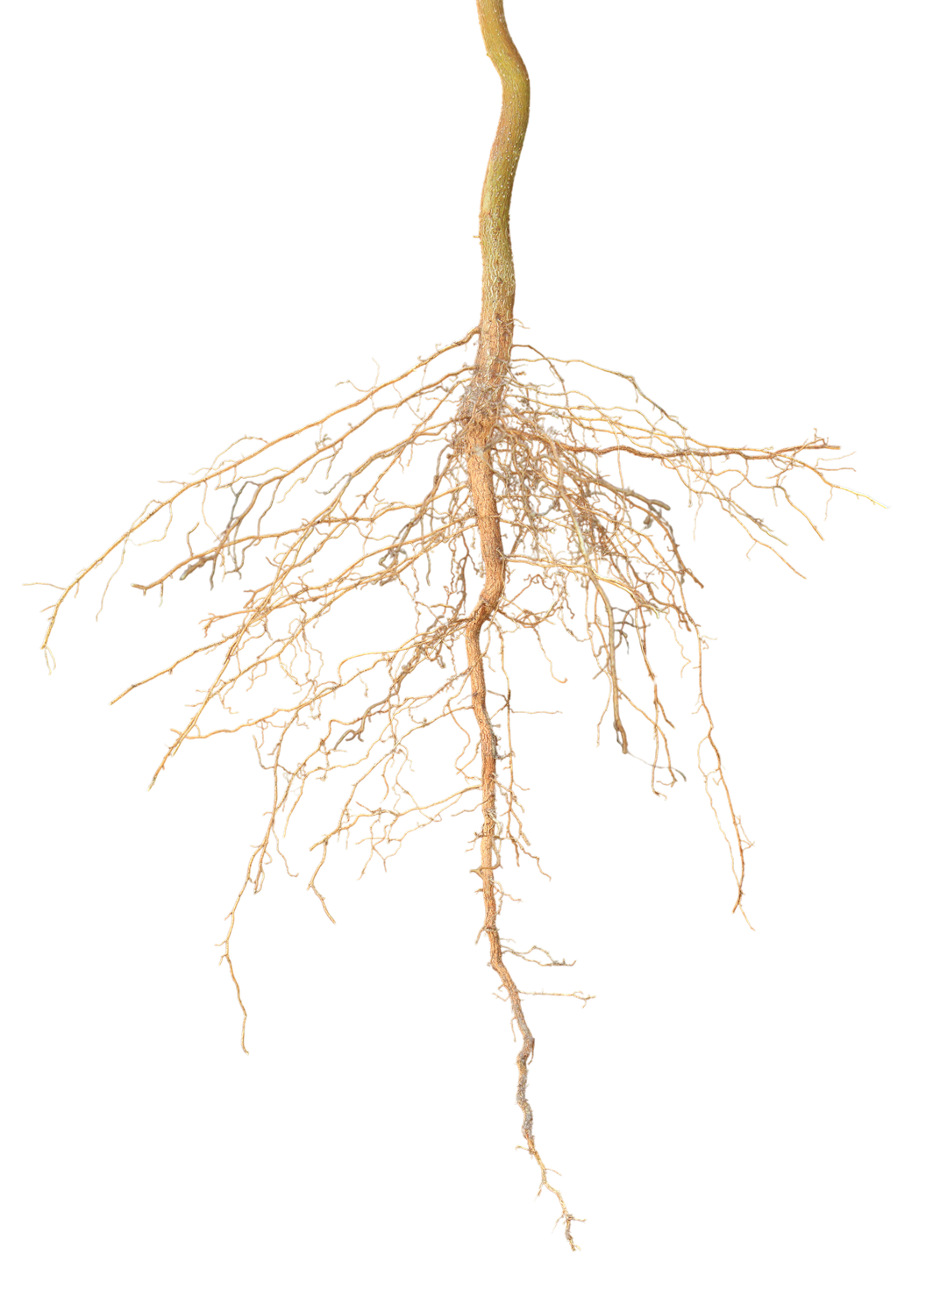
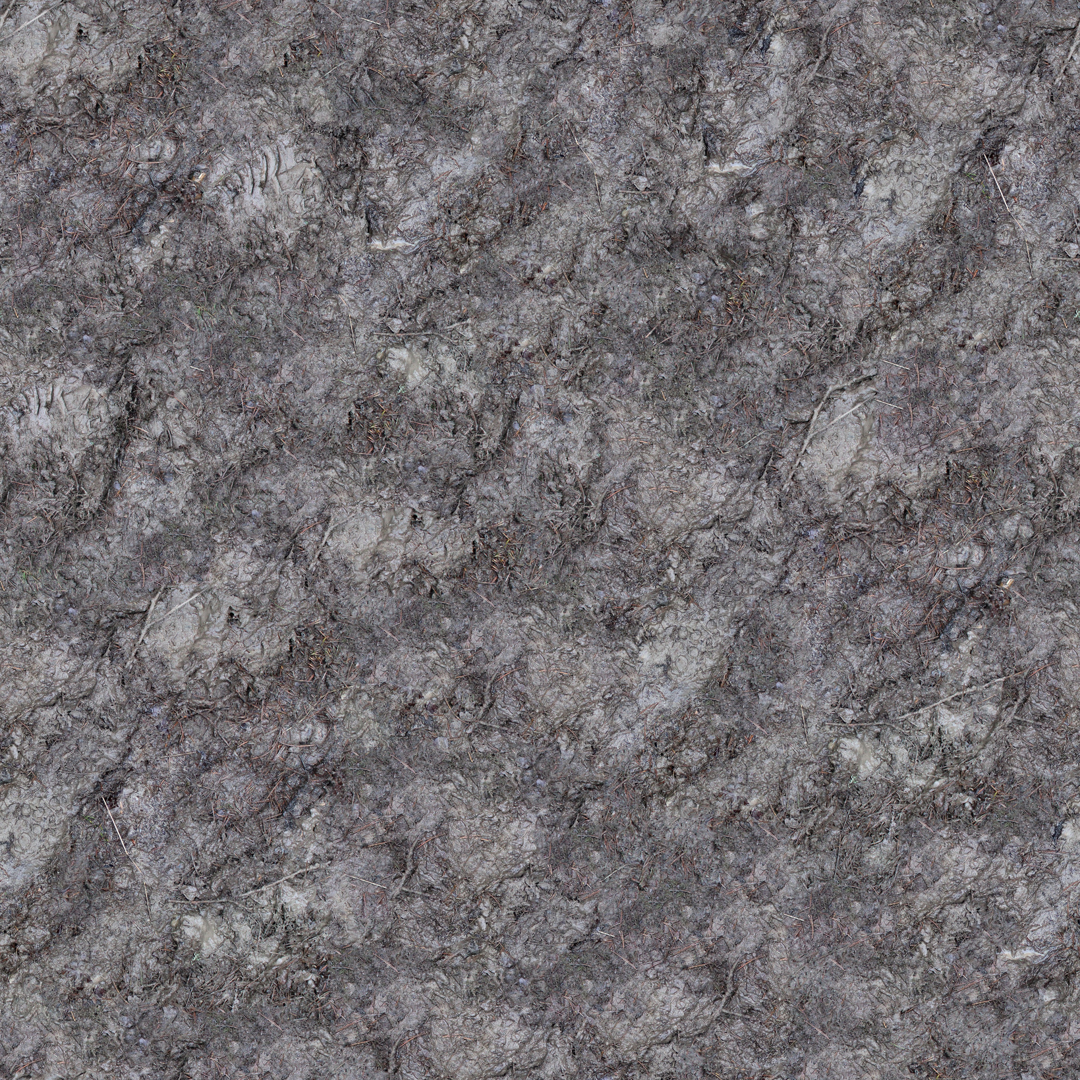
SEAGRASS
The roots of the seagrass are very important, as they help to hold the sediment the grass is growing in together, stopping it from washing away during storms!
This is helps surrounding life to grow without the threat of their habitat being washed away!

Slide 16
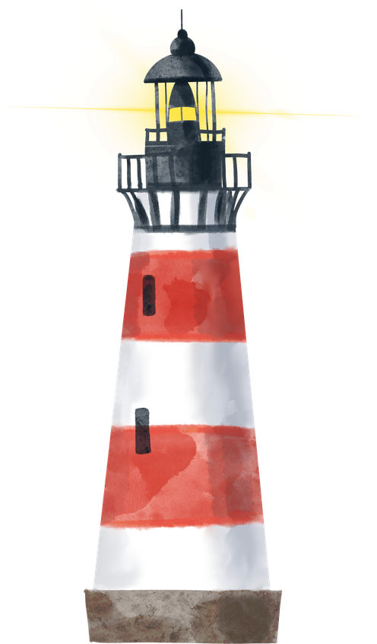
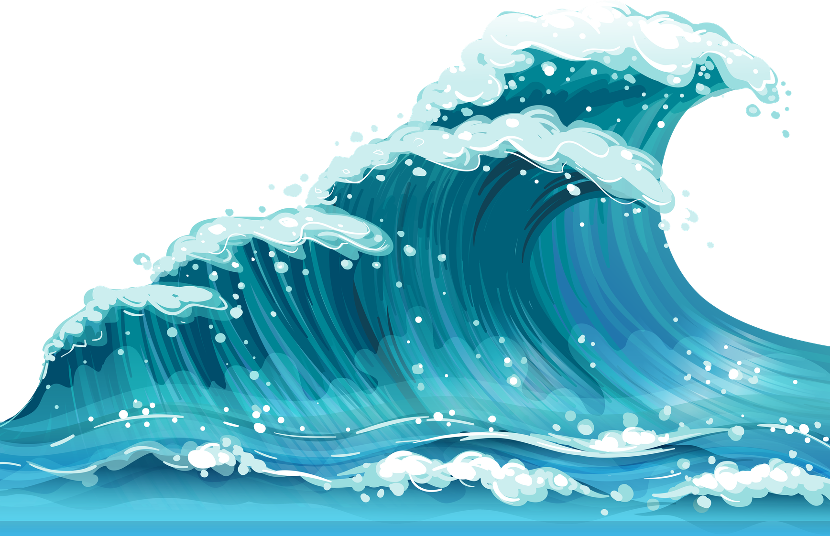
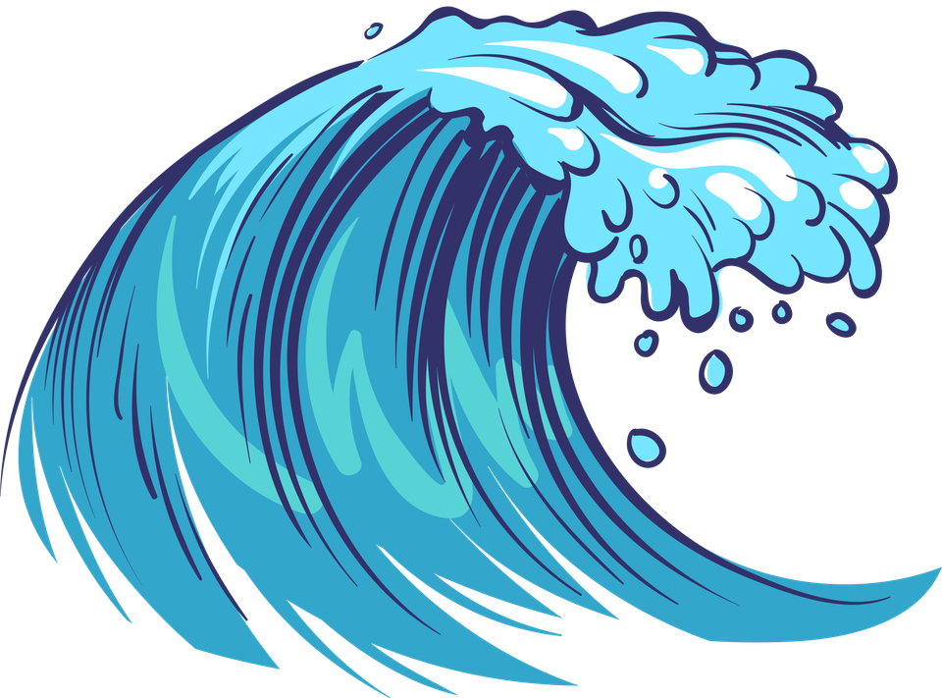
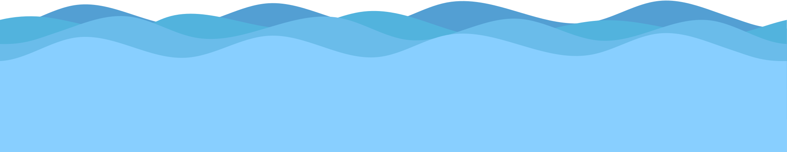
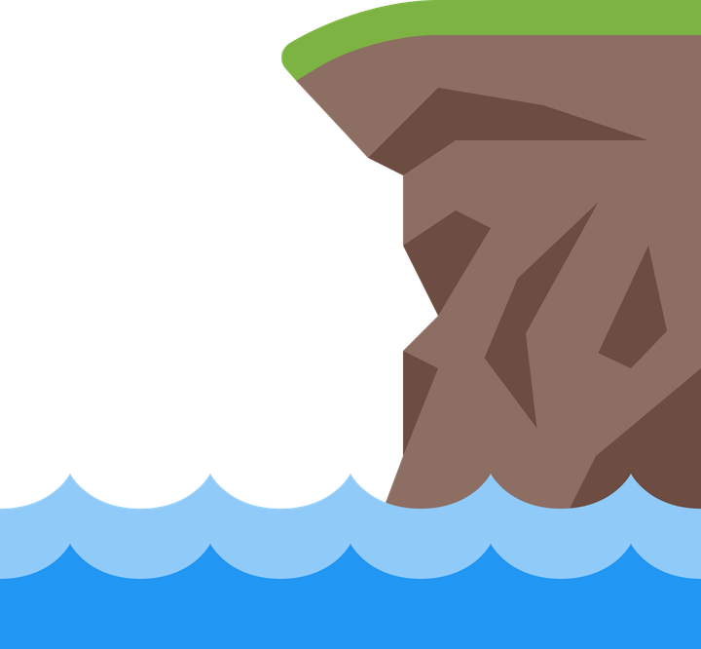
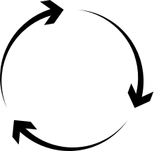
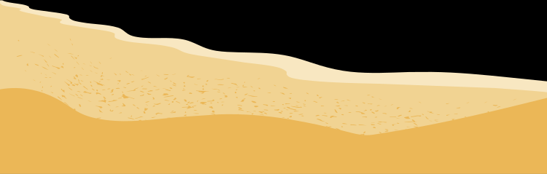
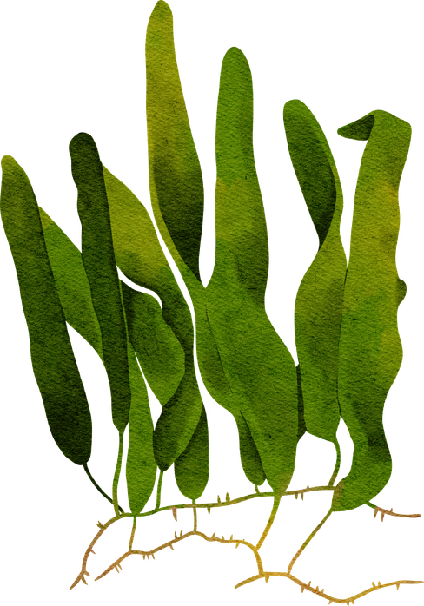
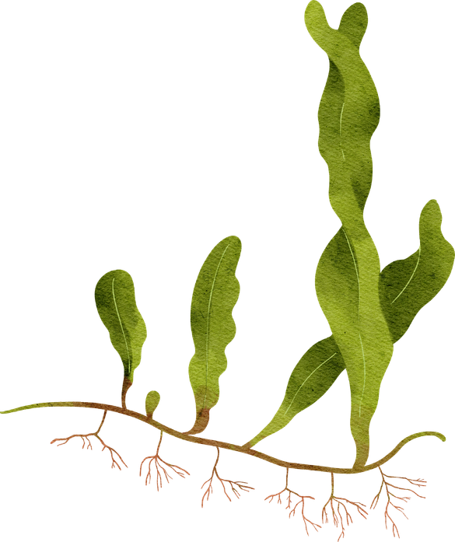
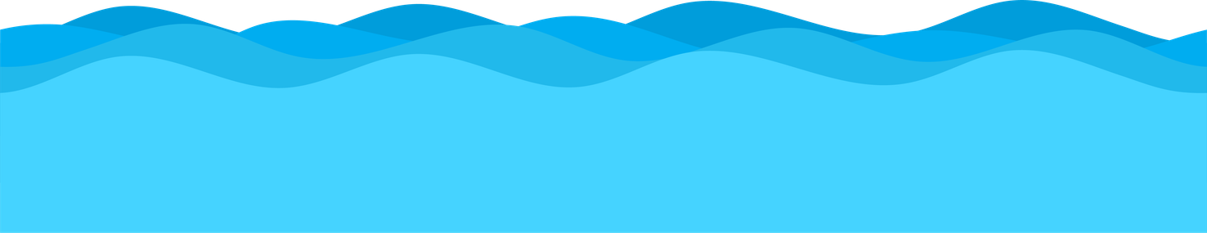
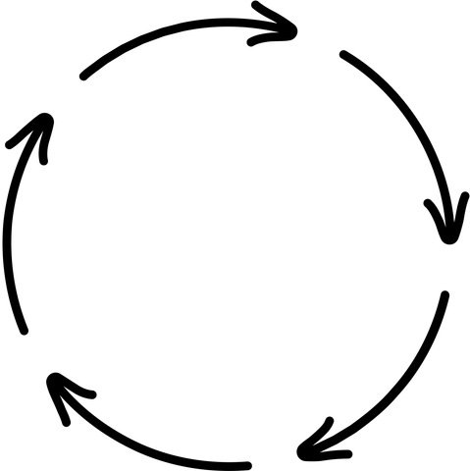
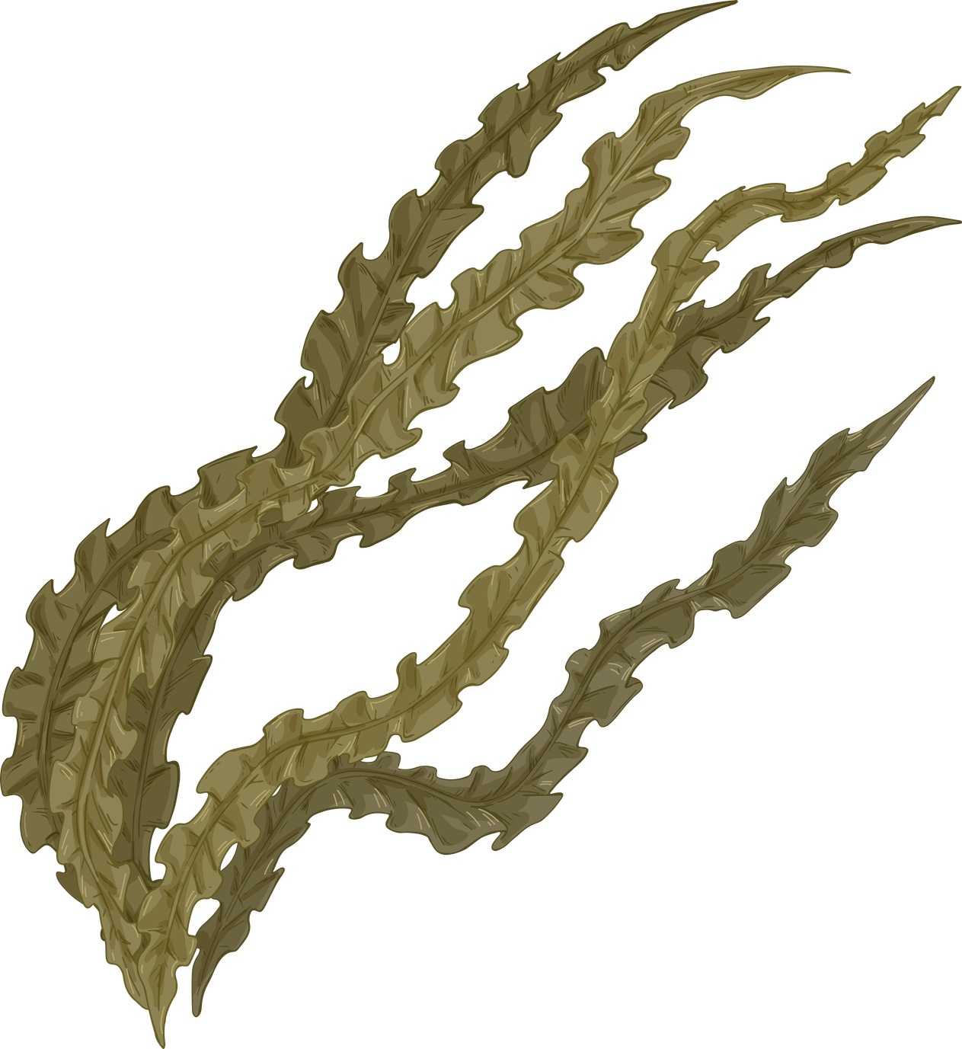
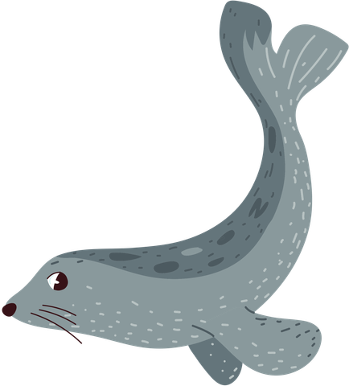
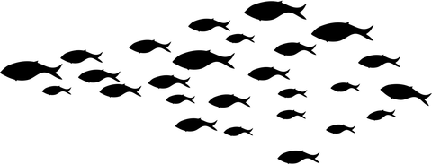
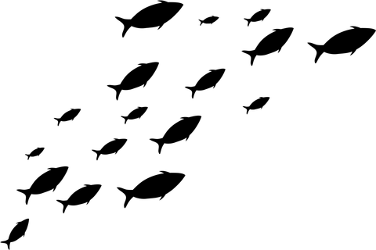
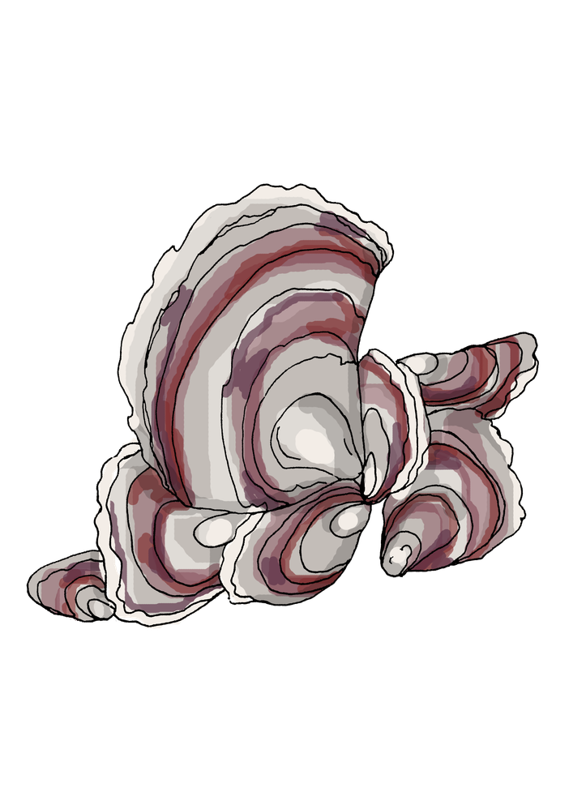
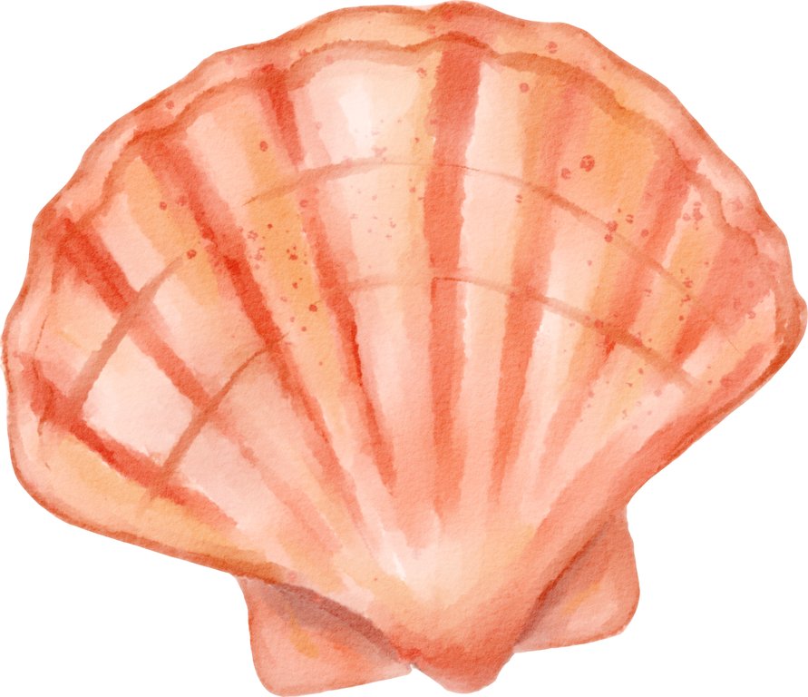
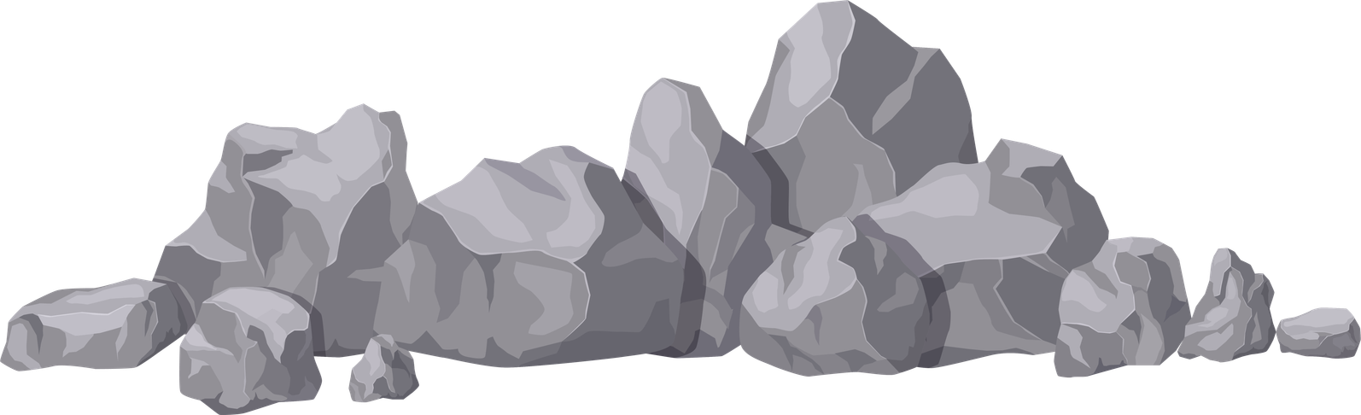
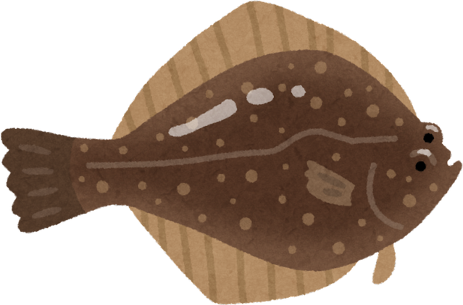
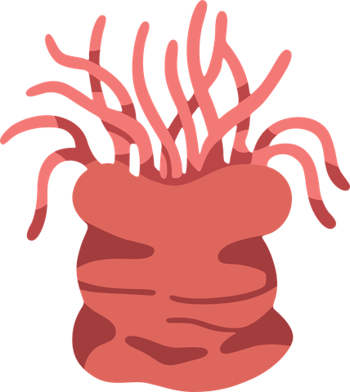
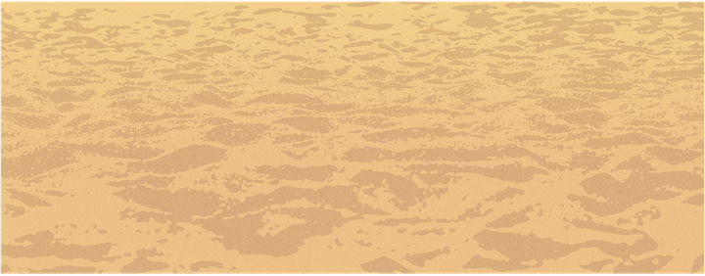
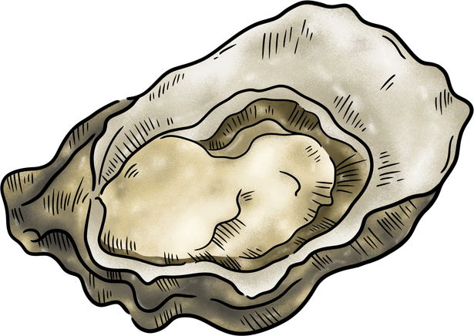
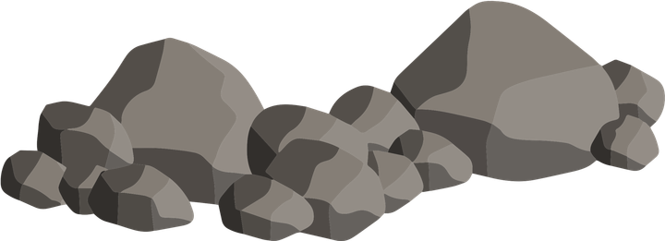
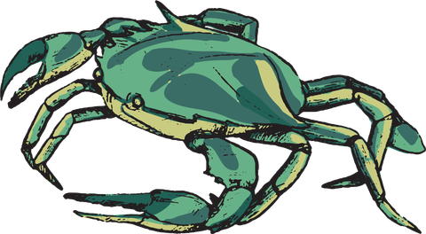
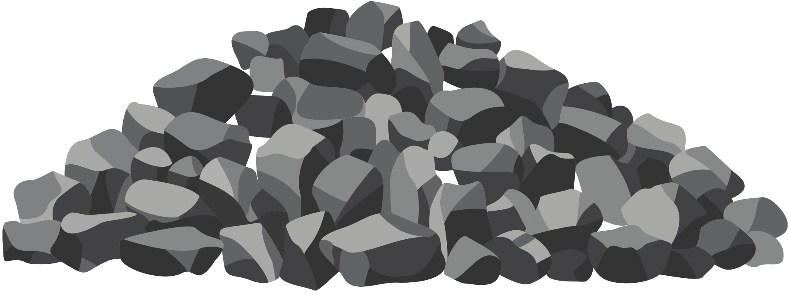
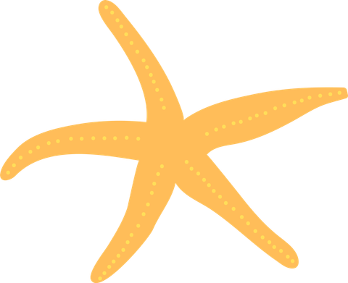
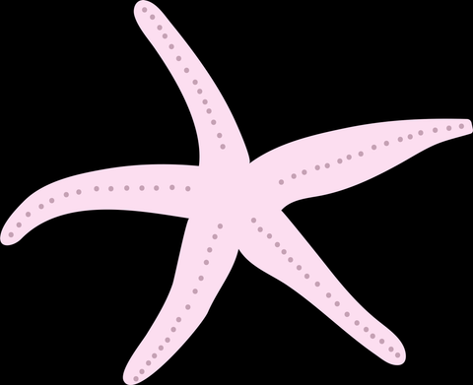
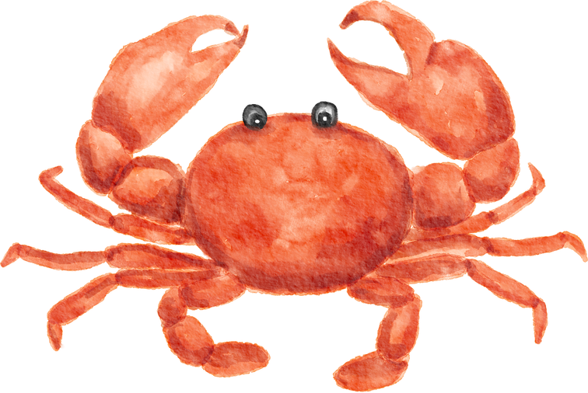
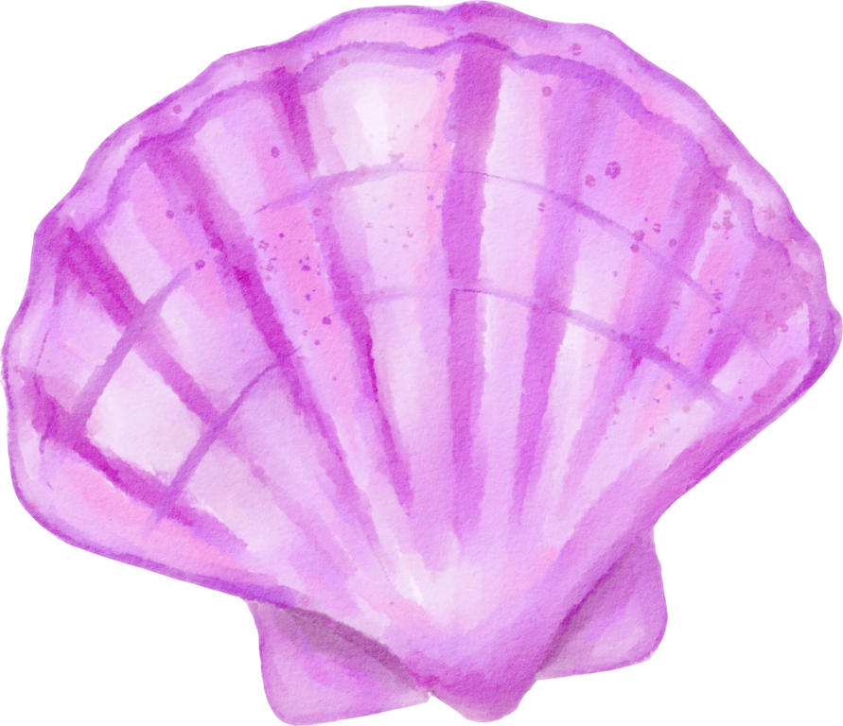
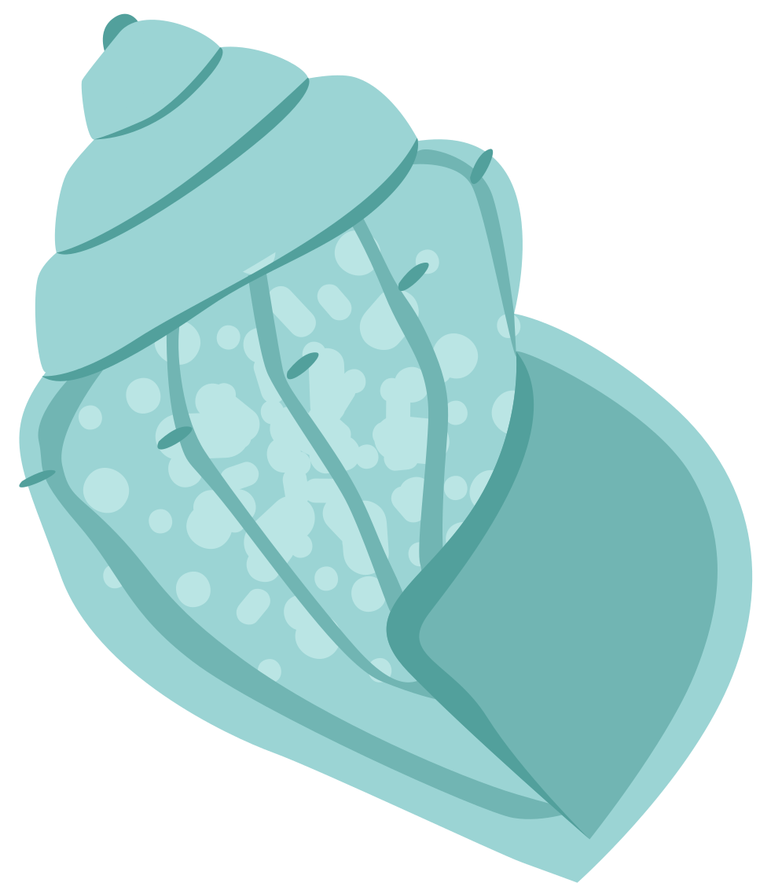
Stronger shores is interested in learning how well kelp, seagrass and oysters can slow down waves, reducing erosion...

Slide 17

BENEFITS
These species all have benefits that they provide the surrounding coastline and associated sea-life, and to humans.
Think back to what you just learned about each habitat, can you remember any of the benefits, or think of new benefits that haven’t been mentioned?

Slide 18






BENEFITS
As well as learning how well the habitats can protect our coasts from erosion, Stronger Shores is learning about all the other benefits we can also get from kelp, seagrass and oysters...
Tourism
Cleaning water
Habitat for commercial fish
Binding seabed with roots
Medicines and other products
Coastal Protection

Slide 19

ACTIVITY TIME
You can now take the quiz and complete the activity in the accompanying PDF.
Notes:
07854109229 Beverley Walton

Slide 20
QUIZ TIME!
COASTAL DEFENCES

Slide 21


WHAT ARE THE 3 HABITATS SHOWN BELOW?

Slide 22
KELP FOREST
SEAGRASS MEADOW
OYSTER REEF

Slide 23

WHAT IS THE TERM FOR THE SEA DEFENCES MADE BY HUMANS?

Slide 24
WHAT IS THE TERM FOR THE SEA DEFENCES MADE BY HUMANS?
HARD ENGINEERING

Slide 25
NAME 1 BENEFIT THAT YOU CAN GET FROM SEAGRASS.

Slide 26
NAME 1 BENEFIT THAT YOU CAN GET FROM SEAGRASS.
Roots stabilise soil; produces oxygen, habitat for marine life, nursery for different species, takes up nutrients in the water...

Slide 27
NAME 1 BENEFIT THAT YOU CAN GET FROM OYSTERS.

Slide 28
NAME 1 BENEFIT THAT YOU CAN GET FROM OYSTERS.
Oysters filter water; cleans pollutants from water, habitat for marine life, nursery for different species, takes up nutrients in the water, source of food for marine life...

Slide 29
NAME 1 BENEFIT THAT YOU CAN GET FROM KELP.

Slide 30
NAME 1 BENEFIT THAT YOU CAN GET FROM KELP.
Can be used for many products from food to fertiliser or even bioplastic, produces oxygen, habitat for marine life, nursery for different species, takes up nutrients in the water...

Slide 31

WHAT IS THE TERM FOR THE SEA DEFENCES PROVIDED BY NATURE?

Slide 32
WHAT IS THE TERM FOR THE SEA DEFENCES PROVIDED BY NATURE?
SOFT ENGINEERING

Slide 33


To find out more about Stronger Shores follow the link in the QR code to visit our StoryMap, or go to:
https://storymaps.arcgis.com/stories/7da0c07ee3d245c9b273c6538bf0e1db

