Slide 1



QUIZ TIME!
EROSION

Slide 2
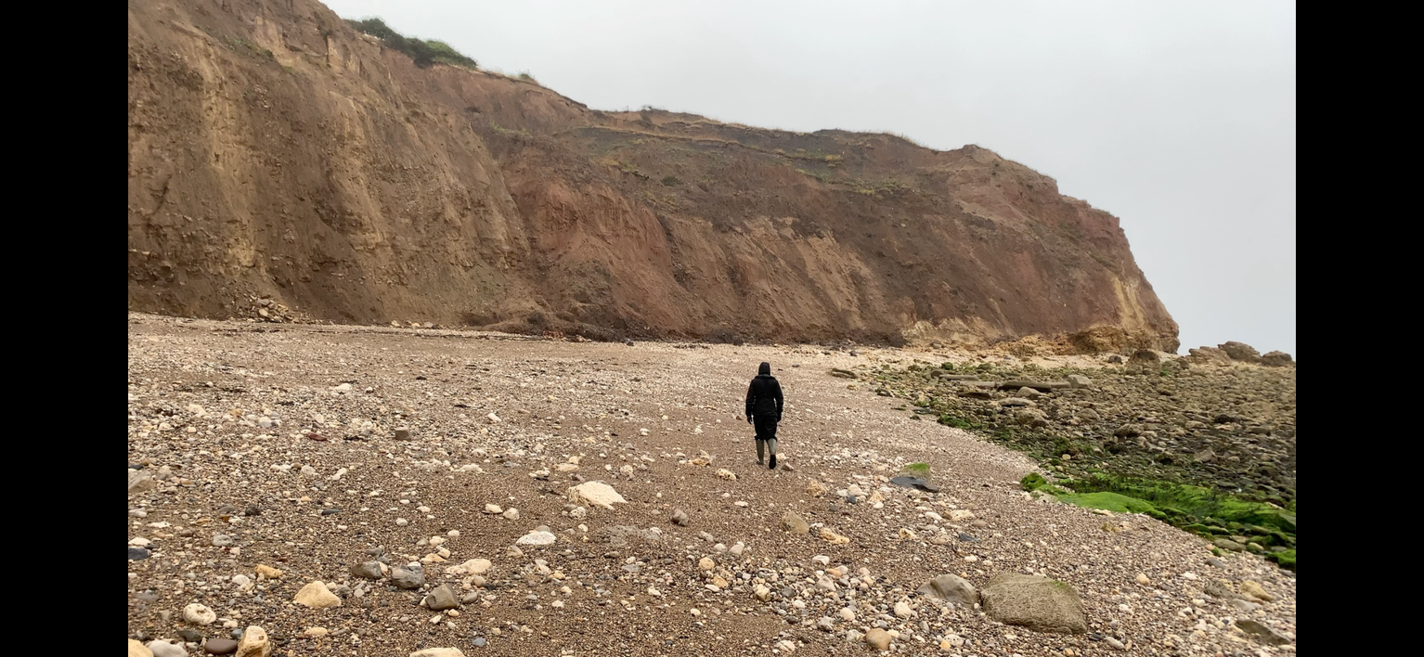
WHAT IS EROSION ?

Slide 3
WHAT IS EROSION?
Wearing away of the rocks through the action of the waves on the coastline.

Slide 4
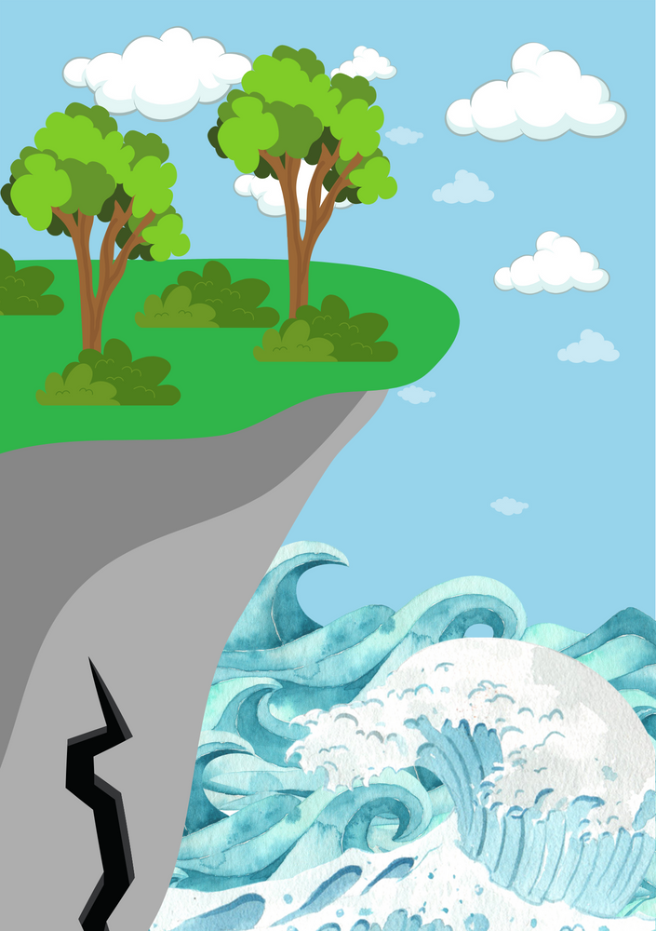
NAME THIS FEATURE...

Slide 5
NAME THIS FEATURE...
CRACK

Slide 6
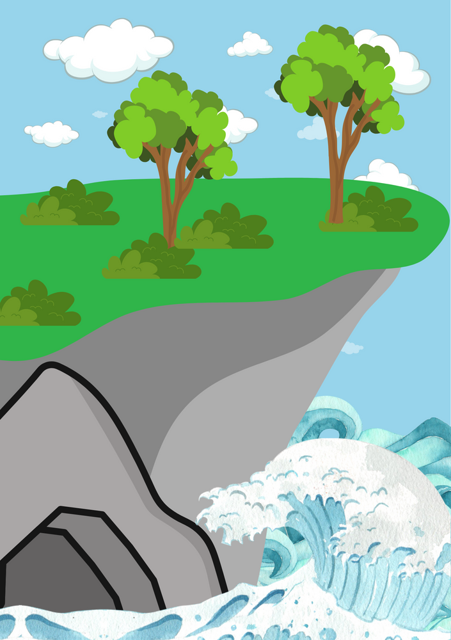
NAME THIS FEATURE...

Slide 7
NAME THIS FEATURE...
CAVE

Slide 8
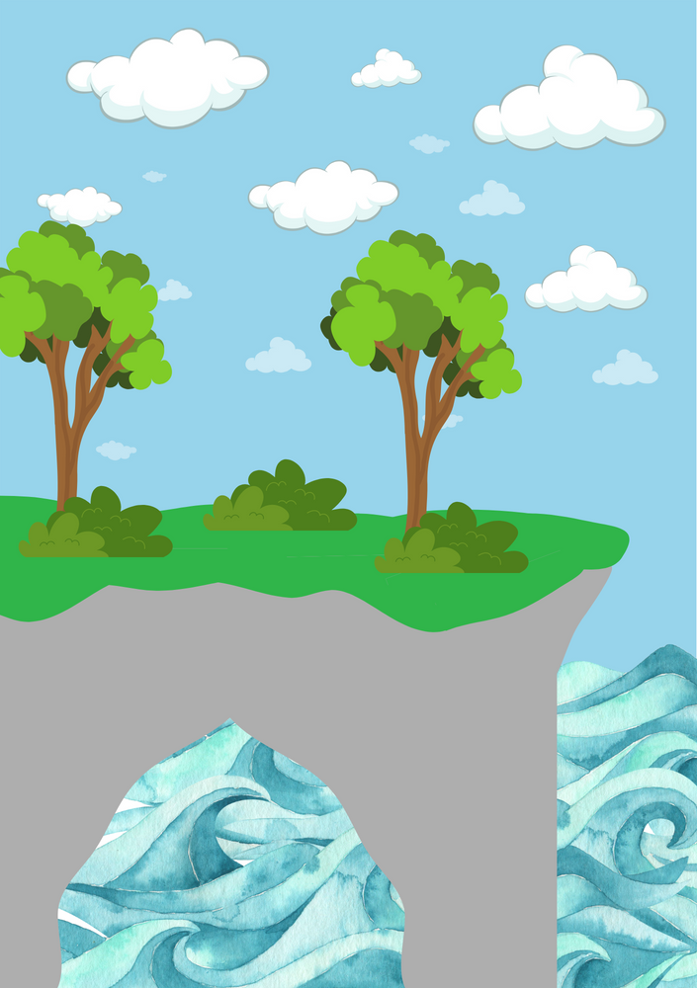
NAME THIS FEATURE...

Slide 9
NAME THIS FEATURE...
ARCH

Slide 10
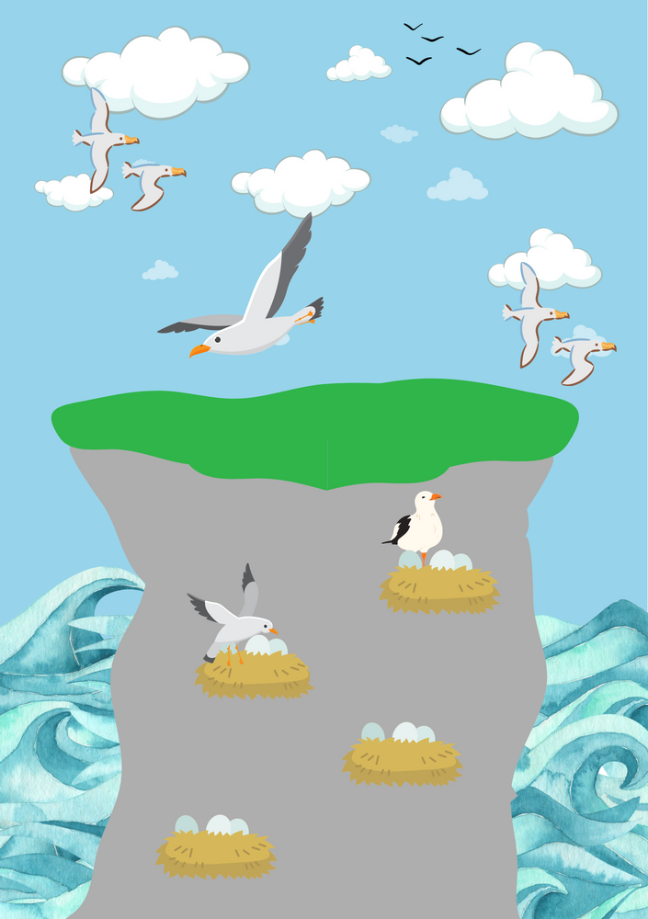
NAME THIS FEATURE...

Slide 11
NAME THIS FEATURE...
STACK

Slide 12

NAME THIS FEATURE...

Slide 13
NAME THIS FEATURE...
STUMP

Slide 14
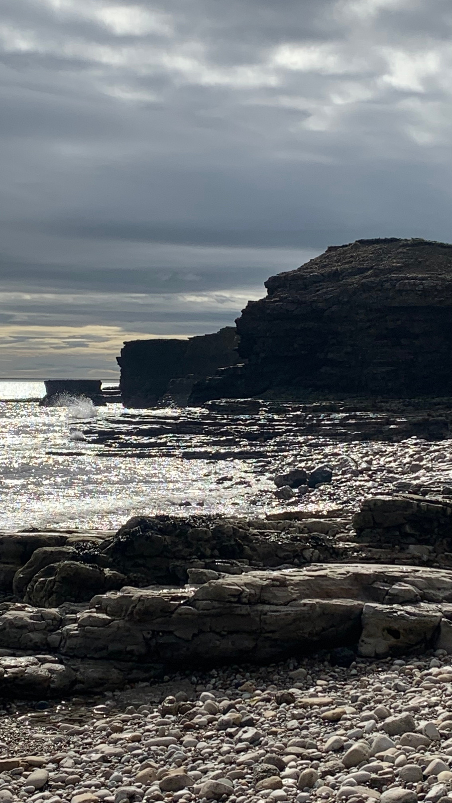
CLIMATE CHANGE IS:
A) SPEEDING UP EROSION
B) SLOWING DOWN EROSION
C) STOPPING EROSION

Slide 15
CLIMATE CHANGE IS:
A) SPEEDING UP EROSION

Slide 16



To find out more about Stronger Shores follow the link in the QR code to visit our StoryMap, or go to:
https://storymaps.arcgis.com/stories/7da0c07ee3d245c9b273c6538bf0e1db

