Slide 1

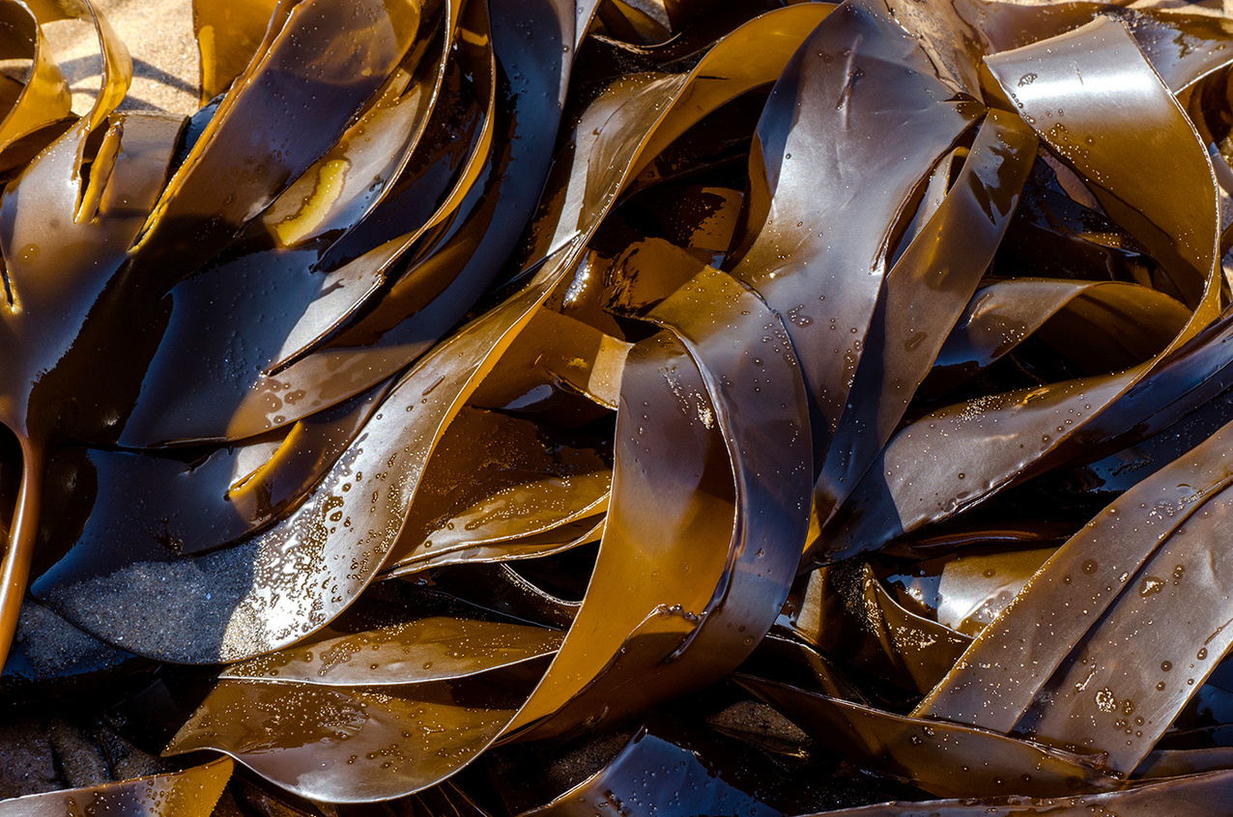

QUIZ TIME!
COASTAL DEFENCES

Slide 2
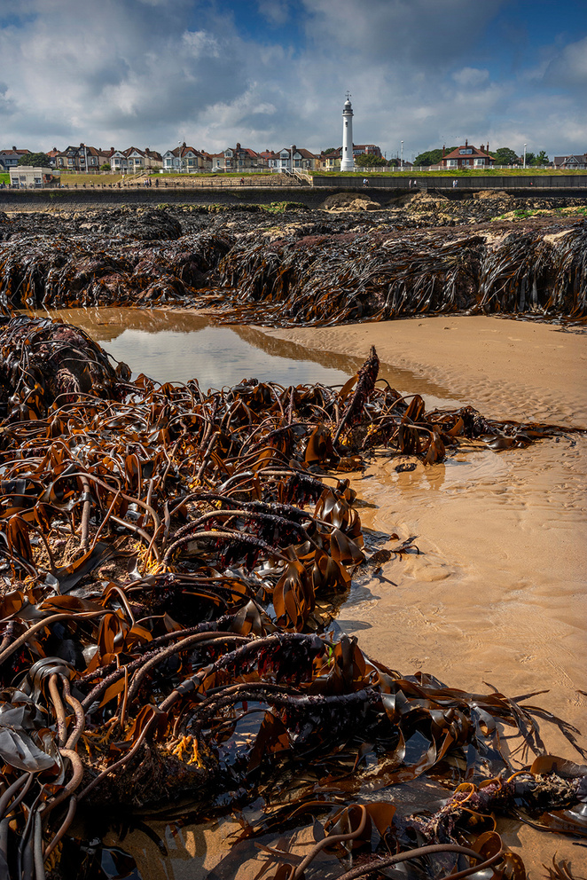
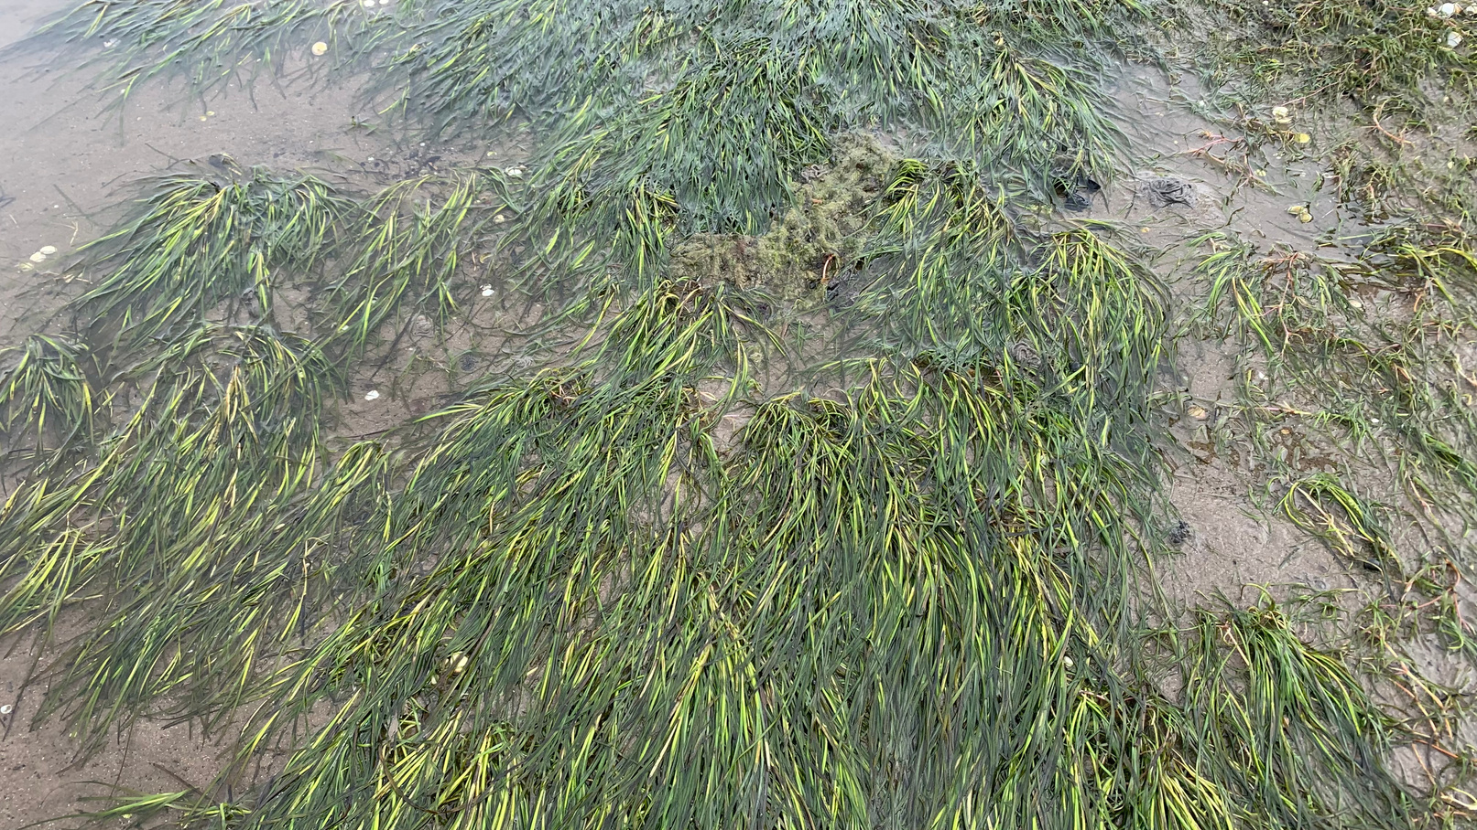
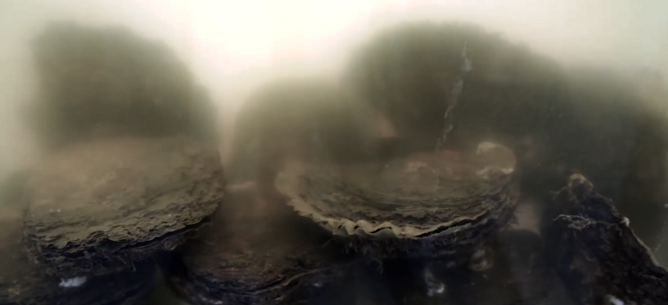
WHAT ARE THE 3 HABITATS SHOWN BELOW?

Slide 3
KELP FOREST
SEAGRASS MEADOW
OYSTER REEF

Slide 4
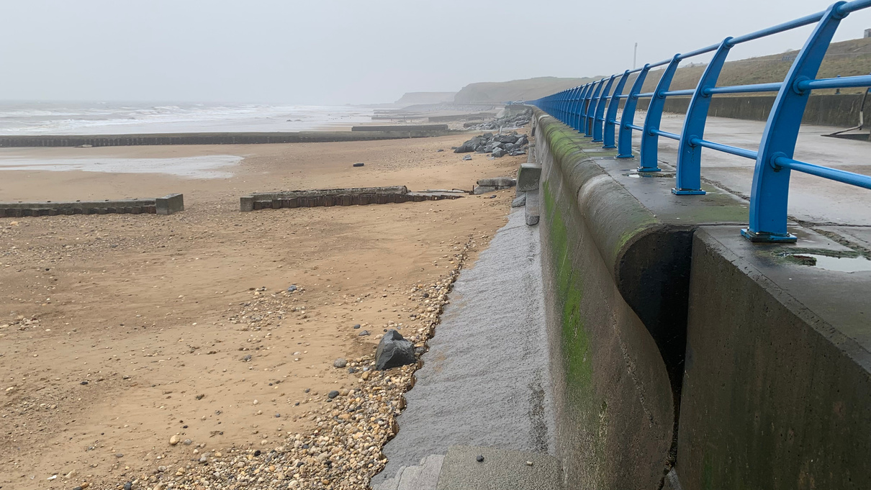
WHAT IS THE TERM FOR THE SEA DEFENCES MADE BY HUMANS?

Slide 5
WHAT IS THE TERM FOR THE SEA DEFENCES MADE BY HUMANS?
HARD ENGINEERING

Slide 6
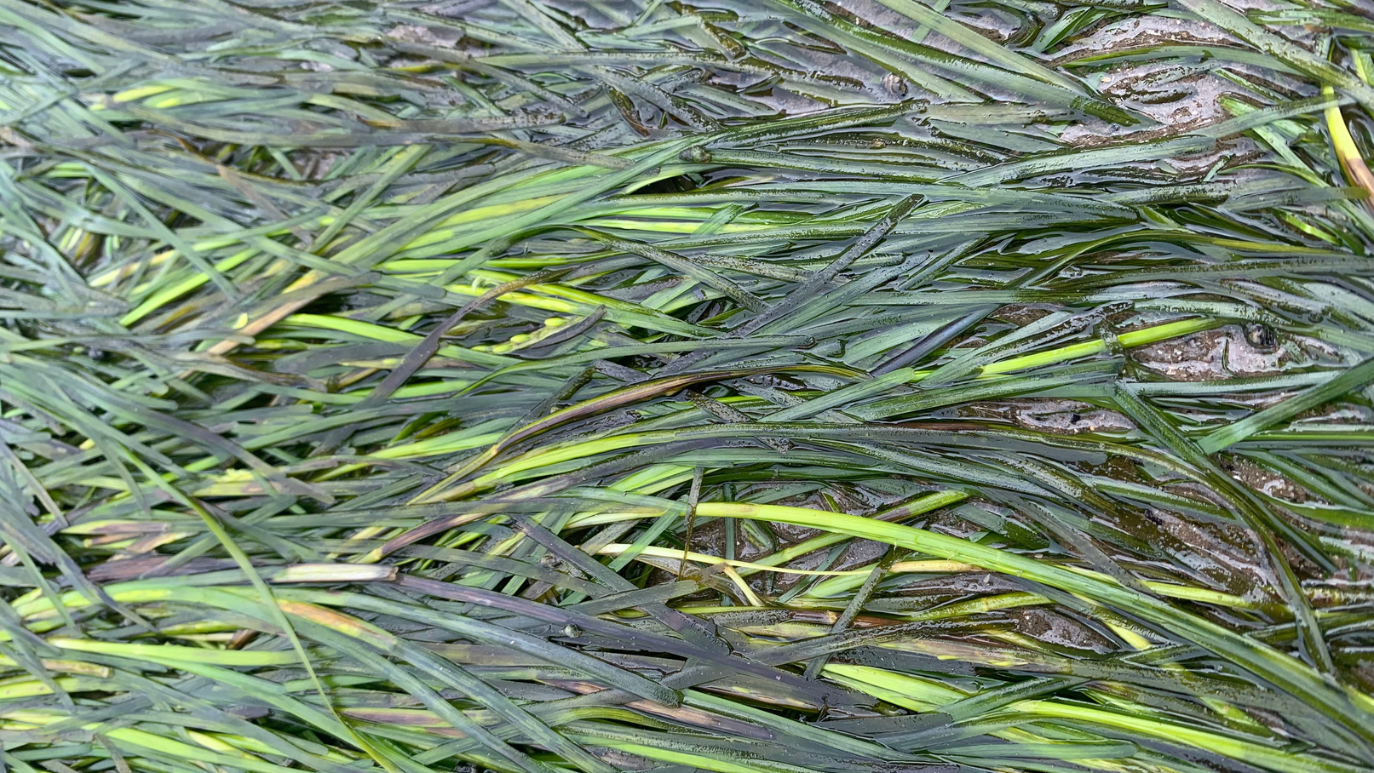
NAME 1 BENEFIT THAT YOU CAN GET FROM SEAGRASS.

Slide 7
NAME 1 BENEFIT THAT YOU CAN GET FROM SEAGRASS.
Roots stabilise soil; produces oxygen, habitat for marine life, nursery for different species, takes up nutrients in the water...

Slide 8
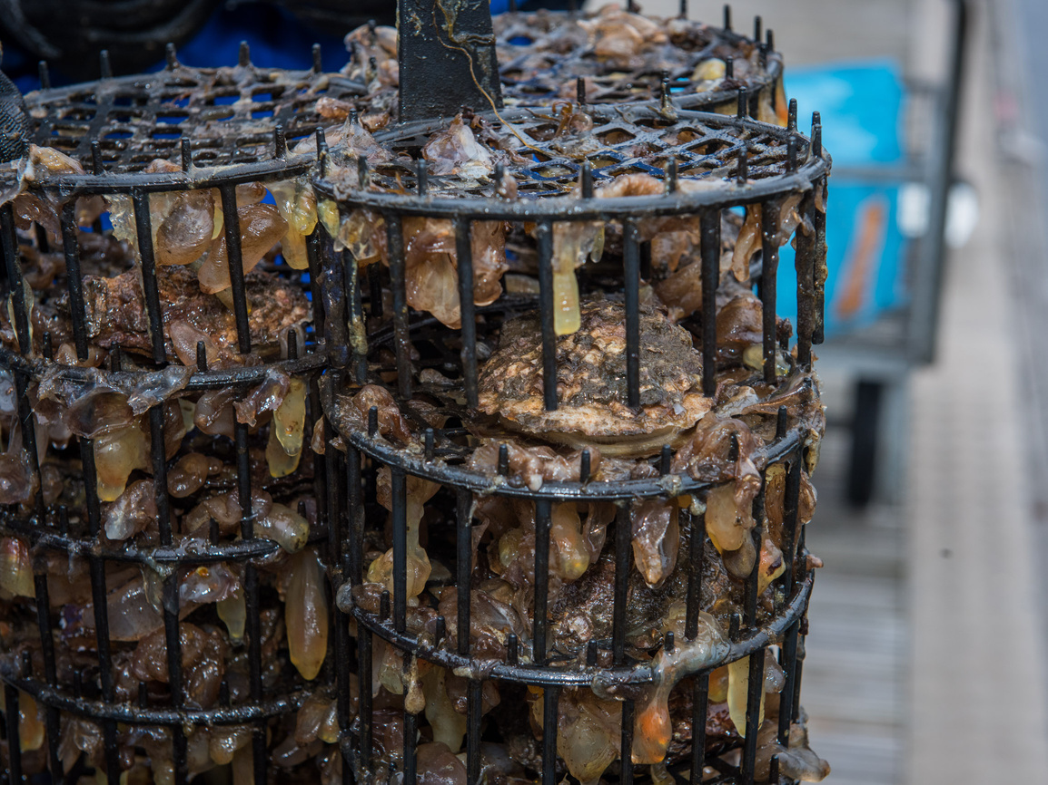
NAME 1 BENEFIT THAT YOU CAN GET FROM OYSTERS.

Slide 9
NAME 1 BENEFIT THAT YOU CAN GET FROM OYSTERS.
Oysters filter water; cleans pollutants from water, habitat for marine life, nursery for different species, takes up nutrients in the water, source of food for marine life...

Slide 10
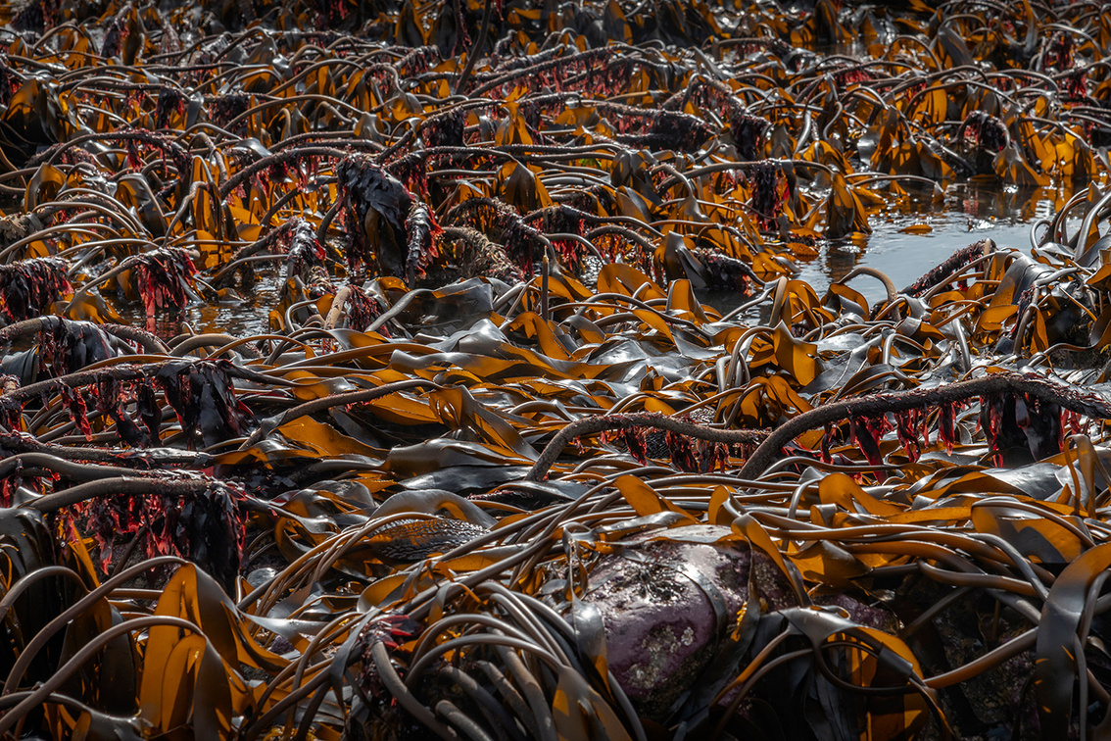
NAME 1 BENEFIT THAT YOU CAN GET FROM KELP.

Slide 11
NAME 1 BENEFIT THAT YOU CAN GET FROM KELP.
Can be used for many products from food to fertiliser or even bioplastic, produces oxygen, habitat for marine life, nursery for different species, takes up nutrients in the water...

Slide 12
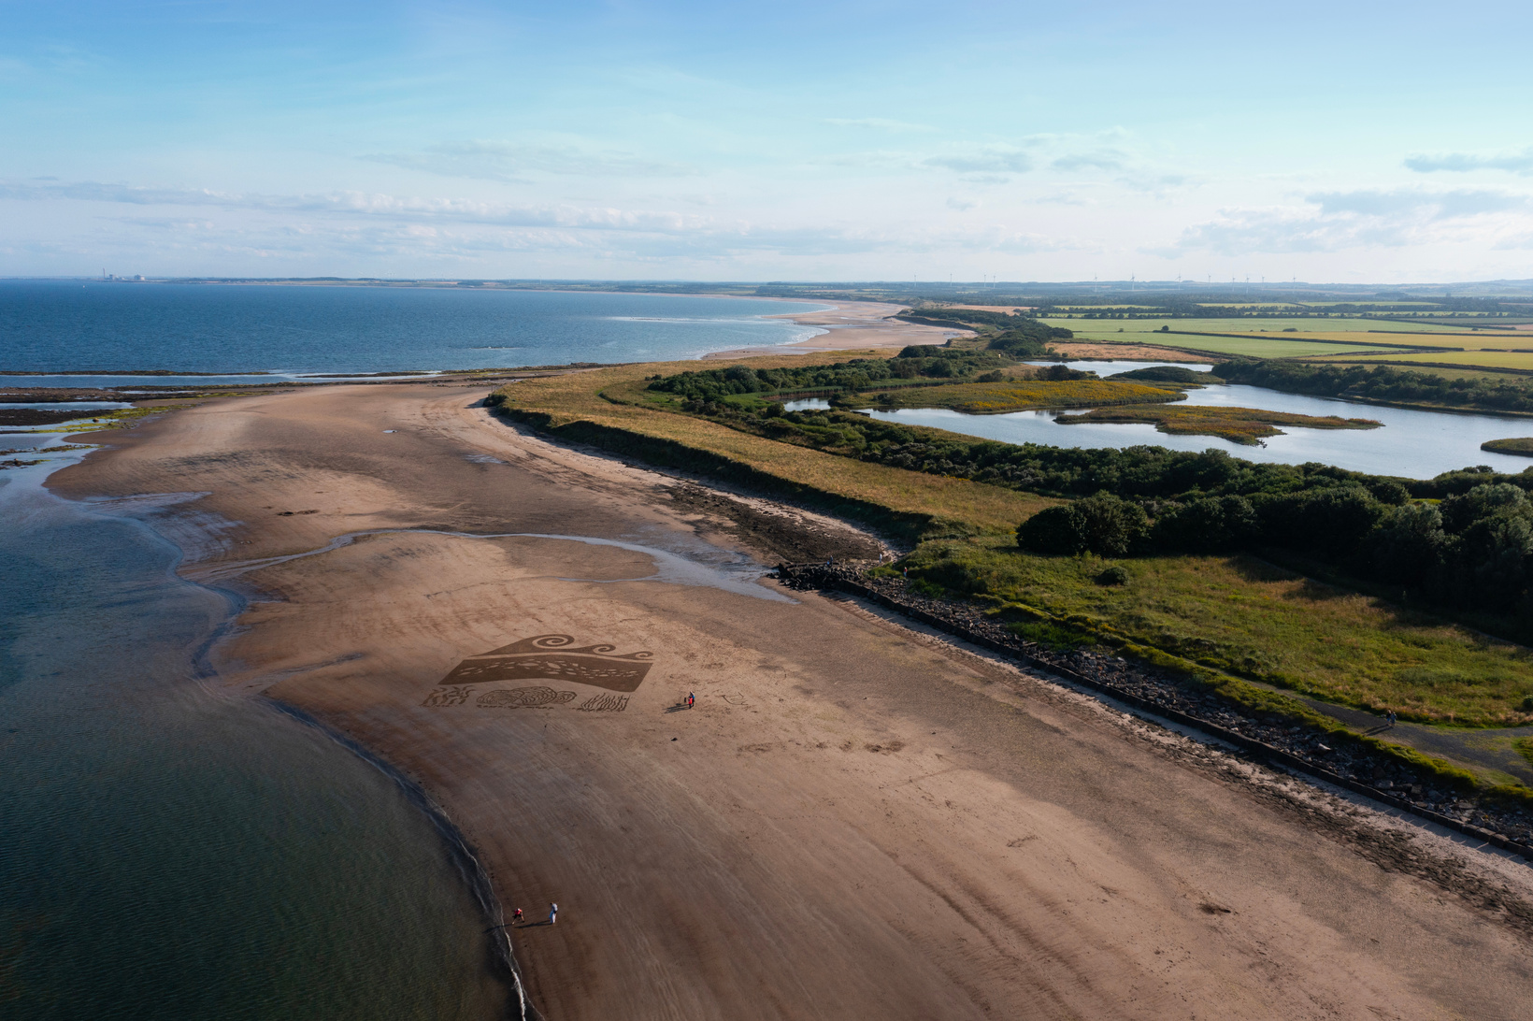
WHAT IS THE TERM FOR THE SEA DEFENCES PROVIDED BY NATURE?

Slide 13
WHAT IS THE TERM FOR THE SEA DEFENCES PROVIDED BY NATURE?
SOFT ENGINEERING

Slide 14


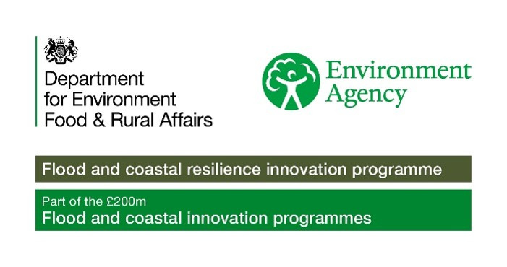
To find out more about Stronger Shores follow the link in the QR code to visit our StoryMap, or go to:
https://storymaps.arcgis.com/stories/7da0c07ee3d245c9b273c6538bf0e1db

