Slide 1

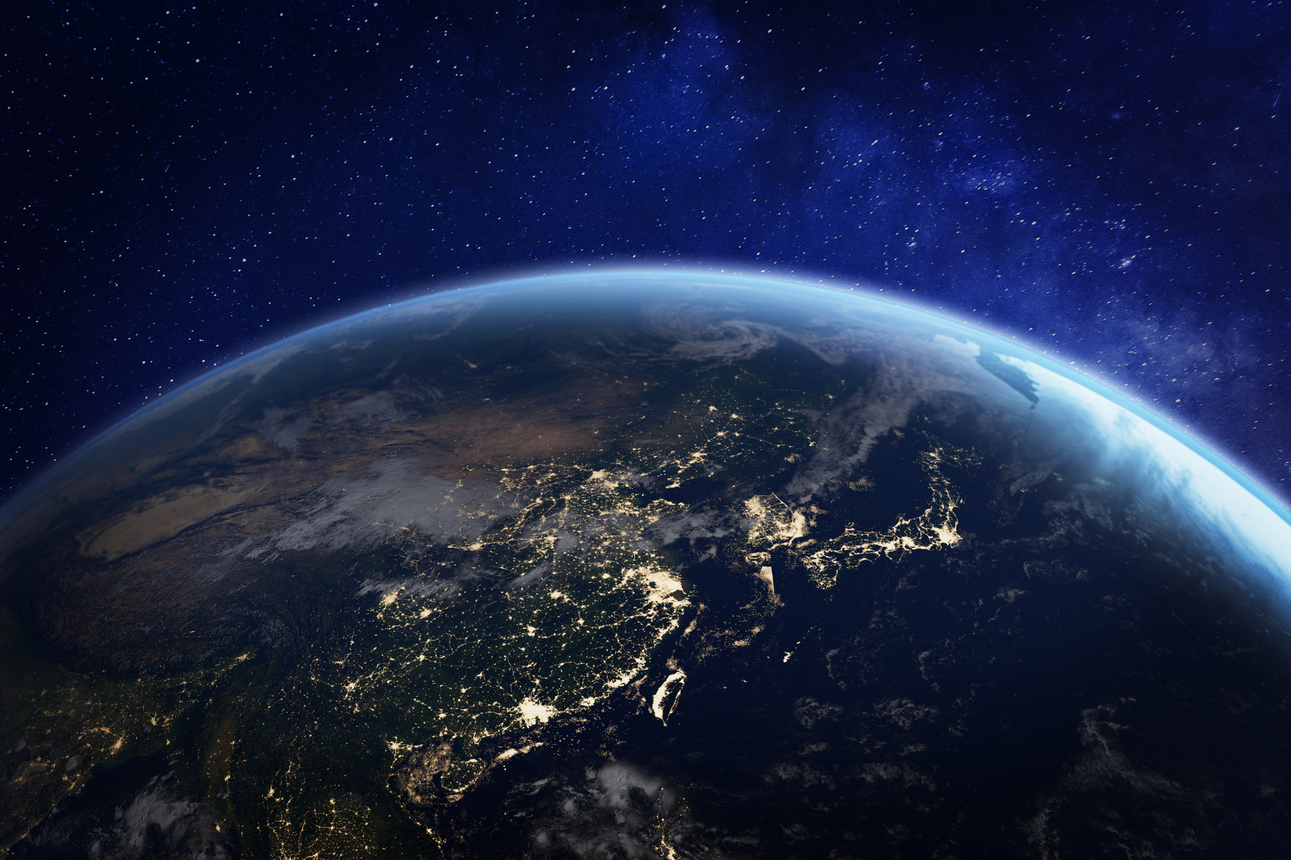

QUIZ TIME!
CLIMATE CHANGE

Slide 2
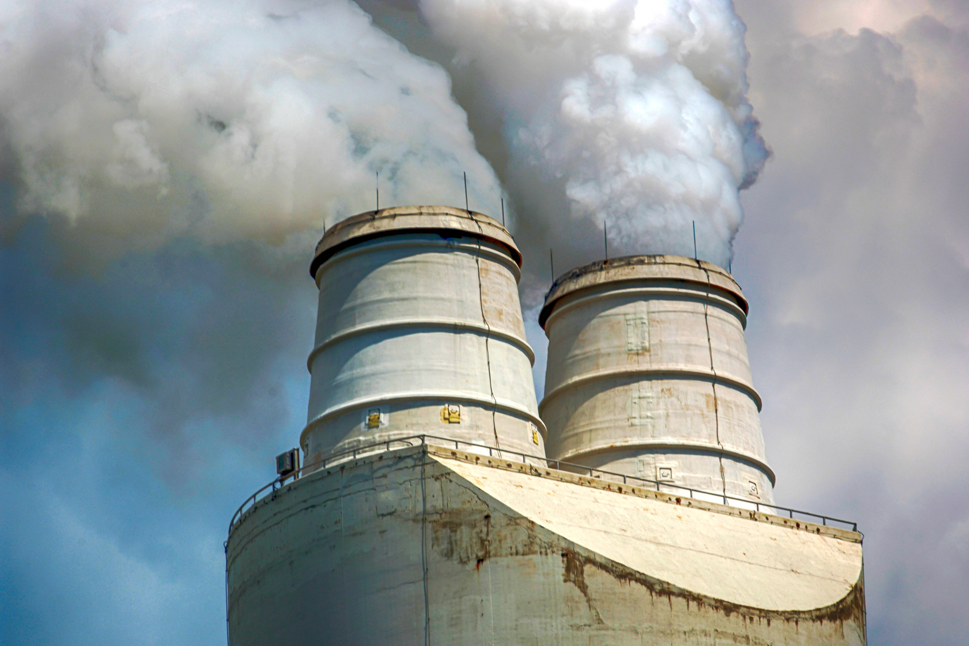
WHAT IS THE NAME WE USE FOR THE GASES THAT ARE WARMING UP OUR PLANET ?

Slide 3
WHAT IS THE NAME WE USE FOR THE GASES THAT ARE WARMING UP OUR PLANET ?
GREENHOUSE GASES

Slide 4
WHAT CLIMATE ZONE DO WE LIVE IN?
T_ _ _ _ _ _ _ E

Slide 5
WHAT CLIMATE ZONE DO WE LIVE IN?
TEMPERATE

Slide 6
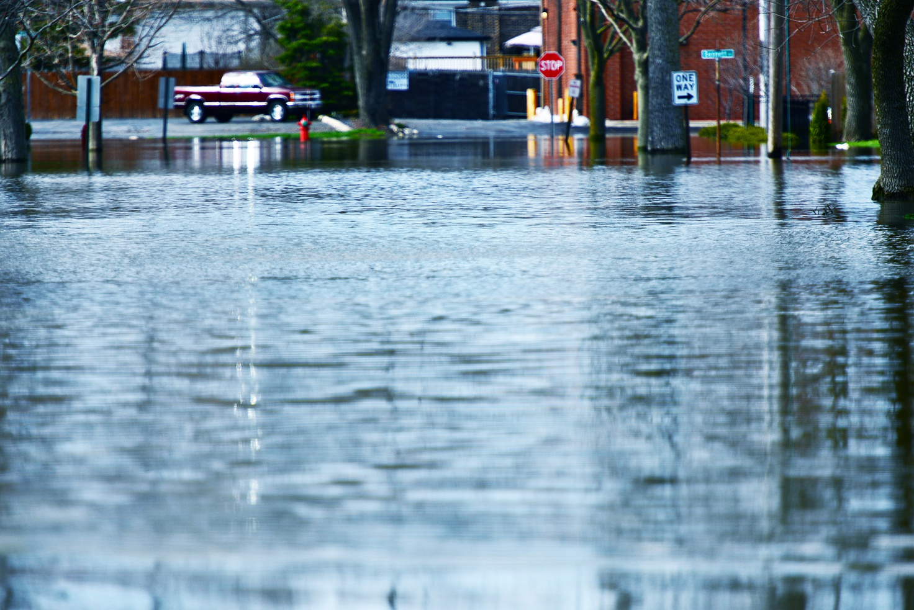
LIST A WAY WE CAN REDUCE IMPACTS FROM CLIMATE CHANGE THAT WE CAN NOT AVOID.

Slide 7
LIST A WAY WE CAN REDUCE IMPACTS FROM CLIMATE CHANGE THAT WE CAN NOT AVOID:
  CREATE COASTAL ‘HARD ENGINEERING’ BARRIERS
  PLANT NATIVE PLANT SPECIES THAT CAN HELP REDUCE FLOODING
  RE-MEANDER RIVERS TO REDUCE FLOODING
  CREATE ‘COOL’ SPACES IN CITIES, WITH CONCRETE HOLDING ON TO THE MOST

Slide 8
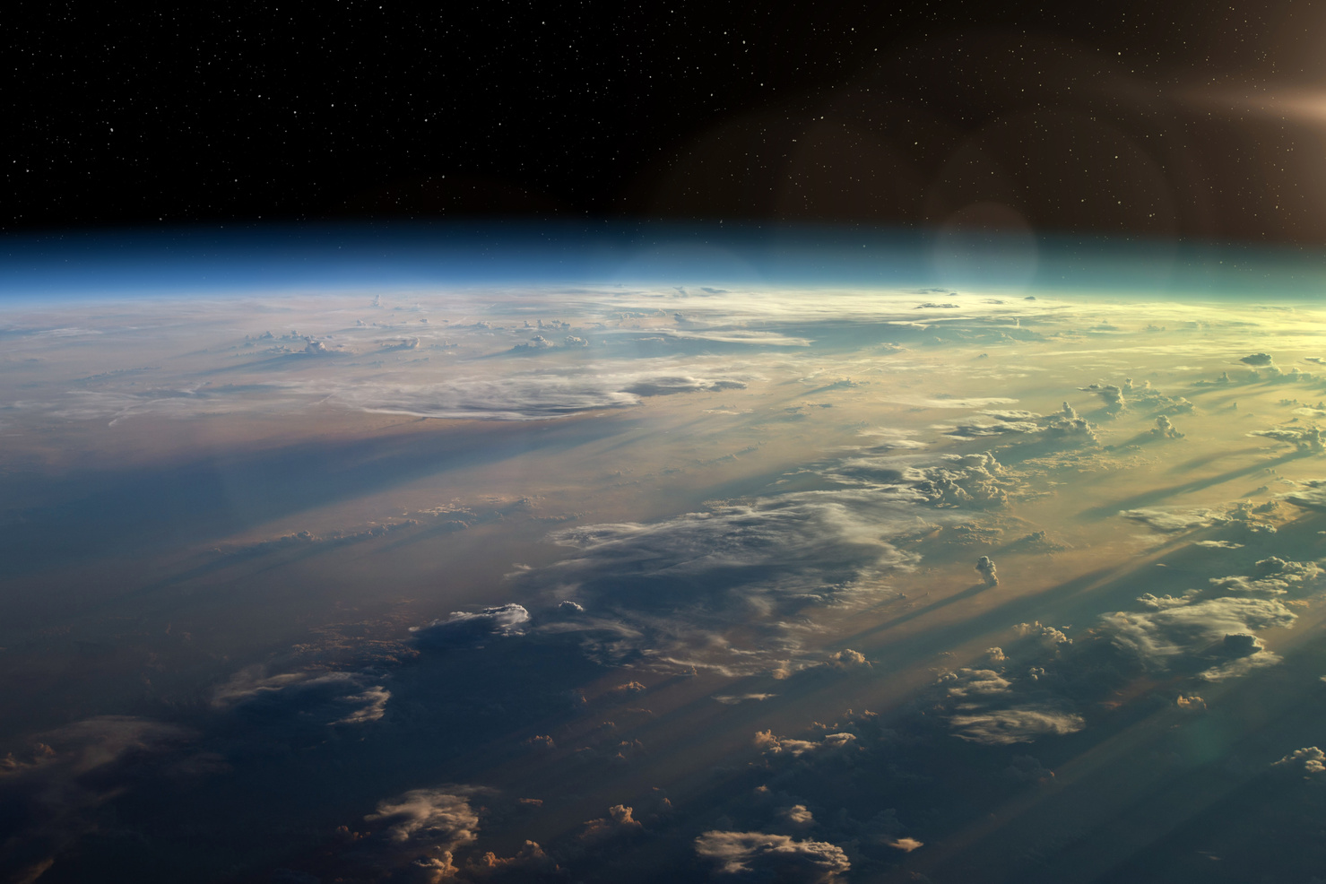
WHAT WAS THE NAME OF THE GREENHOUSE GAS EXPLORED IN THE VIDEO?

Slide 9
WHAT WAS THE NAME OF TH GREENHOUSE GAS EXPLORED IN THE VIDEO?
CARBON DIOXIDE

Slide 10

WHICH STORES HEAT BETTER - AIR OR WATER?

Slide 11
WHICH STORES HEAT BETTER - AIR OR WATER?
WATER

Slide 12
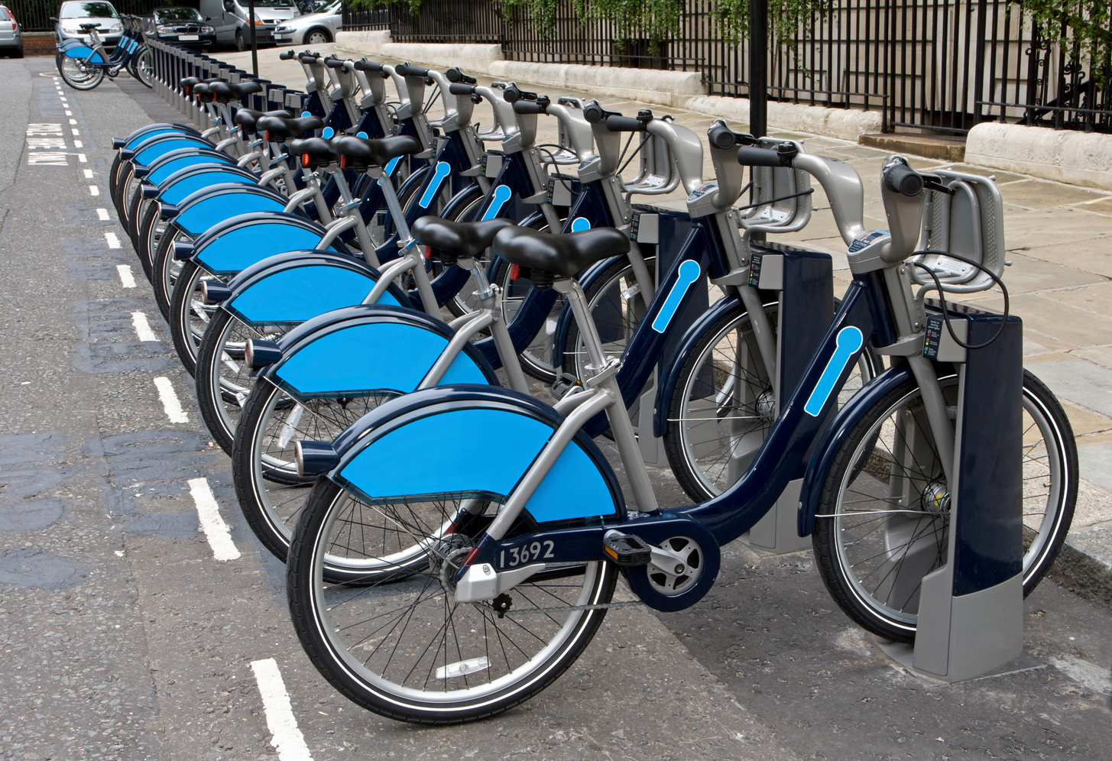
WHAT CAN YOU DO PERSONALLY TO REDUCE YOUR GREENHOUSE GAS EMISSIONS?

Slide 13
WHAT CAN YOU DO PERSONALLY TO REDUCE YOUR GREENHOUSE GAS EMISSIONS?
  Eat less meat
  Walk or cycle when we can instead of using cars
  Lower our heating by a degree or two and wear a jumper
  There are many, many answers - these are just a few!

Slide 14



To find out more about Stronger Shores follow the link in the QR code to visit our StoryMap, or go to:
https://storymaps.arcgis.com/stories/7da0c07ee3d245c9b273c6538bf0e1db

