Slide 1

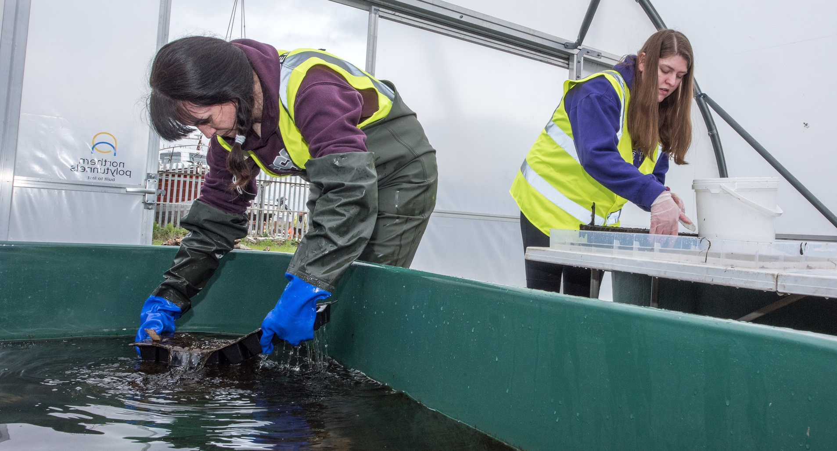

QUIZ TIME!
CAREERS

Slide 2
MANAGERS MUST USE THIS SKILL TO BE ABLE TO EFFECTIVELY EXPLAIN SOMETHING: WHAT IS THE WORD?
C_ _ _ _ _ _ _ _ _ _ _ N

Slide 3
MANAGERS MUST USE THIS SKILL TO BE ABLE TO EFFECTIVELY EXPLAIN SOMETHING: WHAT IS THE WORD?
COMMUNICATION

Slide 4

When doing research, what is the word that is used to describe what the researcher thinks will happen, before they run an experiment?

Slide 5
When doing research, what is the word that is used to describe what the researcher thinks will happen, before they run an experiment?
HYPOTHESIS

Slide 6
What is the title for the person who undertakes practical work to protect or restore a species?
C_ _ _ _ _ _ _ _ _ _ _ _ _ T

Slide 7
What is the title for the person who undertakes practical work to protect or restore a species?
CONSERVATIONIST

Slide 8

List 3 ways that a communicator could use to tell people about science...

Slide 9
List 3 ways that a communicator could use to tell people about science...
ART, MUSIC, WRITING, FILM, GAMES...

Slide 10
It is importnat to have lots of different types of people working together, with everyone having their own ways of thinking. We call this difference amongst people:
D_ _ _ _ _ _ _ Y

Slide 11
It is important to have lots of different types of people working together, with everyone having their own ways of thinking. We call this difference amongst people:
DIVERSITY

Slide 12

FROM THE LESSON YOU’VE JUST DONE, WHO CAN YOU TELL IS MISSING FROM THE PUZZLE?
Conservationist
Communicator
Researcher
P______
M______

Slide 13
FROM THE LESSON YOU’VE JUST DONE, WHO CAN YOU TELL IS MISSING FROM THE PUZZLE?
Conservationist
Communicator
Researcher
Project
Manager

Slide 14



To find out more about Stronger Shores follow the link in the QR code to visit our StoryMap, or go to:
https://storymaps.arcgis.com/stories/7da0c07ee3d245c9b273c6538bf0e1db

