Slide 1

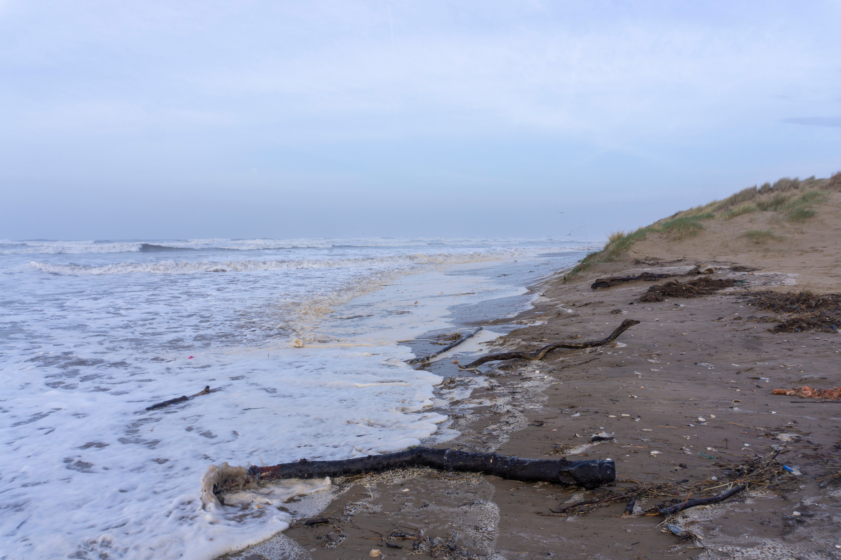

EROSION
Explore the impact of climate change on our coastlines...

Slide 2
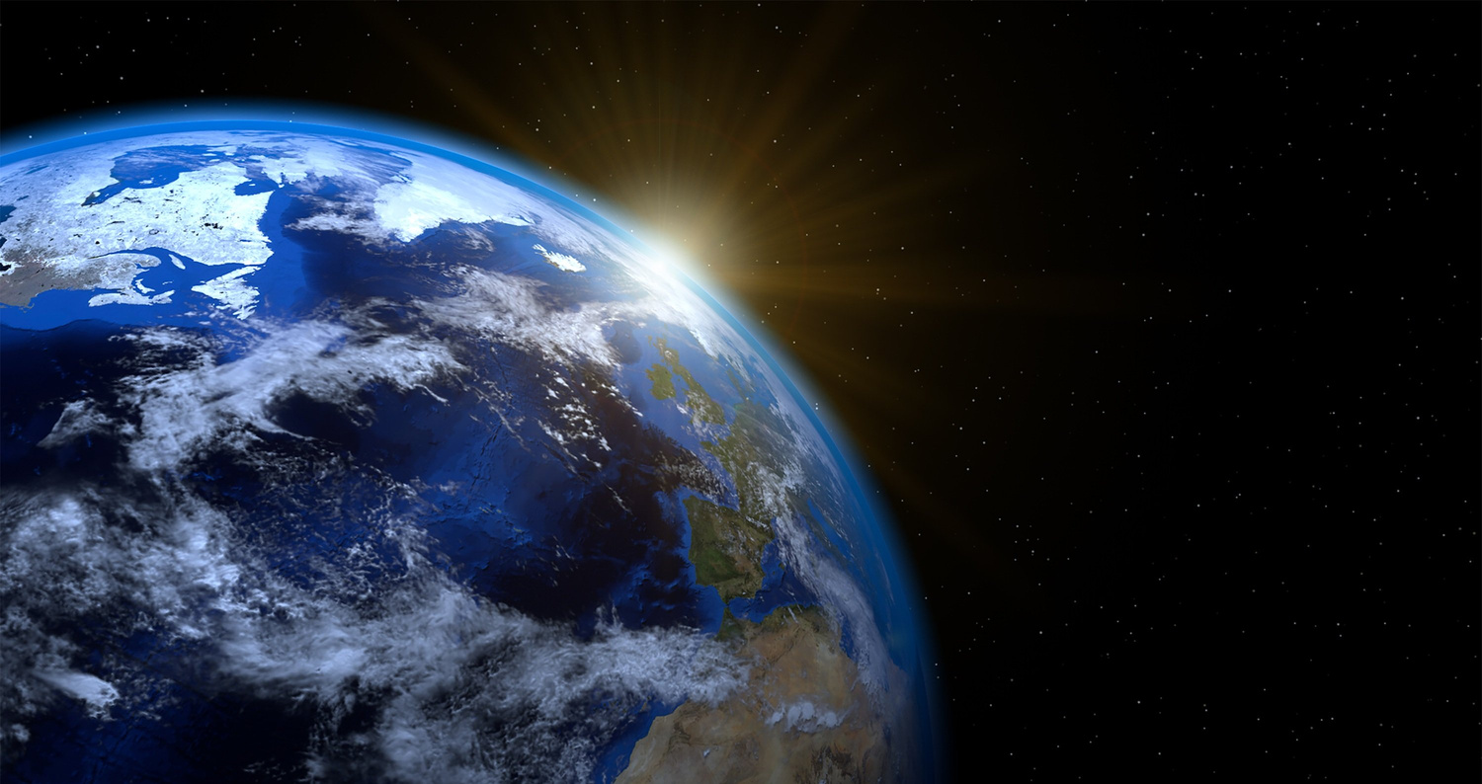
LEARNING OUTCOMES
By the end of this presentation you will have learned:
  What erosion is
  How erosion is affecting our coastline
  The features of erosion
  How we currently slow erosion

Slide 3
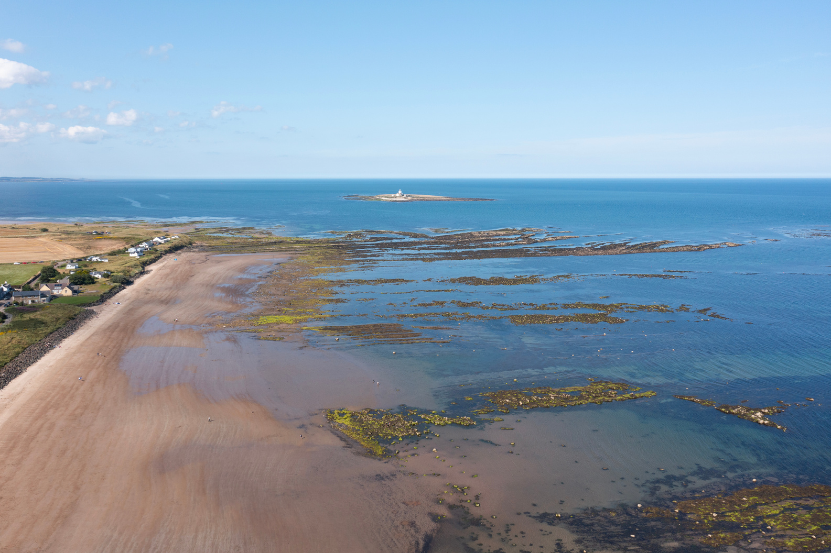
GETTING TO KNOW THE COAST
List some features you might find at the coast:
  Cliffs
  Beaches
  River mouths
  Mudflats
  Rocky shore
  Harbours

Slide 4
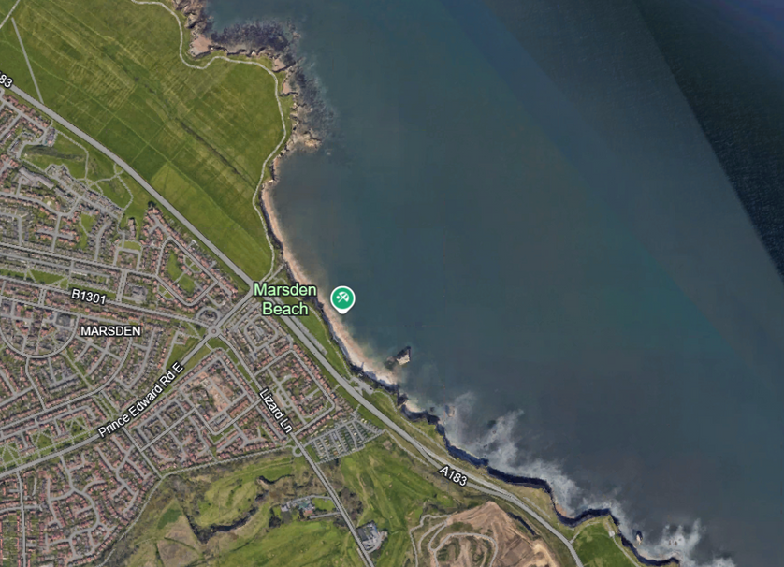
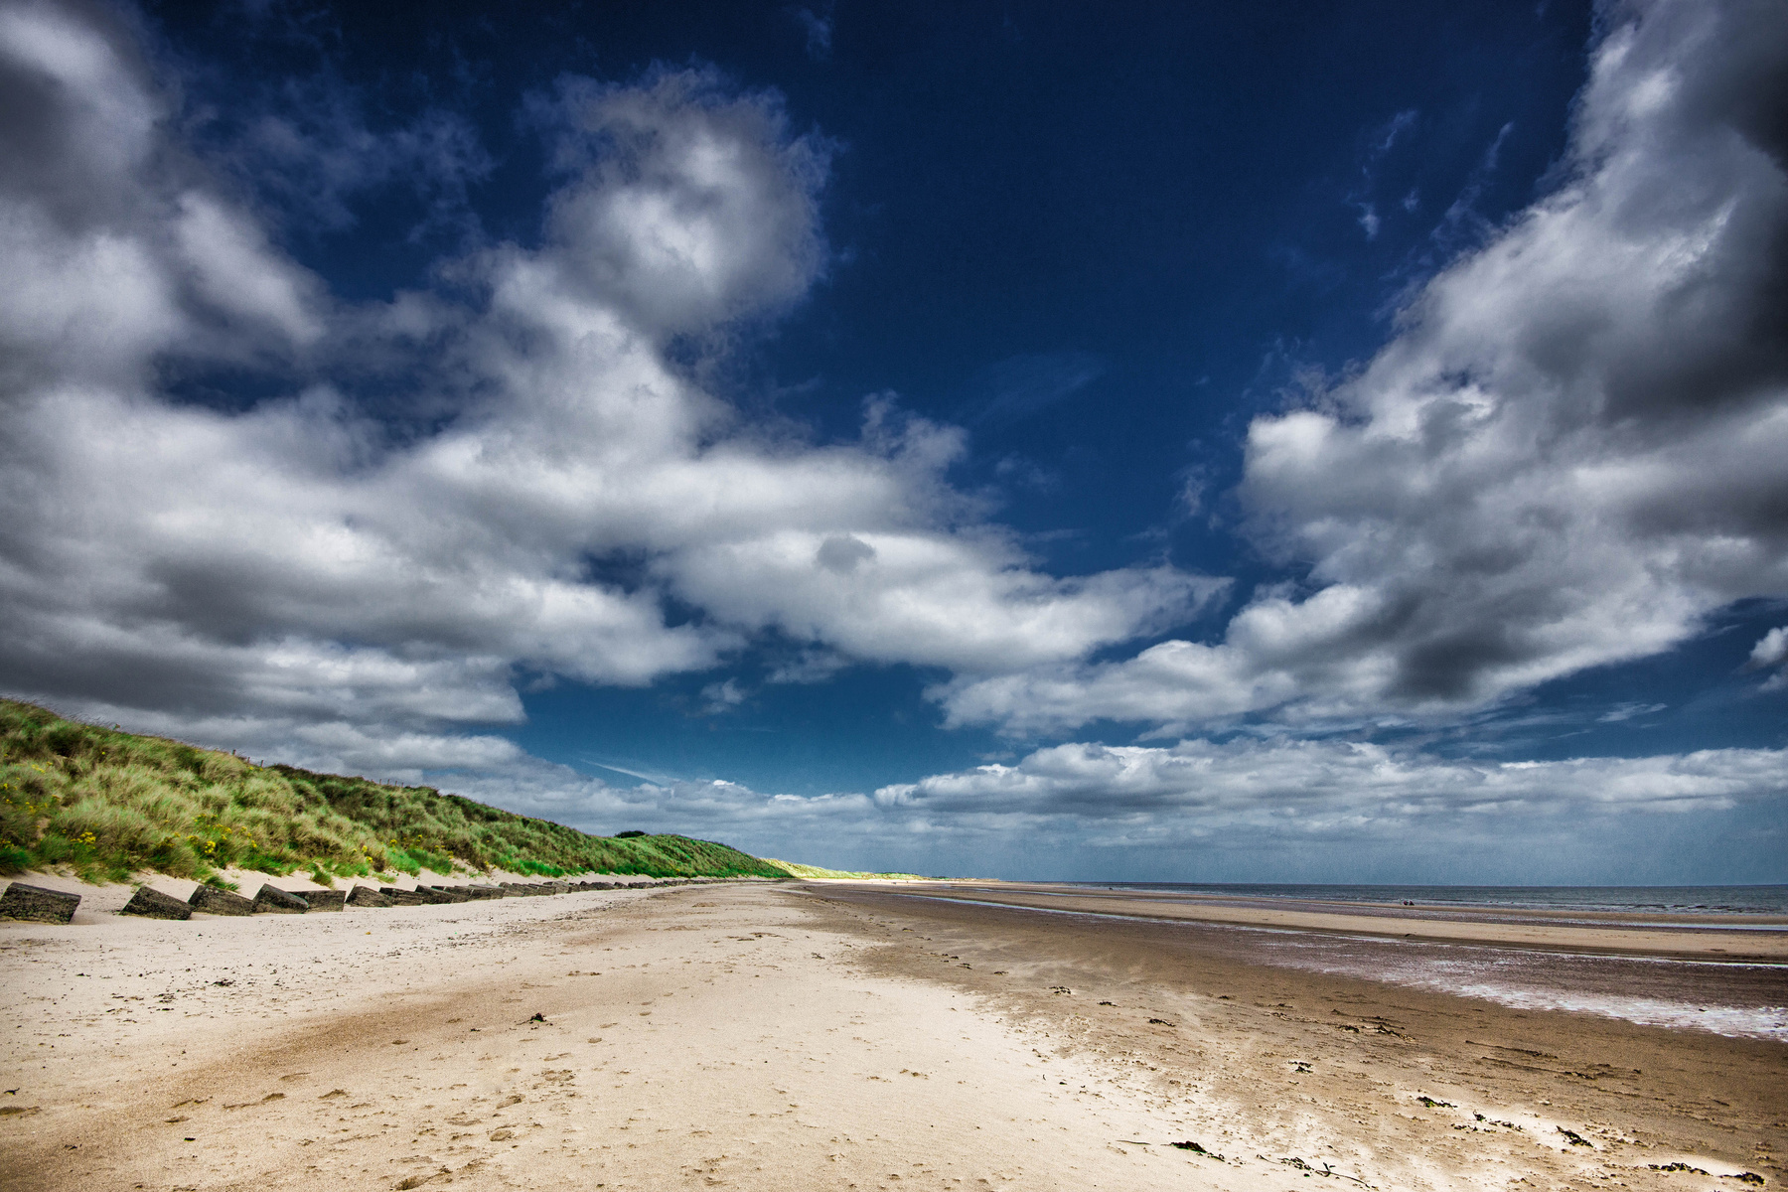
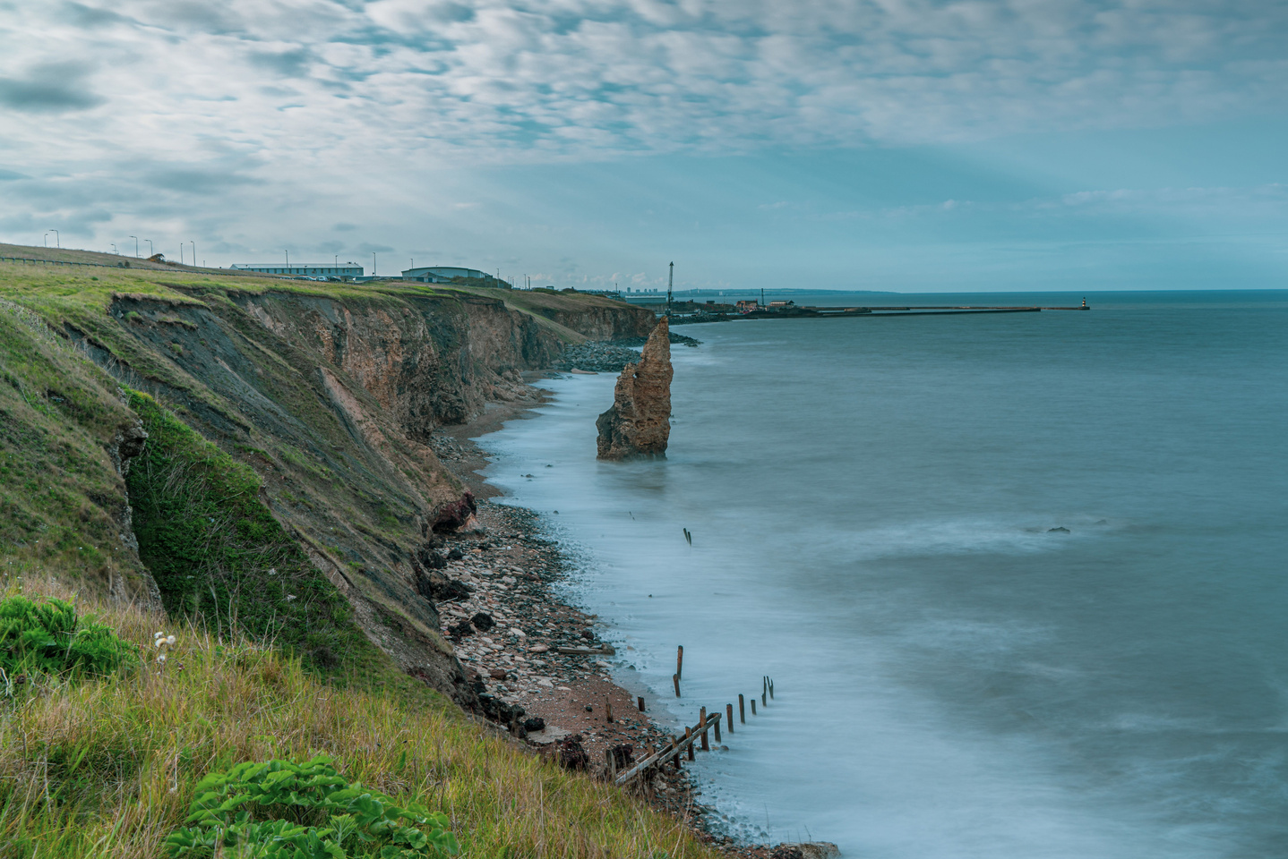
GETTING TO KNOW THE COAST
Coasts are always changing, but what does a typical coast look like?
There are a variety of types of coast that depend upon the way the water moves in the area, nearby rivers, and the type of rock in the area...

Slide 5
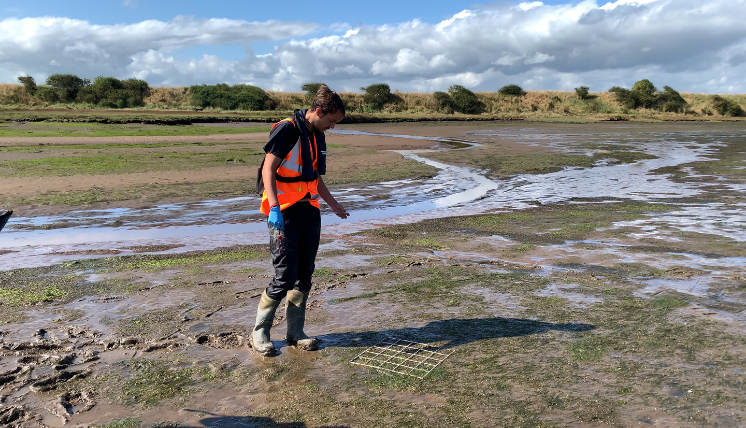
ESTUARIES
Where rivers meet the sea, you might find estuaries, where fresh water mixes with salt water, and where quite often you might find marsh areas and a lot of mud!
This mud is washed downstream in the river to settle at the river mouth.

Slide 6
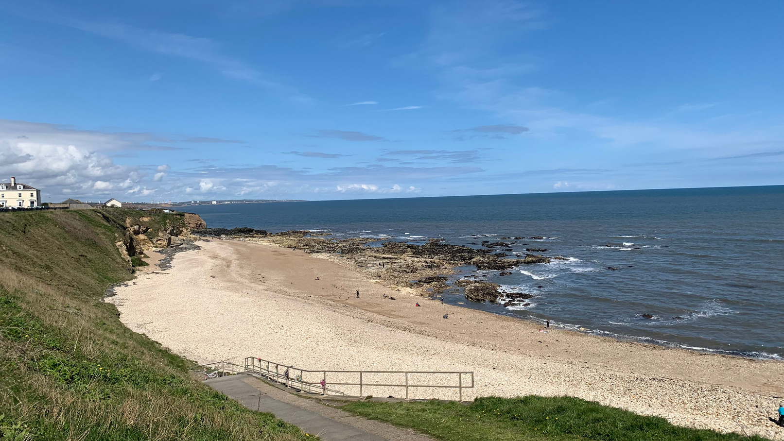
DEPOSITION
In areas where the coast is sheltered from the open ocean, the water is calmer and the waves slower, and so sand can be ‘deposited’ (dropped) here to form long, sandy or stony beaches. On these beaches you might even find mounds of sand called dunes!
Bays are an excellent example of these sheltered areas...

Slide 7
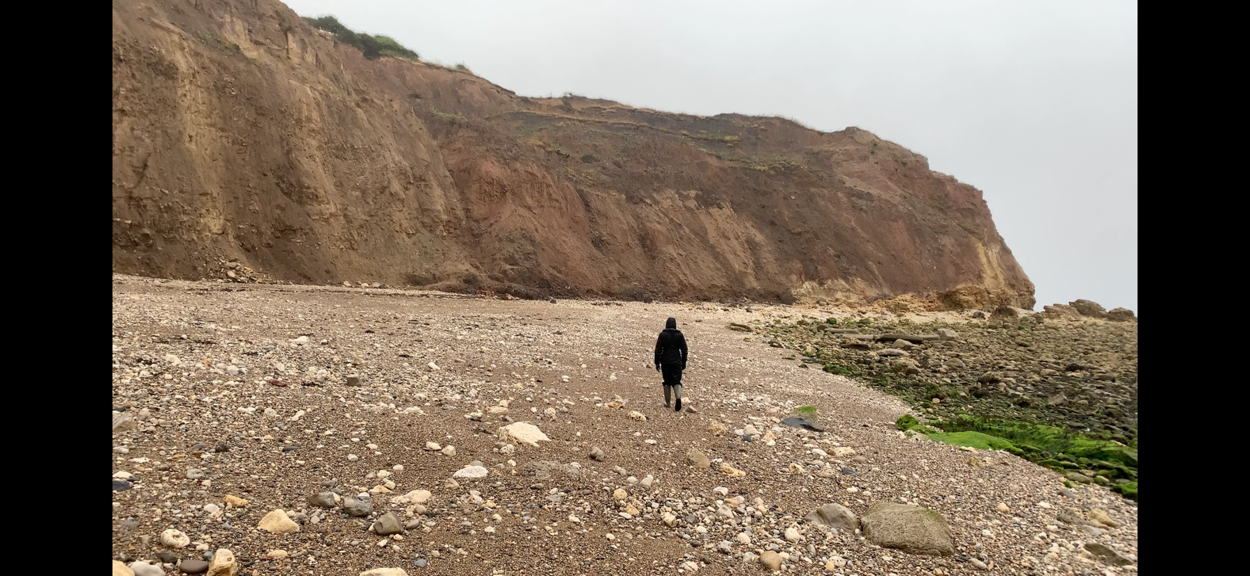
HEADLANDS
In areas with harder rock, such as volcanic rock, parts of the coast might jut out into the sea. That is because the harder rock takes longer to ‘erode’.
What do you think ‘erode’ means?
Headlands are an excellent example of harder rock jutting out into the sea...

Slide 8
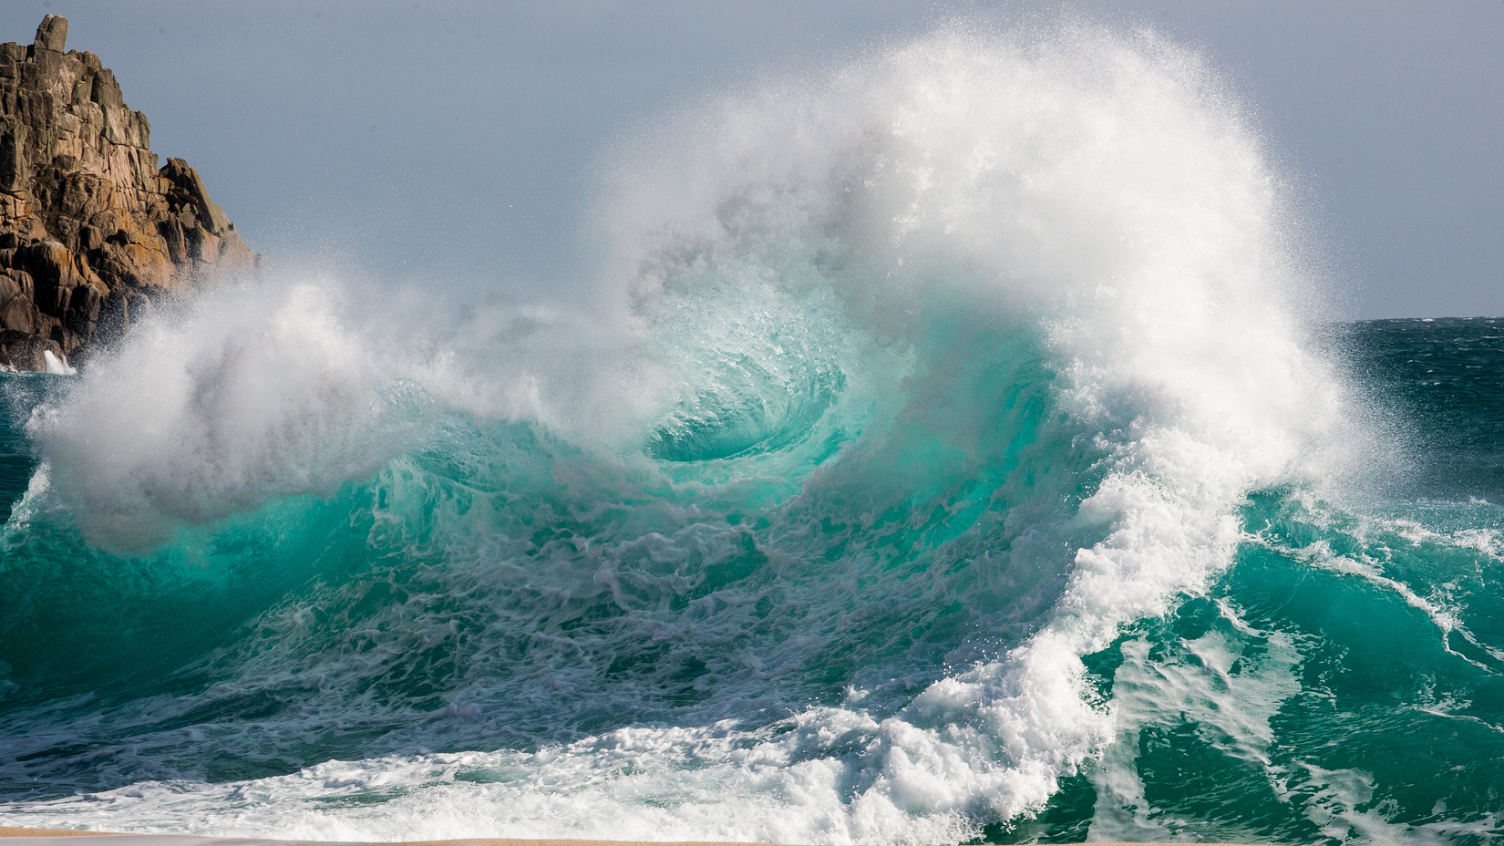
EROSION
Our coasts are always changing, because the sea is always moving! Our coasts might move back in land (eroding) or they might move outwards through deposition, with new beaches forming.
Climate change is causing us trouble however, as it is increasing the speed at which our coast erodes.

Slide 9
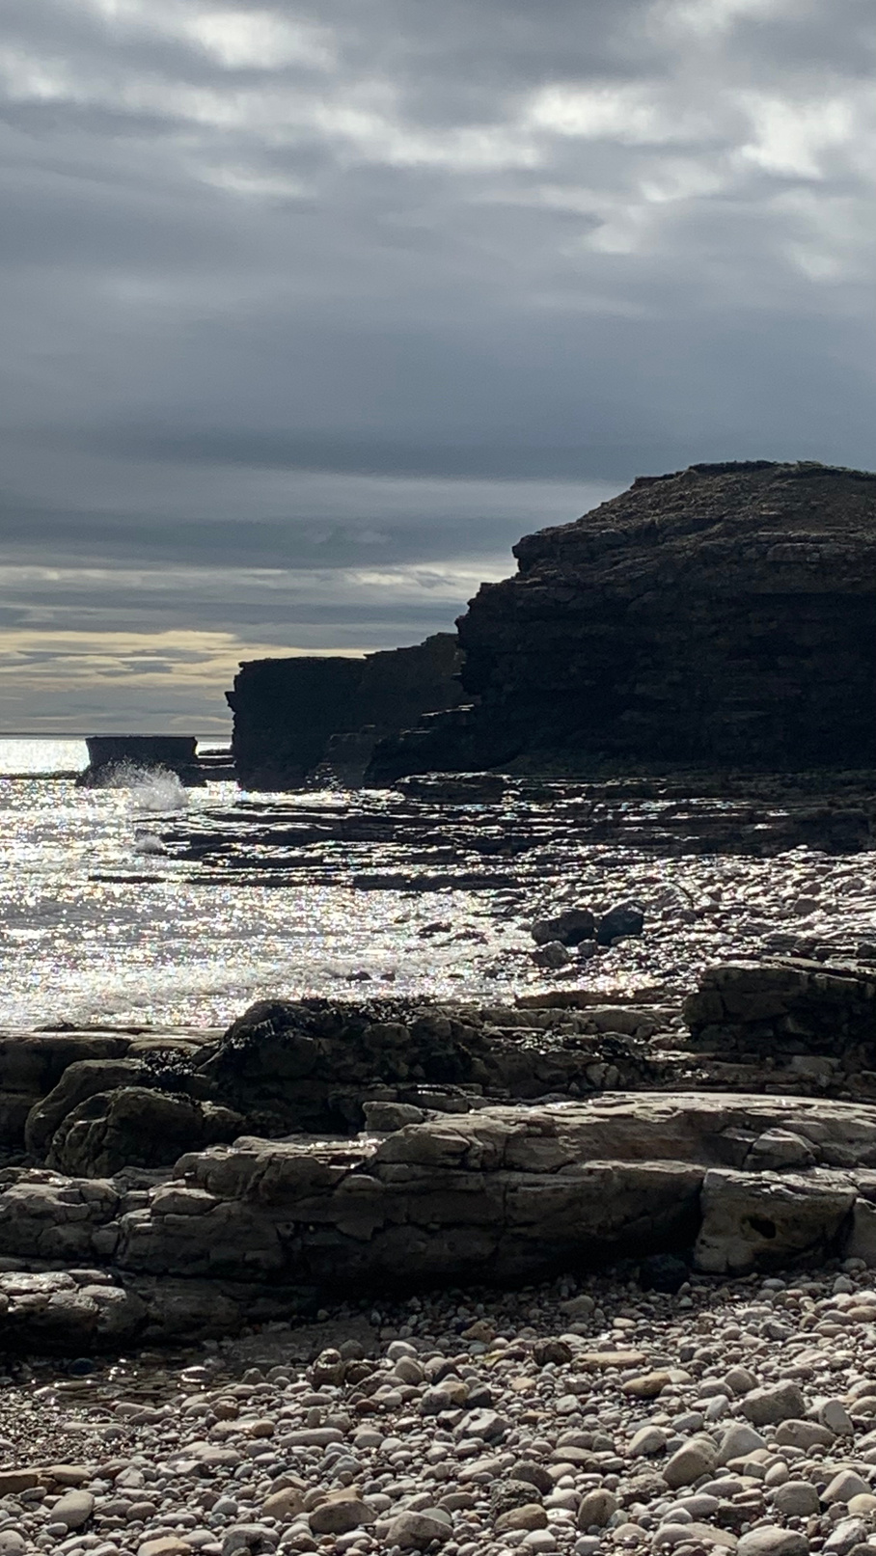
EROSION
Erosion is the breaking up of coastal rock over time, as sea waves crash against the rock. The water breaks off small pieces of rock, however over time this adds up, moving the coast further and further inland...

Slide 10
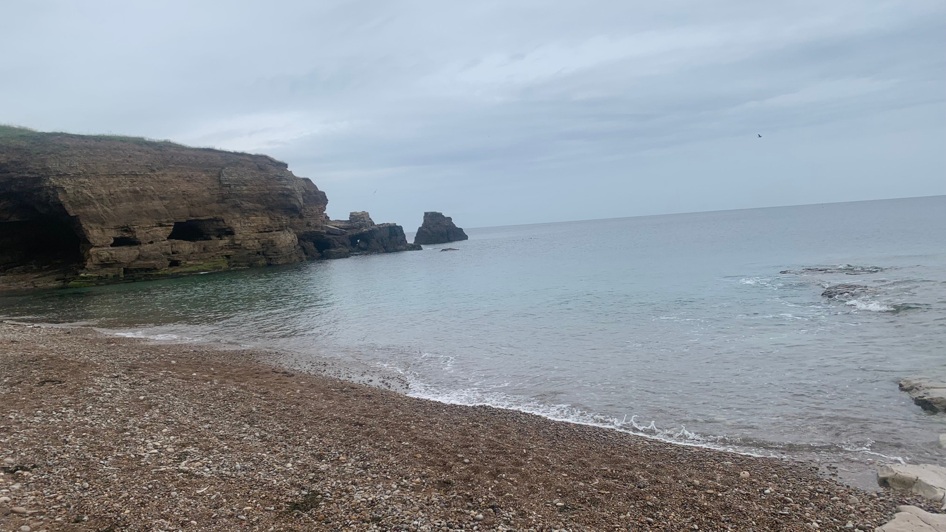
EROSION
The process of erosion follows a similar pattern that repeats again and again, year after year...
As rocks erode we get coastal features, many of which you may recognise!

Slide 11
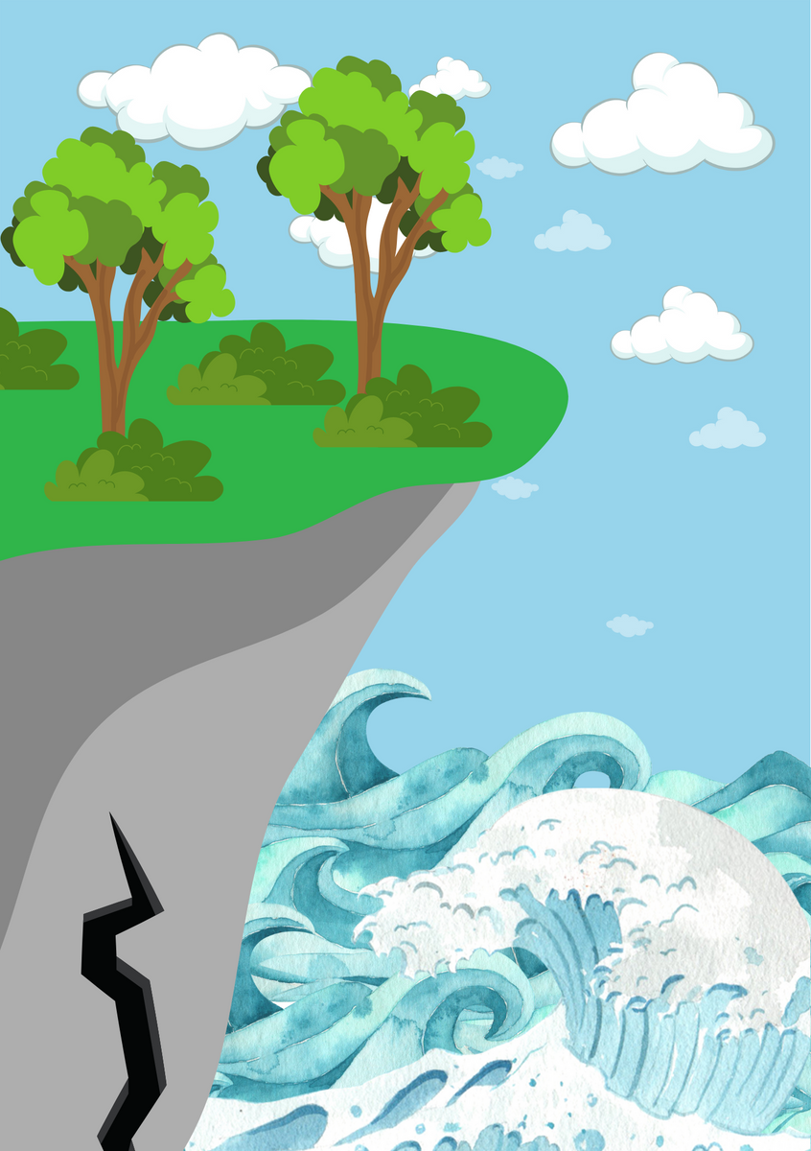
FEATURES OF EROSION
The process starts with a crack forming in the rock...

Slide 12
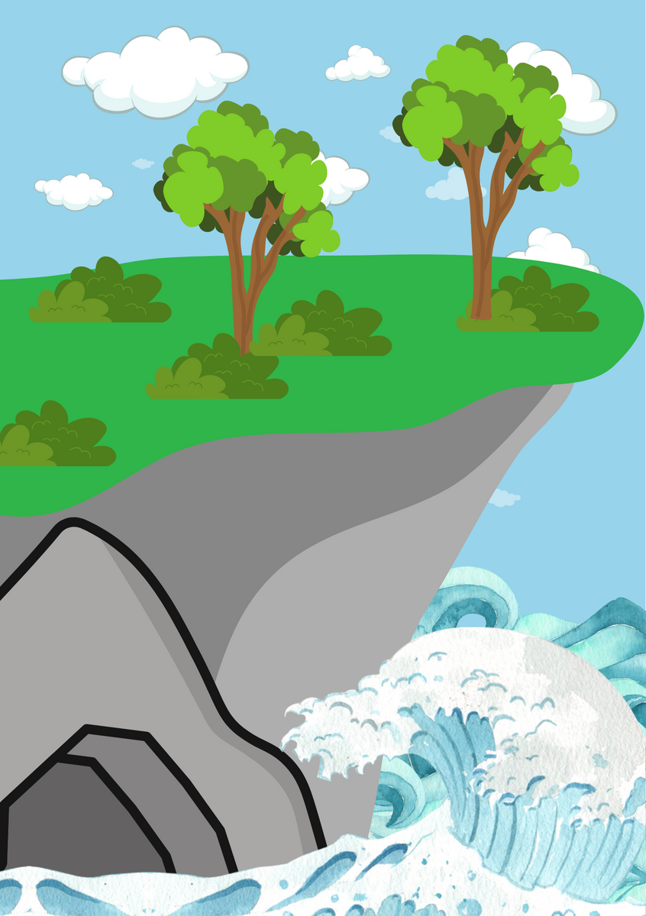
FEATURES OF EROSION
The waves crashing against the crack widen it over time, until it becomes a cave!

Slide 13
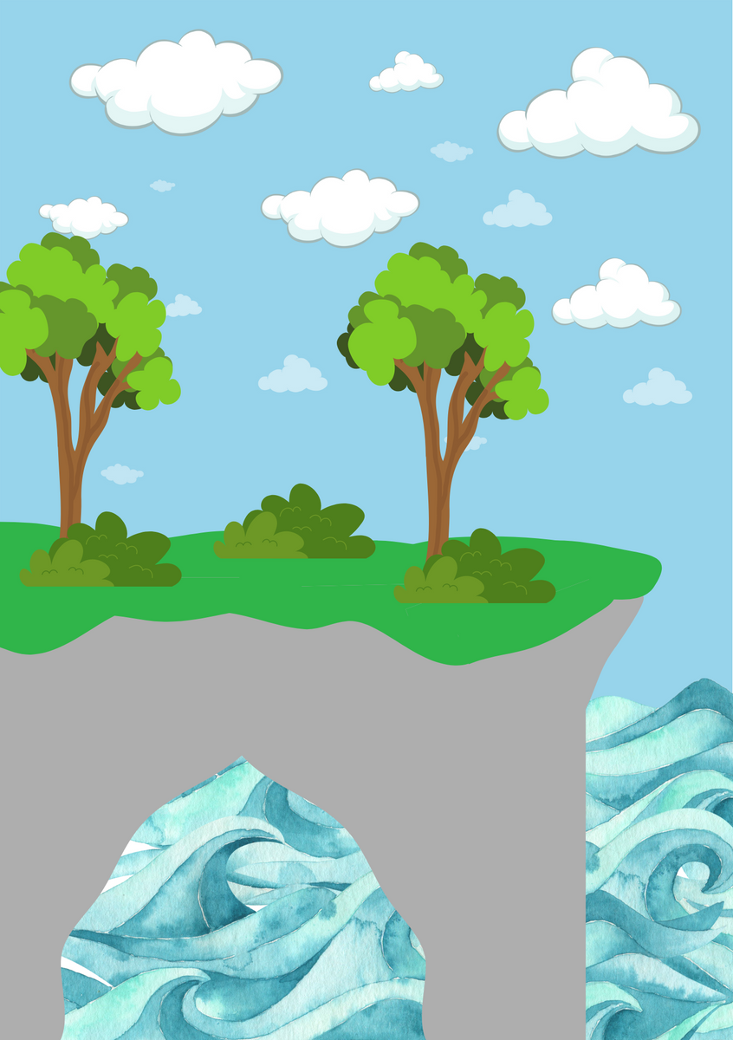
FEATURES OF EROSION
Eventually, if the cave is in a headland, the waves can erode the back of the cave and form an arch...

Slide 14
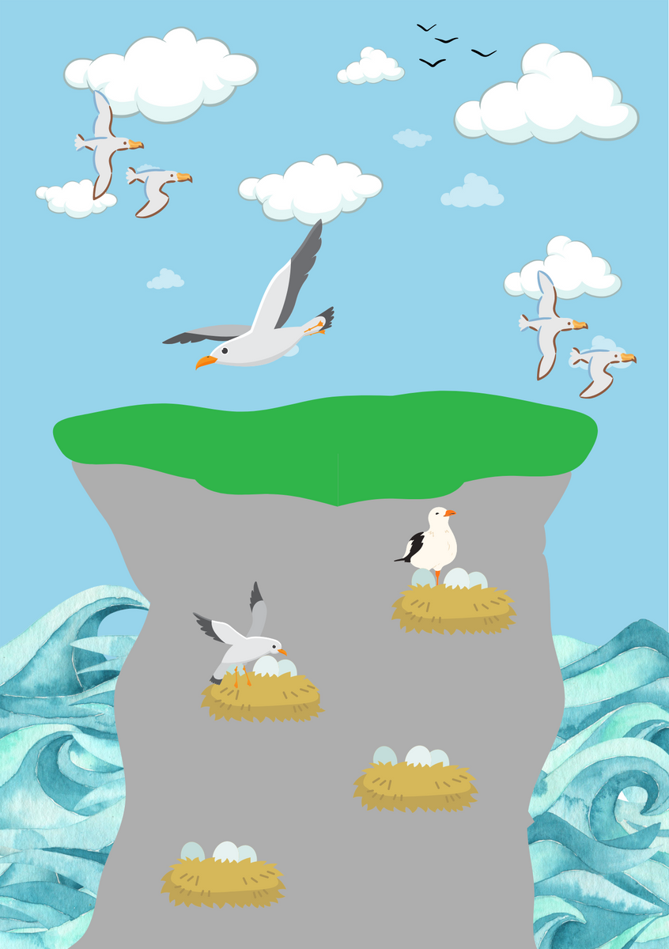
FEATURES OF EROSION
This arch collapses eventually, leaving a stack...

Slide 15
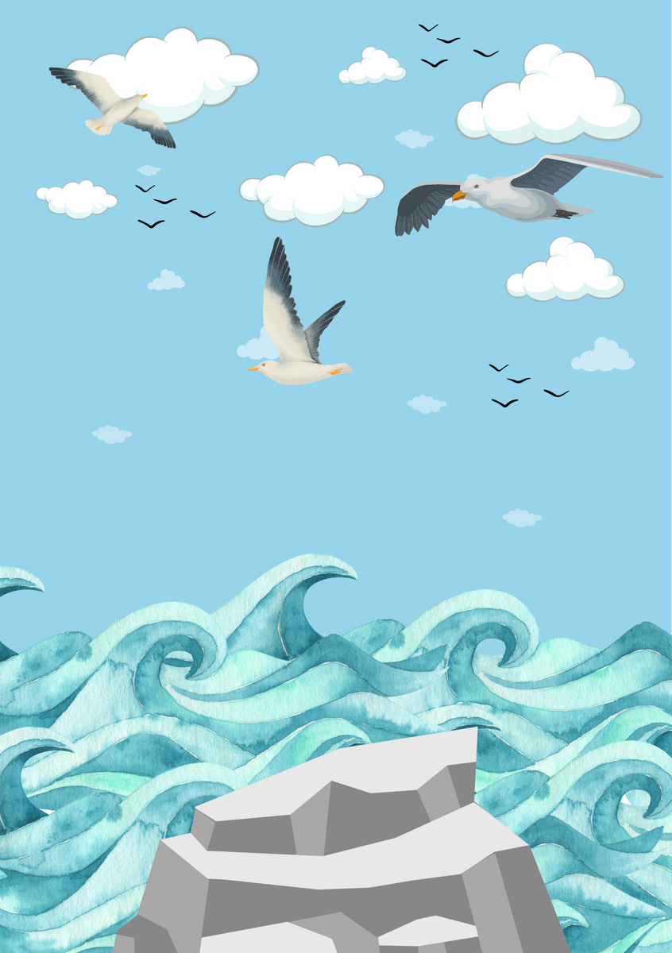
FEATURES OF EROSION
the stack eventually collapses to a stump, and then even the stump eventually erodes to nothing, and the process starts all over again!

Slide 16
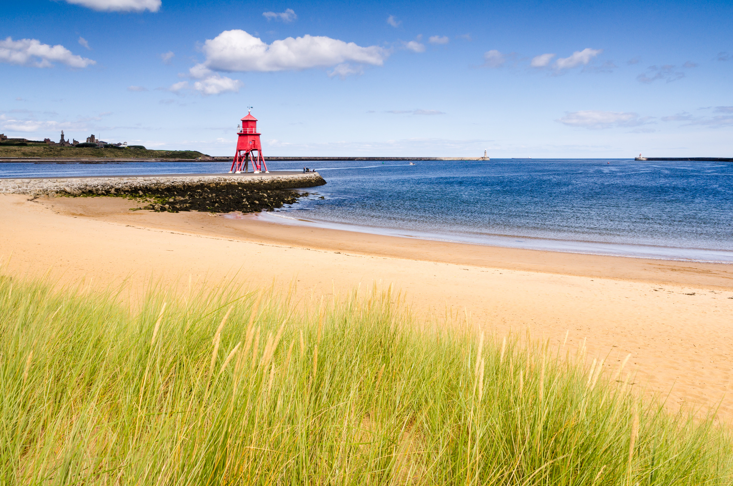
THE PROBLEM
Because climate change is causing bigger storms, and our sea level is rising, our coasts are eroding faster, and as we have a lot of businesses, homes and roads along the coast, amongst other things, that is a big problem!

Slide 17
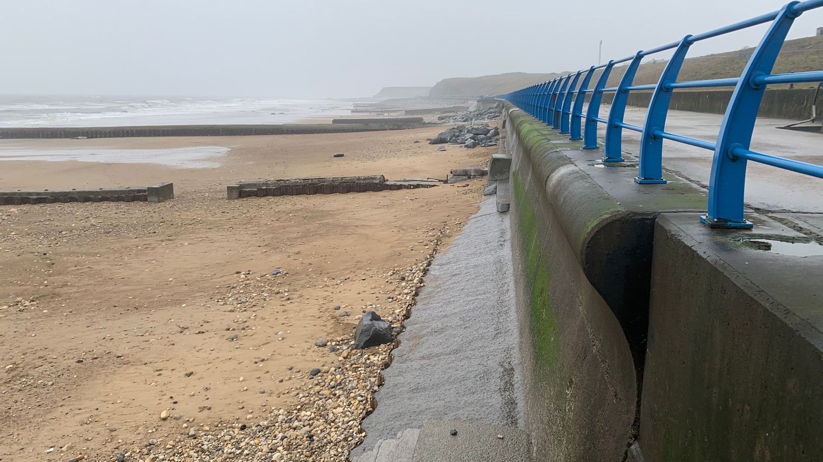
THE SOLUTION
There are a few ways we can slow down erosion thankfully! We can:
  Build sea defences like sea walls (this is called hard engineering)
  Rebuild things away from the coast (like moving roads backwards inland)
  Use nature to help reduce wave energy before they reach the shore (this is called soft engineering)

Slide 18
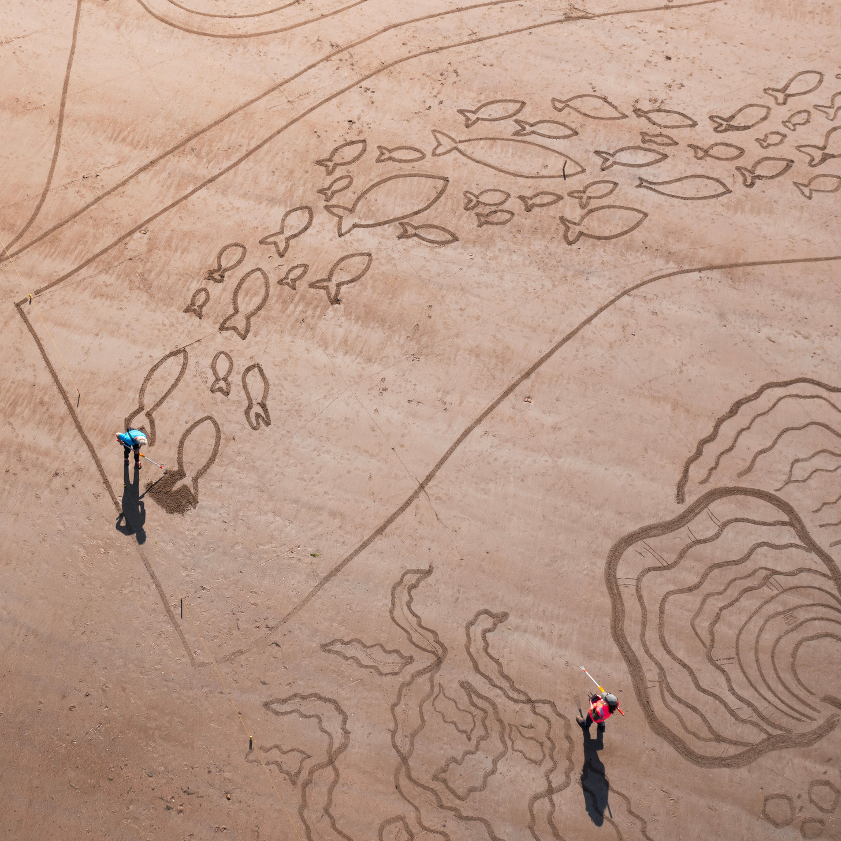
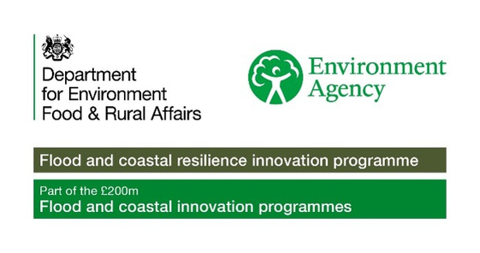

ACTIVITY TIME
In this section you can now complete the associated quiz, and can do the activity in the accompanying pdf!

