Slide 1



QUIZ TIME!
EROSION

Slide 2
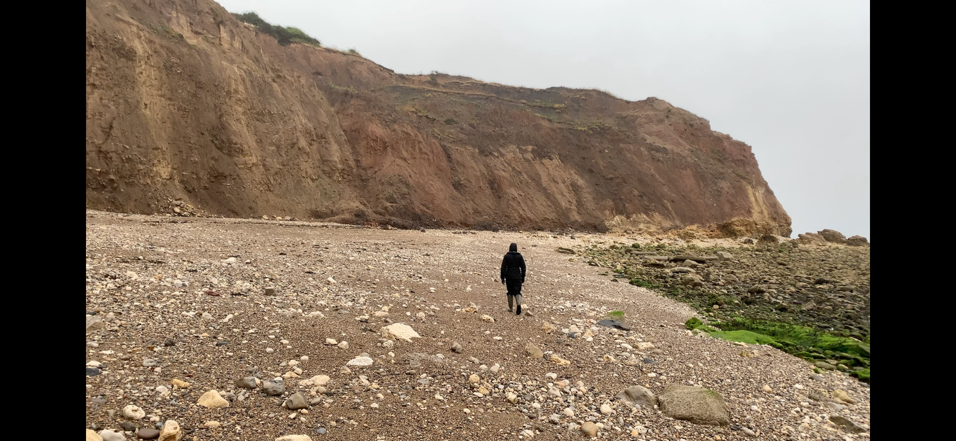
THE LANDFORMS CREATED BY EXTRUDING HARD ROCK AND ERODED SOFT ROCK ARE KNOWN AS...

Slide 3
THE LANDFORMS CREATED BY EXTRUDING HARD ROCK AND ERODED SOFT ROCK ARE KNOWN AS...
HEADLANDS
BAYS

Slide 4
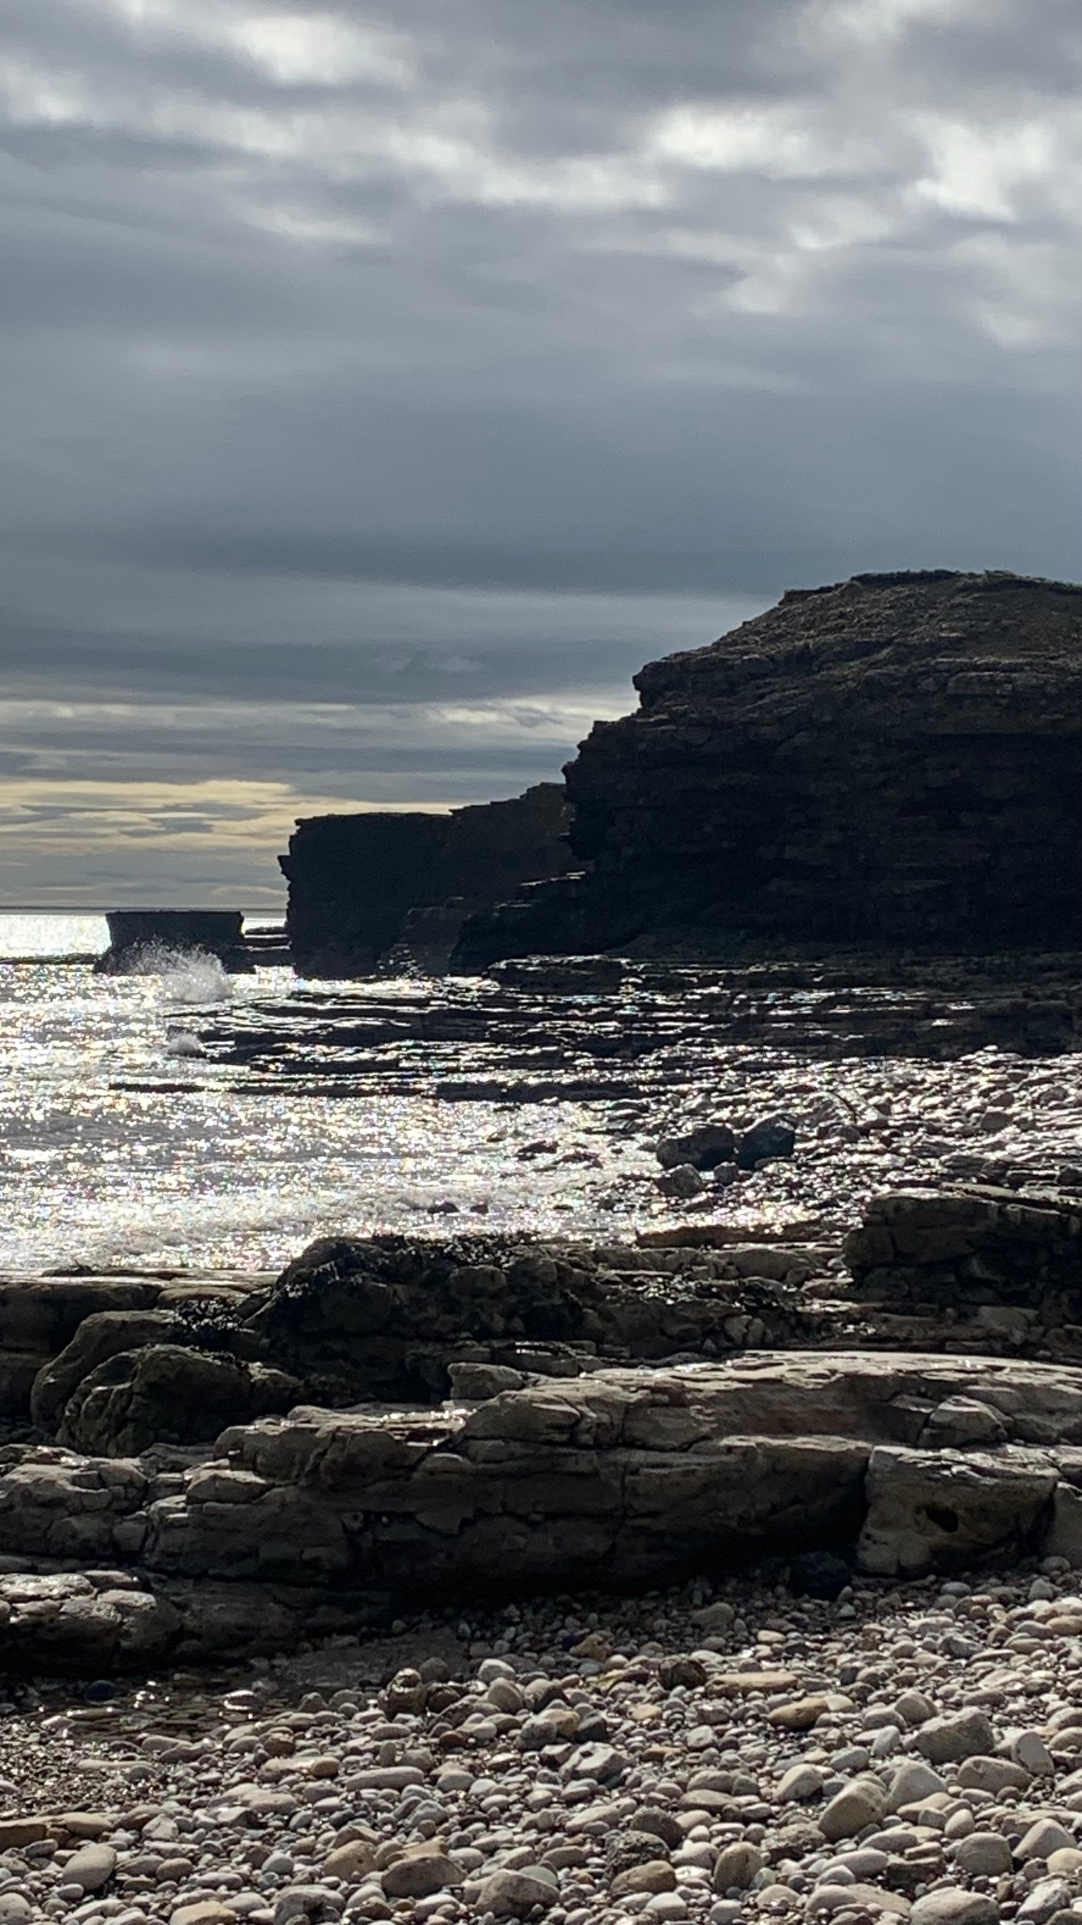
LIST THE ORDER THAT HEADLANDS TYPICALLY ERODE IN, STARTING WITH THE CRACK...

Slide 5
LIST THE ORDER THAT HEADLANDS TYPICALLY ERODE IN, STARTING WITH THE CRACK...
CRACK > CAVE > ARCH > STACK > STUMP

Slide 6

LOCAL AUTHORITY USE A COST - _______ ANALYSIS TO DECIDE WHETHER TO USE COASTAL DEFENCE MEASURES OR ALLOW THE AREA TO ERODE.
FILL IN THE MISSING WORD

Slide 7
LOCAL AUTHORITY USE A COST - BENEFIT ANALYSIS TO DECIDE WHETHER TO USE COASTAL DEFENCE MEASURES OR ALLOW THE AREA TO ERODE.
FILL IN THE MISSING WORD

Slide 8
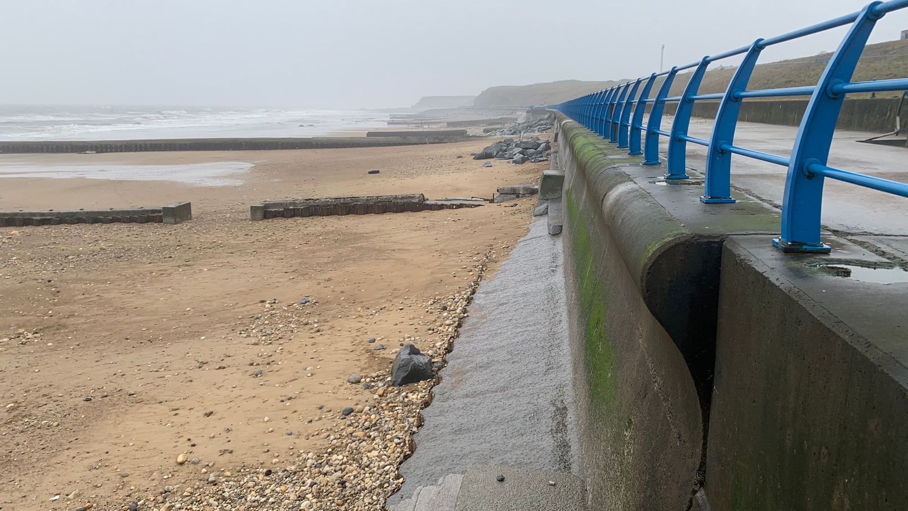
WHAT ARE THE 2 TYPES OF ENGINEERING USED TO PROTECT COASTLINES?

Slide 9
WHAT ARE THE 2 TYPES OF ENGINEERING USED TO PROTECT COASTLINES?
HARD AND SOFT ENGINEERING

Slide 10
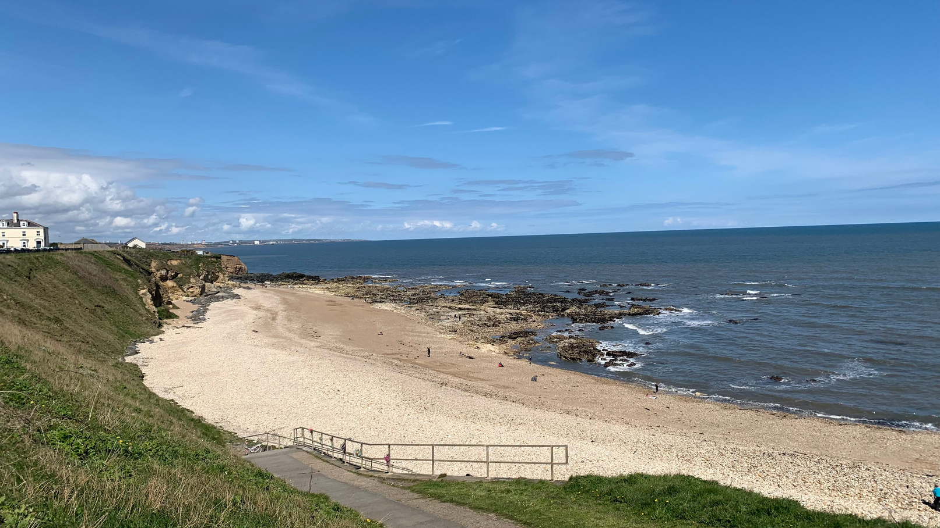
LIST 3 TYPES OF HARD ENGINEERING

Slide 11
LIST 3 TYPES OF HARD ENGINEERING
You could choose from:
Gabion
Seawall
Breakwater
Groyne

Slide 12
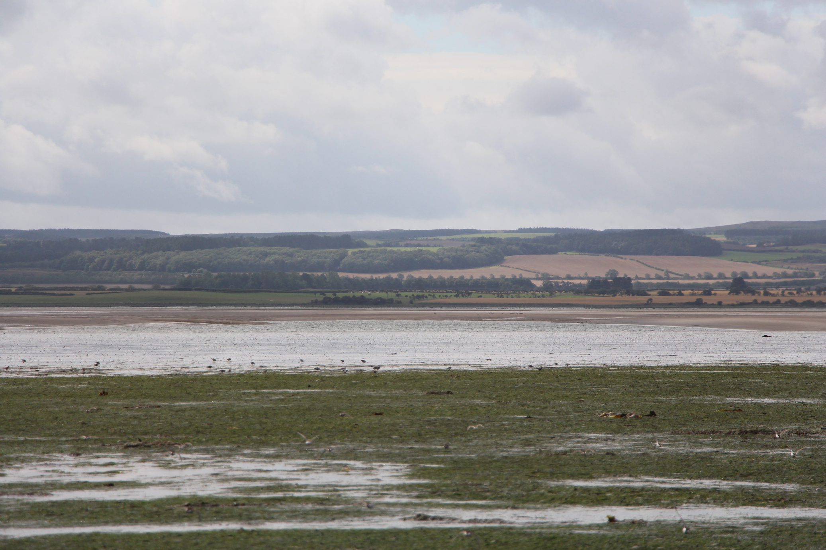
WHAT IS THE TERM FOR BUILDING THE COAST OUTWARD AS A FORM OF COASTAL MANAGEMENT?

Slide 13
WHAT IS THE TERM FOR BUILDING THE COAST OUTWARD AS A FORM OF COASTAL MANAGEMENT?
ADVANCE THE LINE

Slide 14


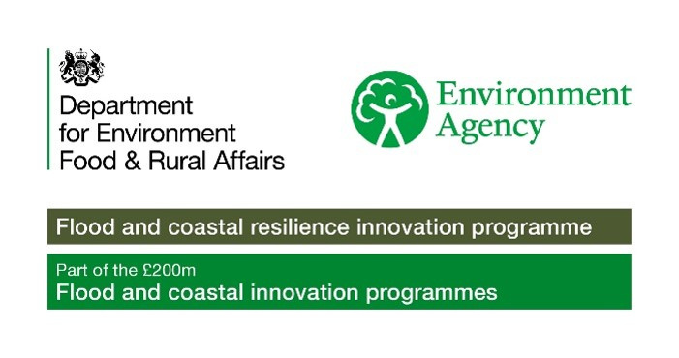
To find out more about Stronger Shores follow the link in the QR code to visit our StoryMap, or go to:
https://storymaps.arcgis.com/stories/7da0c07ee3d245c9b273c6538bf0e1db

