Slide 1

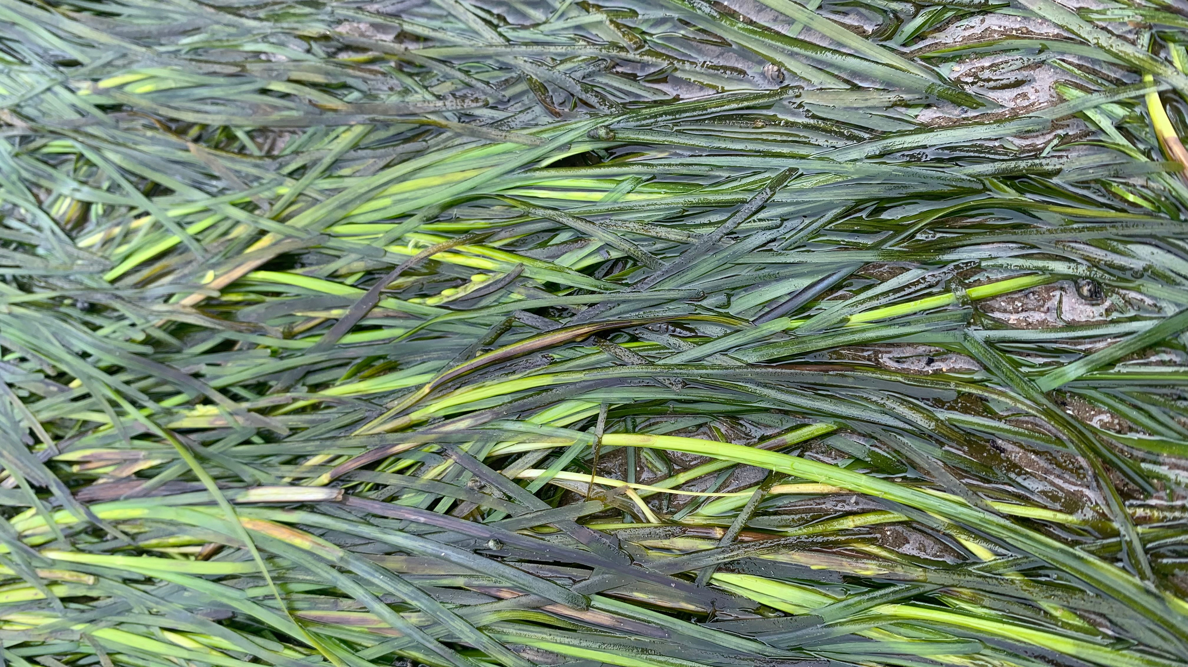
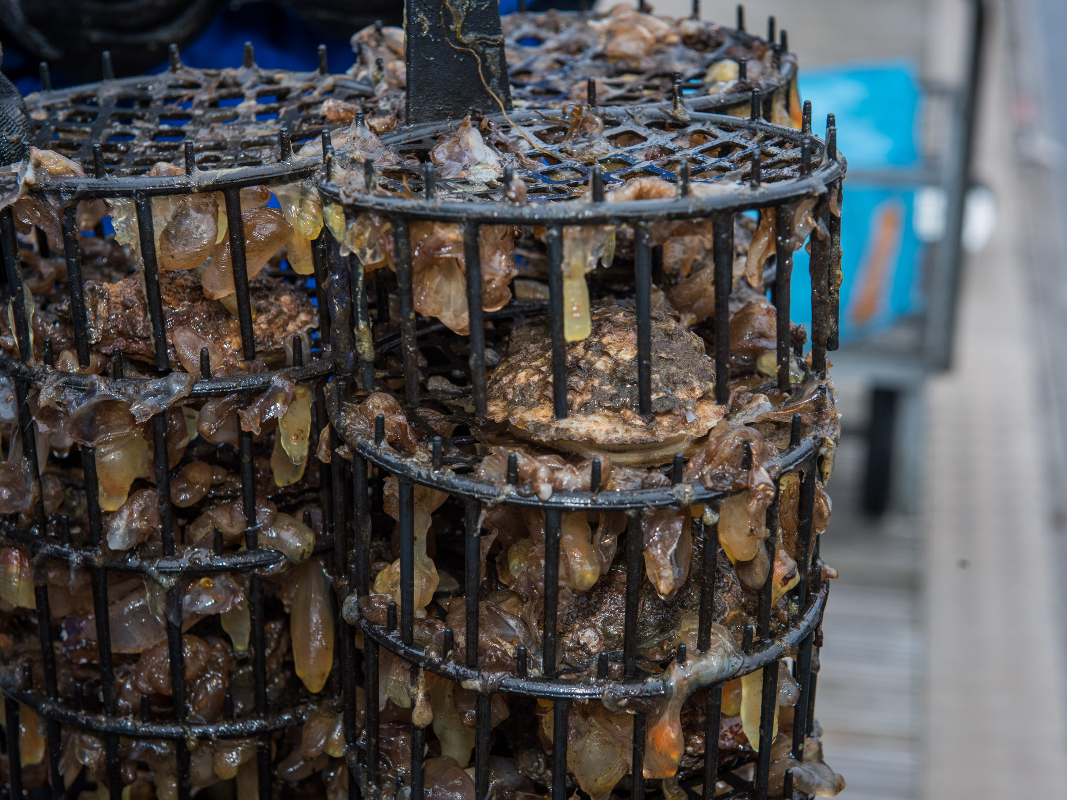
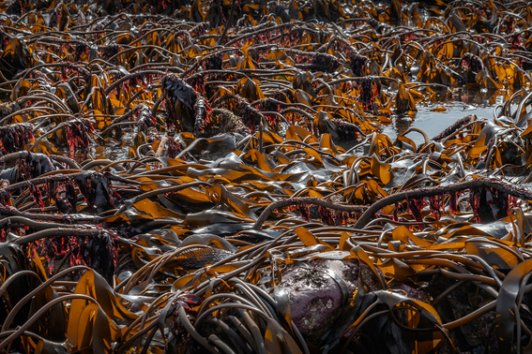

COASTAL DEFENCE
Explore how the natural environment can protect our coasts...

Slide 2
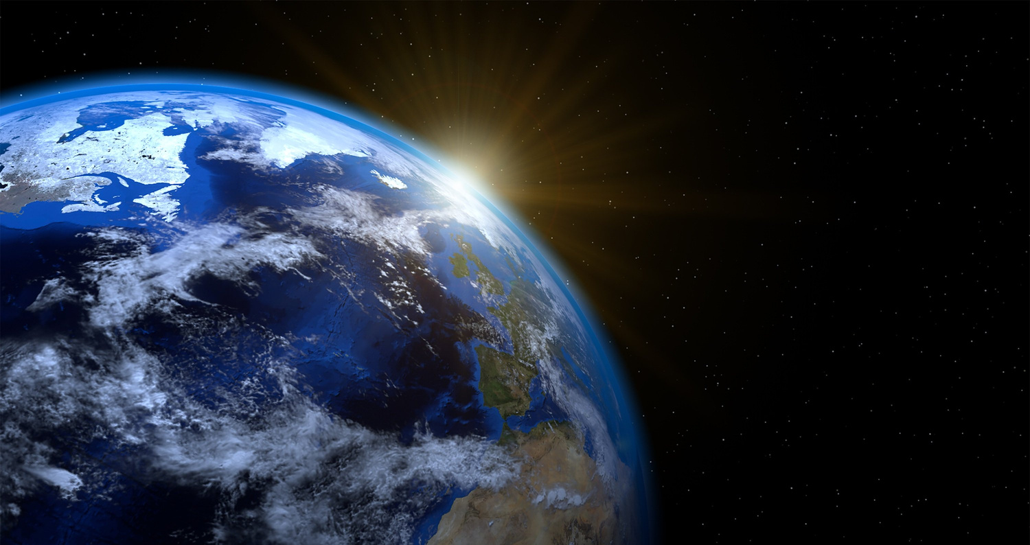
LEARNING OUTCOMES
By the end of this presentation you will have learned:
  That Stronger Shores is a local scientific project looking at using nature to protect our coasts
  The benefits that seagrass, kelp and oysters provide us and the coastal environment
  How coastal habitats affect water quality

Slide 3
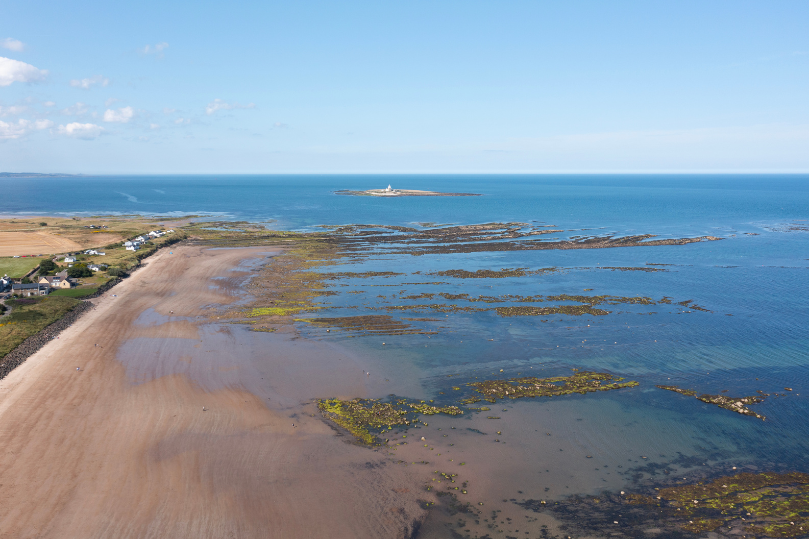
WHAT IS STRONGER SHORES?
Stronger Shores is a scientific project that is exploring how kelp, seagrass and oysters can benefit our coastlines, from protecting it from erosion to providing habitats for marine life and everything in between...

Slide 4
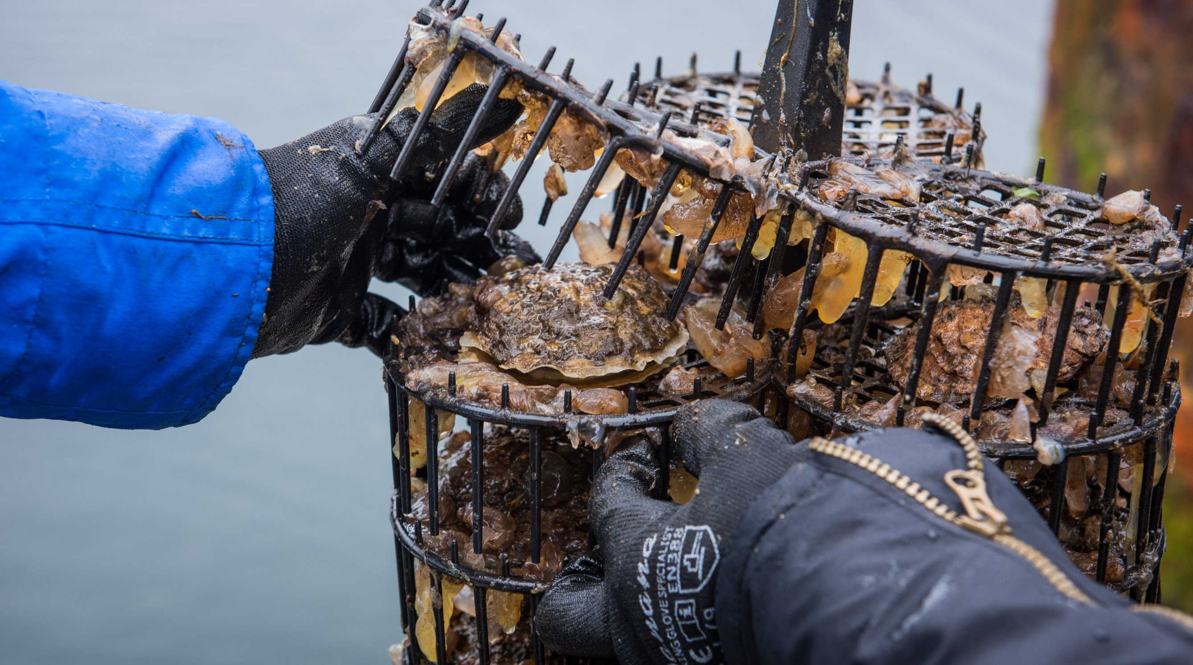
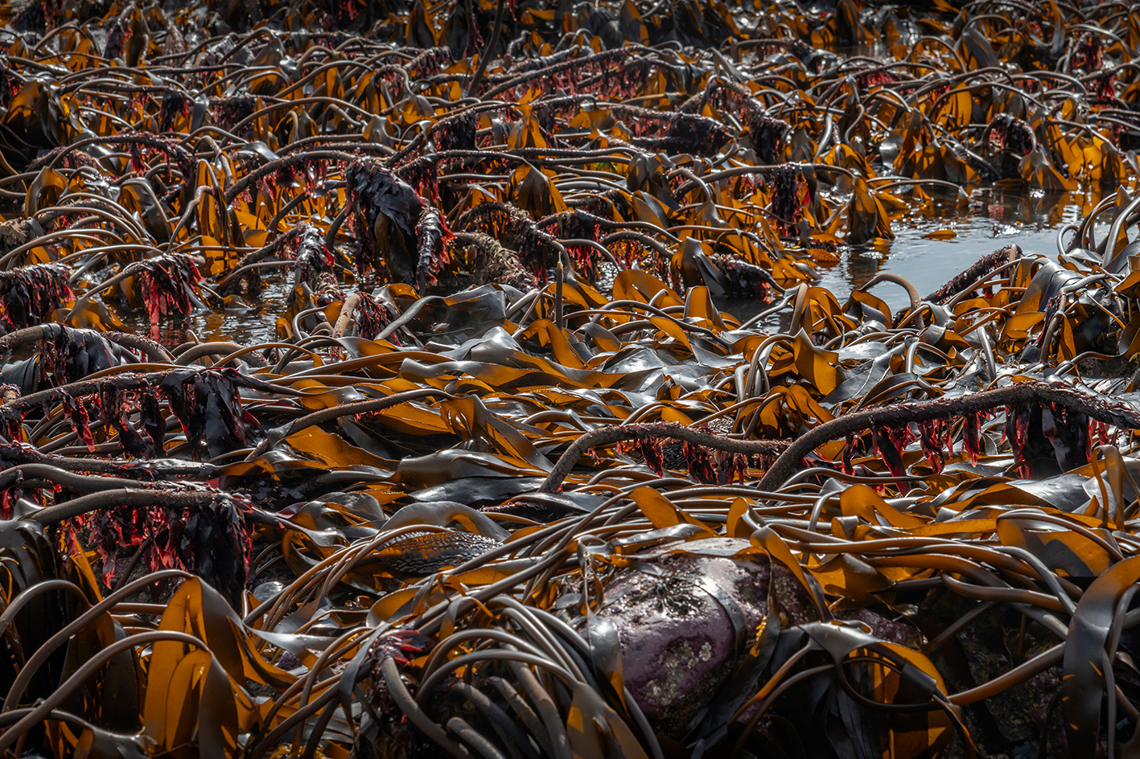
THE SPECIES
SEAGRASS (meadows)
OYSTERS (reefs)
KELP (forests)

Slide 5
KELP
Kelp is in fact edible, and a very environmentally friendly crop to grow, as it requires no fresh water, and no fertiliser, as it gets its water and food from the surrounding seawater.

Slide 6
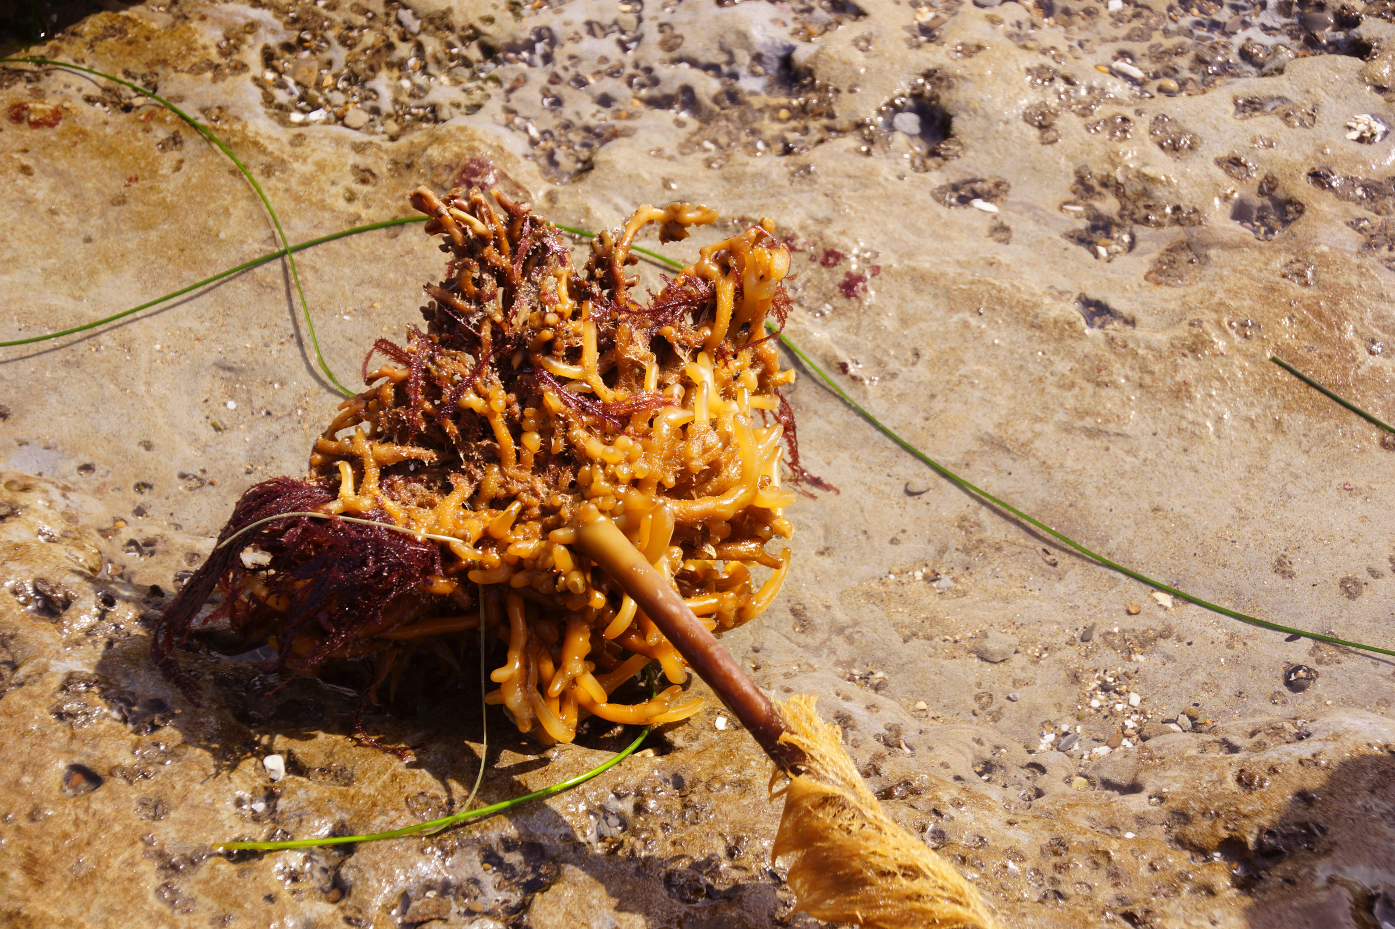
KELP IS NOT A PLANT!
Kelp is not in fact a plant but an algae, differing from a plant in that they do not have roots, but holdfasts, whose function is to bind the kelp to rocky surfaces.

Slide 7
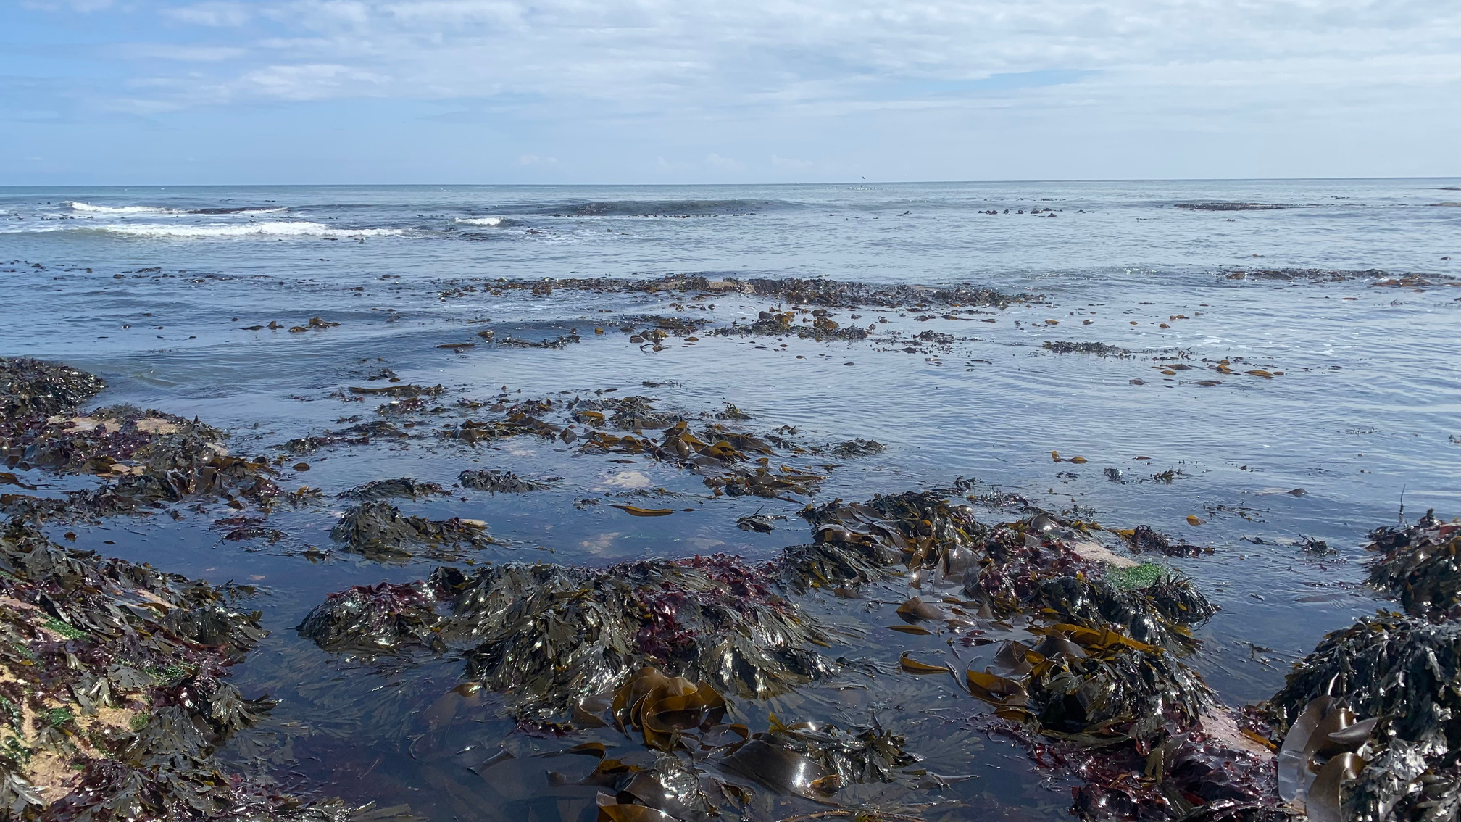
KELP IS NOT A PLANT!
The holdfast leads to a stipe, similar to a stem but much more basic, in that its primary function is to hold the kelp upright, towards the sea surface. The blades, similar to plant leaves, need to be close to the sea surface, as like plants, kelp also photosynthesises and so needs light!

Slide 8
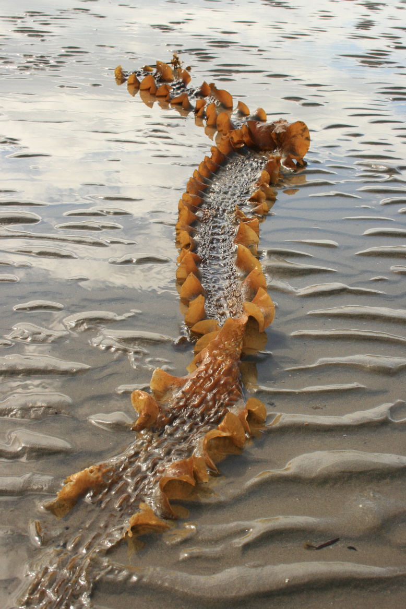
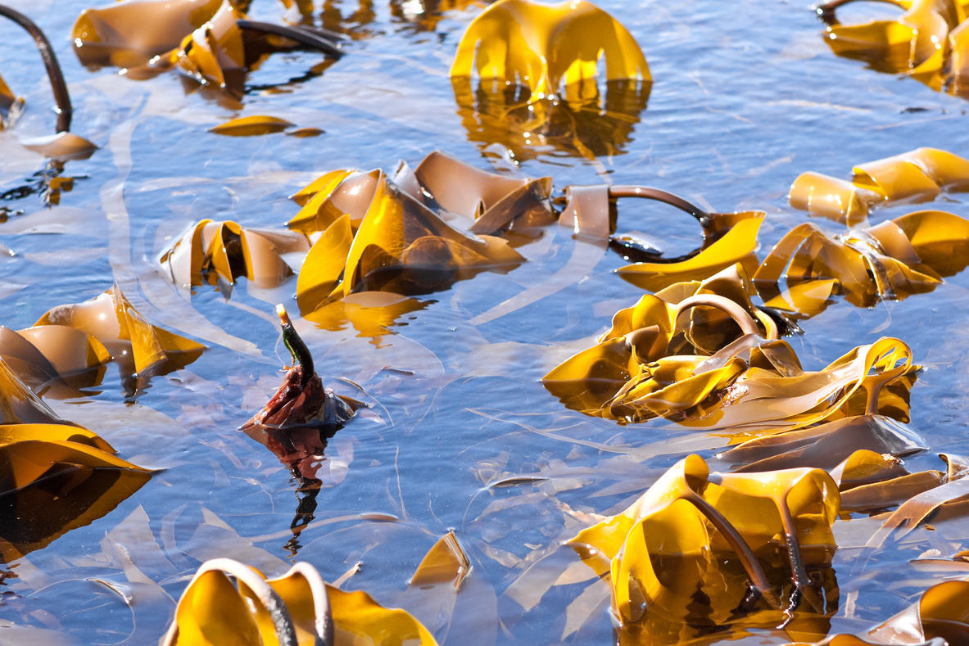
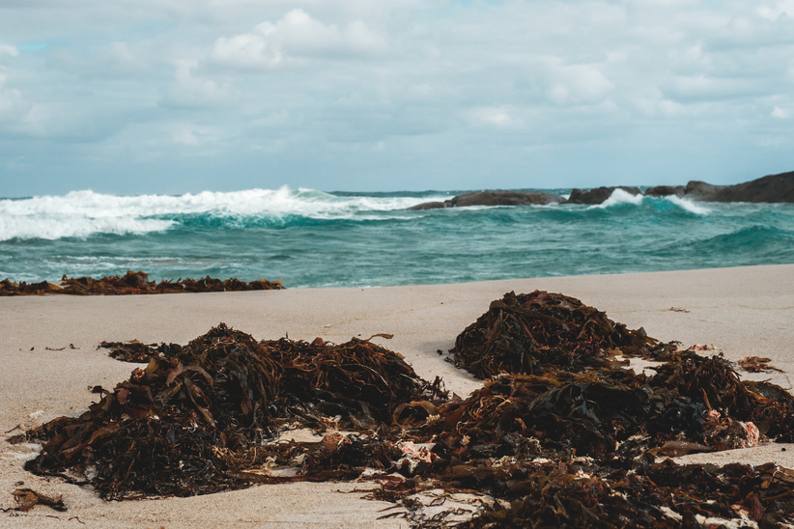
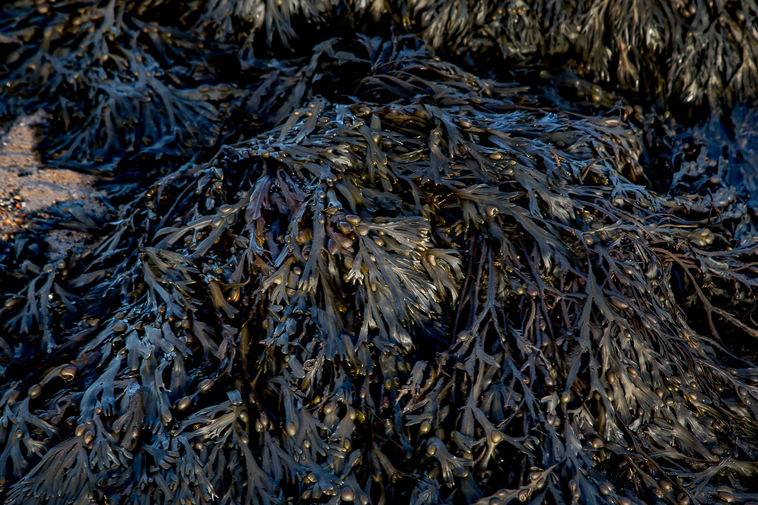
PRESSURES
Kelp populations around the UK are relatively healthy, however, they are threatened by climate change. With kelp in the UK adapted for a temperate climate, warming waters could pose a threat to these algae.

Slide 9
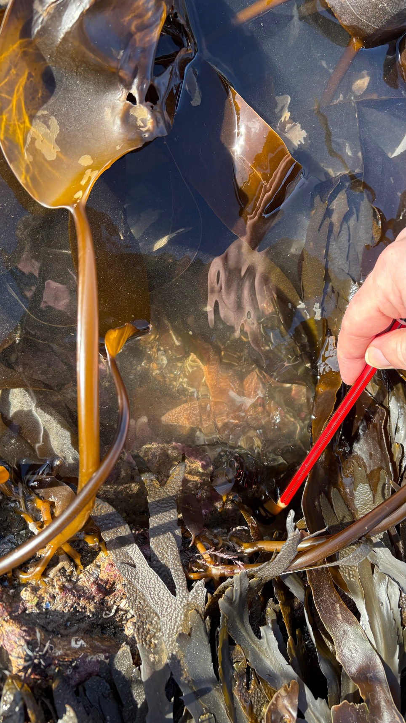
BENEFITS
Kelp has an incredible amount of benefits! Here are just a few:
  Ingredient in food and drink
  Requires no fertilier or fresh water to grow
  Captures carbon
  Provides habitat for many, many species
  Cleans surrounding water by taking up nutrients
  Dampens wave energy
  Used in pharmaceuticals
  Produces oxygen

Slide 10
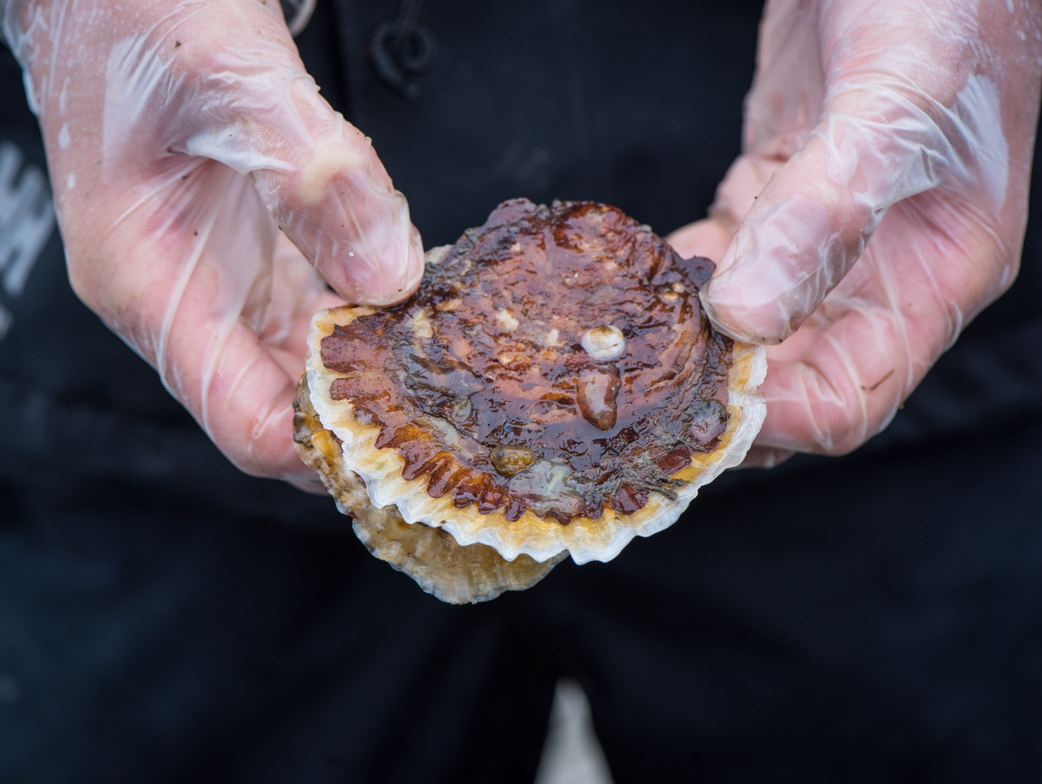
OYSTERS
Oysters are animals that grow a shell around them in order to protect themselves from any predators.
They are filter feeders, which means that they pull in water, pass it through their gills, and any food floating in the water is taken up by the oyster, with the water then expelled back out again!

Slide 11
PRESSURES
Oysters were originally a food of the poor, because there were so many of them, however, years of intensive fishing led to their population collapsing. Since then pollution, disease, and new species being introduced that may be outcompeting the oyster have all contributed to further declining their numbers...

Slide 12
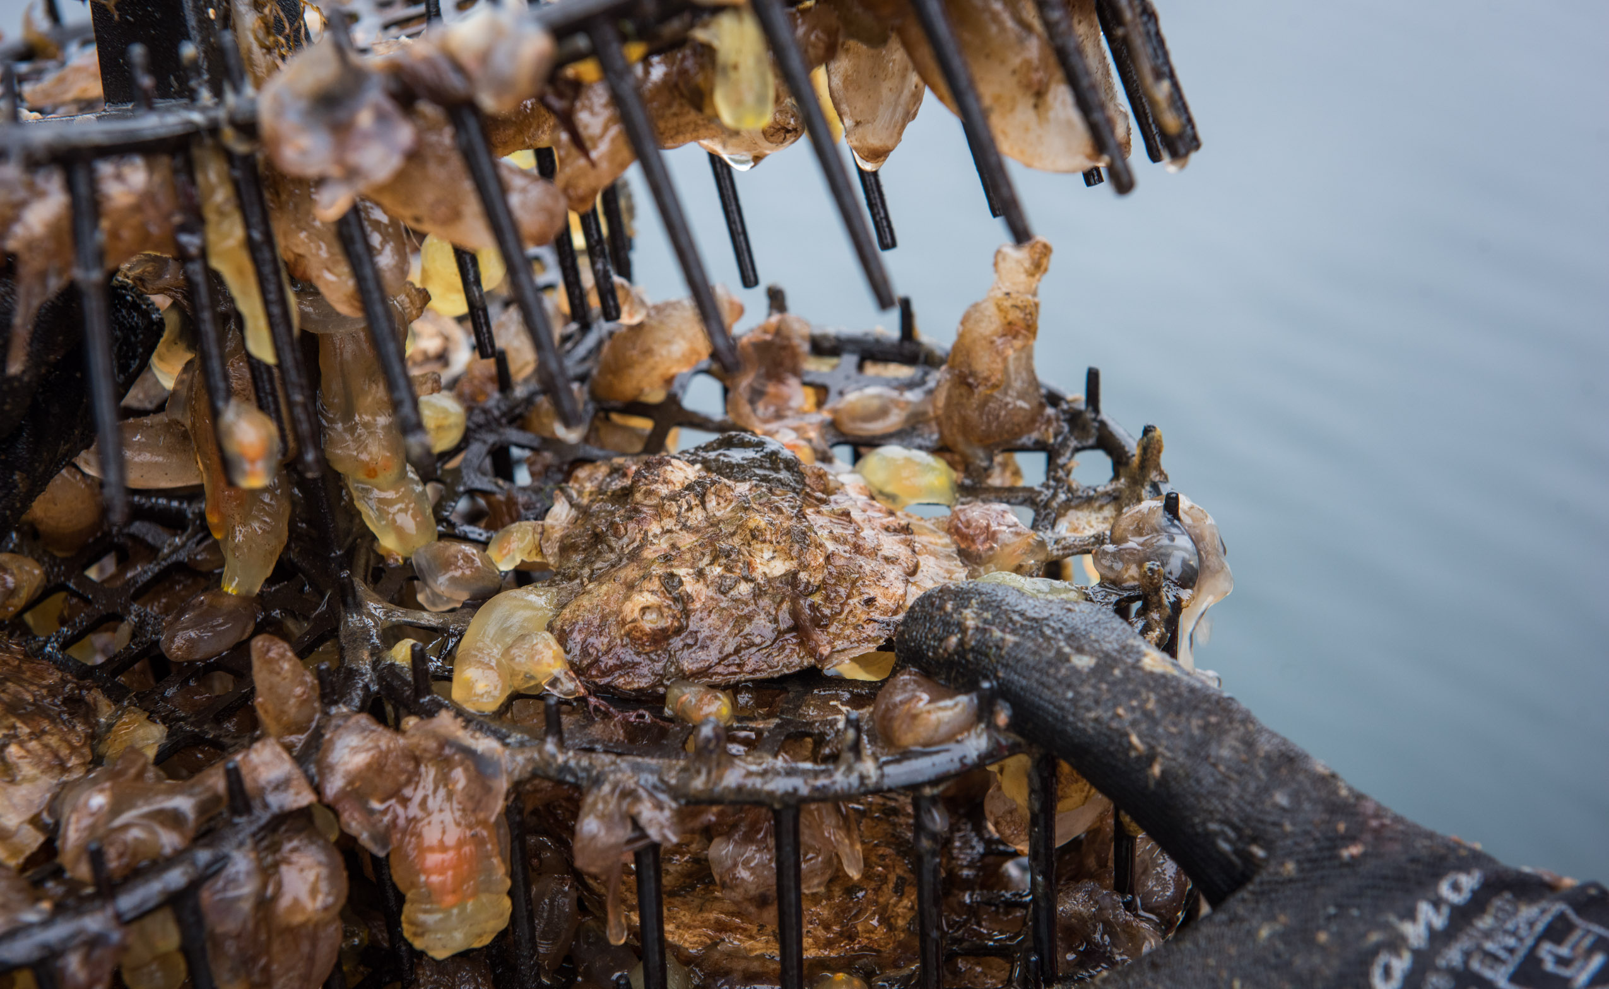
BENEFITS
There are tons of benefits from oysters, such as:
  Cleaning the water through filtration
  Creating habitats for various species
  Trapping and storing carbon
  Potentially reducing wave energy
  Cultural value, with oysters once being the heart of many communities
  Stabilising the seabed during heavy storms

Slide 13
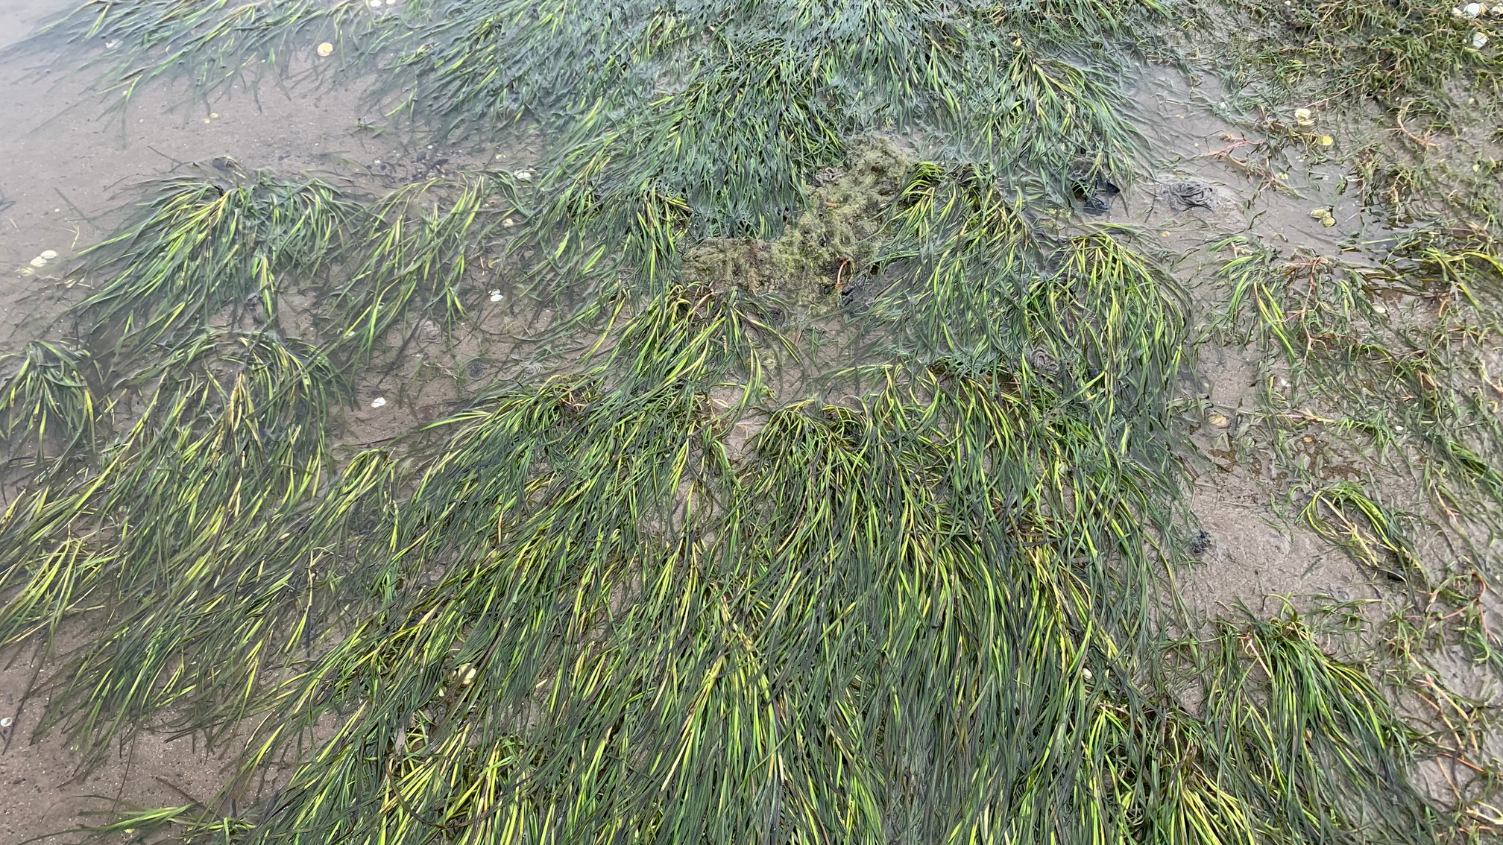
SEAGRASS
Seagrass is our final species. It is the only marine plant in the world!
Seagrass can be found in flat, sheltered areas, growing in muddy or coarse ‘sediment’ - sediment is the material that settles on the seabed (it can be sand, gravel, mud etc.)

Slide 14
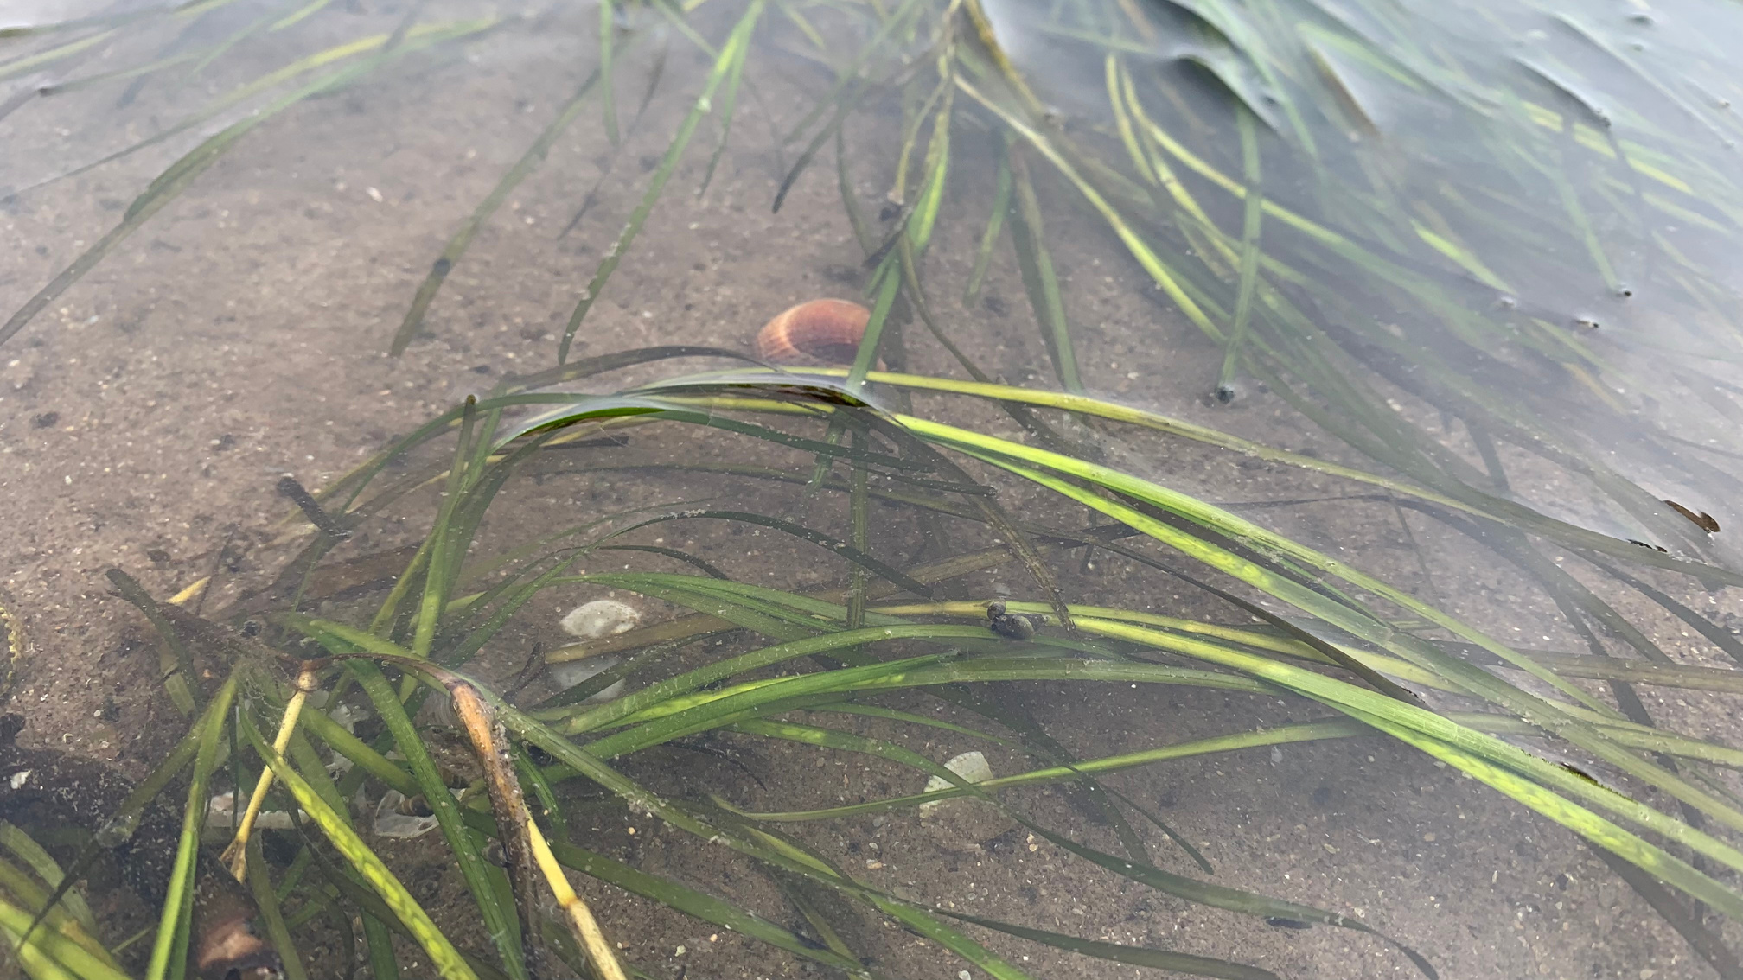
PRESSURES
Seagrass was once an abundant plant in the UK, but since the 1930's we’ve lost an estimated 44%, and since historic times, potentially up to 92% has been lost! This is due to:
  Disease leading to seagrass loss.
  Building along the coast which removes seagrass habitat.
  Agriculture run off from fields and fish farming which lead to too many nutrients in the water, harming the seagrass.
  Tourism e.g. boating which drops anchors to damage the seagrass.

Slide 15
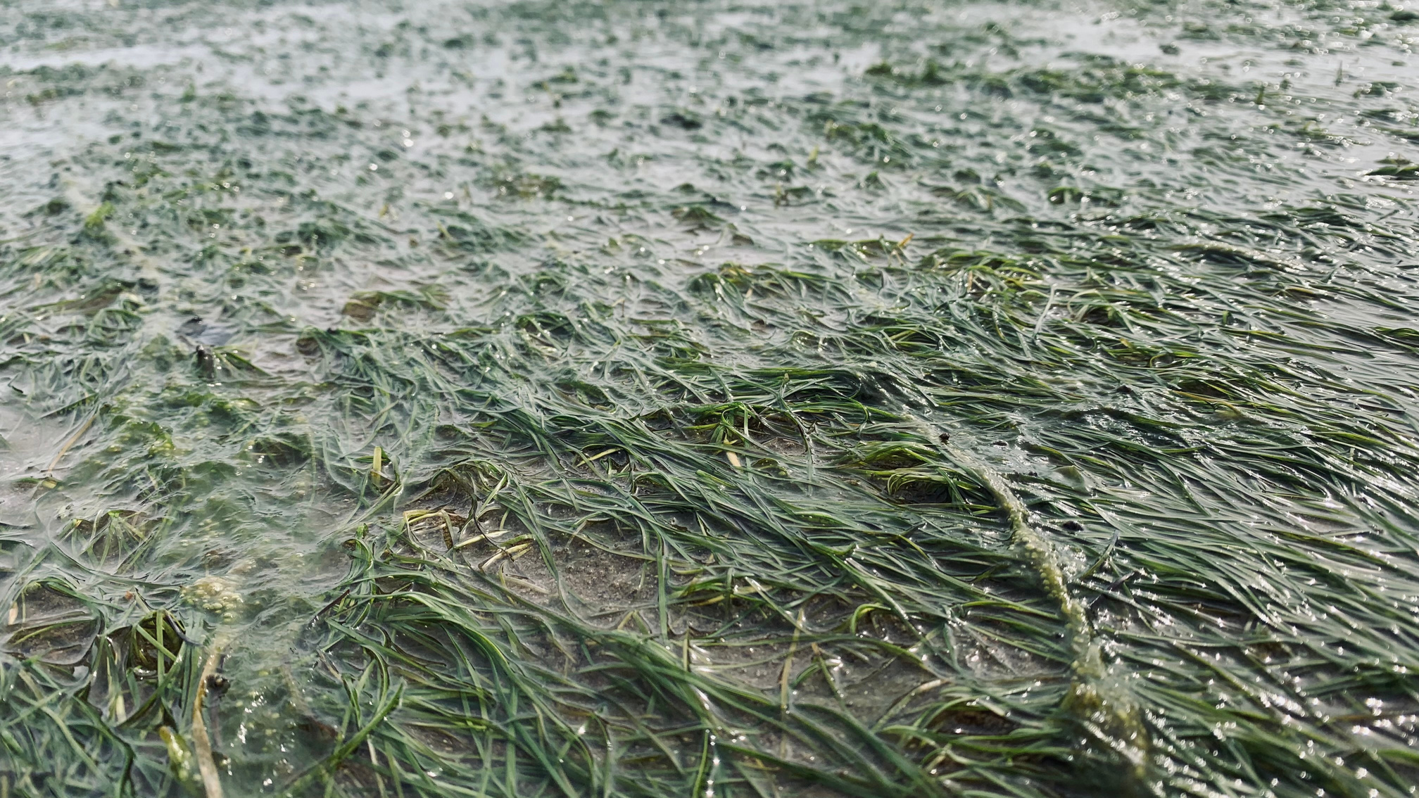
BENEFITS
Like the other 2 habitats, there are a myriad of benefits associated with seagrass:
  Protects the coast
  Creates nurseries for fish (including commercially caught species)
  Creates habitats for lots of species
  Improves water quality
  Stabilises the seabed, improving water quality and visibility
  Captures and stores carbon

Slide 16
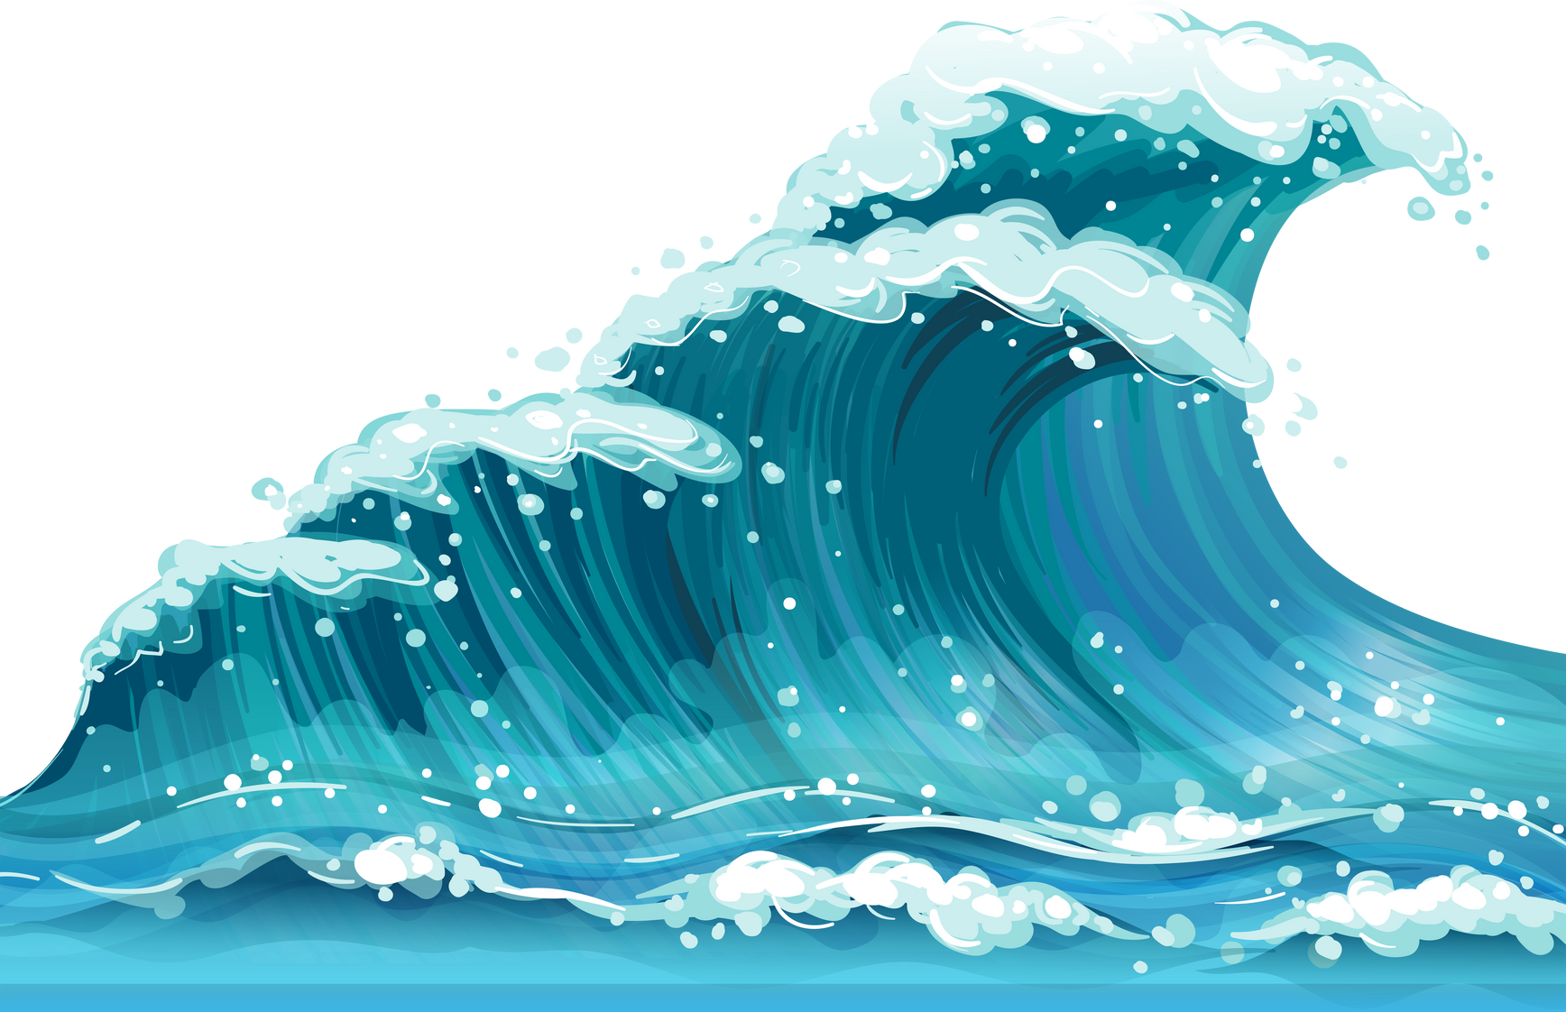
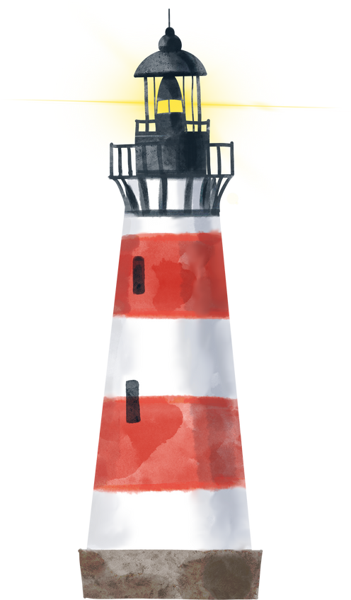
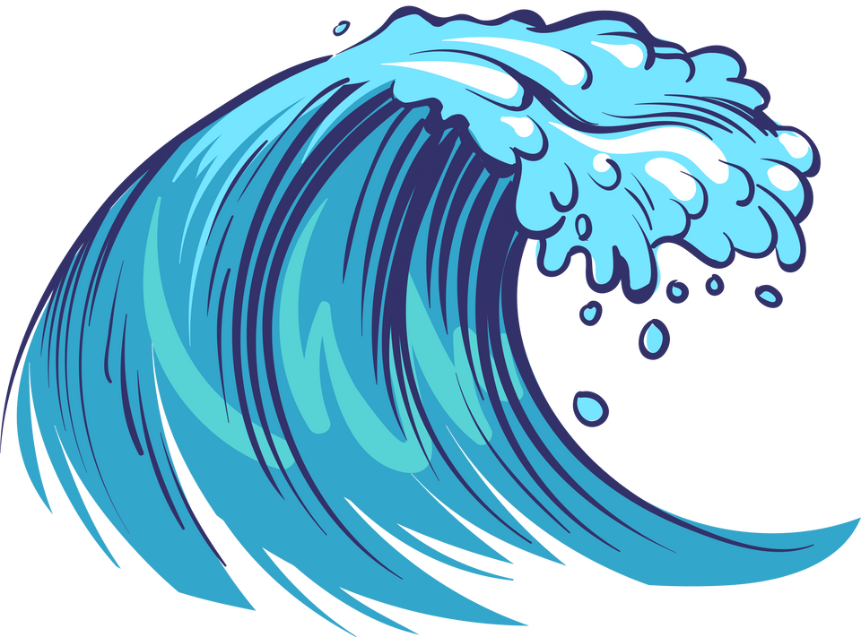
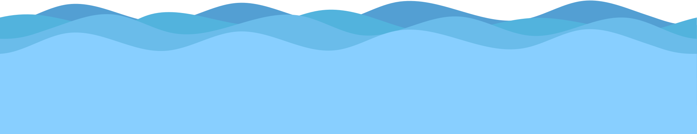
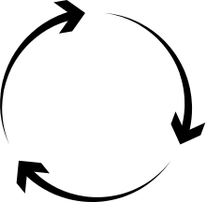
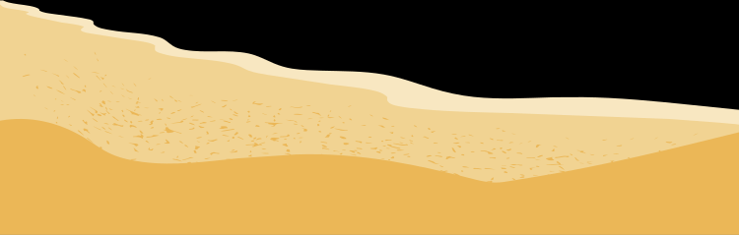
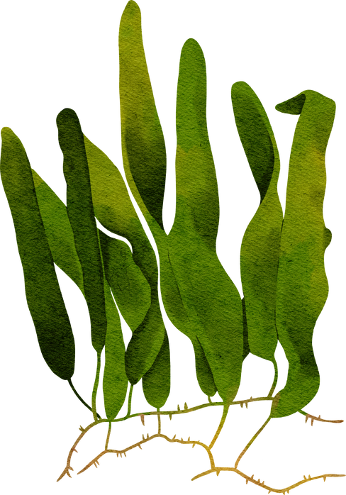
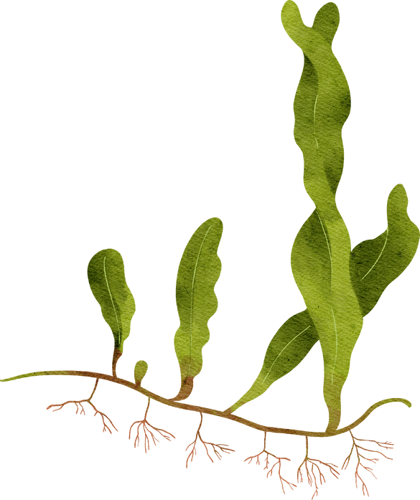
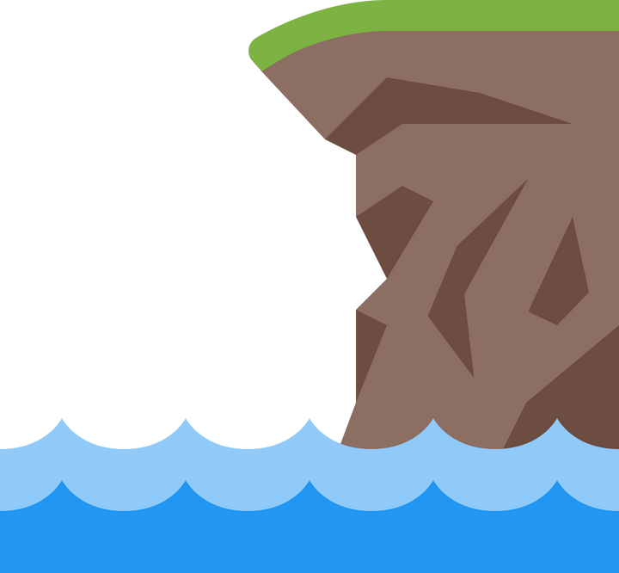
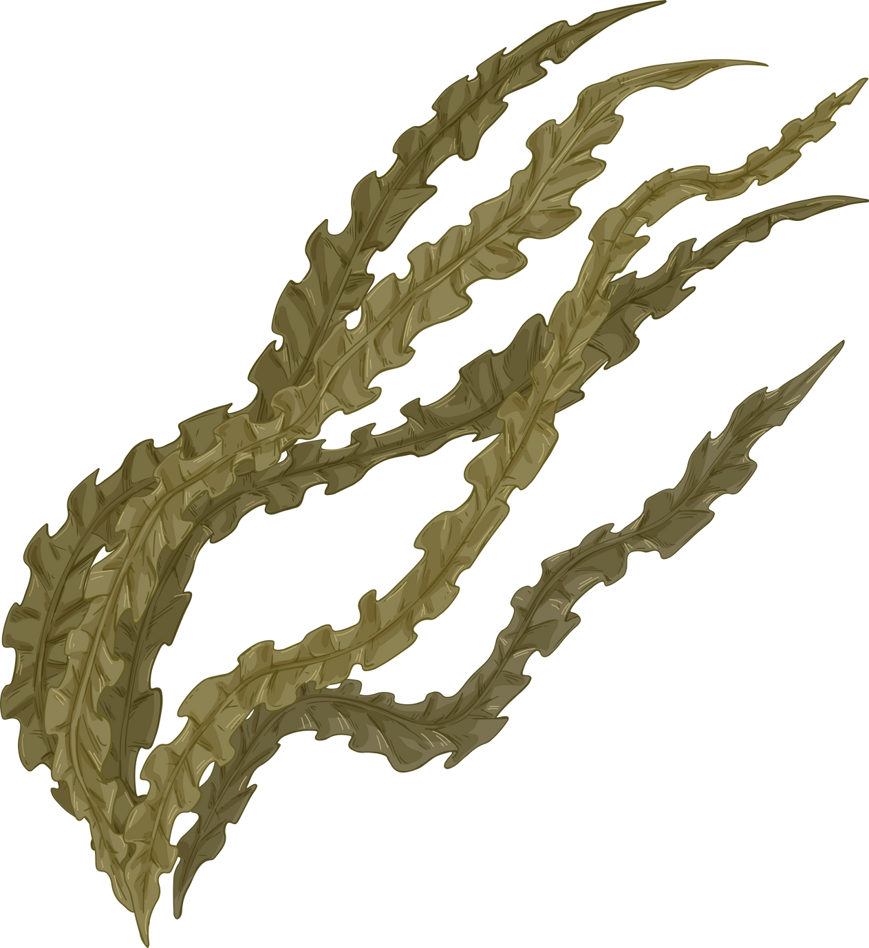
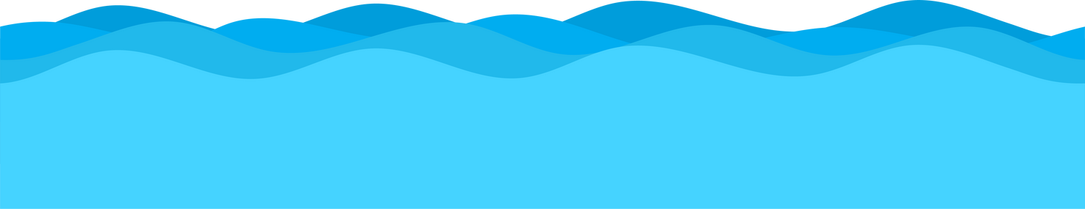
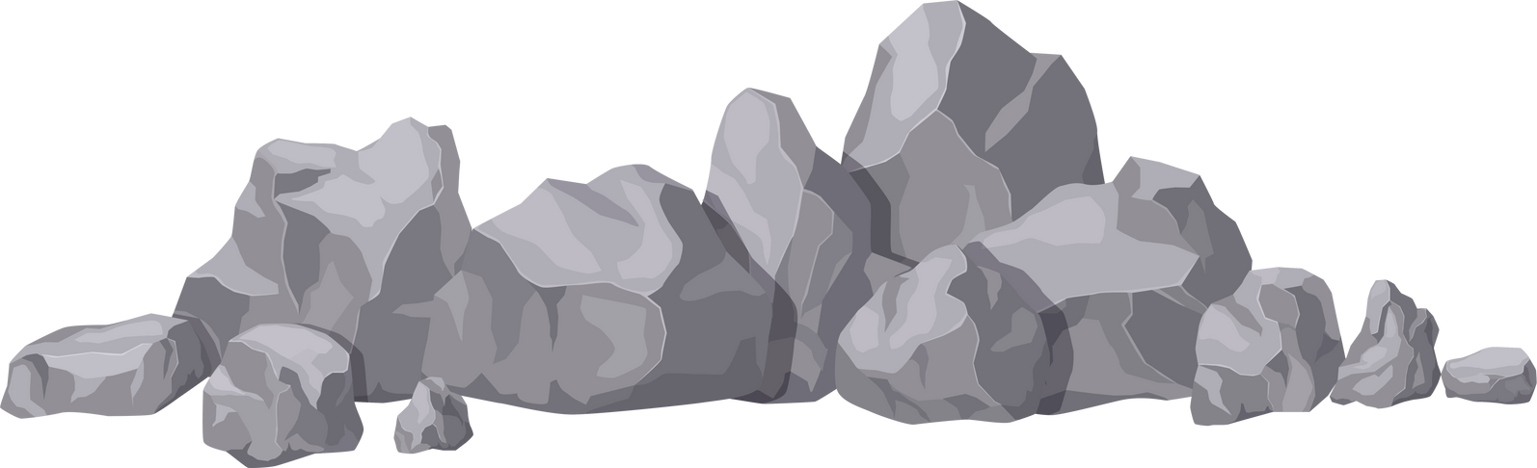
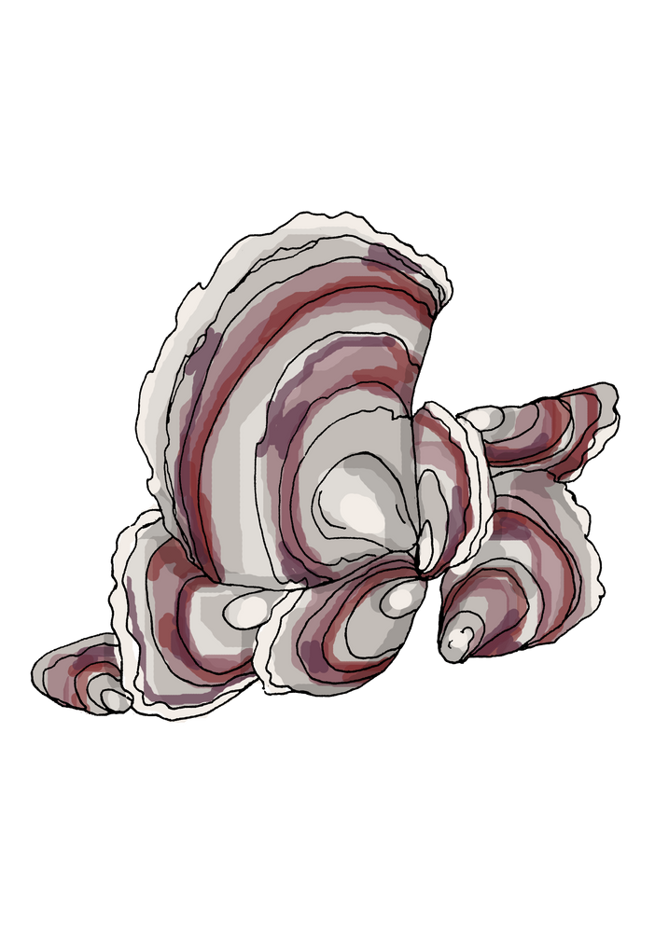
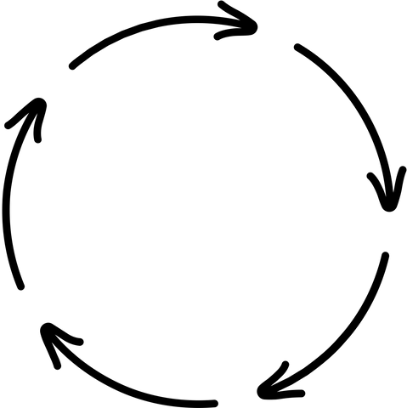
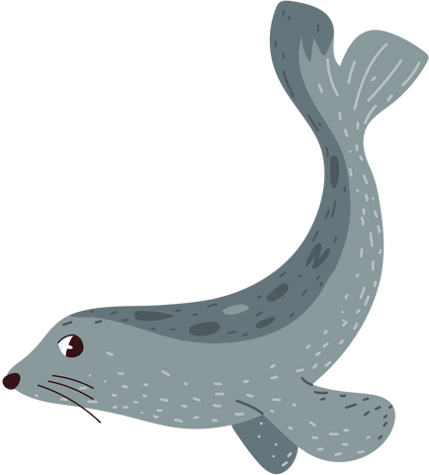
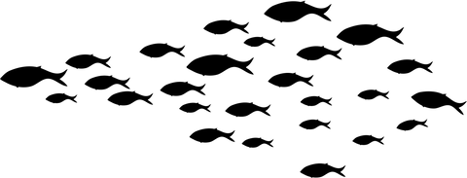
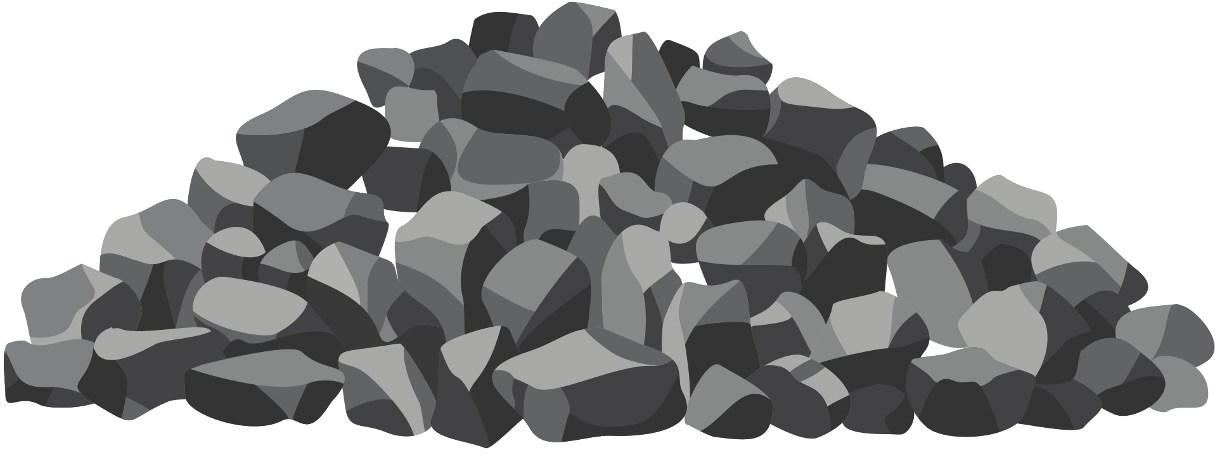
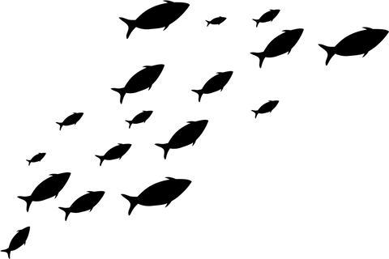
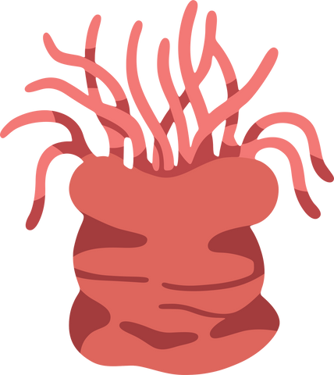
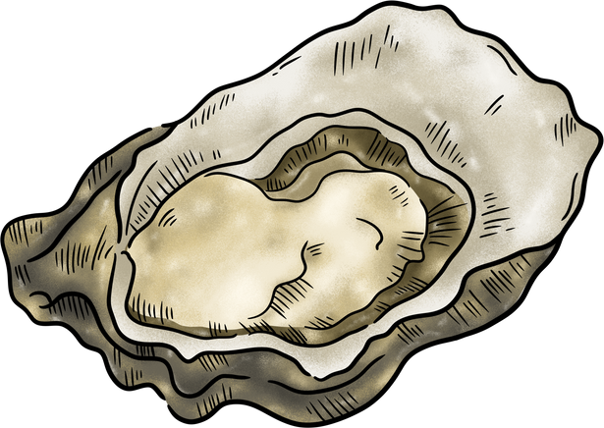
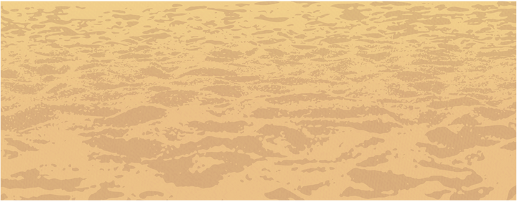
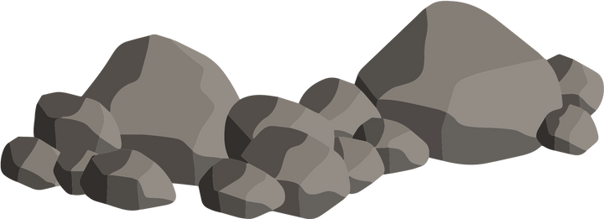
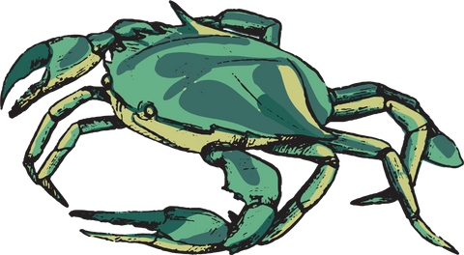


Stronger shores is especially interested in learning how much kelp, seagrass and oysters can slow down waves, reducing erosion by creating friction as the waves pass over.

Slide 17
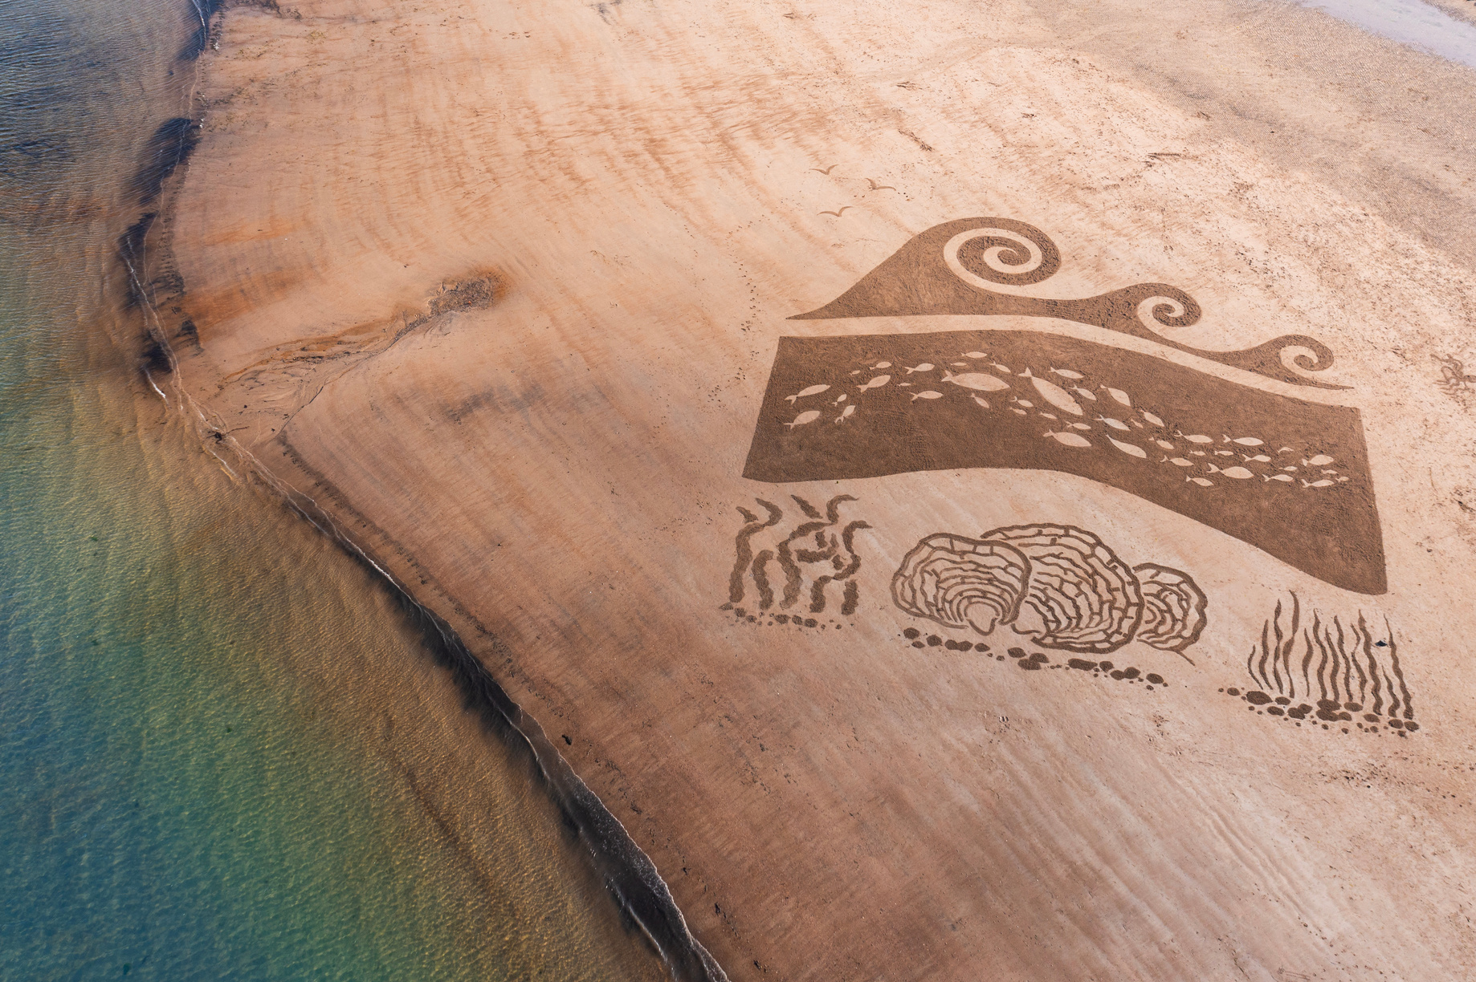
WATER QUALITY
All 3 species can improve water quality, a major benefit of these habitats, but how?
  Oysters filter out particles that makes the water cloudy and dark
  Seagrass takes up nutrients and stabilises sediment
  Kelp can take up nutrients and limit ocean acidification!

Slide 18
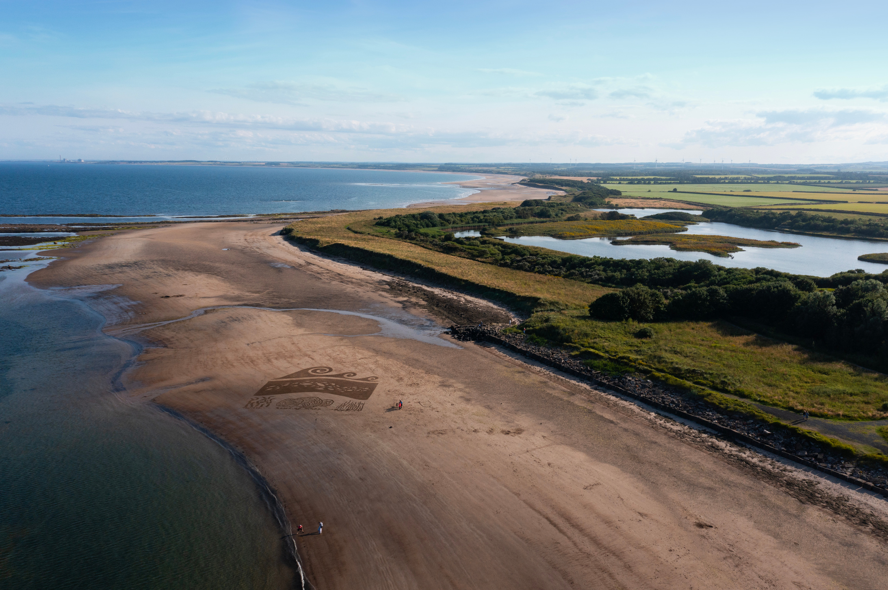
WATER QUALITY
Let’s explore how each of the species can improve water quality!

Slide 19
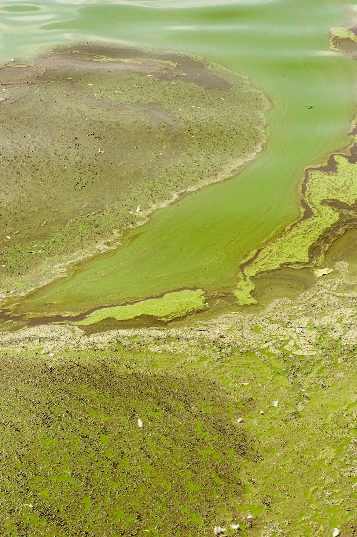
THE PROBLEM WITH NUTRIENTS
Nutrients are chemicals that are sources of food. In the sea, nutrients are beneficial, but too many can lead to explosions of marine algal life that can block out sunlight, smother organisms, and create oxygen free dead zones when the algae dies and begins to decompose.

Slide 20
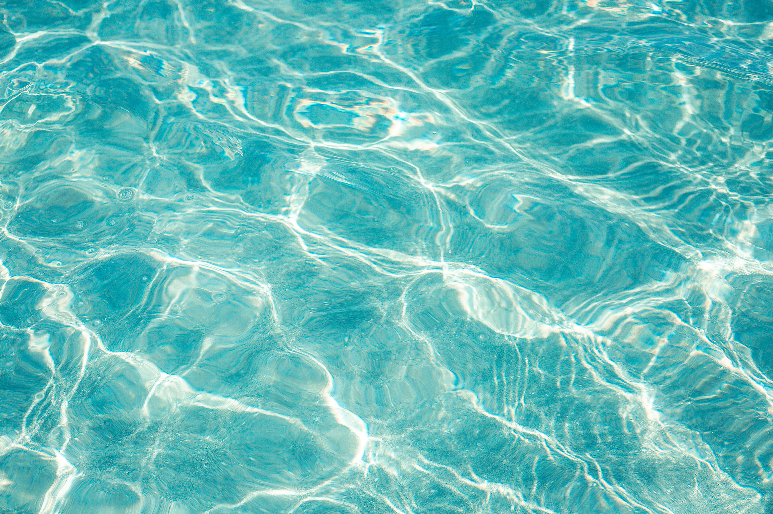
THE PROBLEM WITH NUTRIENTS
Seagrass, Oysters and Kelp can all take in various nutrients, removing excess from the water and preventing these algal blooms from occuring! These nutrients can be introduced to our coasts from runoff from farms, with fertilisers being a major source of nutrients, or even from sewage run off!

Slide 21
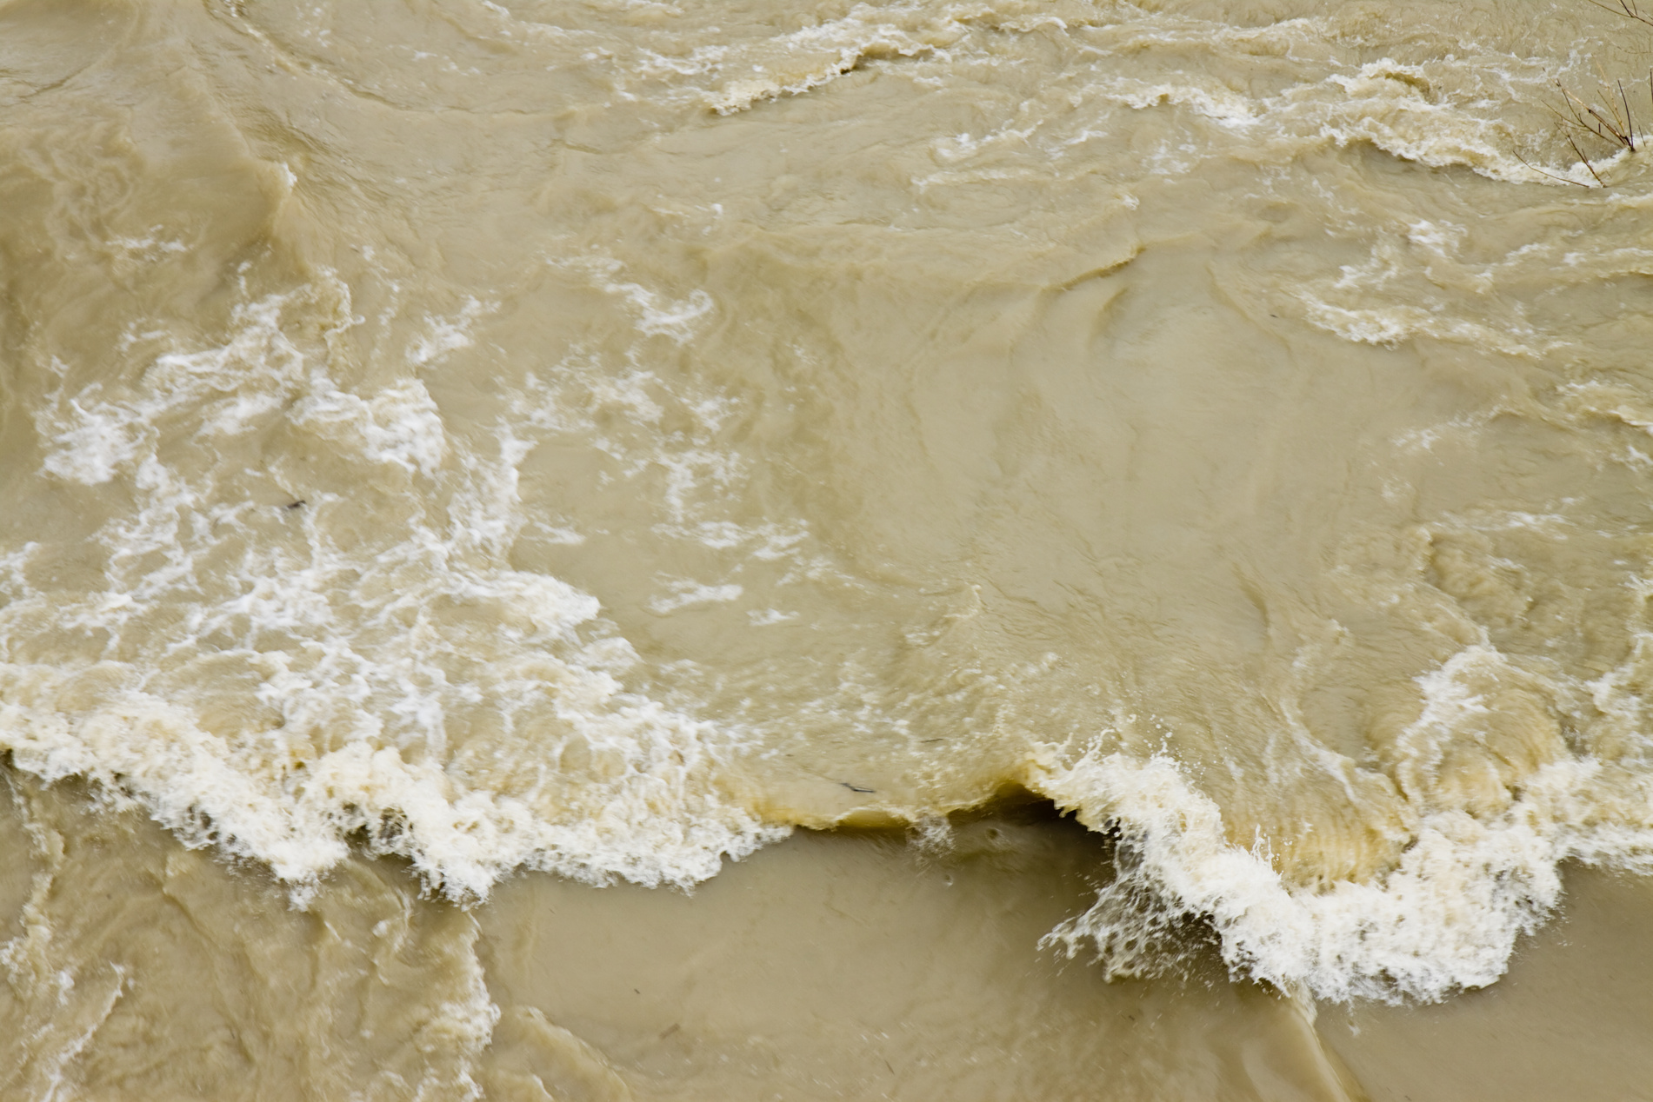
ROUGH WATERS
During storms when the water is moving and the seabed is churned up, the water becomes murky, and light is limited - bad news for species that needs light to photosynthesise!
Kelp, seagrass and oysters create habitats that can prevent this, ensuring the conditions are right for plenty of life along the coast!

Slide 22
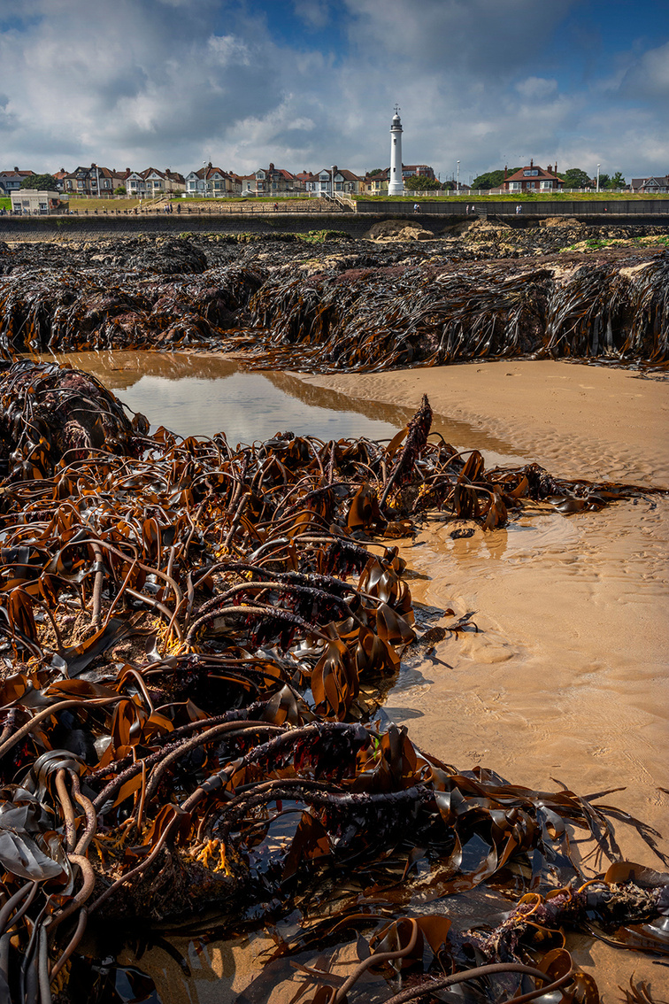
KELP CLEANERS
Kelp forests reduce the speed of water passing through,limiting the amount of ‘sediment’ from the seabed that is stirred up, ensuring there is still plenty of light in the water!

Slide 23
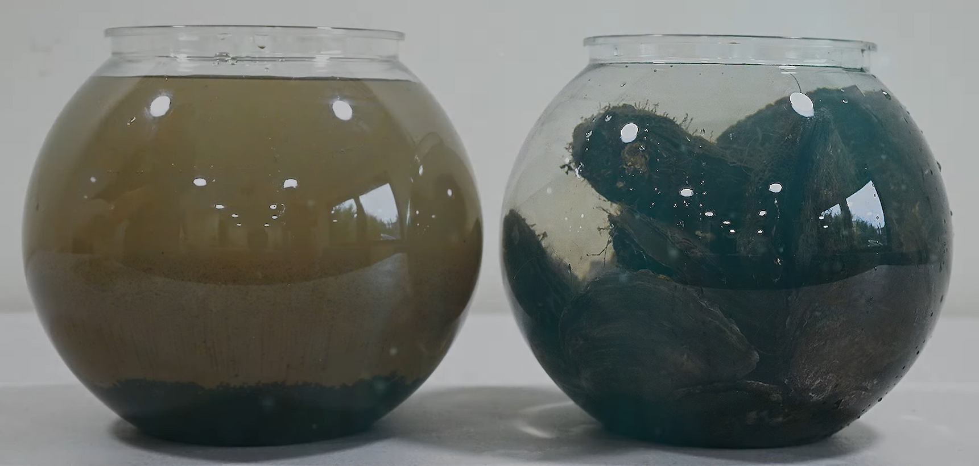
OYSTER FILTERERS
Oysters filter water through their gills, taking in floating matter in the water, and either feeding on it, or spitting it out onto the seabed in larger clumps that sink, keeping the water clear!

Slide 24
SEAGRASS STABILISERS
Seagrass has roots that grow deep into the sediment and bind the sand and mud, stopping it from being churned up during storms. This keeps the water clear!

Slide 25
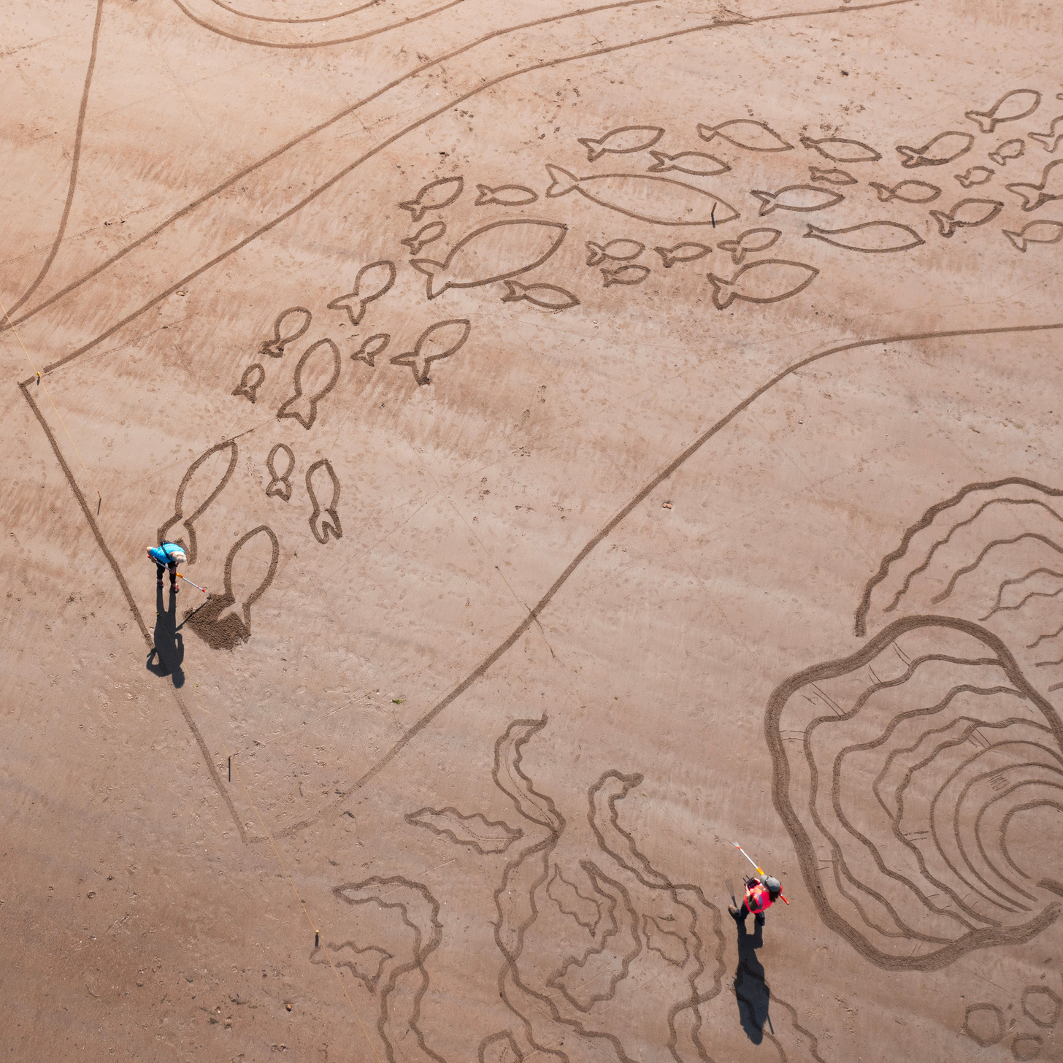


ACTIVITY TIME
In this section you can now complete the associated quiz, and can do the activity in the accompanying pdf!

