Slide 1

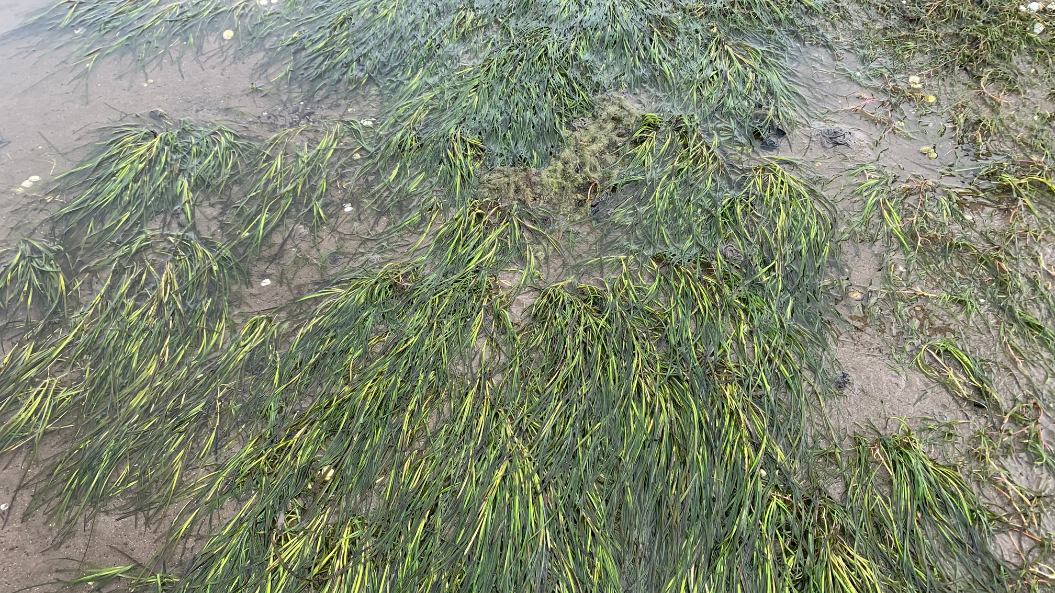
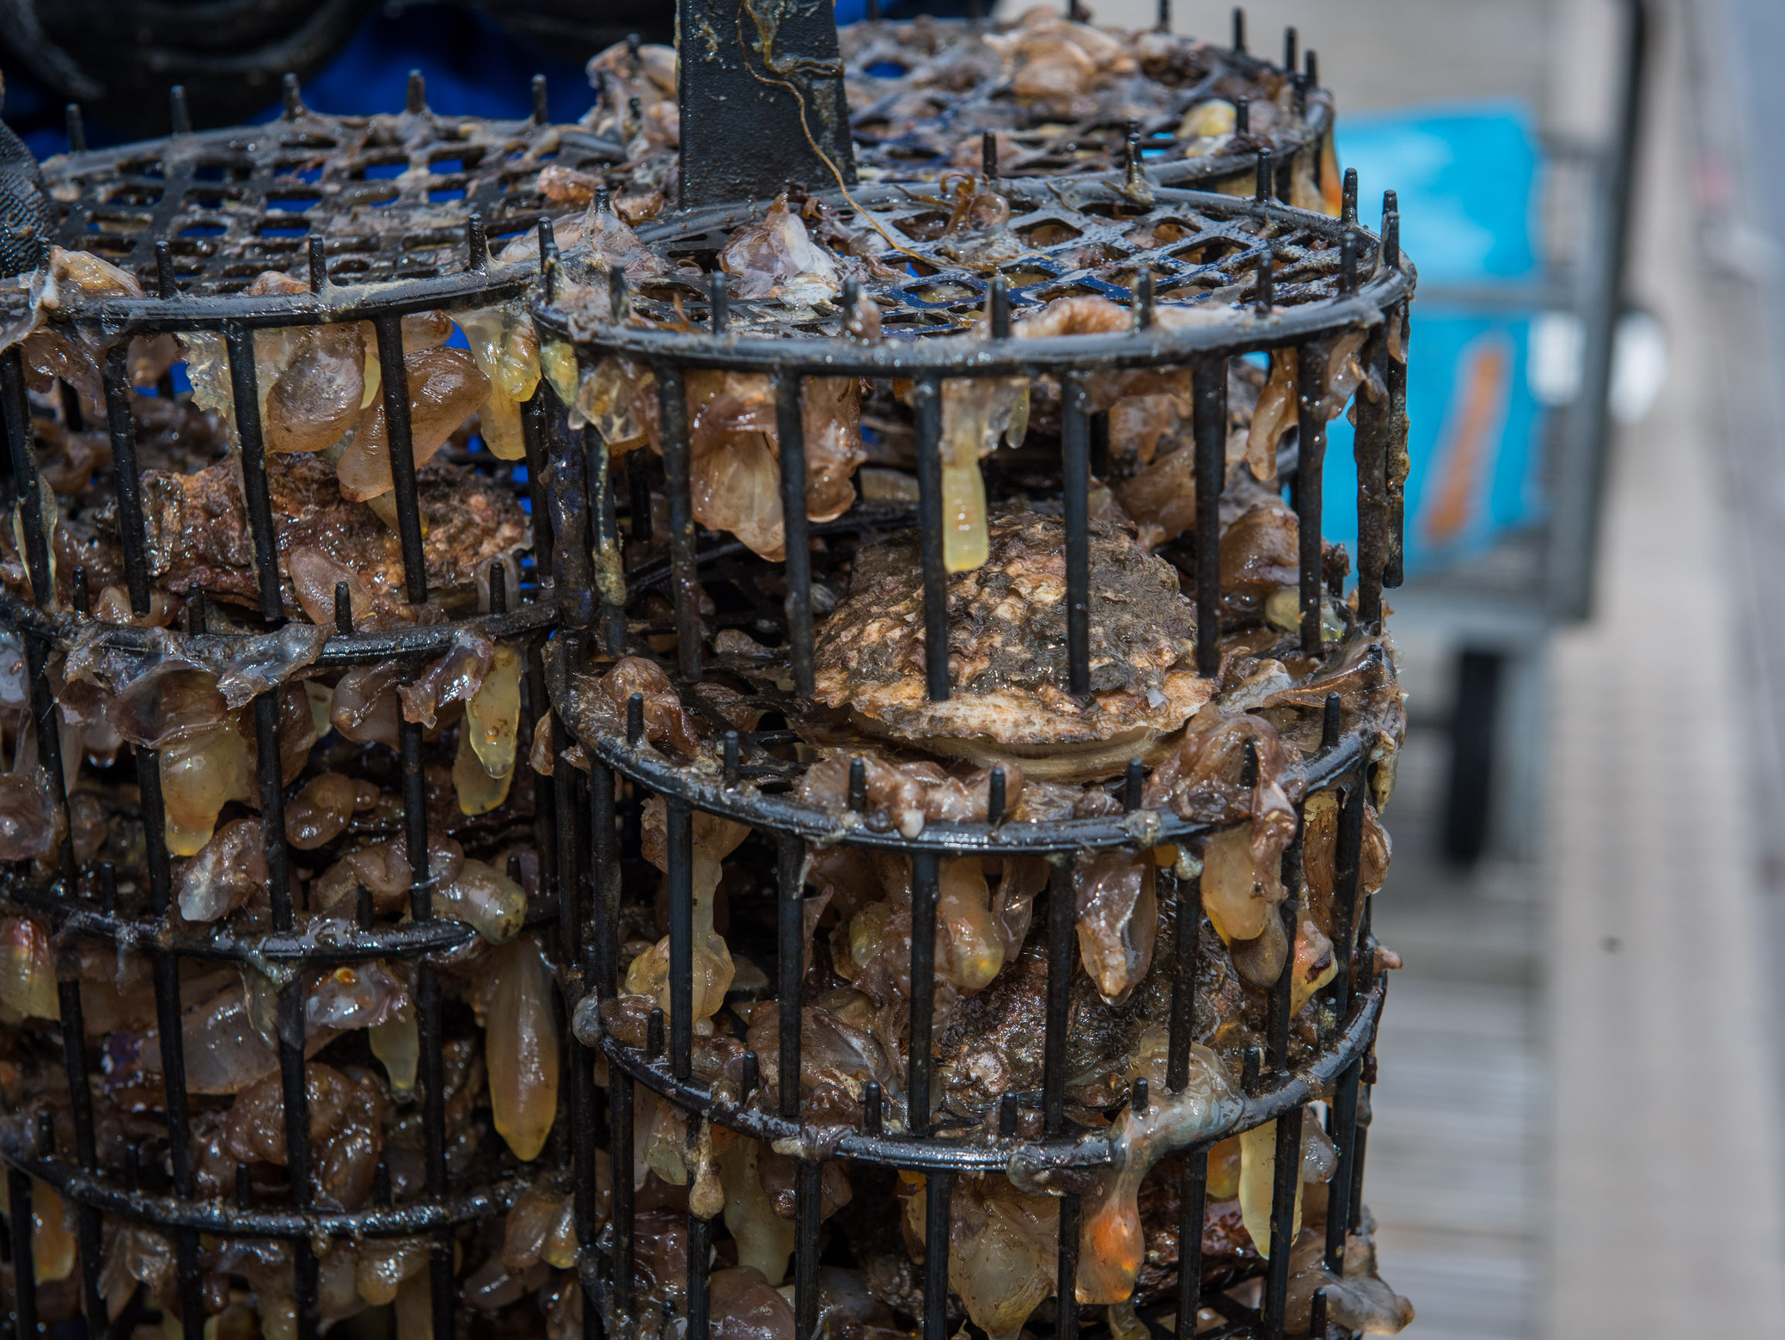
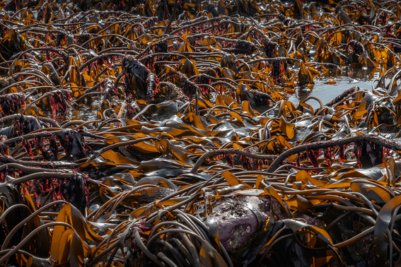

COASTAL DEFENCE
Explore how nature can protect our coasts...

Slide 2
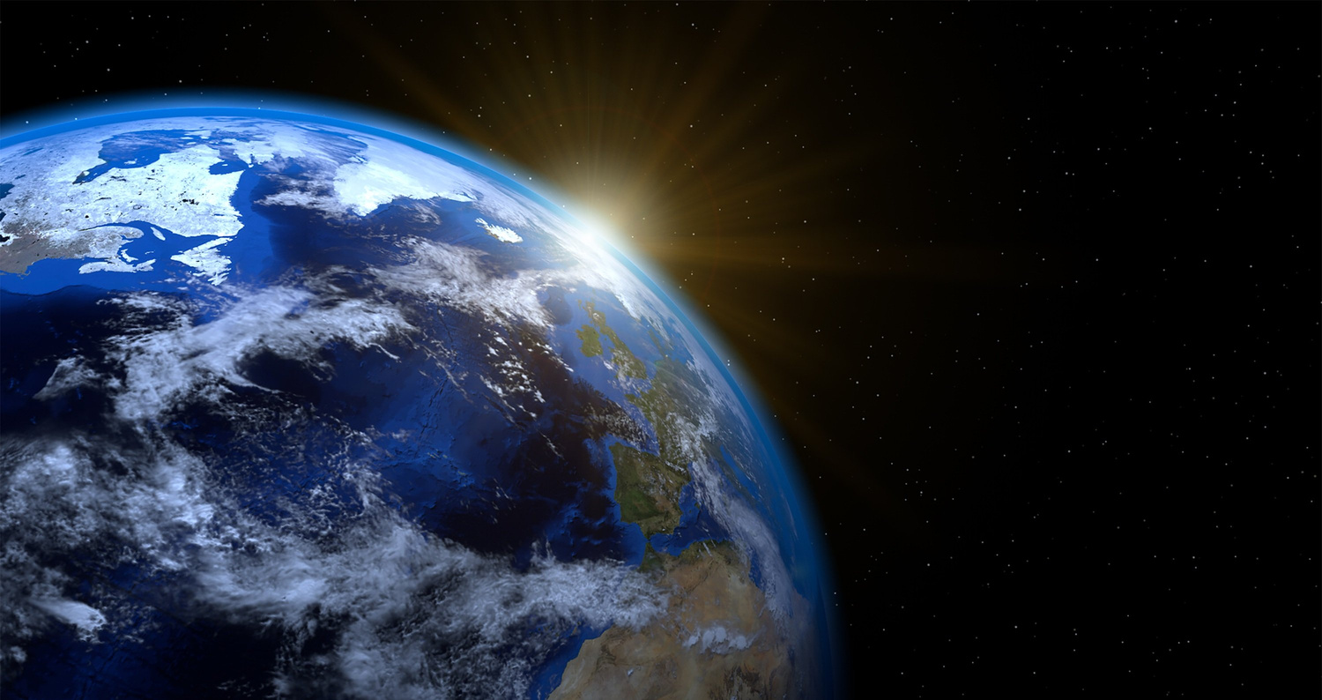
LEARNING OUTCOMES
By the end of this presentation you will have learned:
  That marine habitats provide various benefits to both humans, and the coastal environment.
  The difference between a plant, and algae.
  That oysters can help to filter water to clean it.
  That seagrass roots help to bind the sediment it grows in.

Slide 3
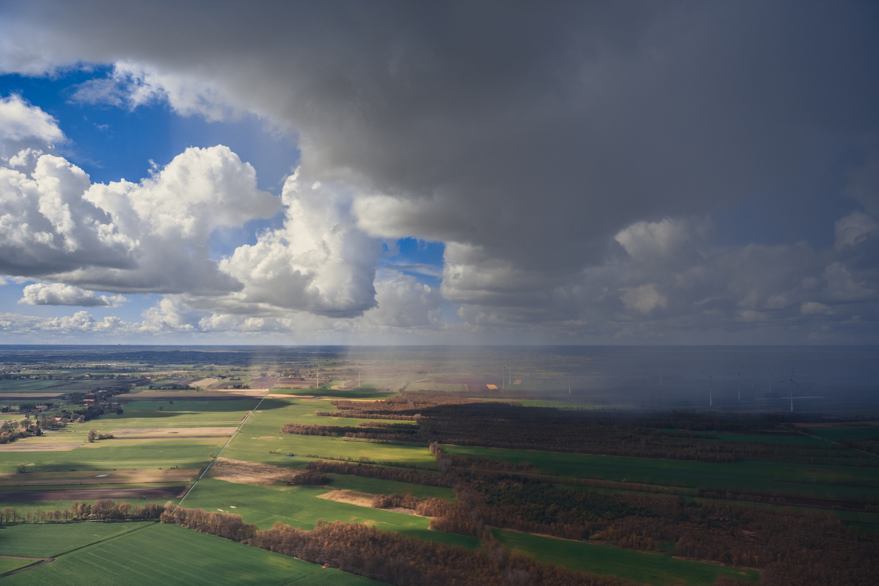
WHAT IS STRONGER SHORES?
Stronger Shores is a scientific project that is exploring how kelp, seagrass and oysters can benefit our coastlines, from protecting it from erosion to providing habitats for marine life and everything in between...

Slide 4
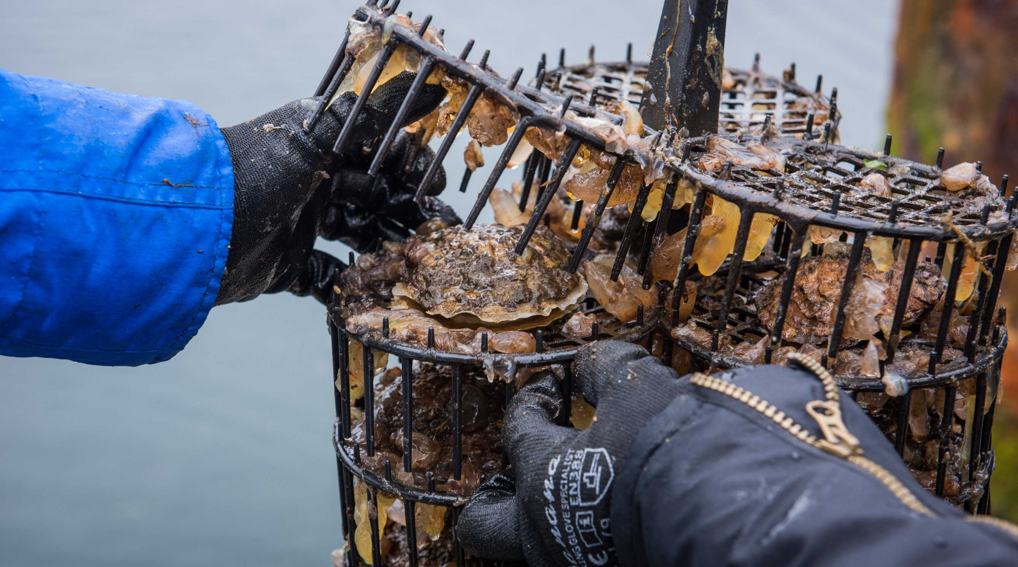
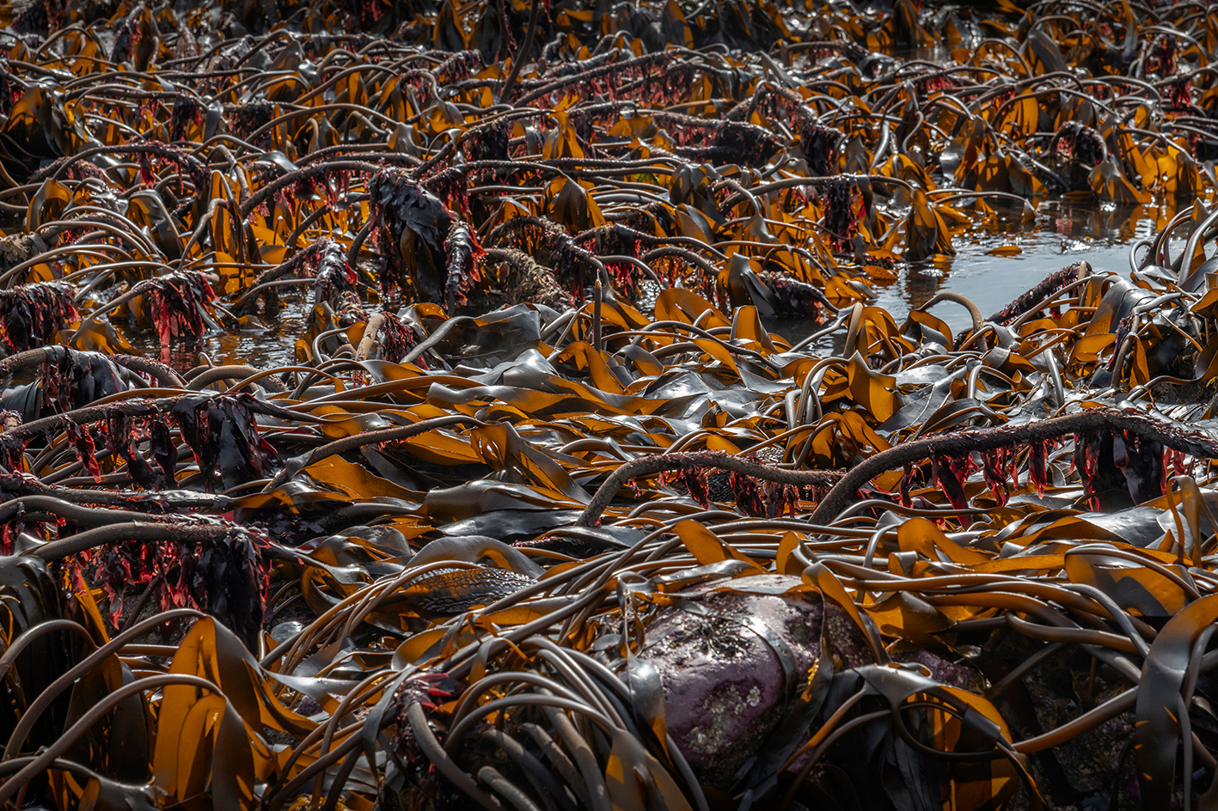
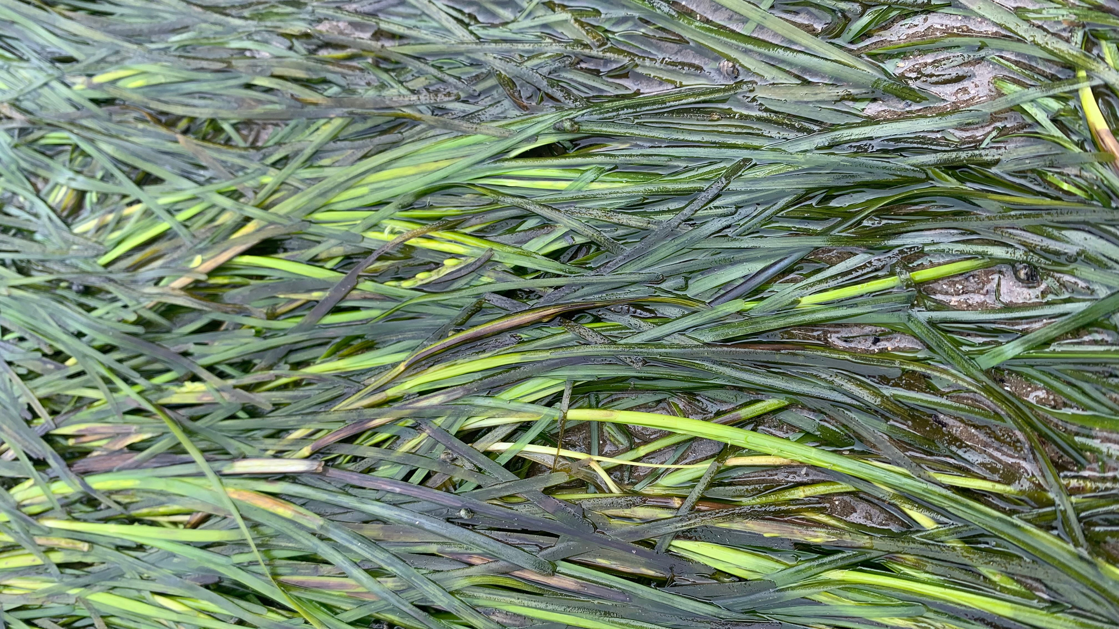
THE SPECIES
SEAGRASS
OYSTERS
KELP

Slide 5
KELP
Kelp is not in fact an animal or a plant, but an algae!
Kelp is in fact edible, and a very environmentally friendly crop to grow, as it requires no fresh water, and no fertiliser, as it gets its water and food from the surrounding seawater.

Slide 6
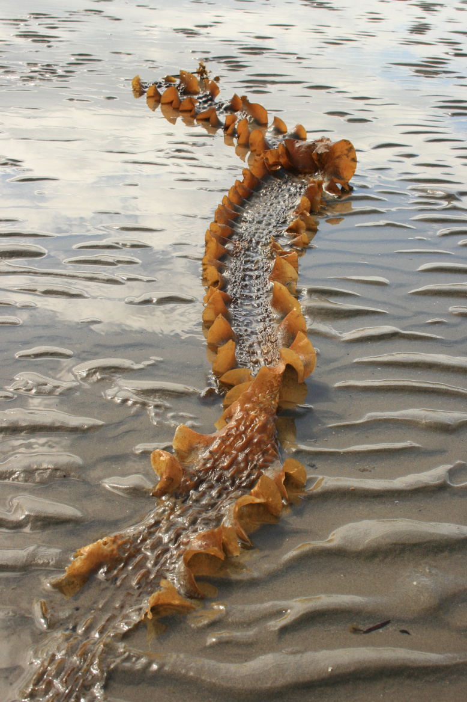
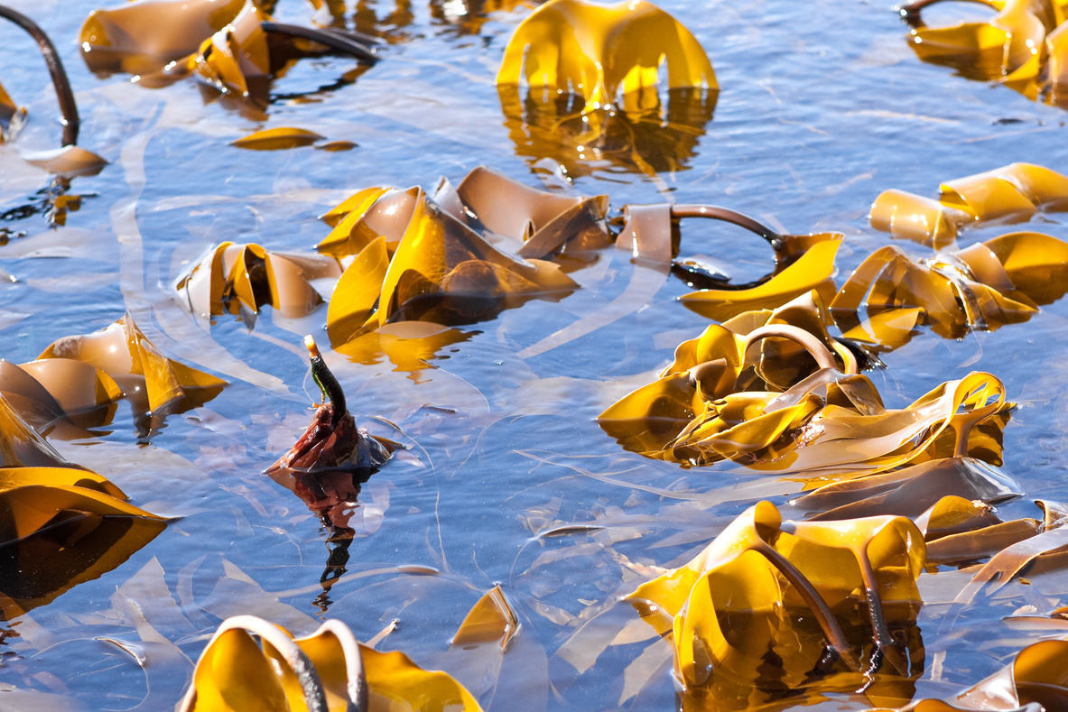
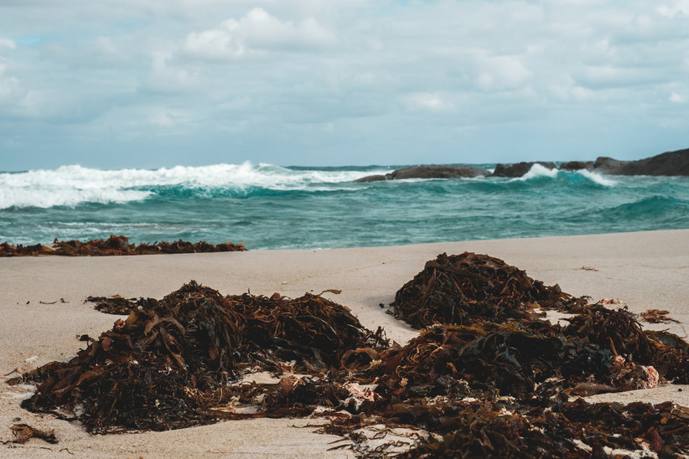
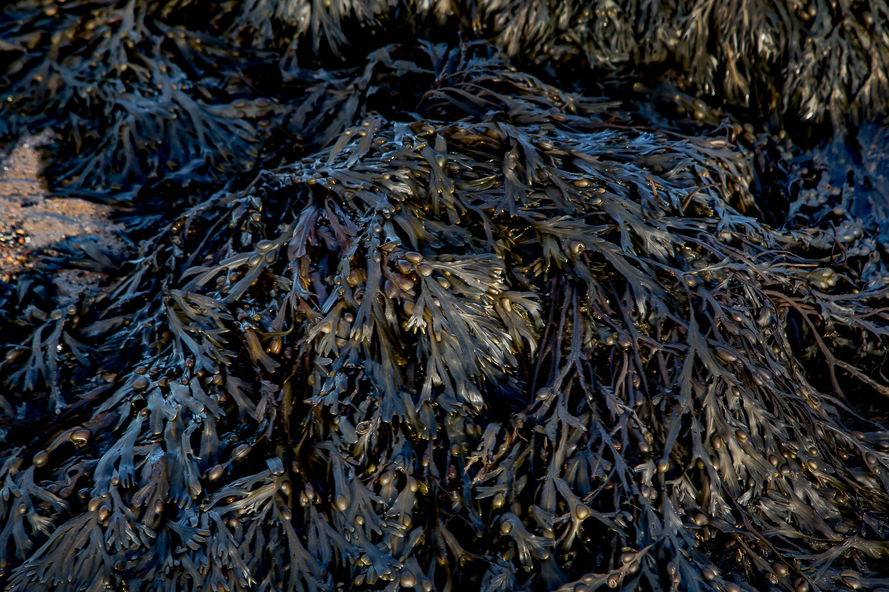
KELP
There are many types of seaweed. Kelp is the term given to describe any of the larger brown seaweeds that grow in cool waters (such as those around the UK).

Slide 7
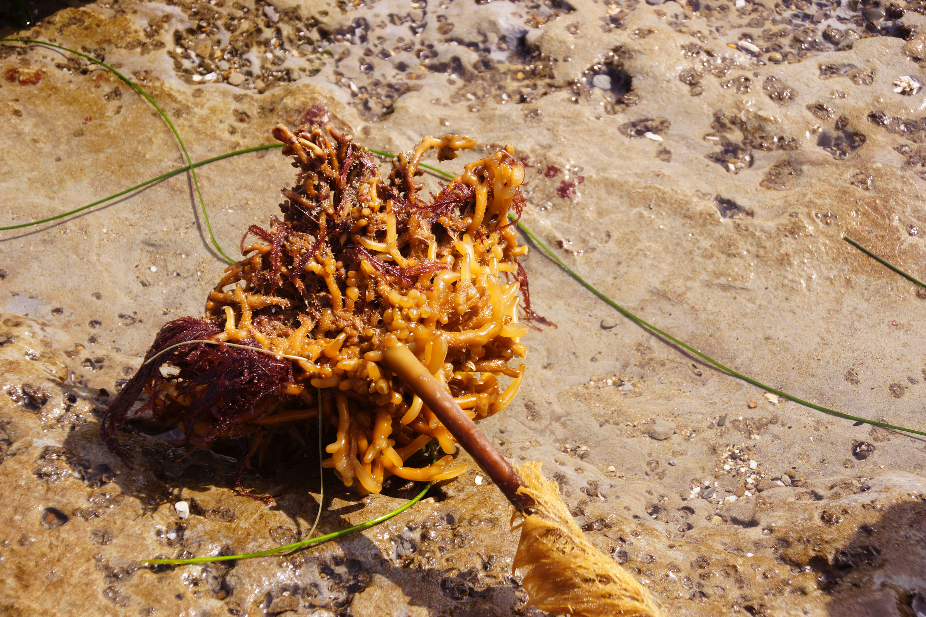
KELP
Why is kelp not a plant?
  Roots vs Holdfast:
Plants have roots to take up nutrients and water from the soil. Kelp have a holdfast, this attaches them to the rocks that they grow on, however, the kelp is submerged in water, and so the whole structure can take up nutrients and water!

Slide 8
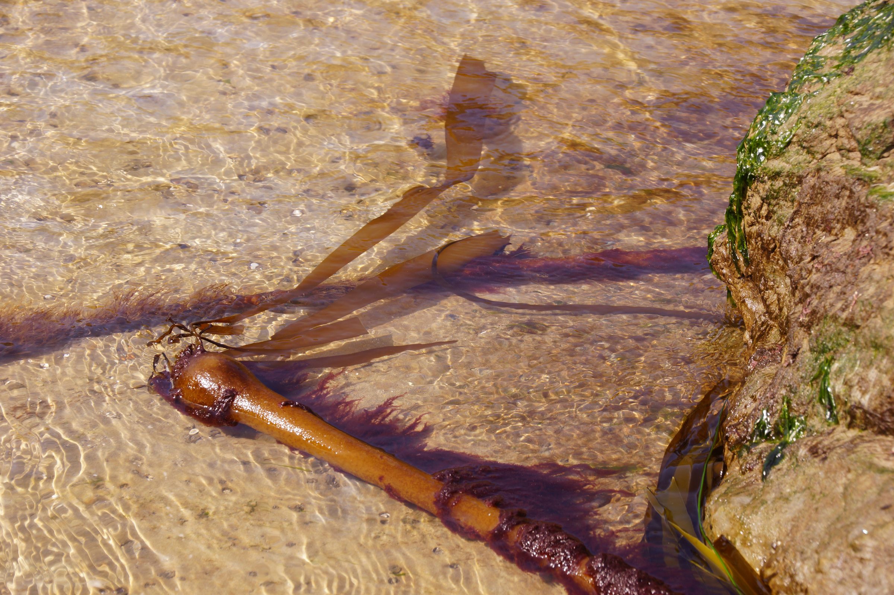
KELP
Why is kelp not a plant?
2. Stem vs. stipe
Plant stems have internal parts that are designed to carry the nutrients and water from the roots to the leaves. The stipe, what looks like the kelp stem, is there to provide support to hold up the kelp’s ‘blades’.

Slide 9
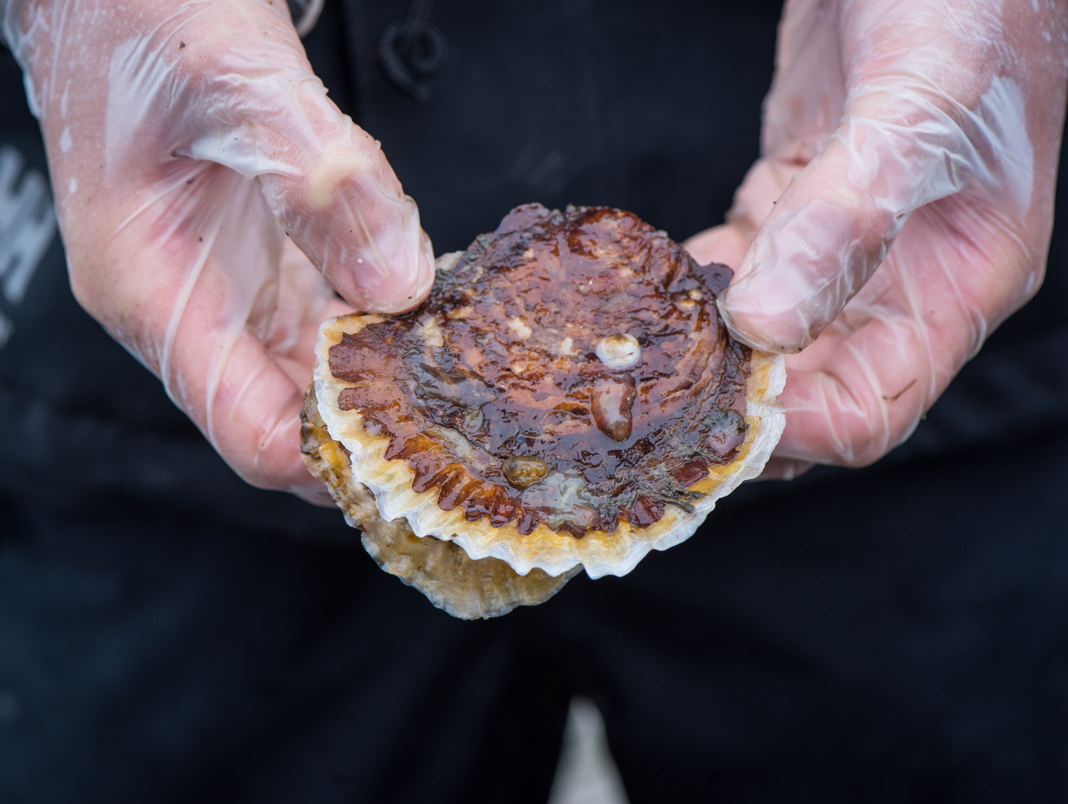
OYSTERS
Oysters are animals that grow a shell around them in order to protect themselves from any predators.
They are filter feeders, which means that they pull in water, pass it through their gills, and any food floating in the water is taken up by the oyster, with the water then expelled back out again!

Slide 10
OYSTERS
By filtering the water, the oysters help to clean it, which is massively beneficial for both humans and the surrounding marine life.
Filtering the water clears it, allowing in more light, which is beneficial for kelp and other marine life that requires sunlight.

Slide 11
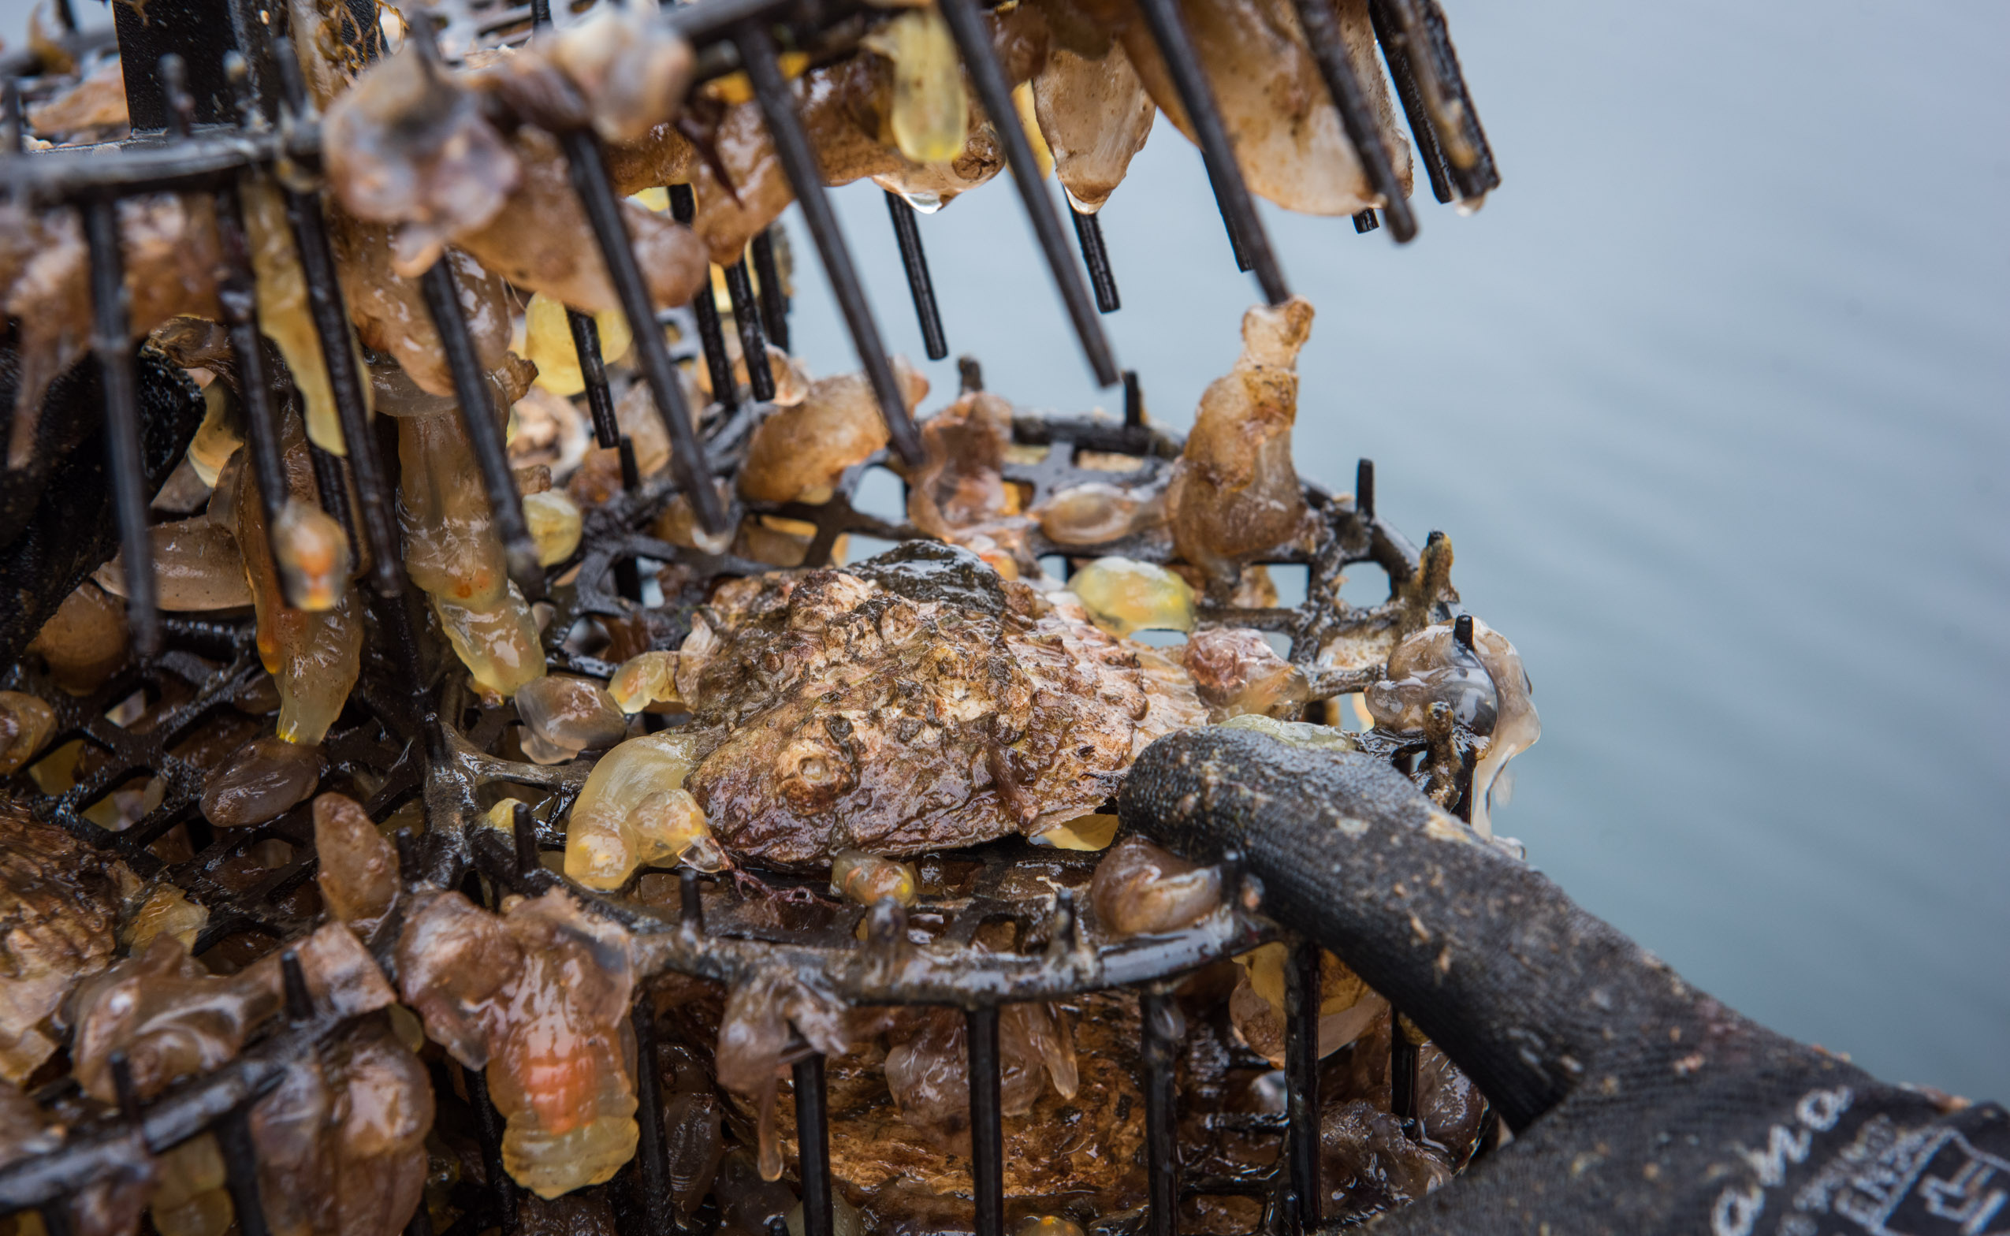
OYSTERS
Oysters also grow in reefs, attaching to each other to create hard structures on the sea bed. This is very important, as by doing this they create a habitat for marine life to grow on top of, and spaces for fish to live within, and to lay eggs on. These oyster reefs therefore help to bring lots and lots of life to an area!

Slide 12
SEAGRASS
Seagrass is our final species. It is the only marine plant in the world!
Seagrass can be found in flat, sheltered areas, growing in muddy or coarse ‘sediment’ - sediment is the material that settles on the seabed (it can be sand, gravel, mud etc.)

Slide 13
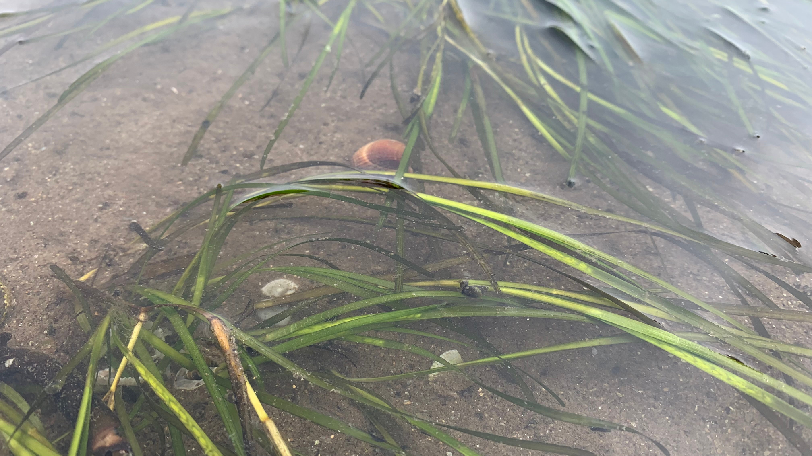
SEAGRASS
This marine plant produces seeds every year, which are washed around in the surf, and settle on the seabed to grow and create new plants.

Slide 14
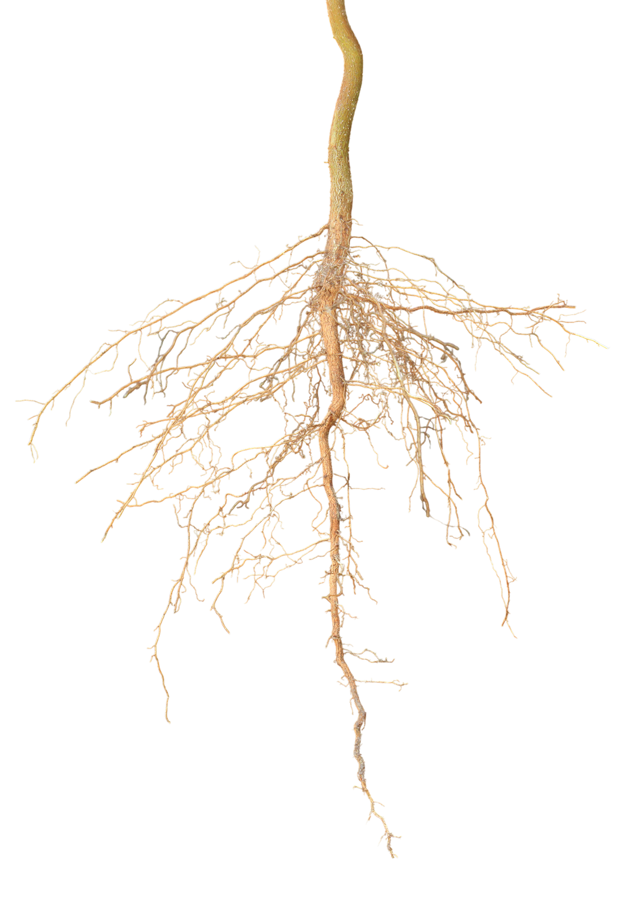
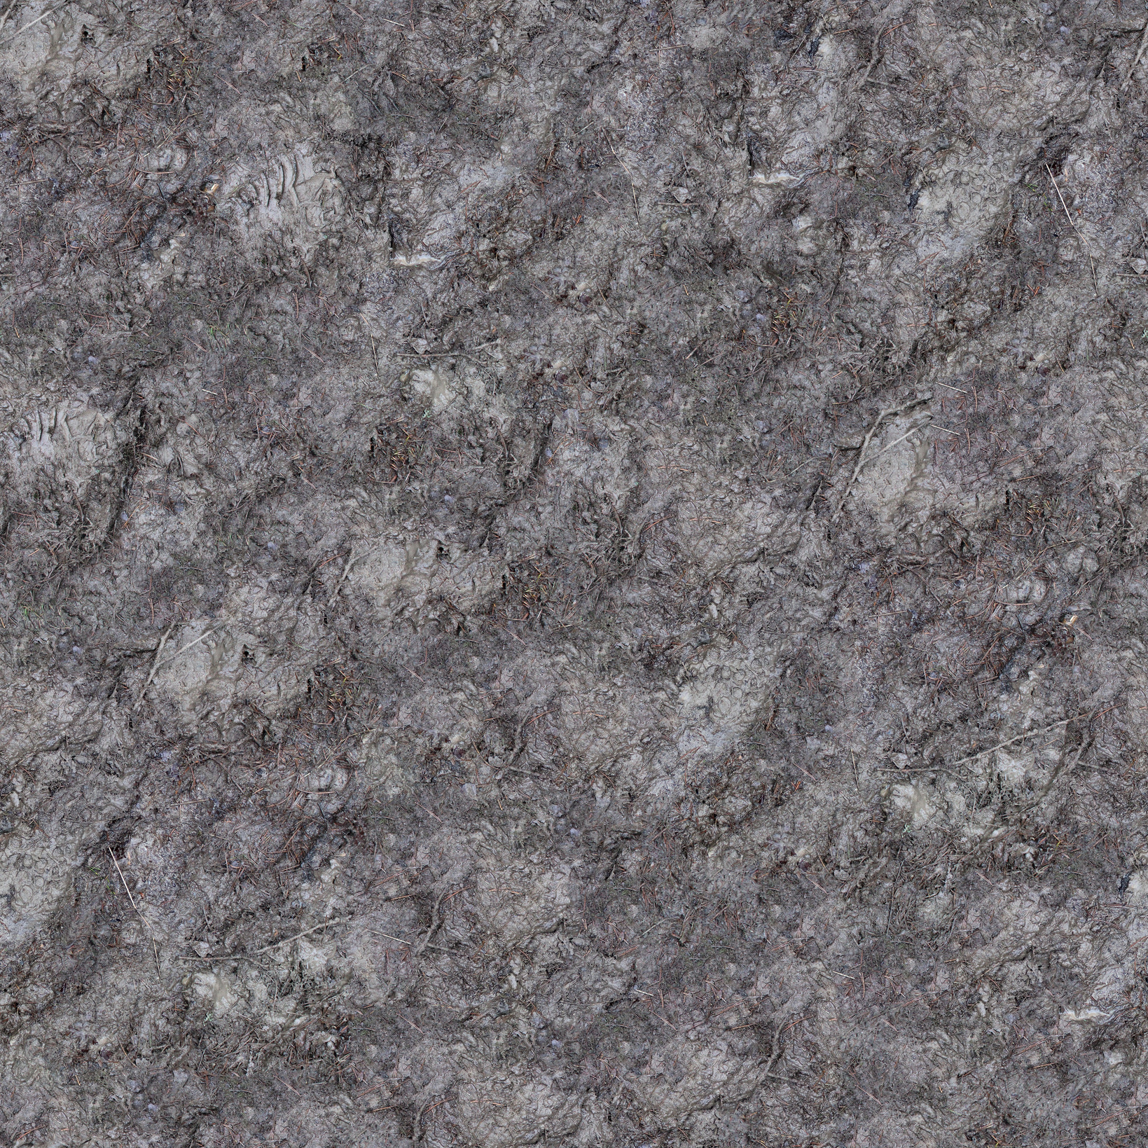
SEAGRASS
The roots of the seagrass are very important, as they help to hold the sediment the grass is growing in together, stopping it from washing away during storms!
This is helps surrounding life to grow without the threat of their habitat being washed away!

Slide 15
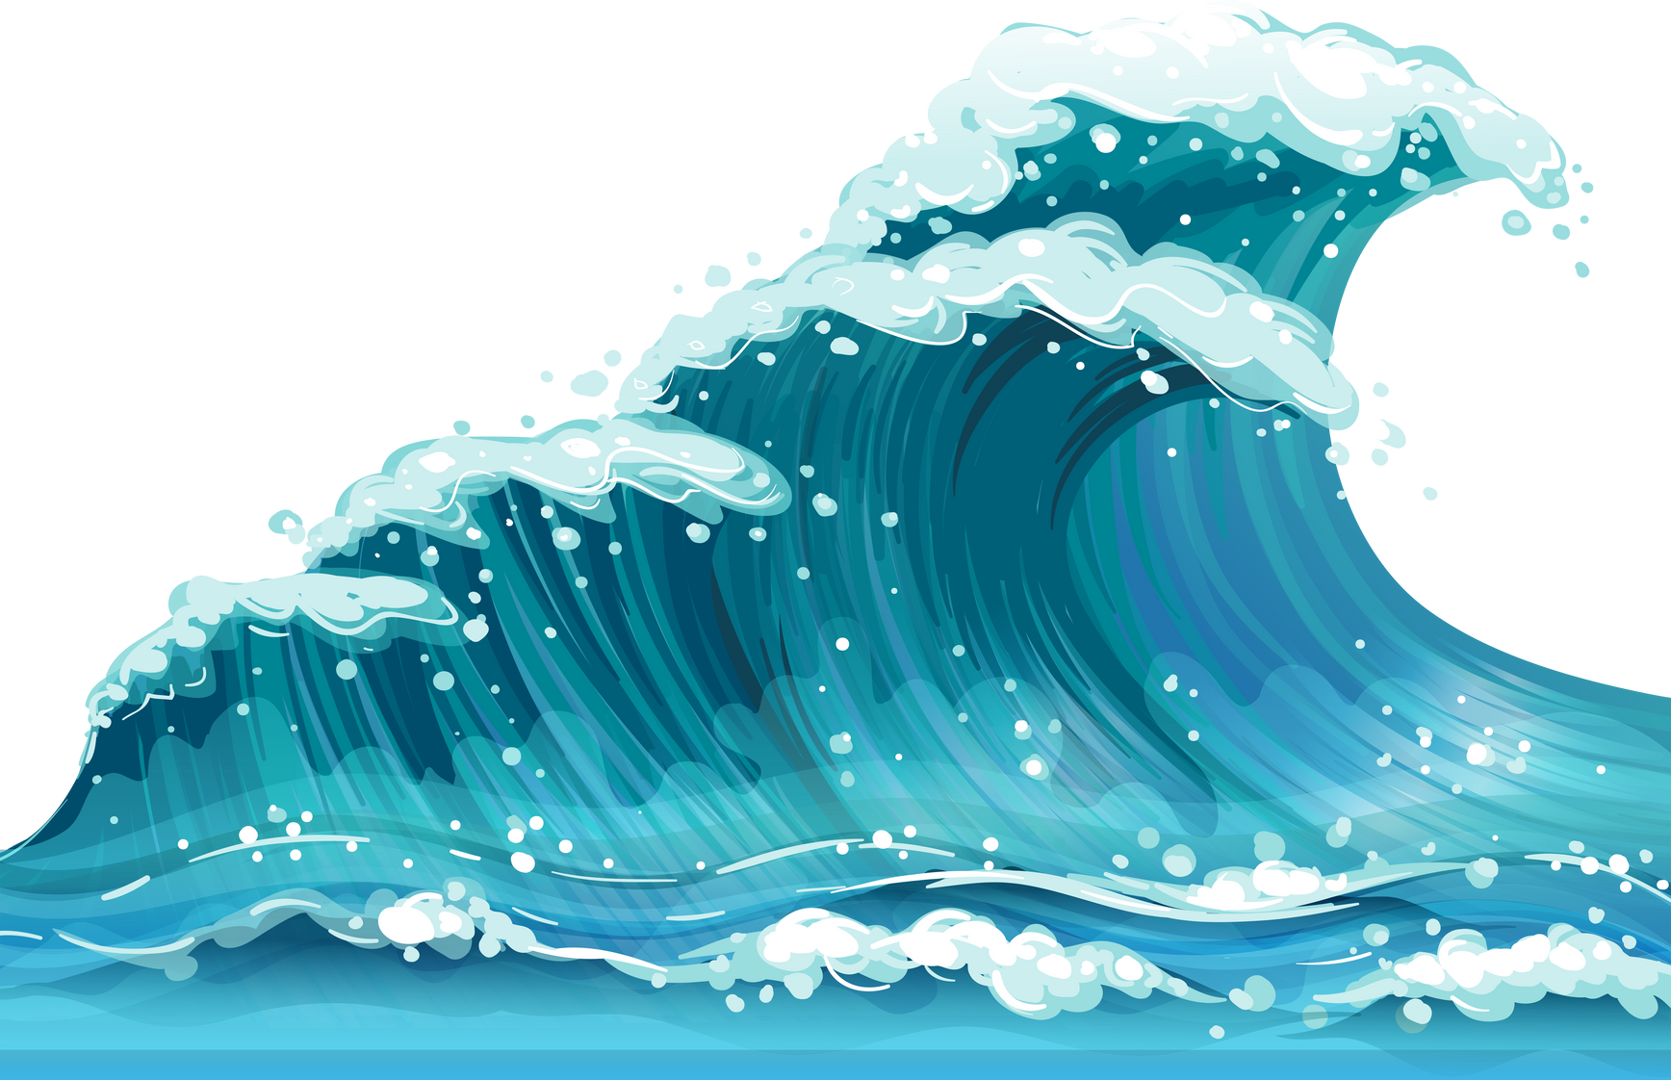
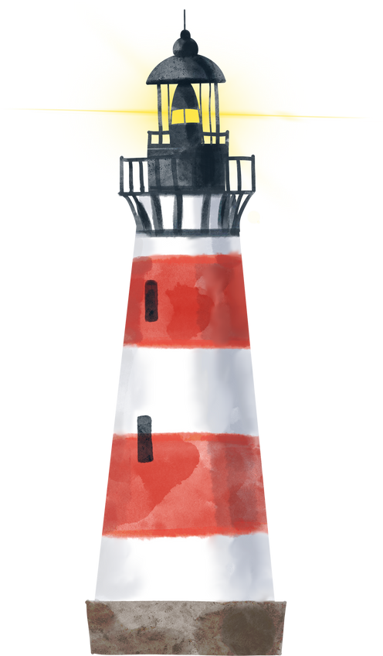
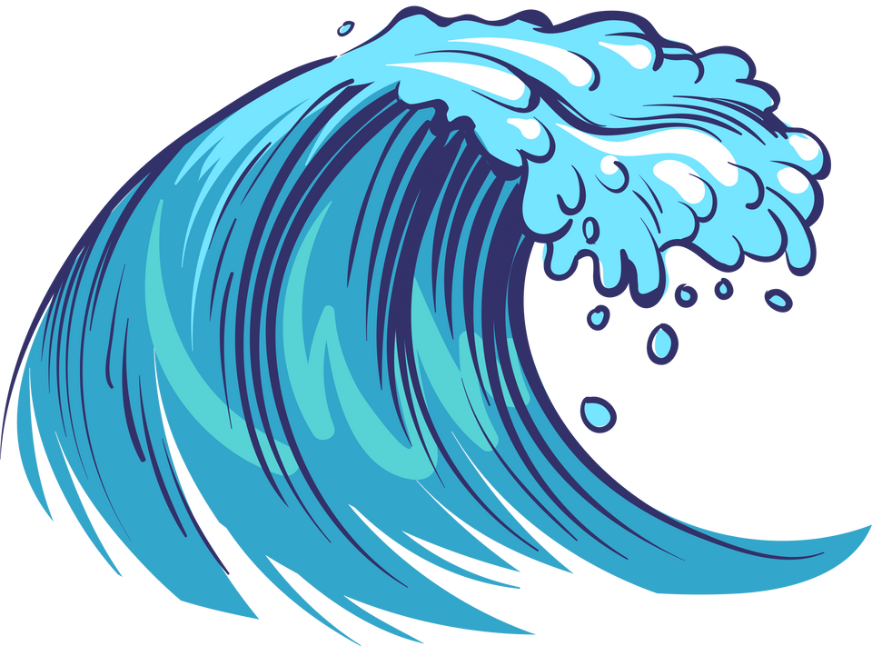
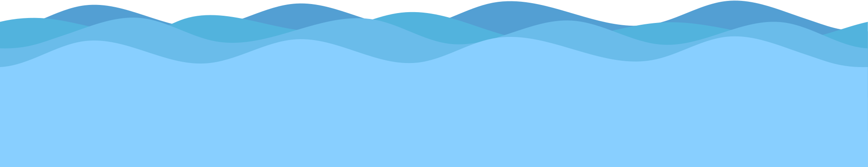
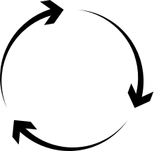
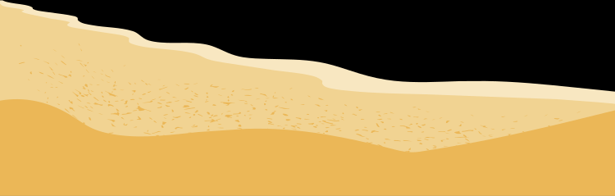
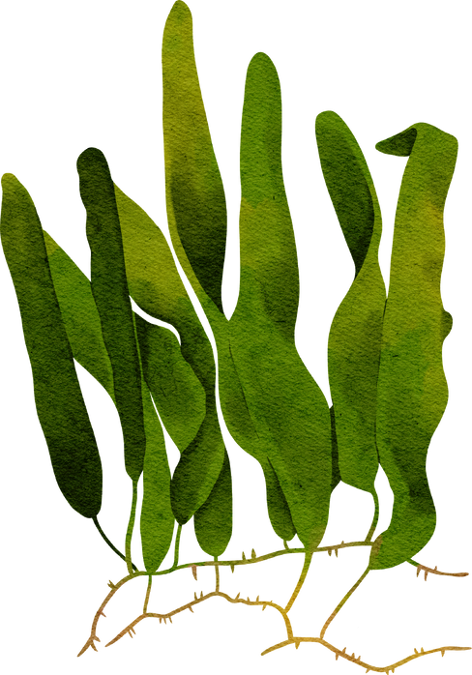
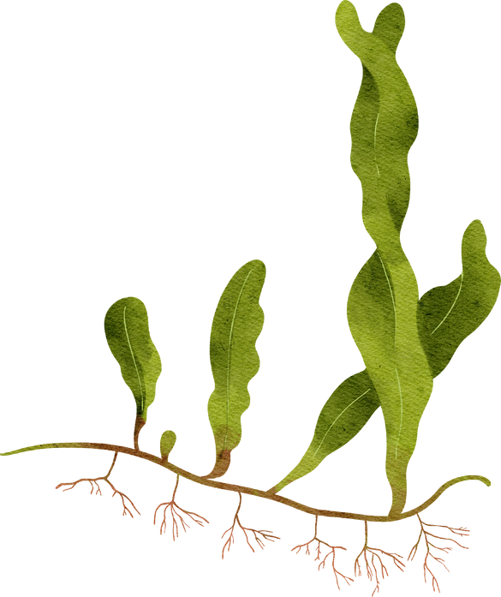
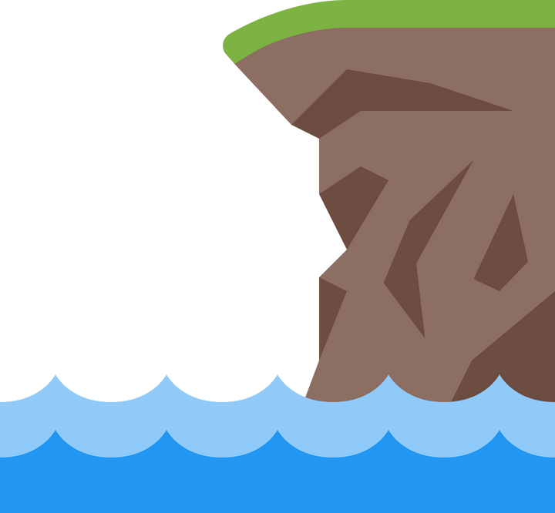
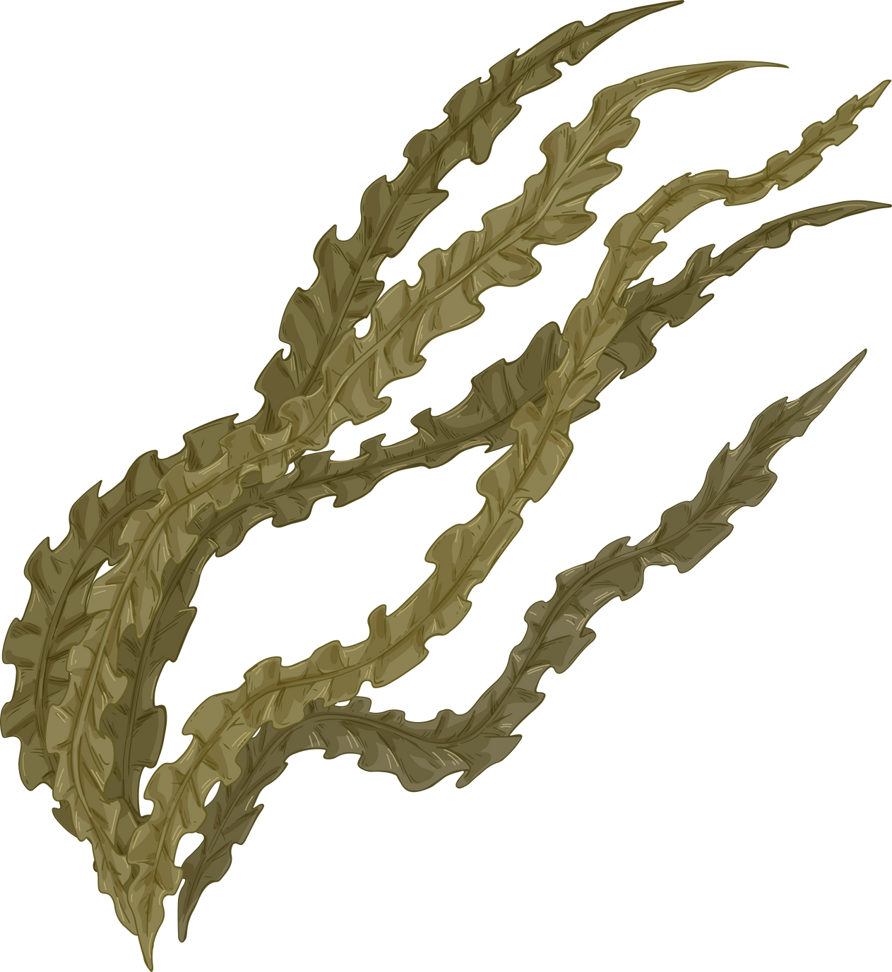
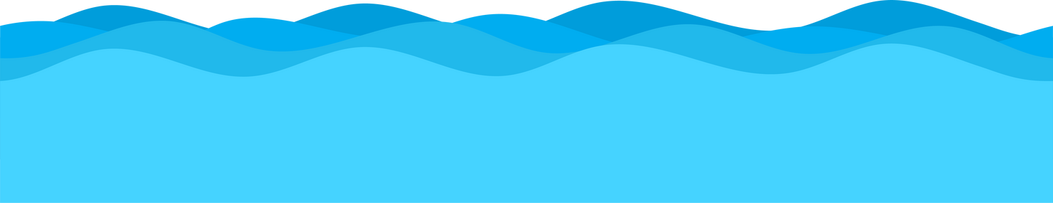
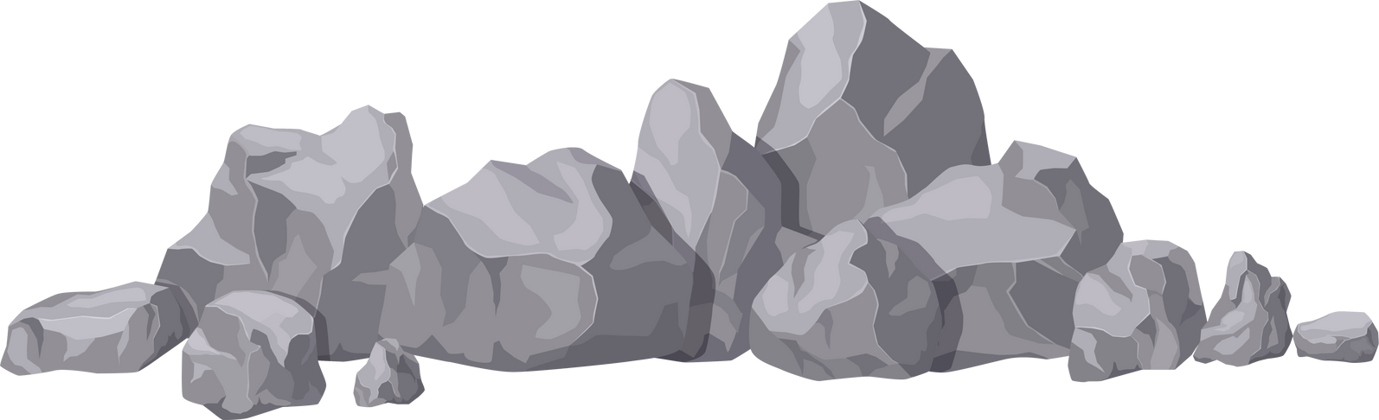
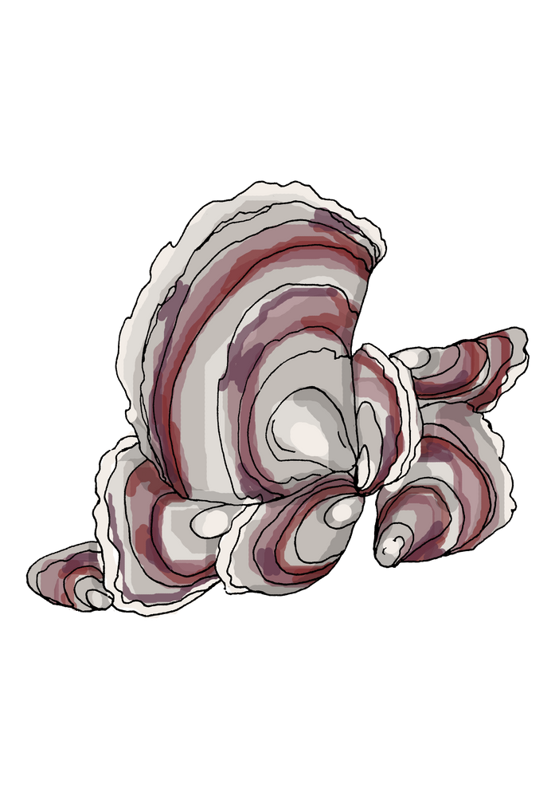
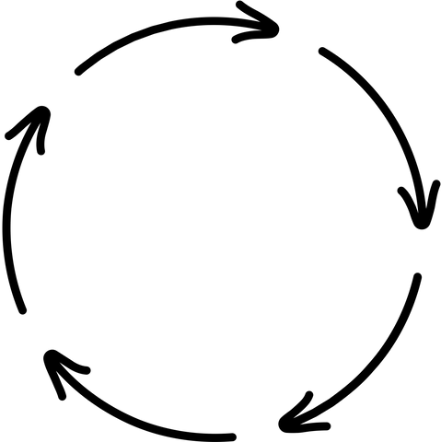
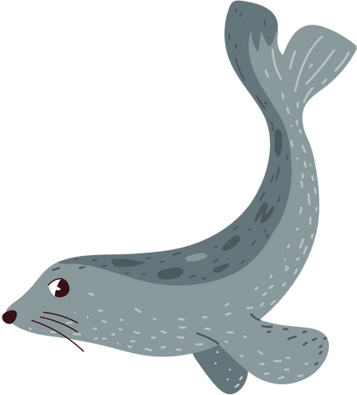
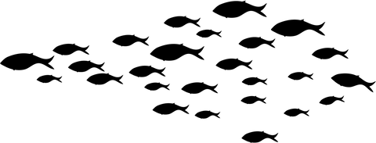
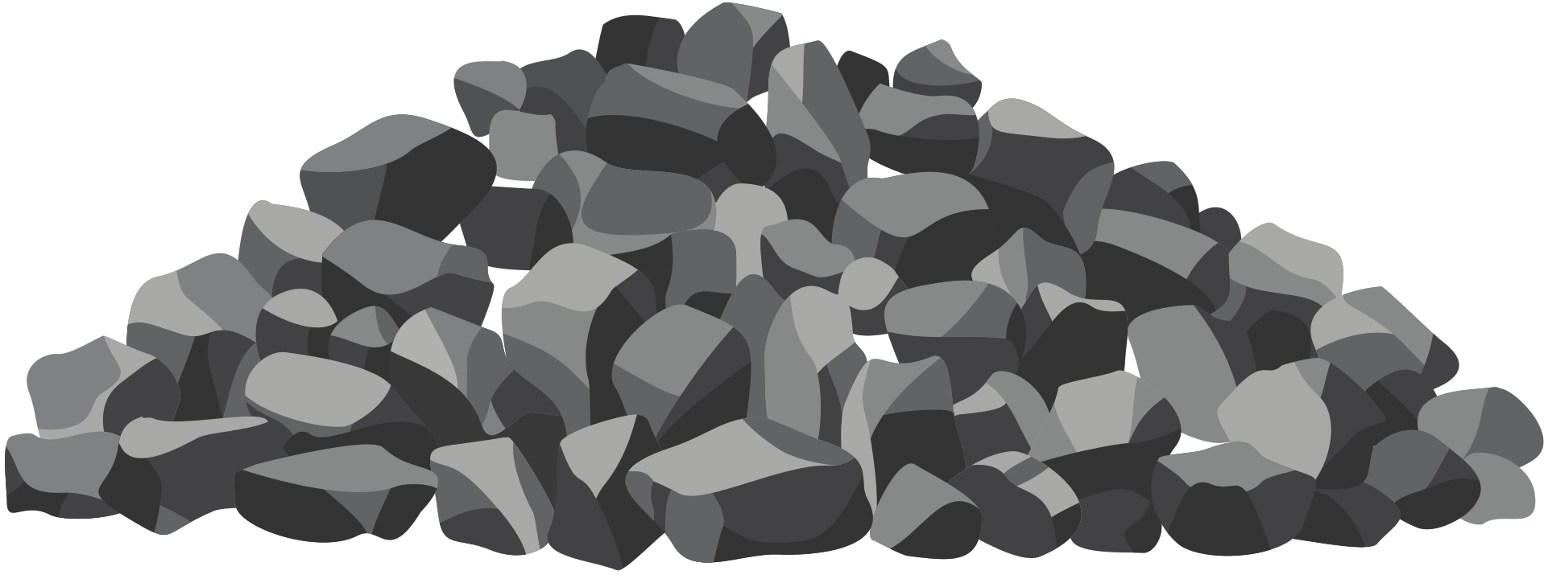
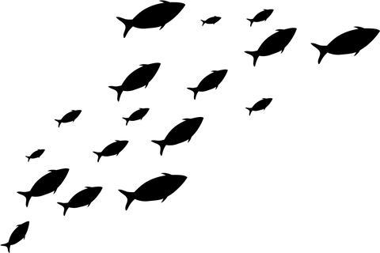
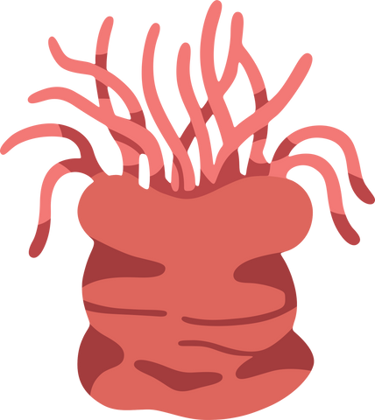
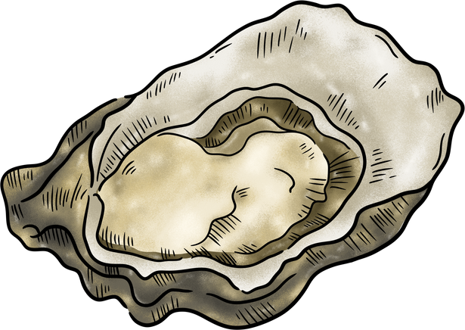
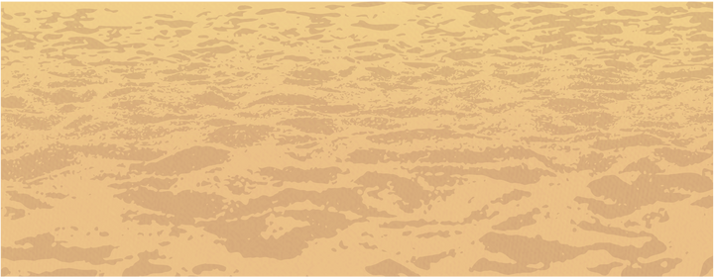
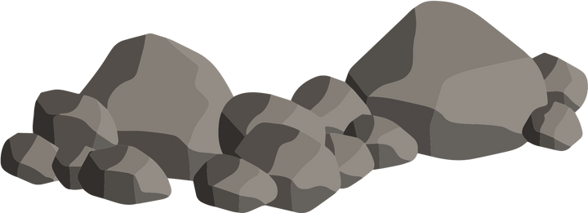
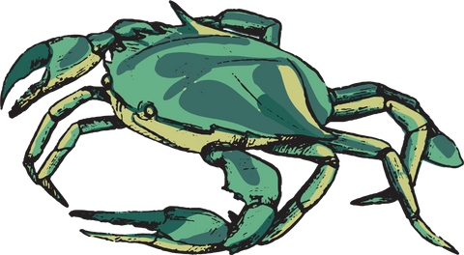
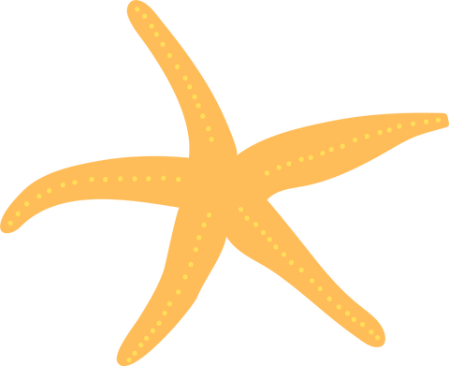
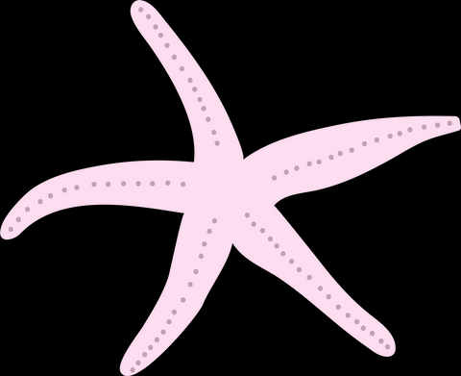
Stronger shores is interested in learning how well kelp, seagrass and oysters can slow down waves, reducing erosion...

Slide 16
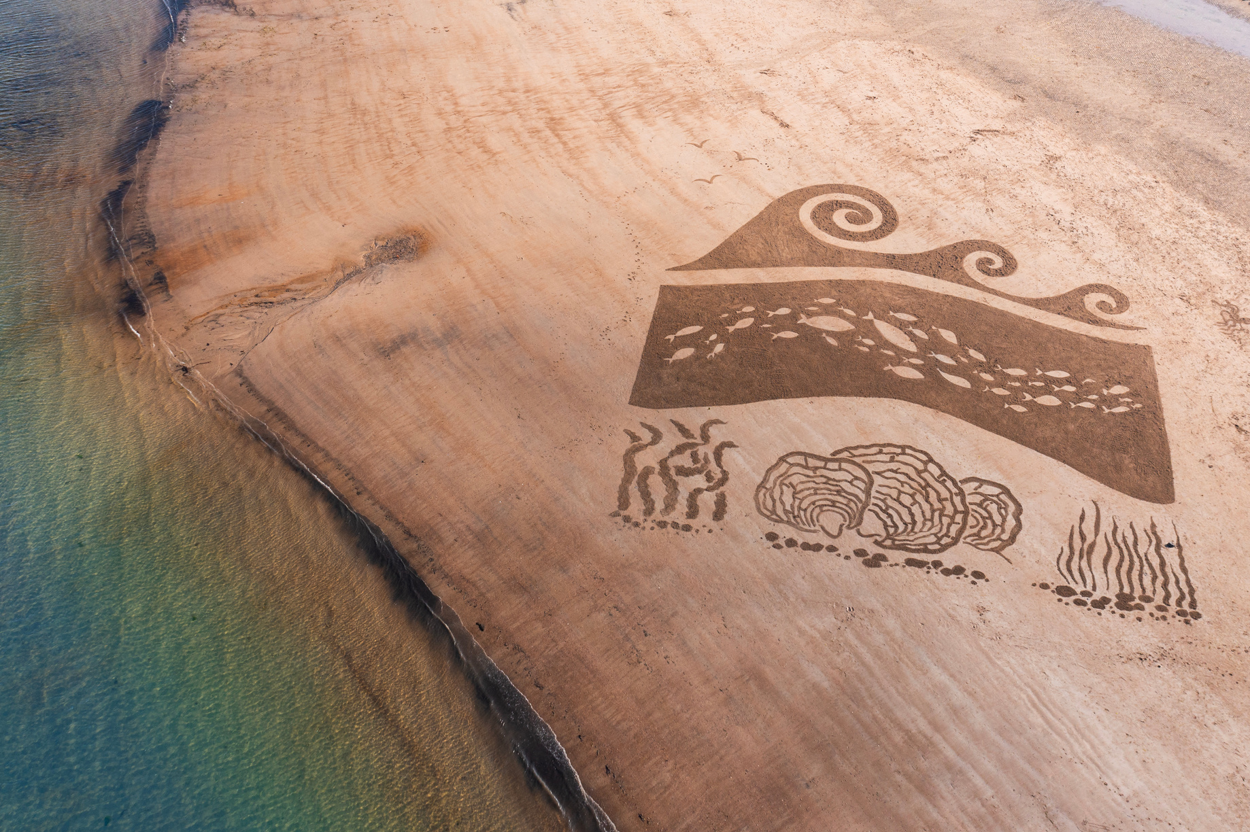
BENEFITS
These species all have benefits that they provide the surrounding coastline, the life along the coast and within the sea, and to humans.
Think back to what you just learned about each habitat, can you remember any of the benefits, or think of new benefits that haven’t been mentioned?

Slide 17
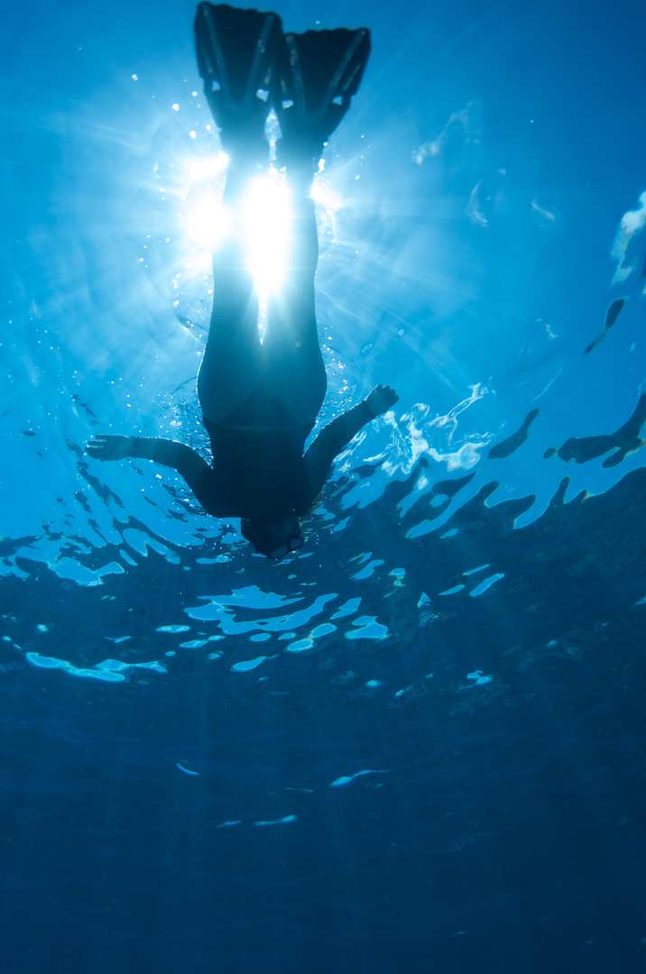
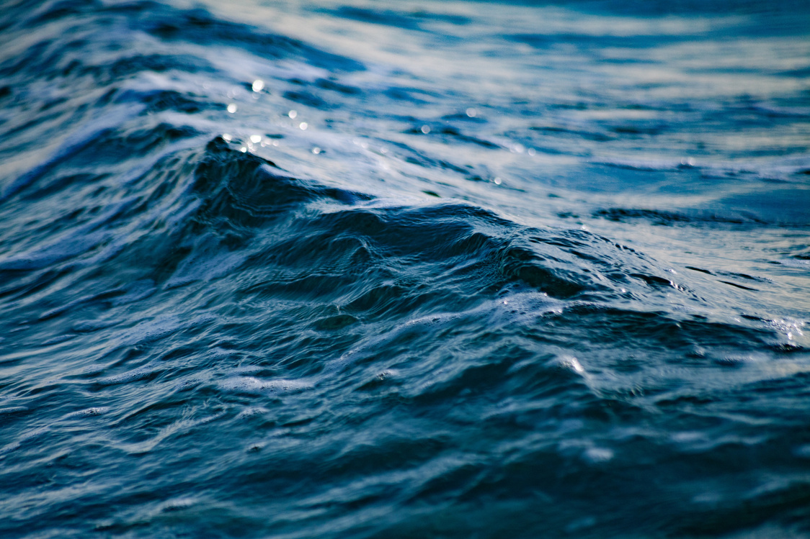
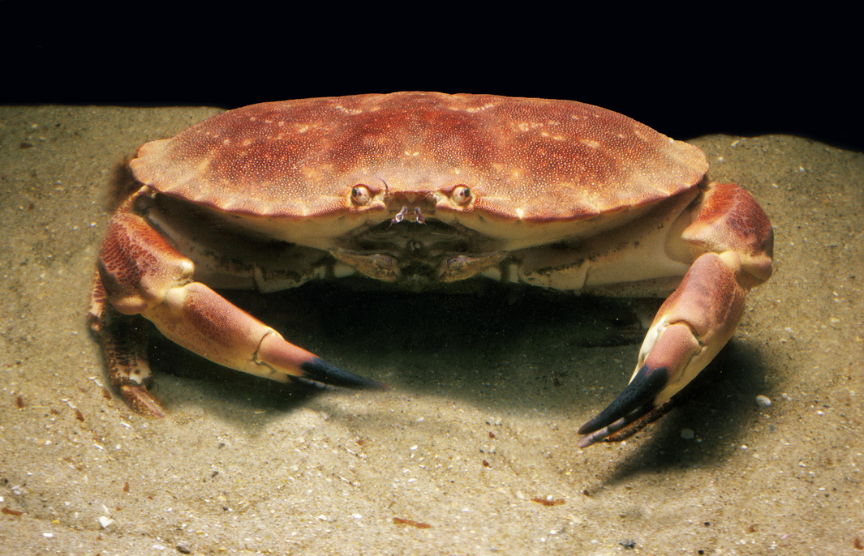
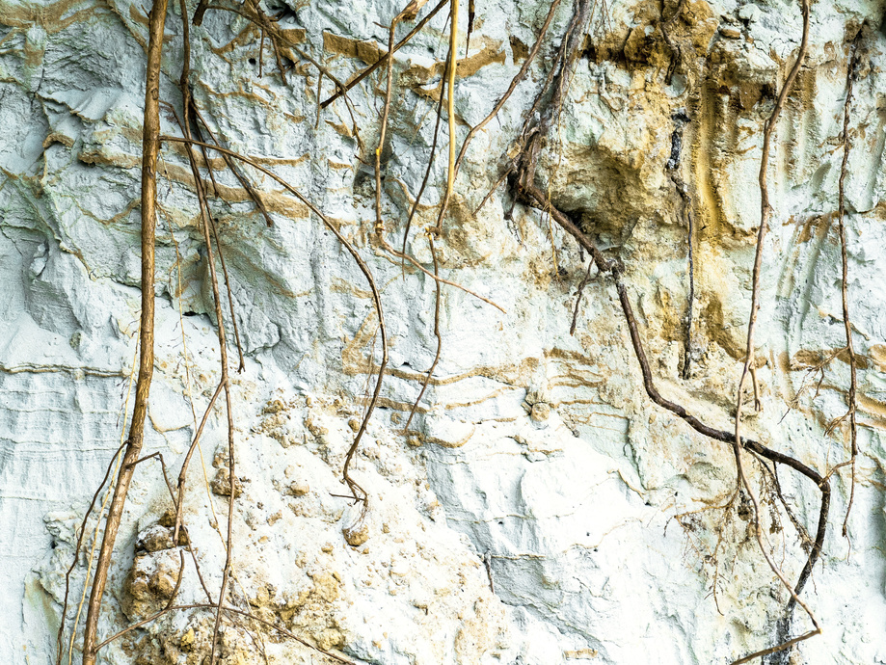
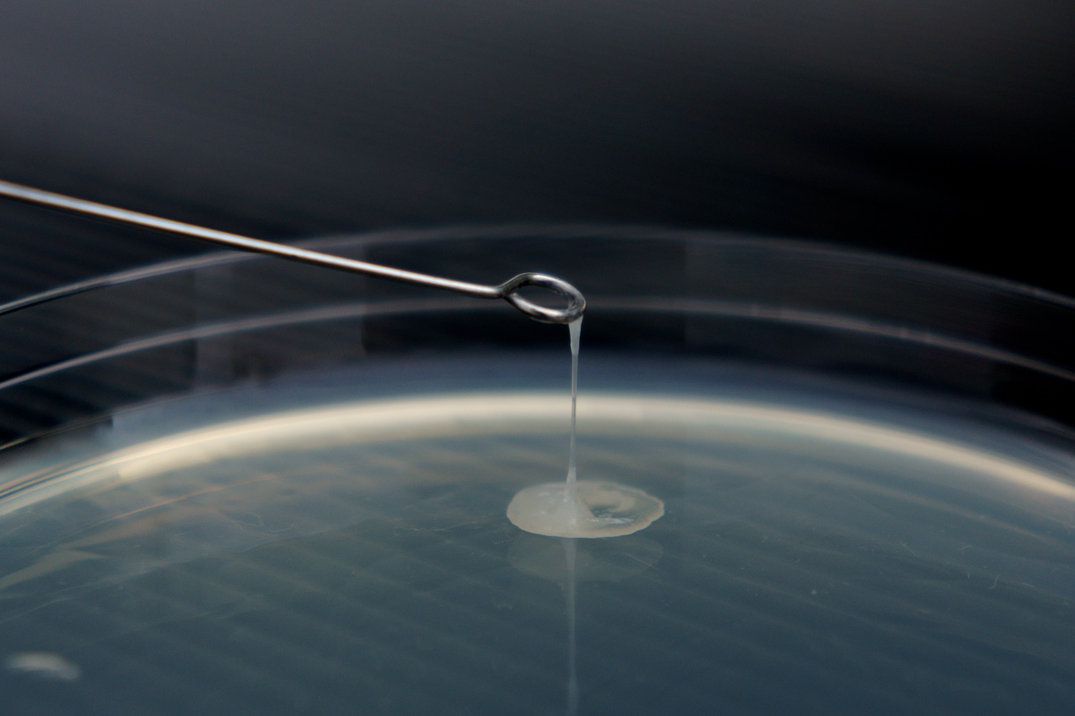

BENEFITS
As well as learning how well the habitats can protect our coasts from erosion, Stronger Shores is learning about all the other benefits we can also get from kelp, seagrass and oysters...
Tourism
Cleaning water
Habitat for commercial fish
Binding seabed with roots
Medicines and other products
Coastal Protection

Slide 18



ACTIVITY TIME
In this section you can now complete the associated quiz, and can do the activity in the accompanying pdf!

