Slide 1

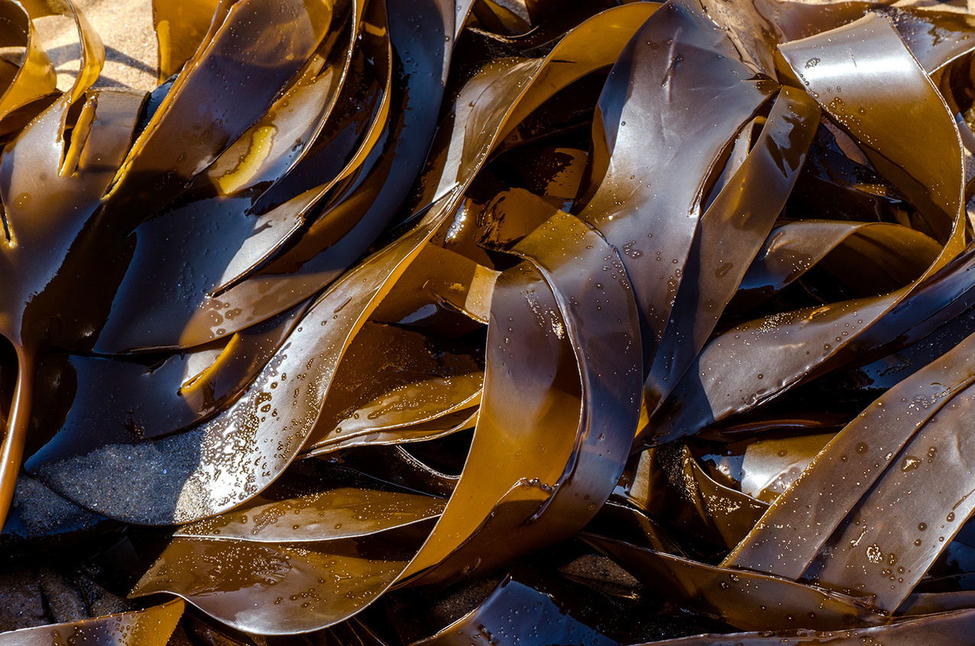

QUIZ TIME!
COASTAL DEFENCES

Slide 2
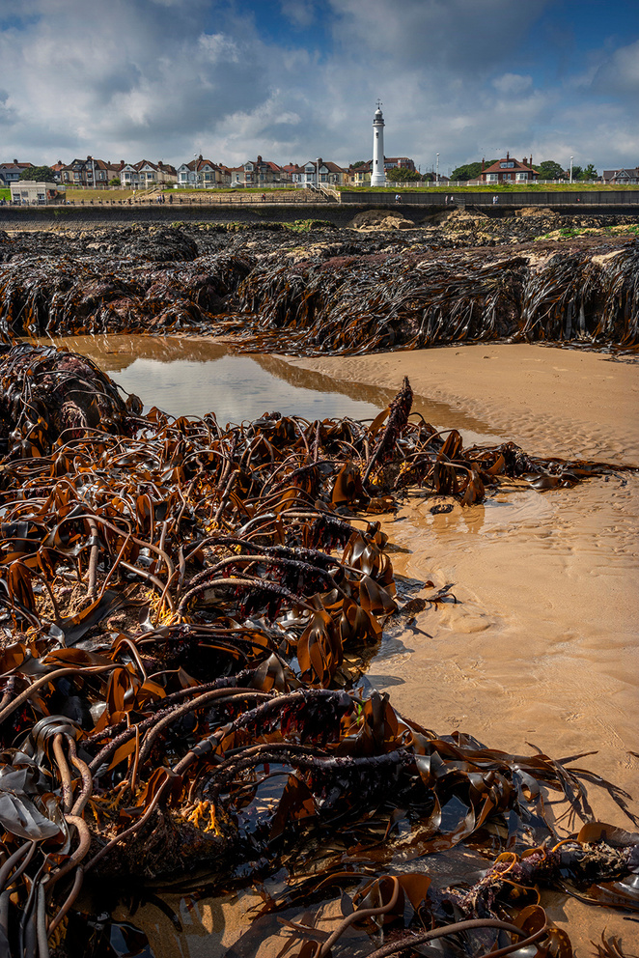
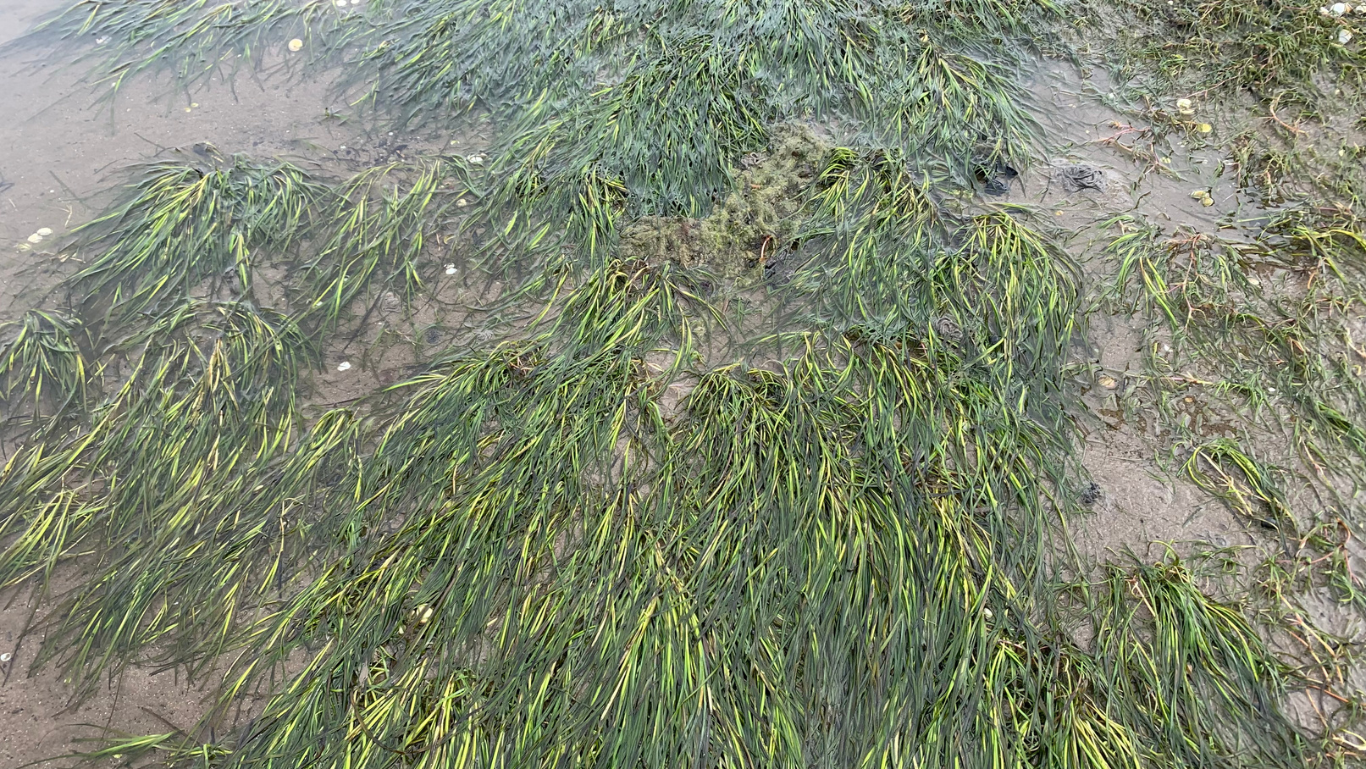
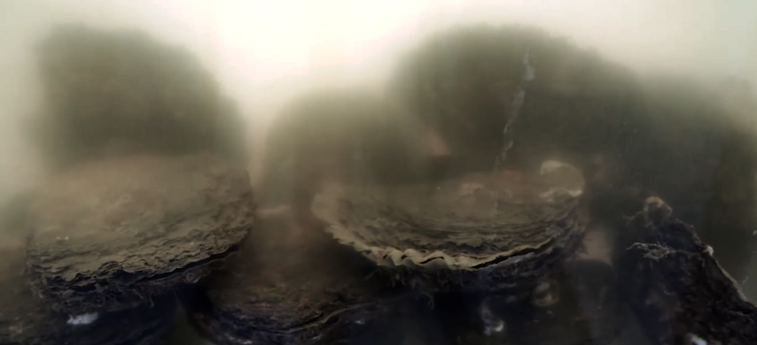
WHAT ARE THE 3 HABITATS SHOWN BELOW?

Slide 3
KELP FOREST
SEAGRASS MEADOW
OYSTER REEF

Slide 4
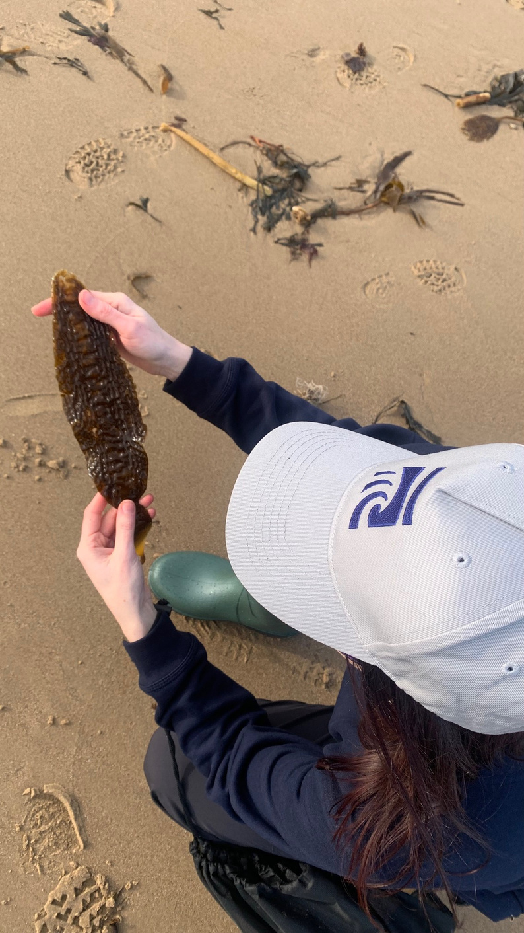
Kelp is not a plant, but an _ _ _ _ _, as although they look similar, the various kelp structures have different functions.

Slide 5
Kelp is not a plant, but an algae, as although they look similar, the various kelp structures have different functions.

Slide 6
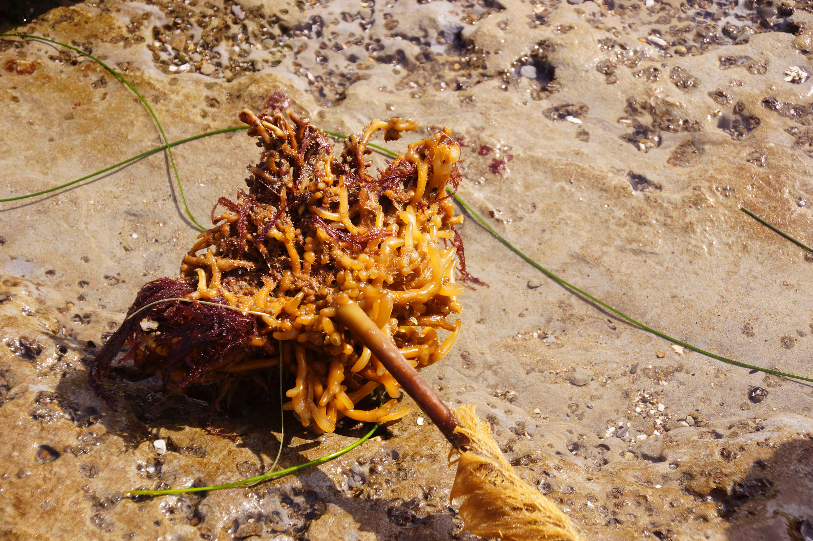
WHAT IS THE TERM FOR THE ROOT-LIKE BASE OF THE KELP?

Slide 7
WHAT IS THE TERM FOR THE ROOT-LIKE BASE OF THE KELP?
HOLDFAST

Slide 8
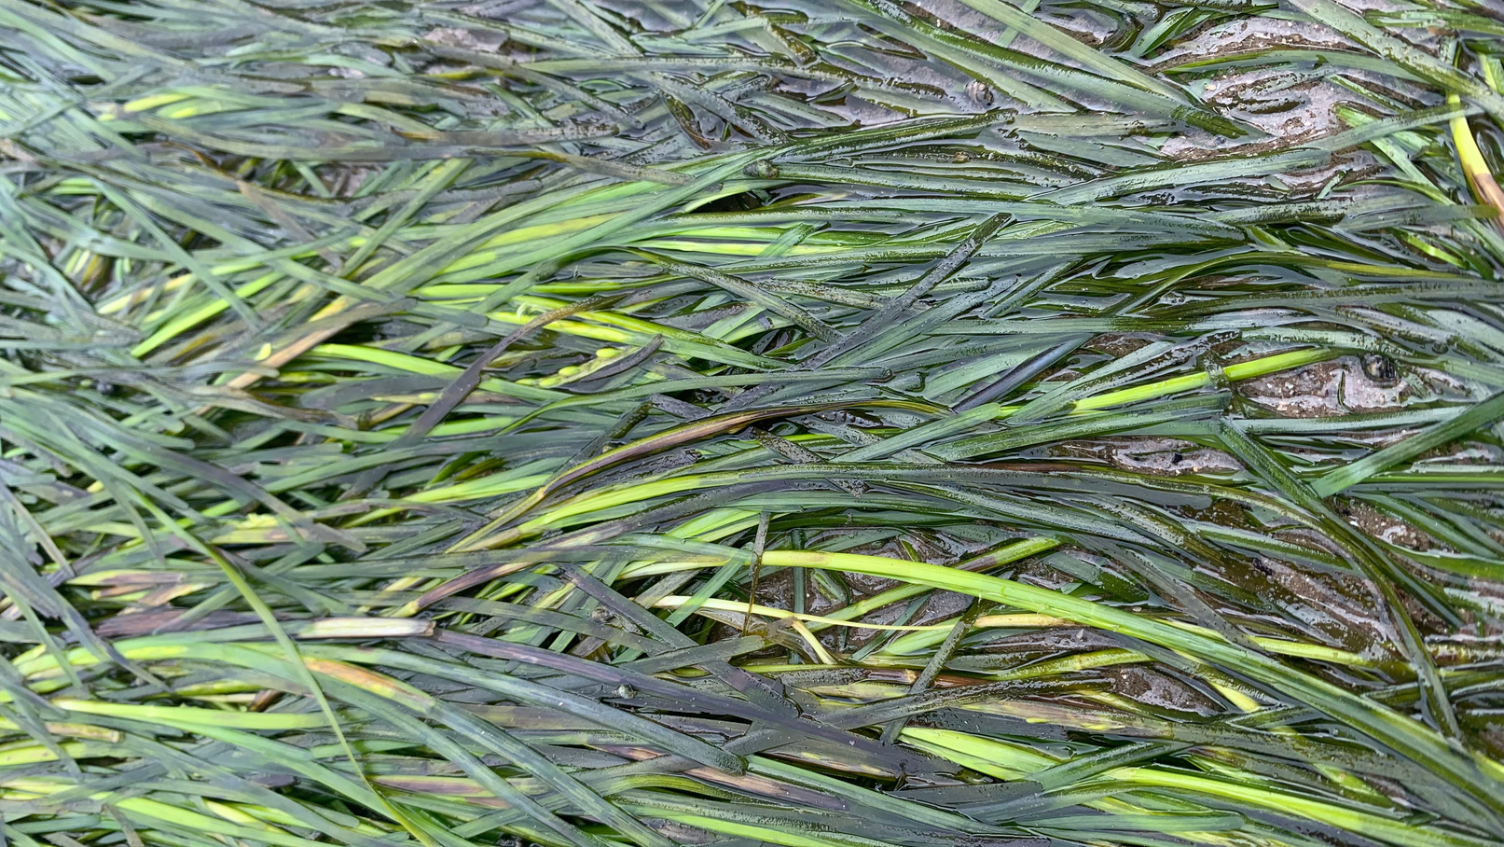
NAME 1 PRESSURE THAT THREATENS SEAGRASS

Slide 9
NAME 1 PRESSURE THAT THREATENS SEAGRASS
  Disease
  Building along the coast
  Agriculture run off from fields
  Fish farming
  Tourism e.g. boating

Slide 10
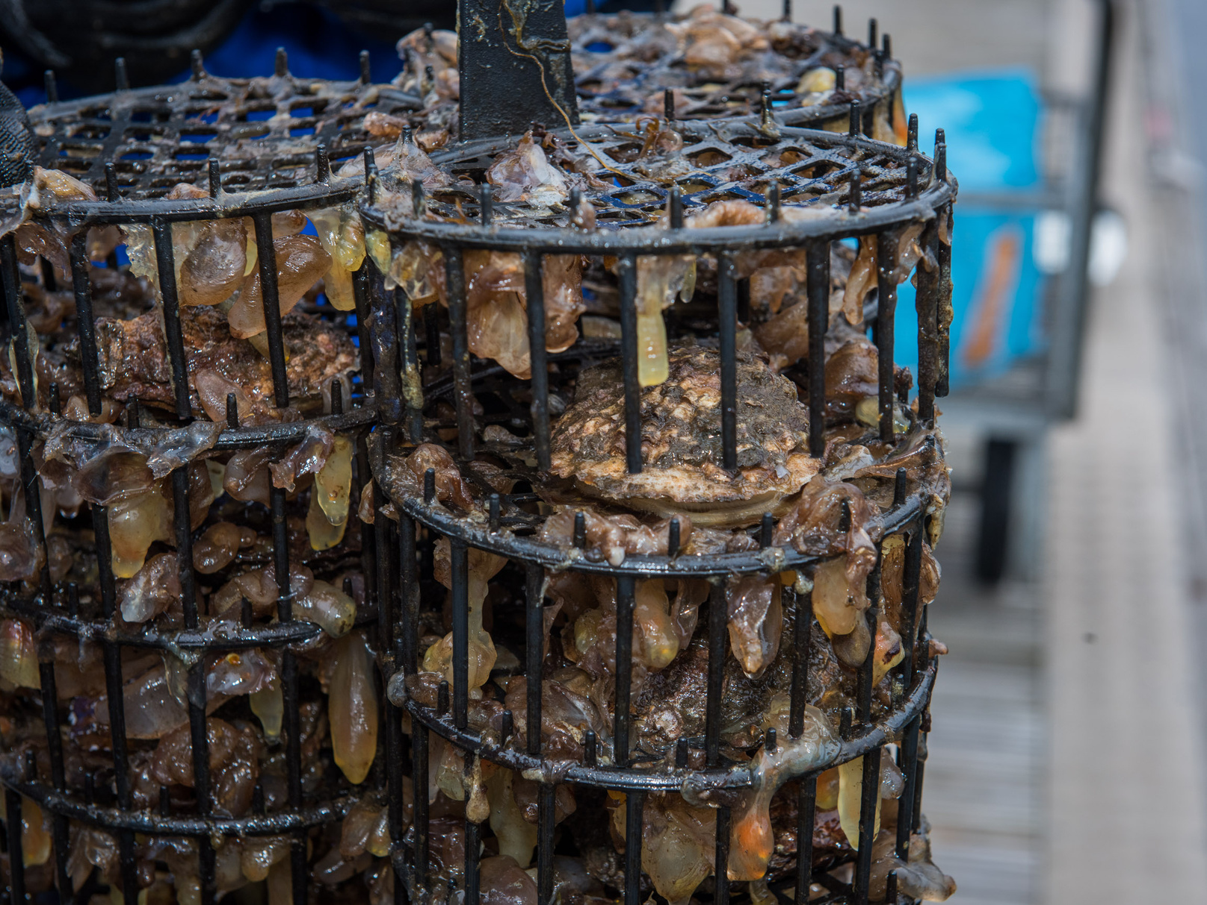
WHAT IS THE NAME OF THE PROCESS THROUGH WHICH THE OYSTERS REMOVE PARTICLES FROM THE WATER?

Slide 11
WHAT IS THE NAME OF THE PROCESS THROUGH WHICH THE OYSTERS REMOVE PARTICLES FROM THE WATER?
FILTRATION

Slide 12
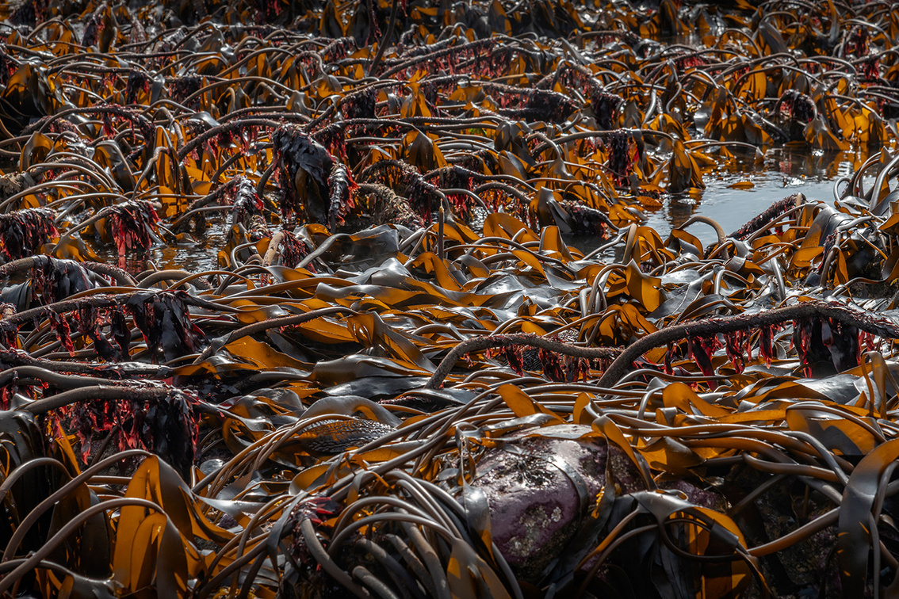
NAME 1 BENEFIT THAT YOU CAN GET FROM KELP.

Slide 13
NAME 1 BENEFIT THAT YOU CAN GET FROM KELP.
  Ingredient in food and drink
  Requires no fertiliser or fresh water to grow
  Captures carbon
  Provides habitat for many, many species
  Cleans surrounding water by taking up nutrients
  Dampens wave energy
  Used in pharmaceuticals
  Produces oxygen

Slide 14


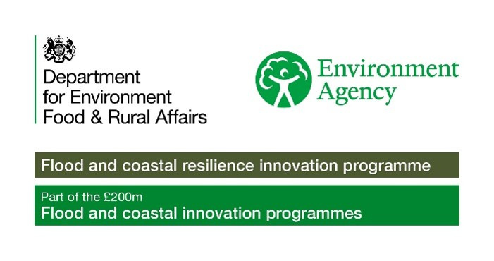
To find out more about Stronger Shores follow the link in the QR code to visit our StoryMap, or go to:
https://storymaps.arcgis.com/stories/7da0c07ee3d245c9b273c6538bf0e1db

