Slide 1

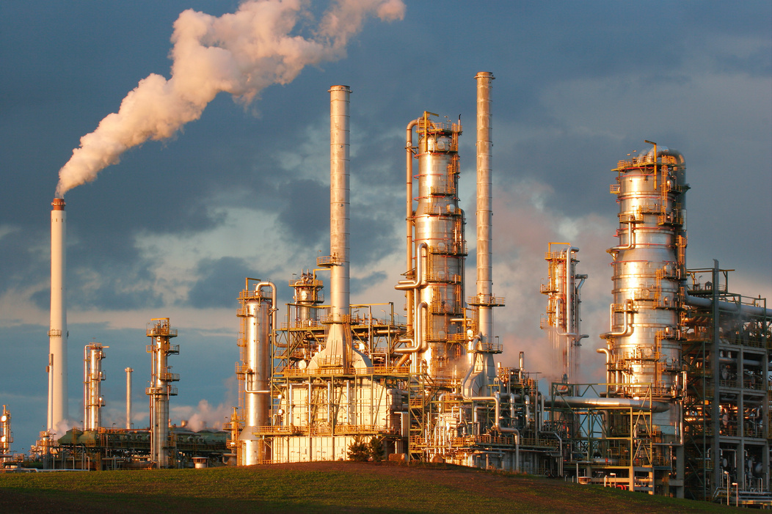
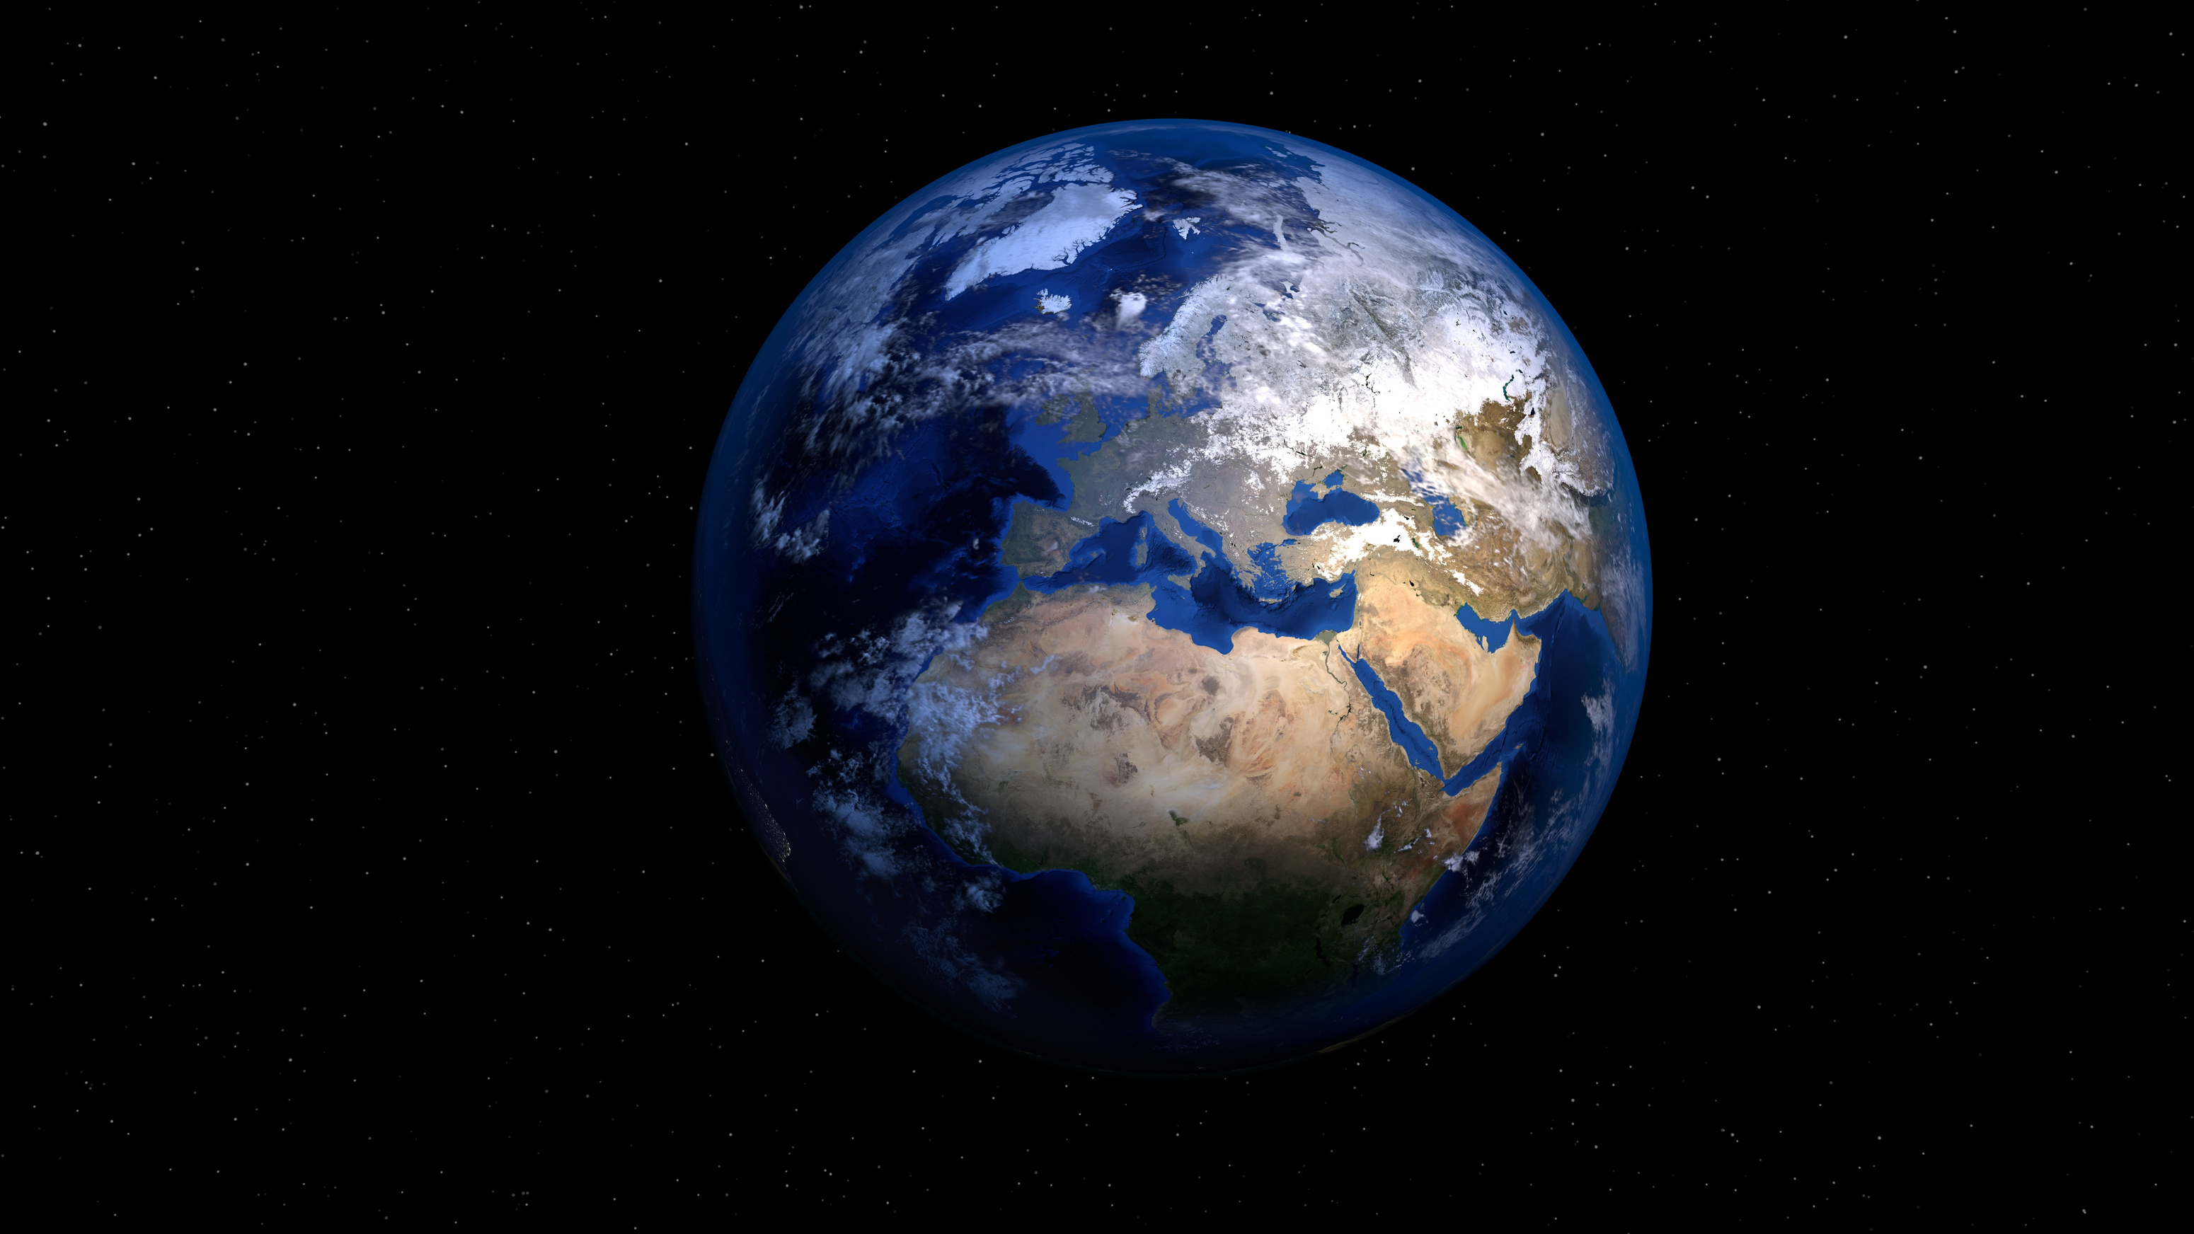
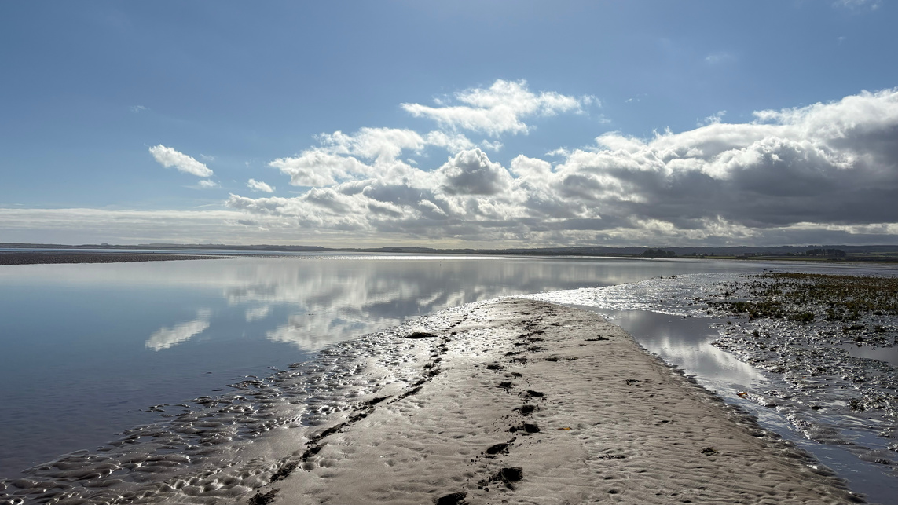

CLIMATE
CHANGE
Explore how humans are affecting our planet...

Slide 2
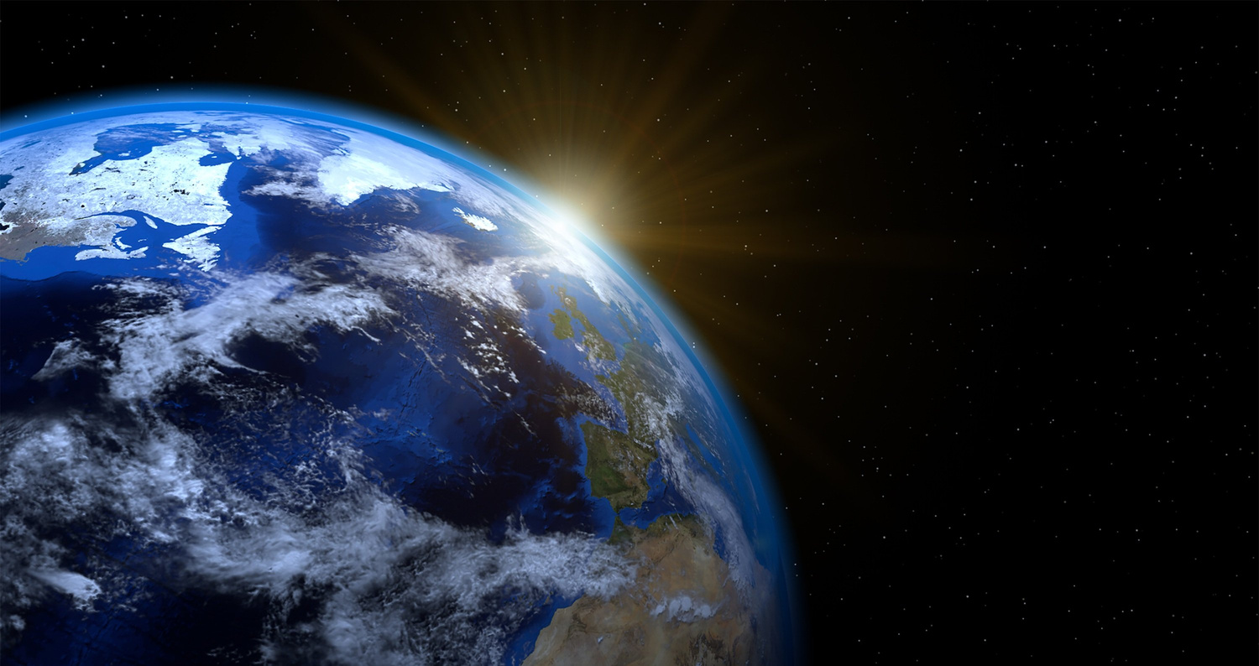
LEARNING OUTCOMES
By the end of this presentation you will have learned:
  About the composition of the atmosphere
  How greenhouse gases are affecting our planet
  The impacts of climate change
  How we can combat climate change and mitigate its impacts
  Carbon Dioxide is made of 2 Oxygen atoms and one Carbon atom

Slide 3
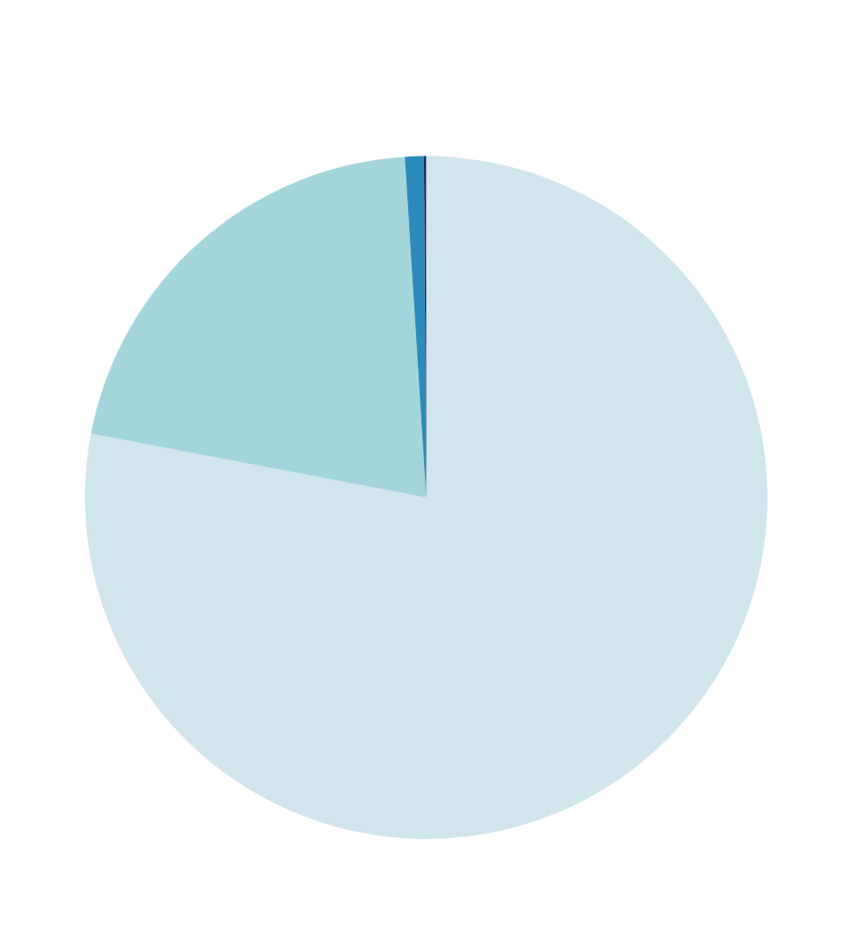
ATMOSPHERE
Our planet’s atmosphere is made up of a mixture of gases, with the main gases being Nitrogen, Oxygen and Argon.

Slide 4


GREENHOUSE GASES
0.1% of the ‘other’ gases includes greenhouse gases, gases which trap heat from the sun, and warm our atmoshpere...

Slide 5
GREENHOUSE GASES
These gases are beneficial, without them our planet would be too cold for life to exist, however, too much of these gases and...

Slide 6
GREENHOUSE GASES
more and more heat energy is captured, and the warmer our atmosphere becomes.
Too much heat can cause severe issues, including melting ice; stronger, more frequent storms, and flooding or droughts!

Slide 7
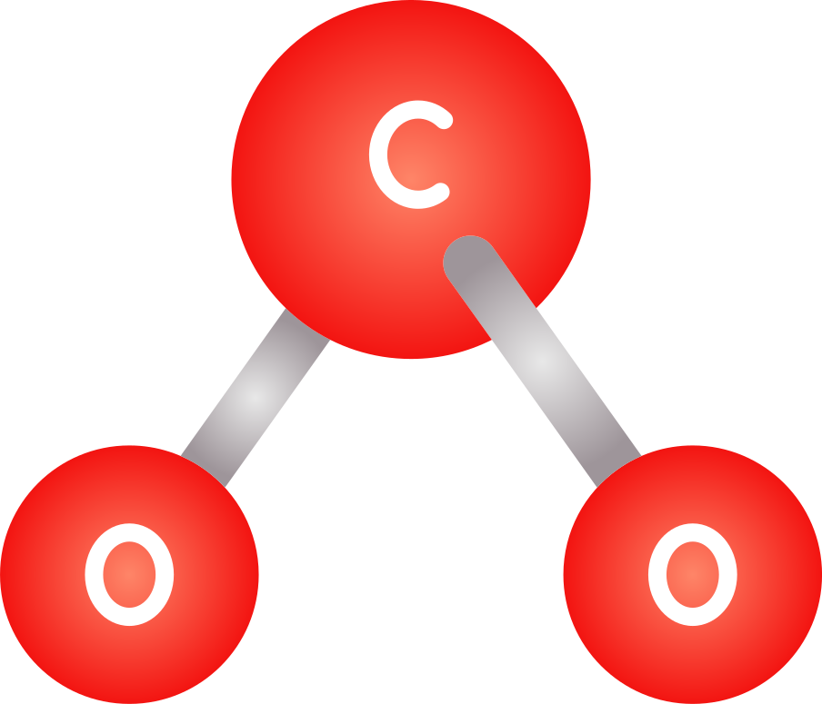
GREENHOUSE GASES
One of the more common greenhouse gases you may have heard of is ‘Carbon Dioxide’ - A chemical compound (meaning a chemical made up of more than one element) consisting of two Oxygen atoms and one Carbon atom.

Slide 8

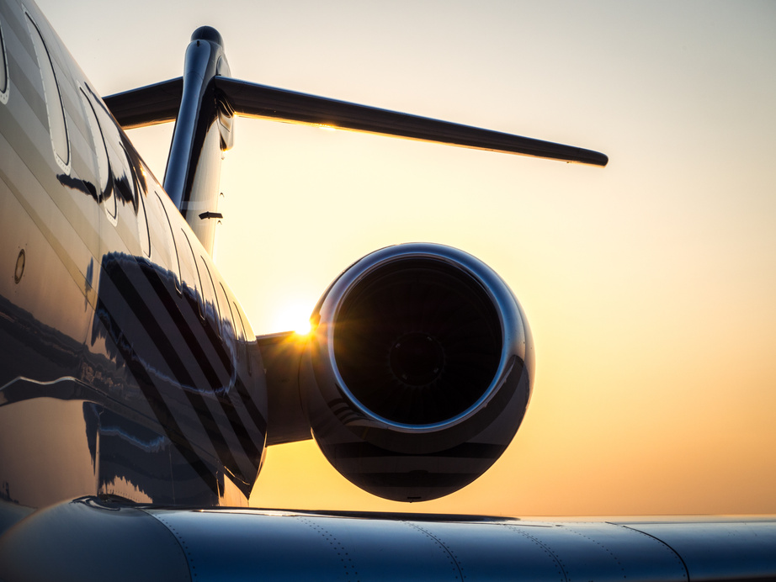
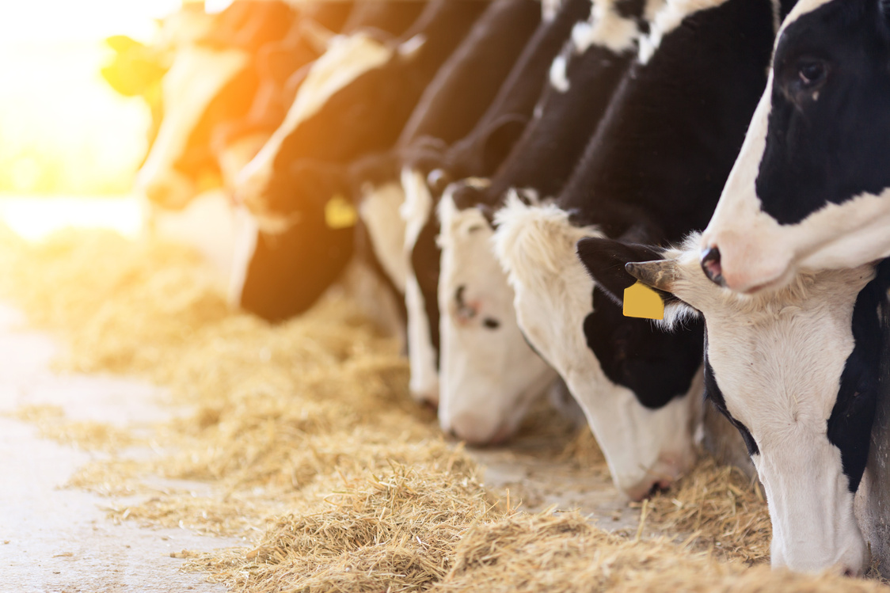
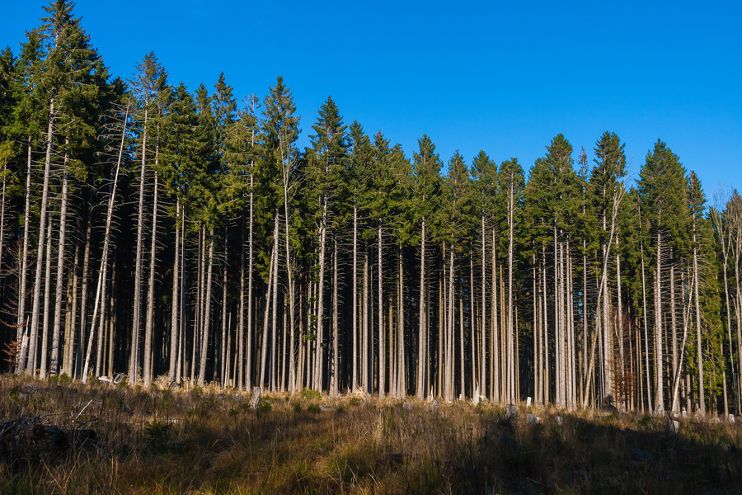
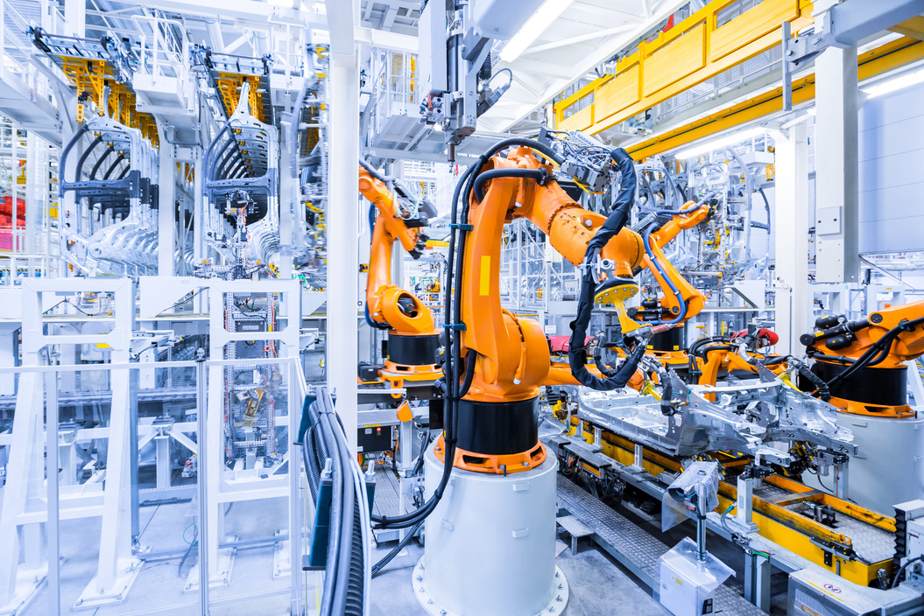
SOURCES
Where do these greenhouse gases come from?
Electricity and heat (31%)
Transport (15%)
Agriculture (11%)
Forestry (6%)
Manufacturing (12%)

Slide 9
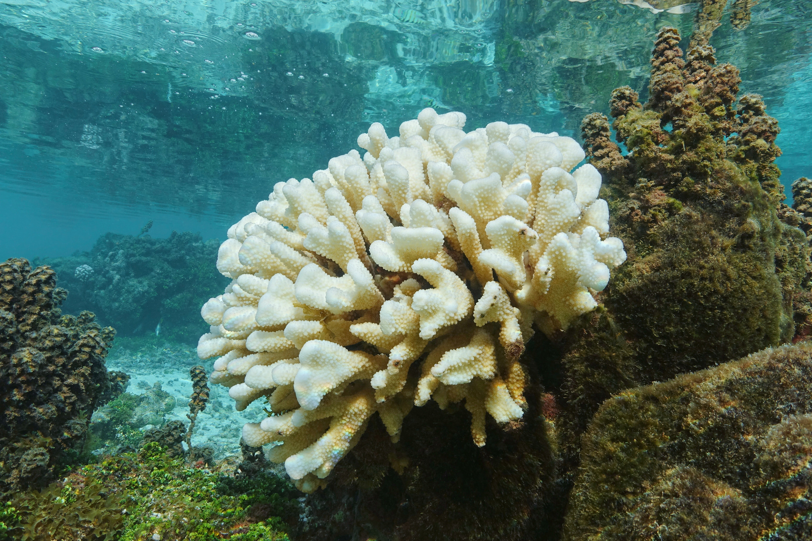
IMPACTS
Rising global temperatures can impact our world in many ways:
  Melting ice
  Rising sea levels
  Droughts
  Floods
  Extreme heat waves
  More powerful storms
  Increased number of storms
  Changes in animal habitats

Slide 10

IMPACTS
Our ocean is doing us a favour - since the beginning of the industrial revolution in the 19th century, when humans began releasing harmful levels of greenhouse gases, it has taken up over 90% of the extra heat stored because of climate change!

Slide 11

WHAT CAN WE DO?
Have a discussion amongst yourselves, and think about ways that we can reduce the impact that we have on our climate:
  Personally
  Collectively

Slide 12
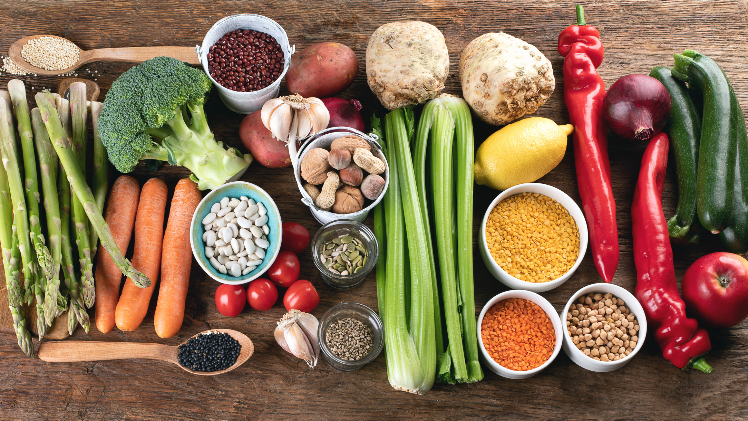
WHAT CAN WE DO?
Personally, to reduce greenhouse gases, we could:
  Eat less meat
  Walk or cycle when we can instead of using cars
  Lower our heating by a degree or two and wear a jumper
  Reduce the amount of energy we use at home

Slide 13
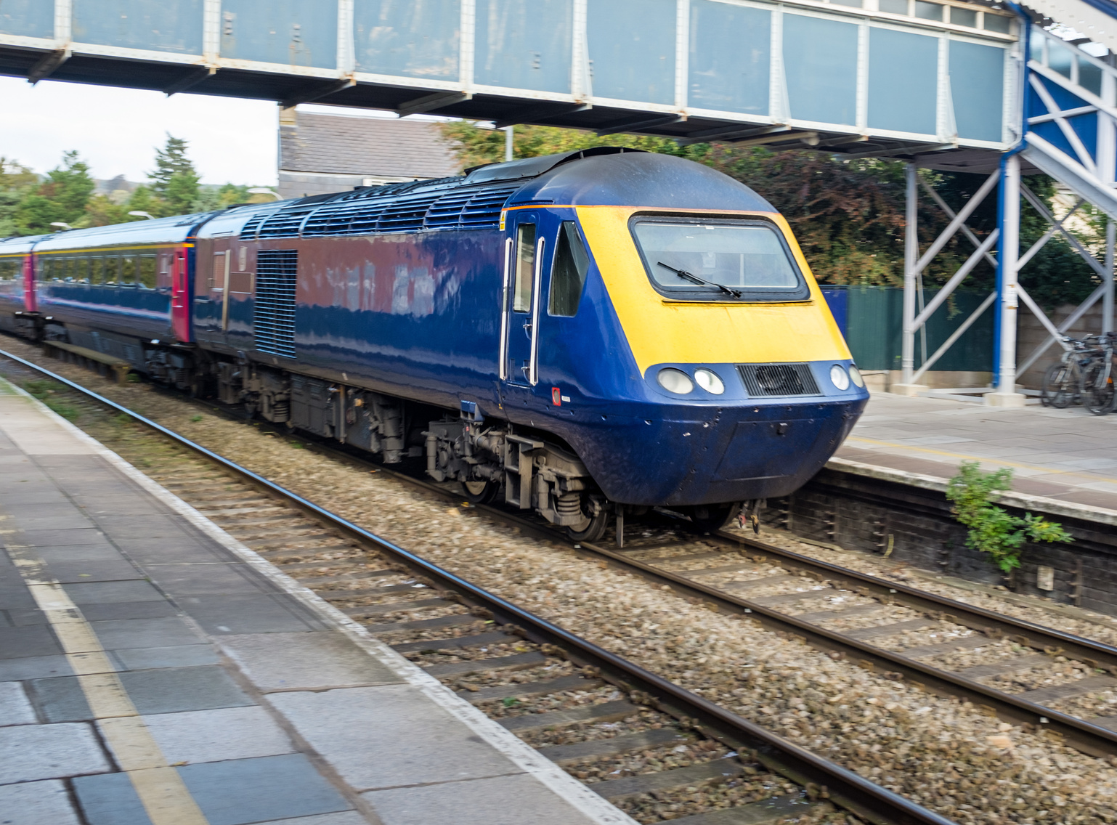
WHAT CAN WE DO?
As a collective, to reduce greenhouse gases, we could:
  Move to renewable energy
  Expand our use of public transport
  Promote meat and dairy alternatives
  Properly insulate homes
  Innovating: scientists are always researching new ways to reduce our reliance on fossil fuels!

Slide 14
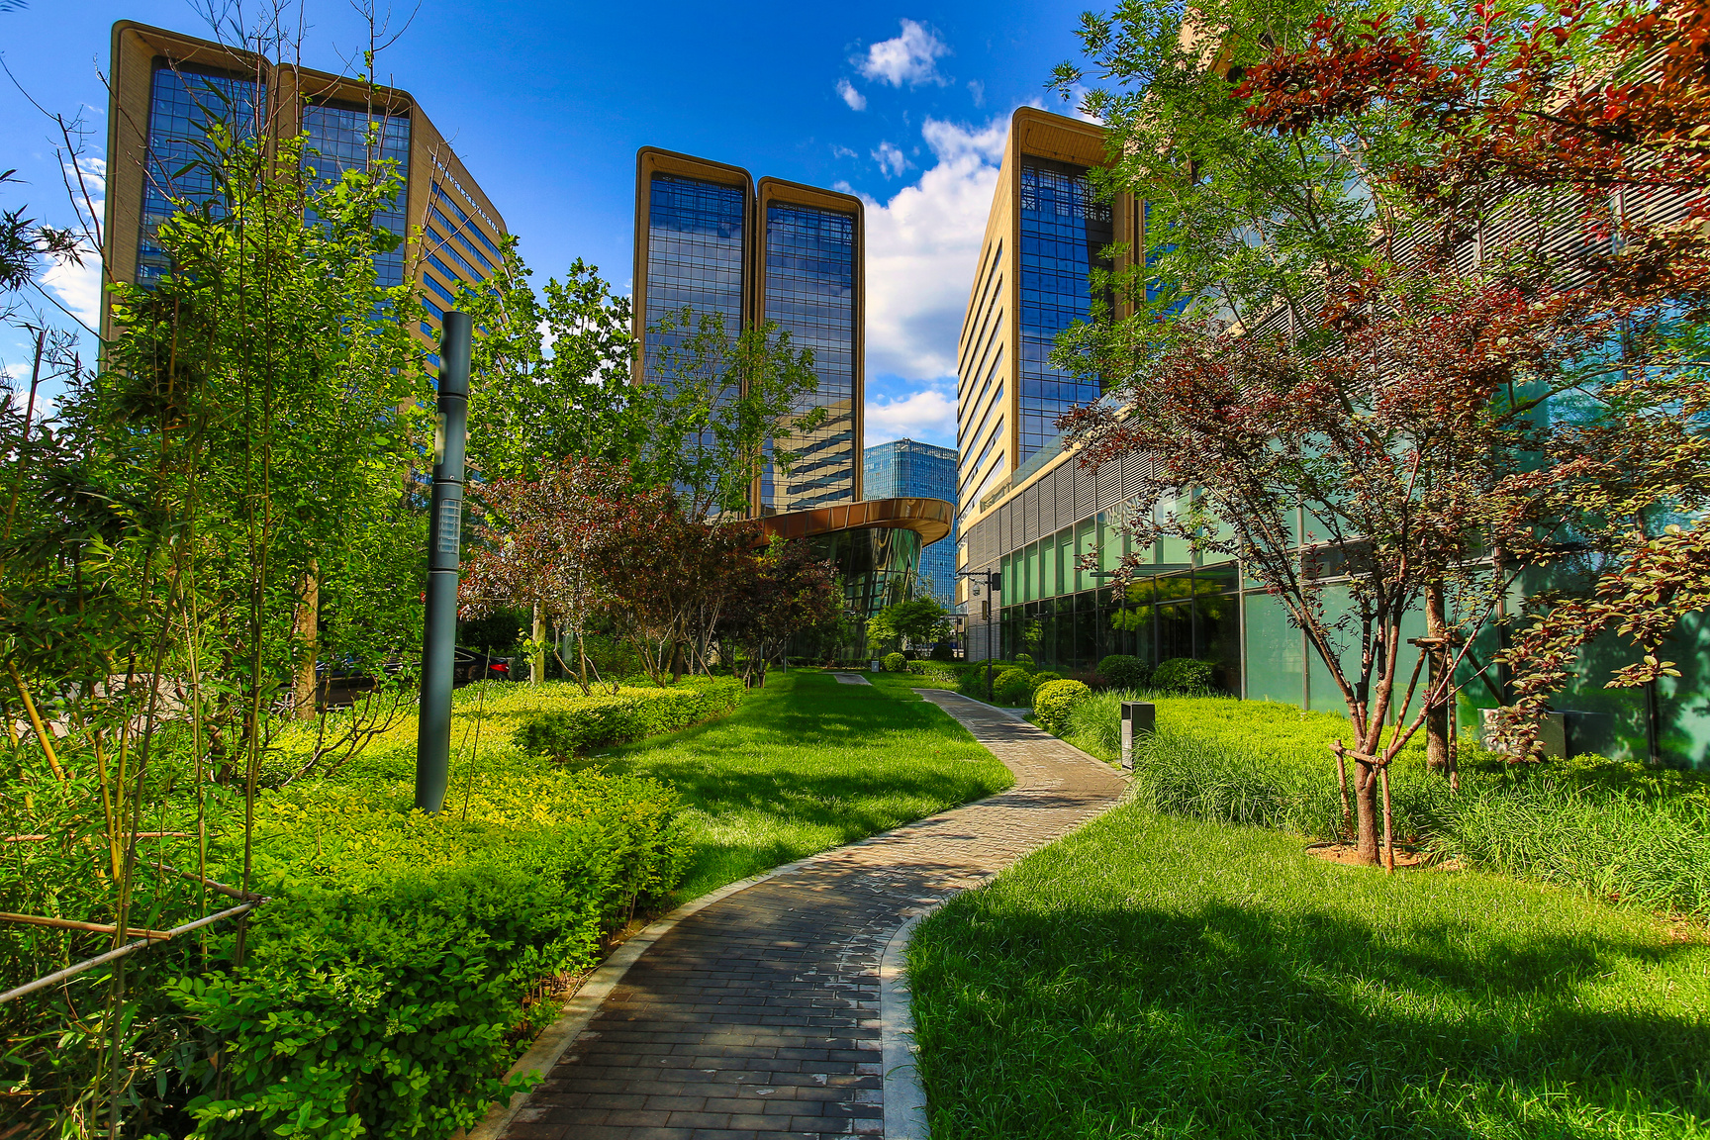
IMPACT
Some impacts of climate change are now unavoidable, and will be keenly felt along our coastlines...
  Erosion
  Flooding
  Loss of land from sea level rise

Slide 15
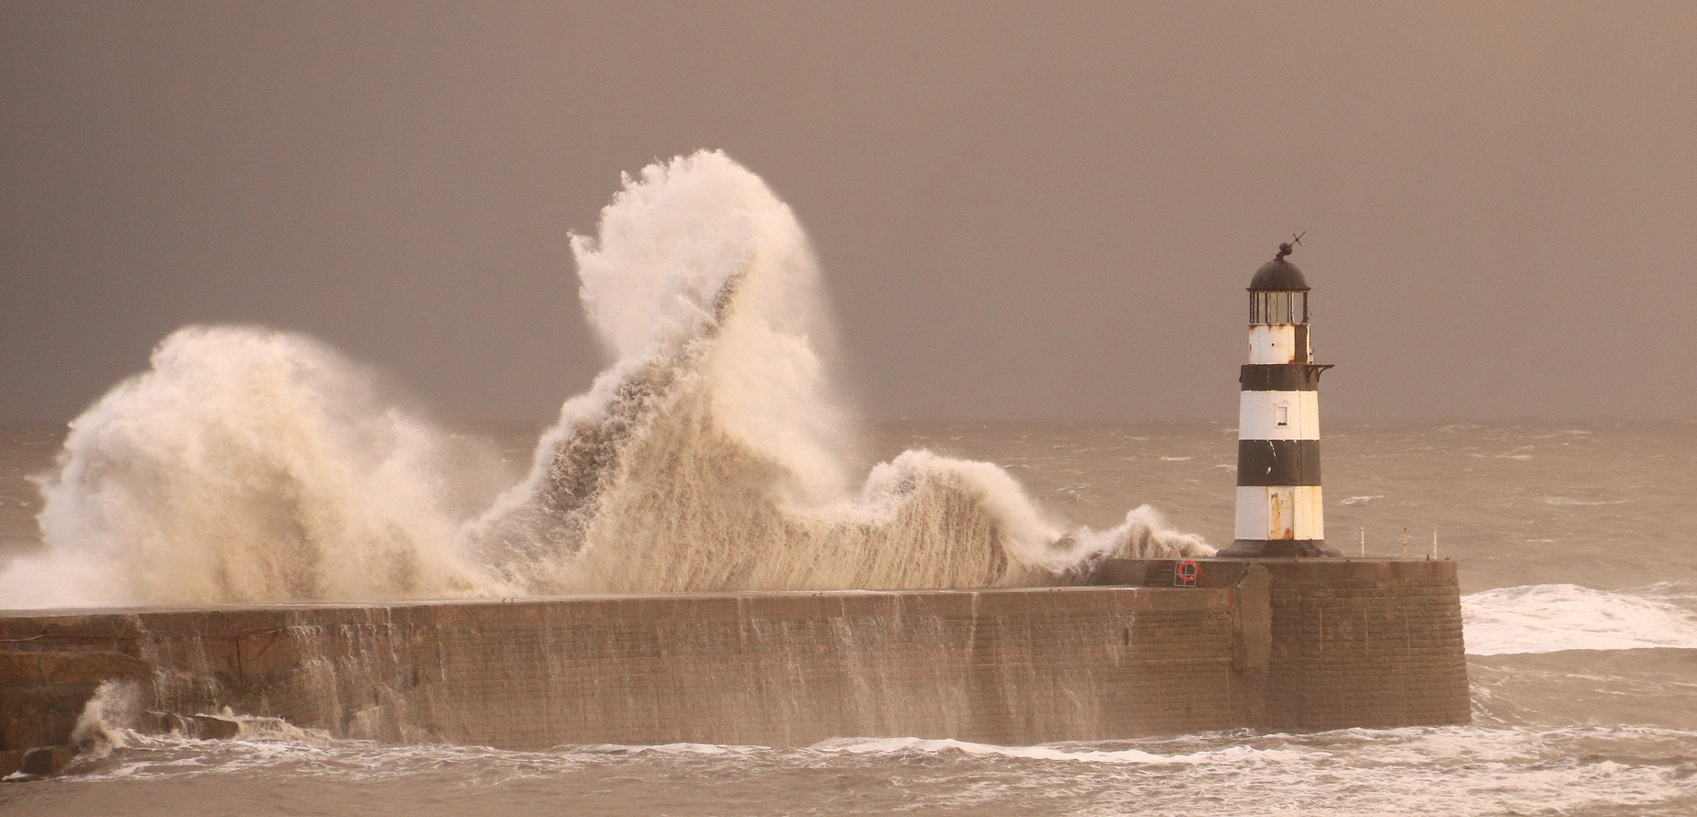
WHAT CAN WE DO?
To reduce impacts from climate change that we cannot avoid:
  Create coastal defence barriers
  Plant native plant species that can help reduce flooding
  Re-meander rivers to reduce flooding
  Create ‘cool’ spaces in cities, with concrete holding on to heat, cities will begin to get hotter as our gobal temperature rises!

Slide 16
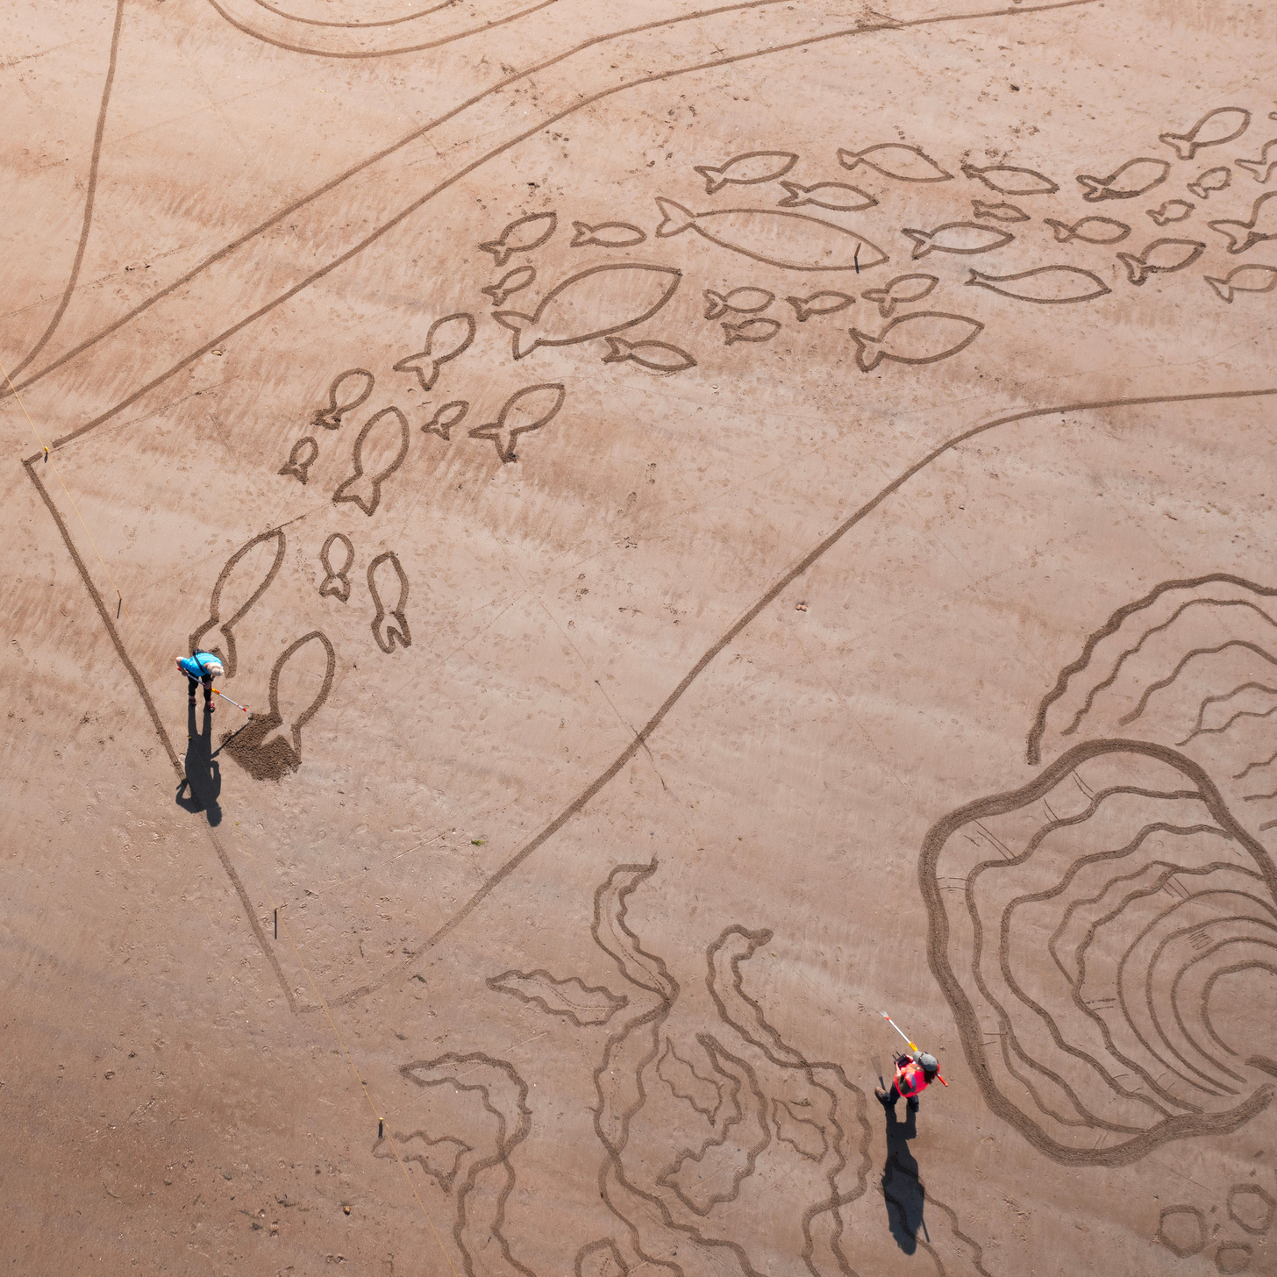
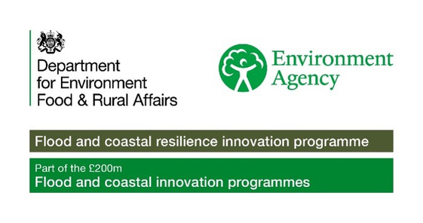

ACTIVITY TIME
In this section you can now complete the associated quiz, and can do the activity in the accompanying pdf!

