Slide 1

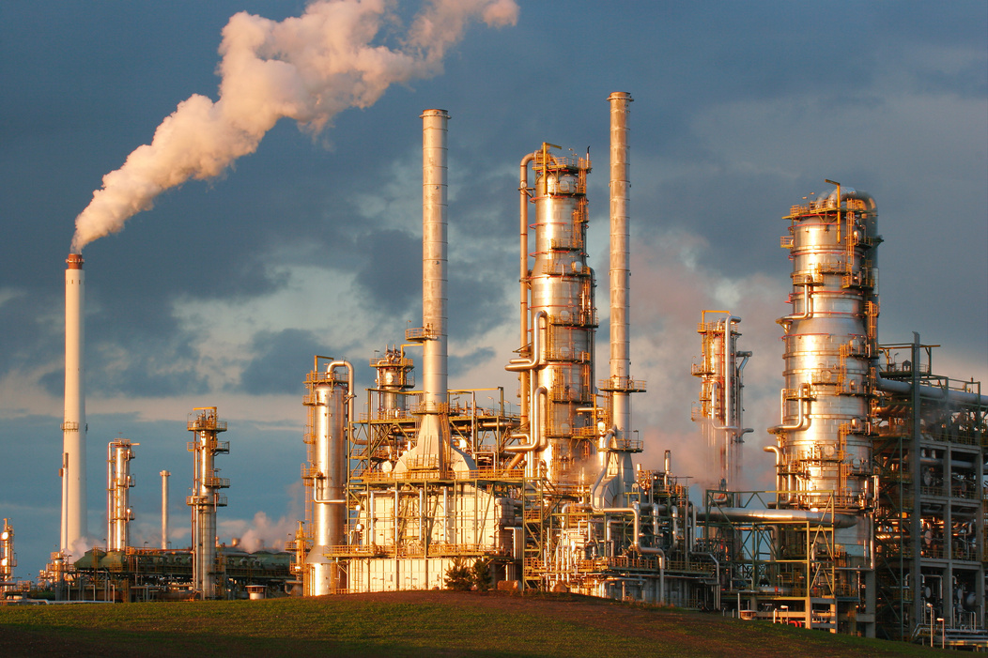
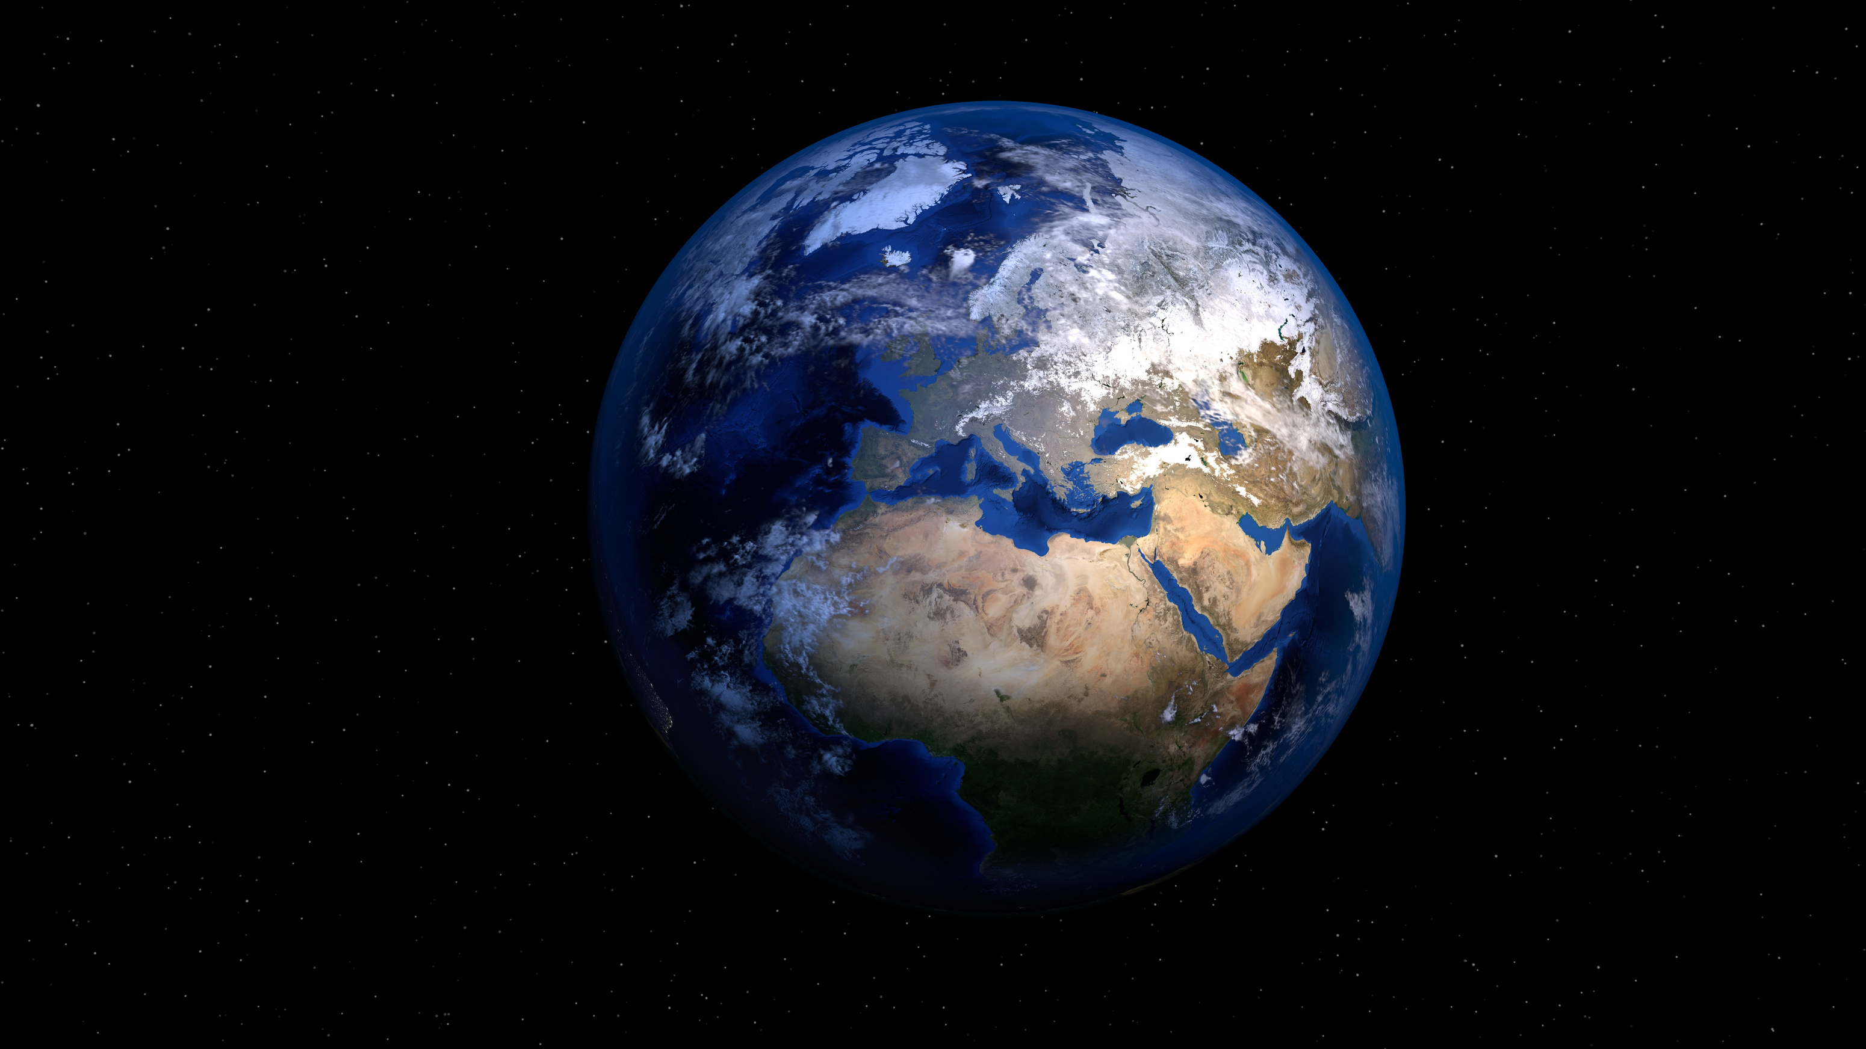
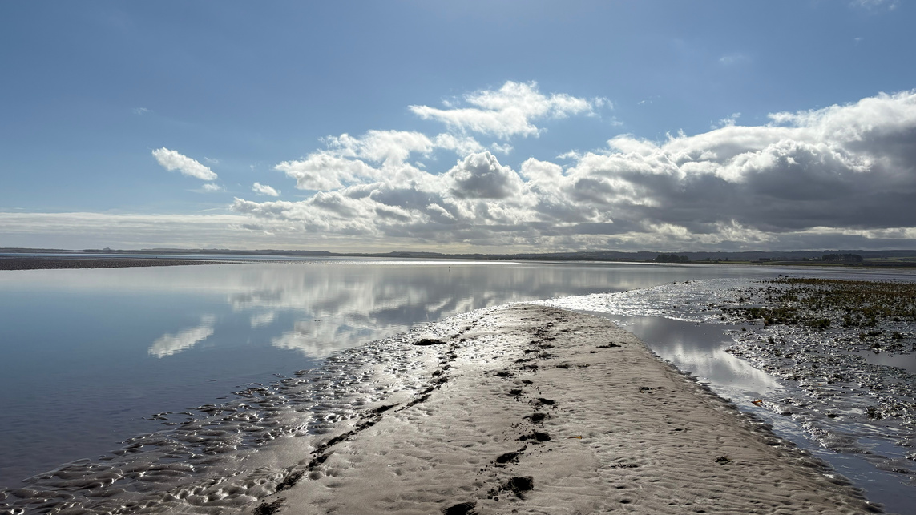

CLIMATE
CHANGE
Explore how humans are affecting our planet...

Slide 2
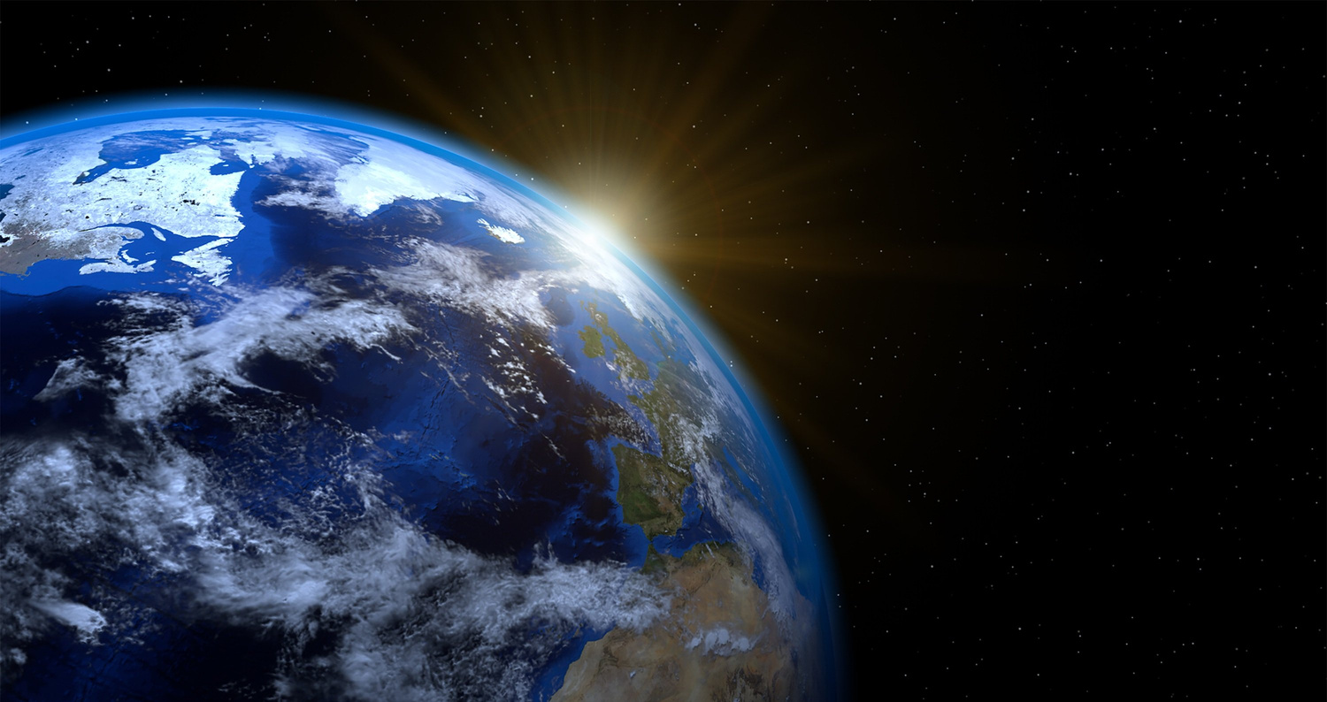
LEARNING OUTCOMES
By the end of this presentation you will have learned:
  What climate is
  How humans are changing the climate
  What impacts this is causing our planet
  How humans are working to protect our planet from climate change

Slide 3
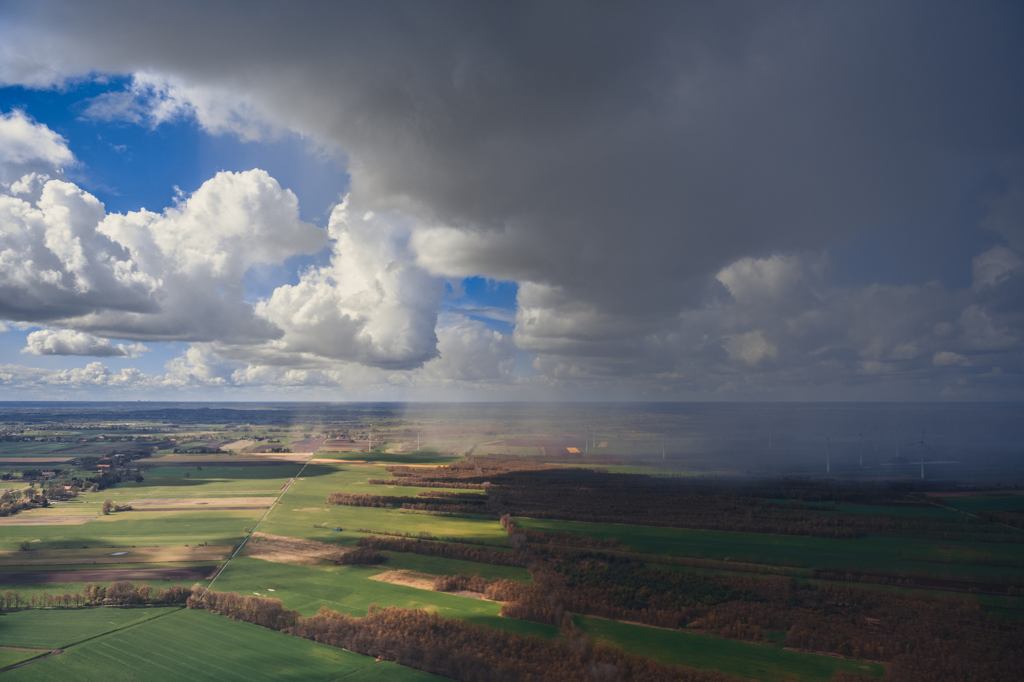
WHAT IS CLIMATE?
An area’s climate is decided by an average of the temperature throughout the year, as well as its rainfall and other weather conditions, such as snow, wind etc.

Slide 4
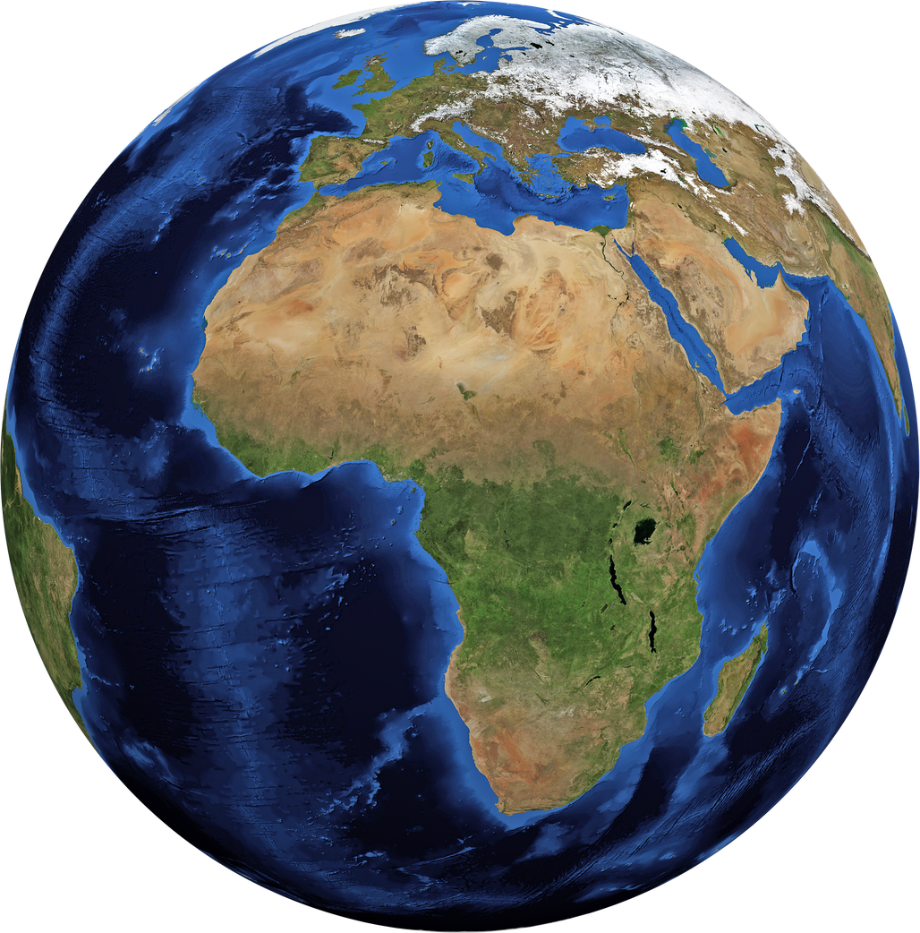
CLIMATE ZONES
We have 5 climate zones on planet Earth:
  Polar: Has very low temperatures on average.
  Temperate: Edge of continents with warm summers and cold winters.
  Continental: Inland areas away from coast with warm summers and cold winters.
  Dry: Low Rainfall year round.
  Tropical: Warm year round

Slide 5
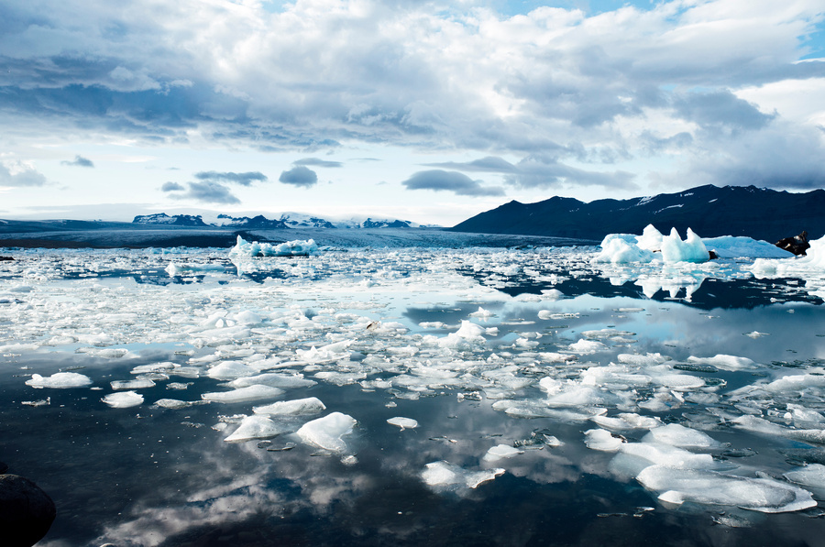
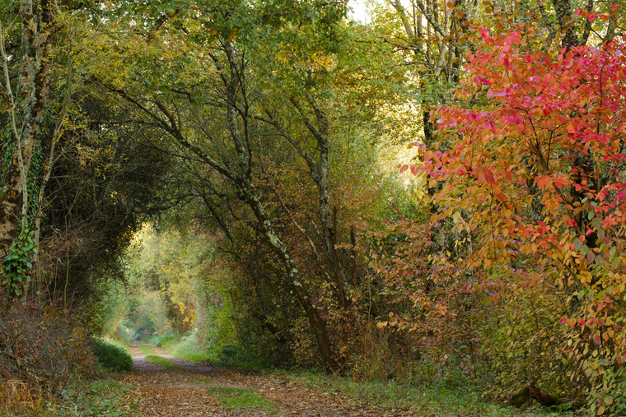
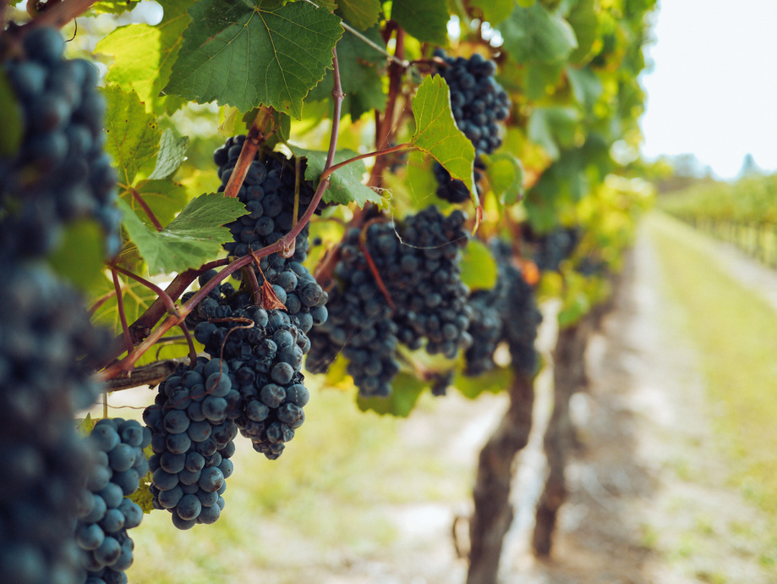
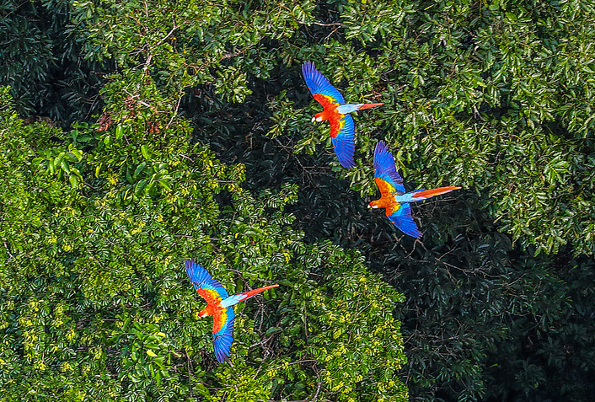
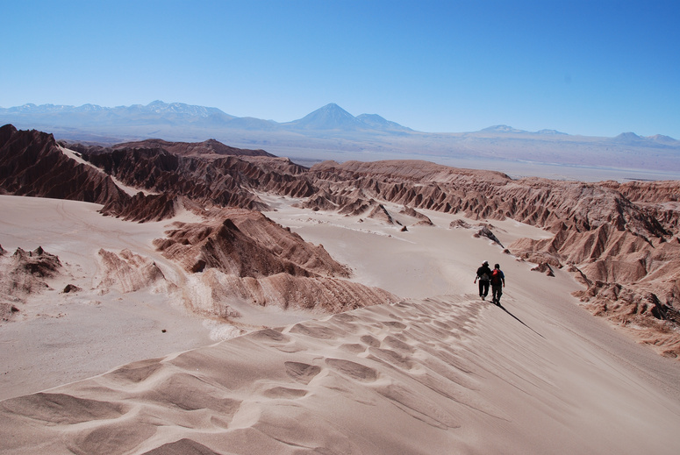
ACTIVITY
Although we have only listed five main climate zones, there are many sub-categories. Let’s focus on the five we just explored.
Can you match the different areas to the correct climate zone?
  Polar
  Dry
  Temperate
  Continental
  Tropical
Arctic Circle
United Kingdom
Eastern France
Amazon River Basin
Atacama Desert

Slide 6
ACTIVITY
Arctic Circle
United Kingdom
Eastern France
Amazon River Basin
Atacama desert
Polar
Temperate
Continental
Tropical
Dry
HOW MANY DID YOU GET RIGHT?

Slide 7
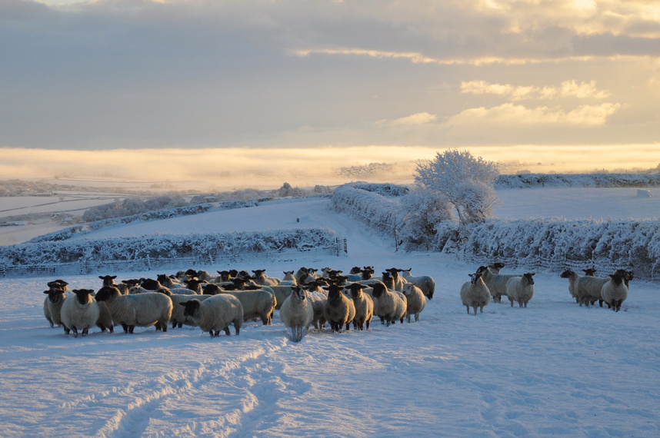
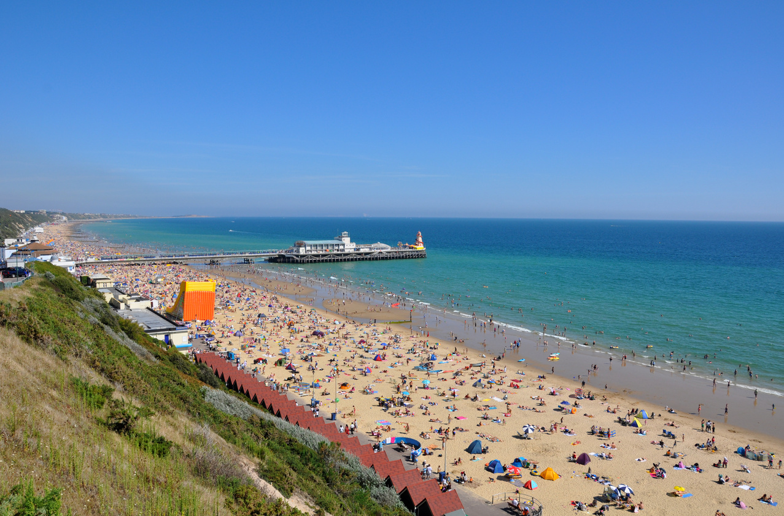
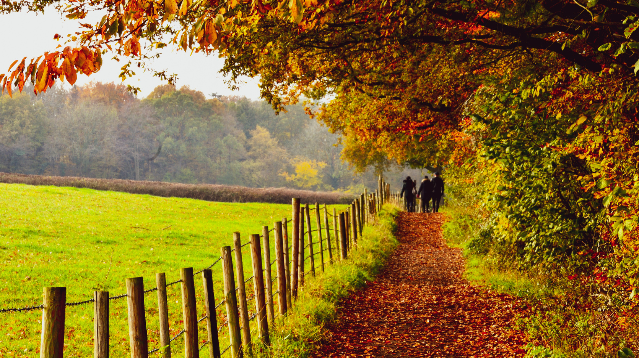
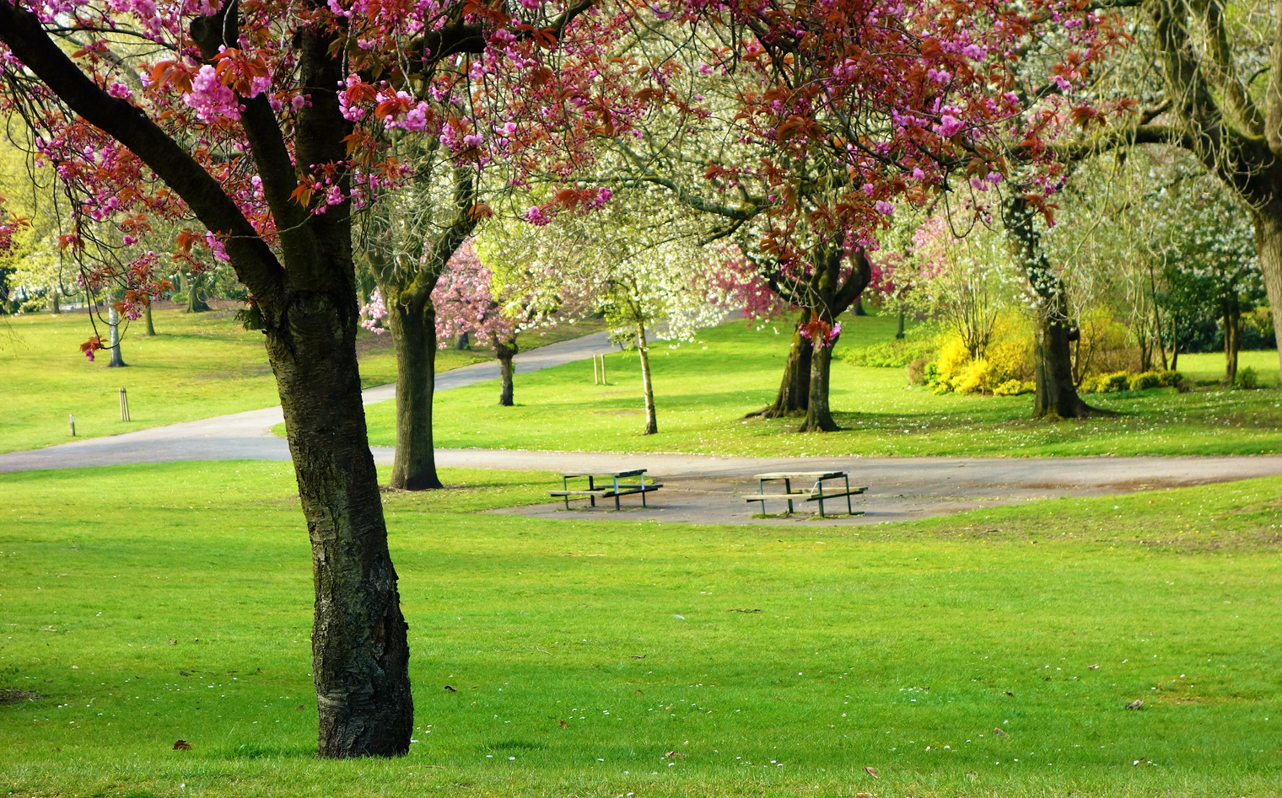
OUR CLIMATE
We live in a temperate climate, as our summers are warmer than 10 degrees Celsius, our winters warmer than -3 degrees Celsius, and we have four seasons throughout the year - spring, summer, autumn and winter!

Slide 8
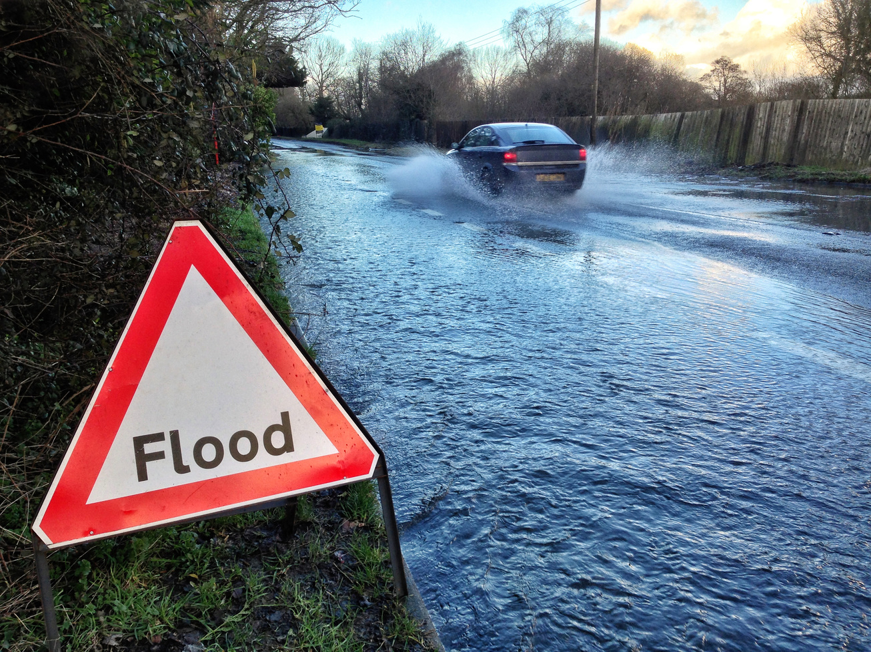
CLIMATE CHANGE
Our climates across the planet are changing because of humans, but how are we changing them, and why does it matter?

Slide 9
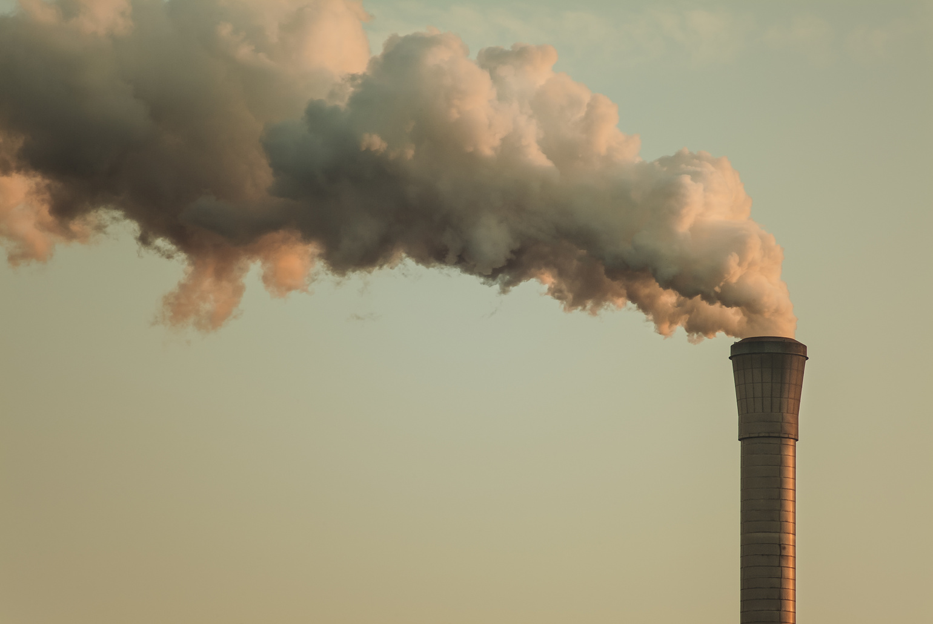
CLIMATE CHANGE
Our planet is becoming warmer, and that is because of what we call ‘greenhouse gases’.
These are gases in our air that trap heat from our sun, warming up our planet. Imagine these gases like a big blanket around Earth.

Slide 10
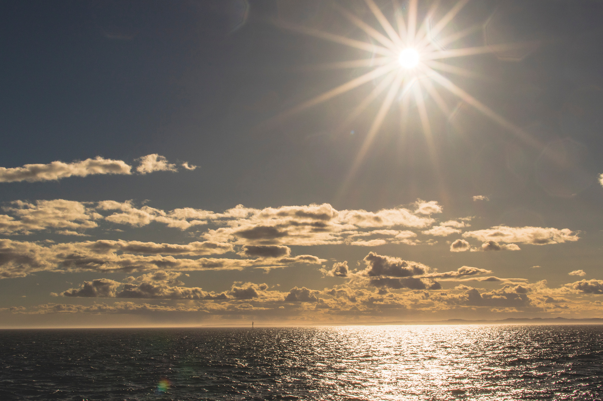
CLIMATE CHANGE
We need these gases to make our planet warm enough to live on, but too much can make our world too warm, which is bad for nature, including us.

Slide 11
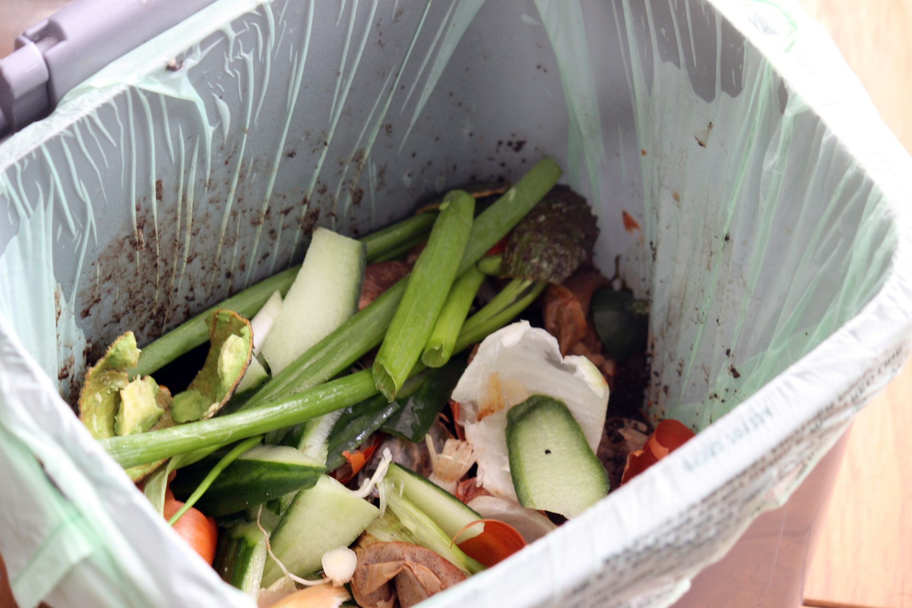
GREENHOUSE GASES
There are 5 main sources of greenhouse gases from human activity:
  Transport: Most transport requires fuel like petrol and diesel.
  Agriculture (especially gasses from cows)
  Electricity Production: We get electricity from burning fossil fuels like coal and gas.
  Waste from homes and heating homes
  Industry: Factories burn a lot of fossil fuels to make different products.

Slide 12
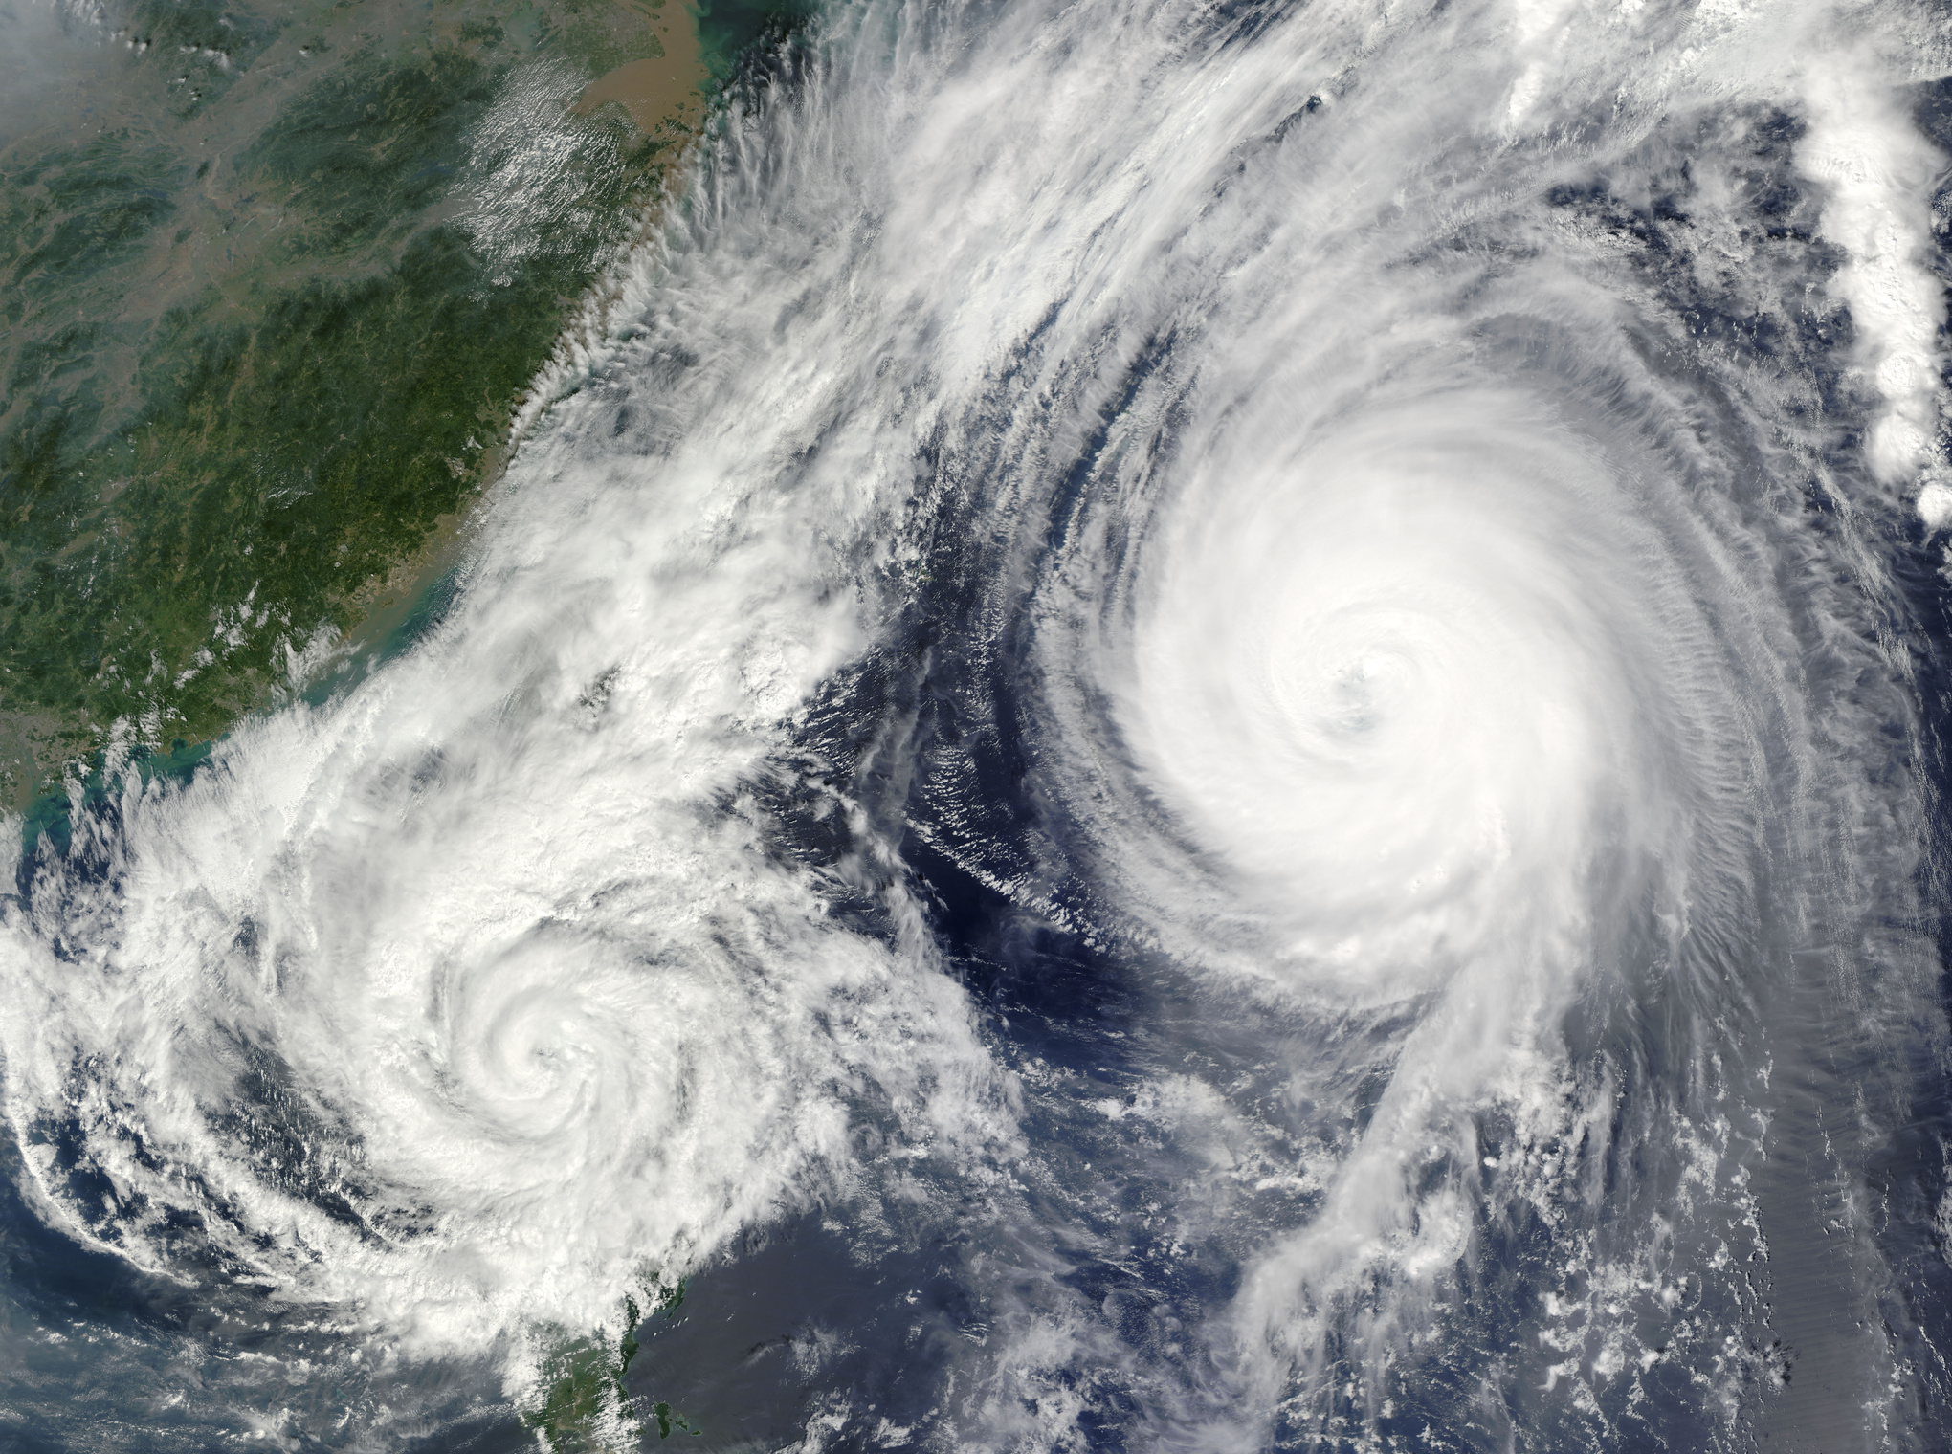
CLIMATE CHANGE
These greenhouse gases are affecting our world in many ways. More heat makes storms bigger, and it also helps to melt ice, which runs into the sea and raises sea levels.

Slide 13
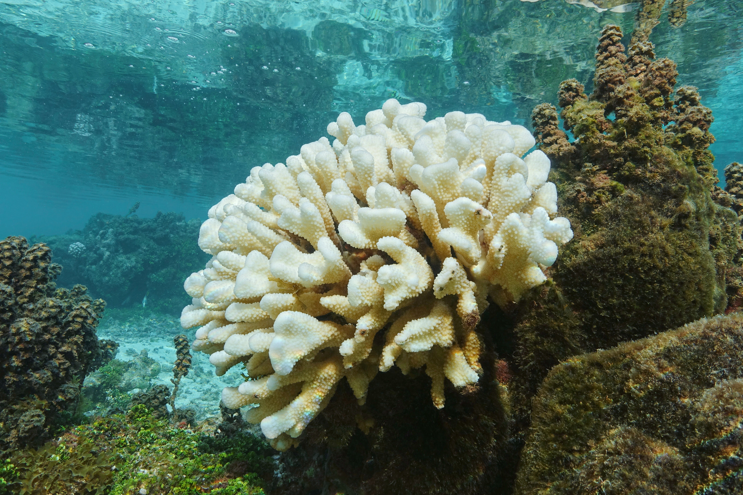
CLIMATE CHANGE
Our oceans help us by taking in a lot of this heat, but this leads to our oceans becoming warmer, which can be harmful to many species that live in the sea!

Slide 14
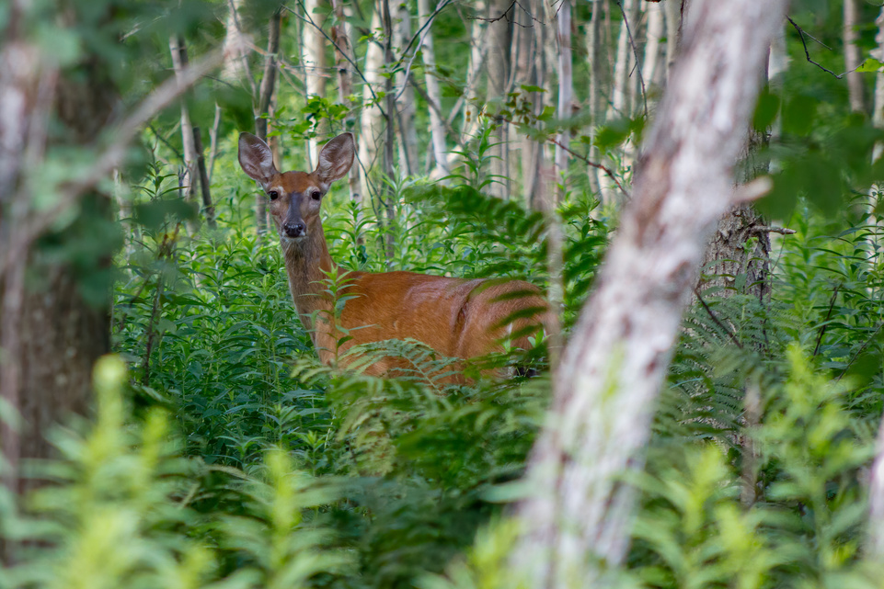
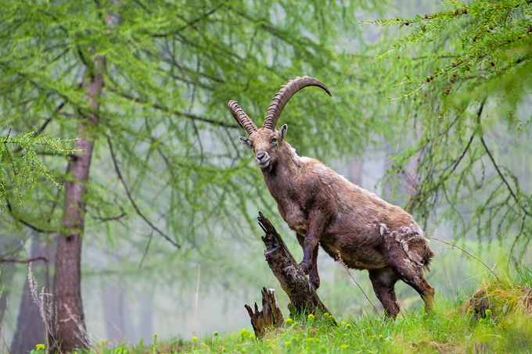
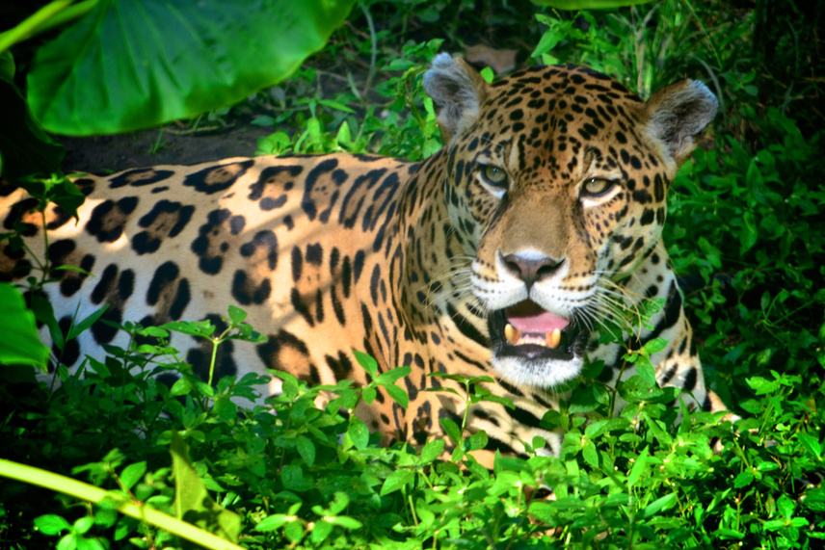
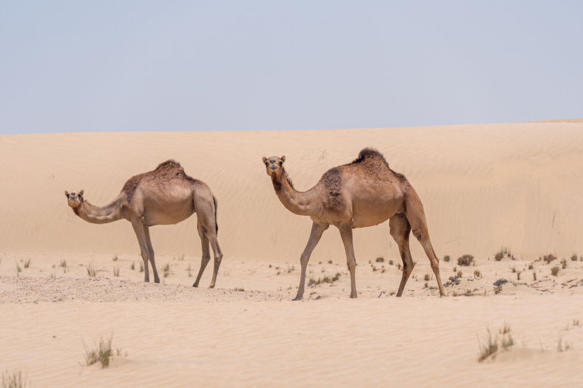
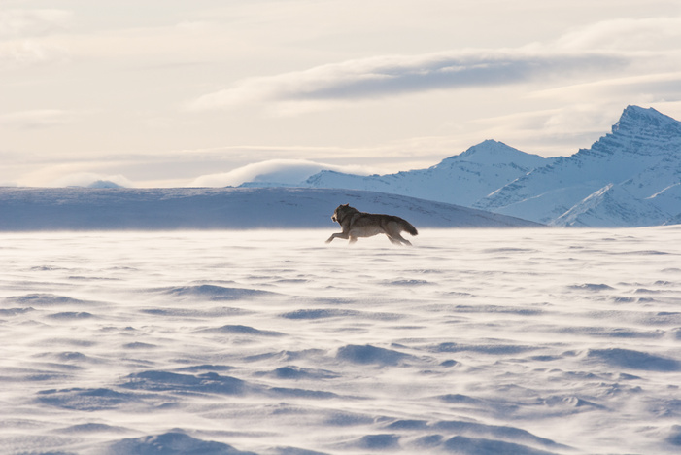
ACTIVITY
As our climate changes, this affects plants and animals that have evolved to survive in different climate zones - we call areas with plants and animals adapted to certain climate zones ‘biomes’!
Can you match the ‘biome’ to the climate zone?
Deciduous forest
Alpine coniferous forest
Rainforest
Continental
Temperate
Tropical
Desert Biome
Tundra
Dry
Polar

Slide 15
ACTIVITY
Deciduous forest
Desert Biome
Alpine coniferous forest
Tundra
Rainforest
Temperate
Dry
Continental
Polar
Tropical

Slide 16
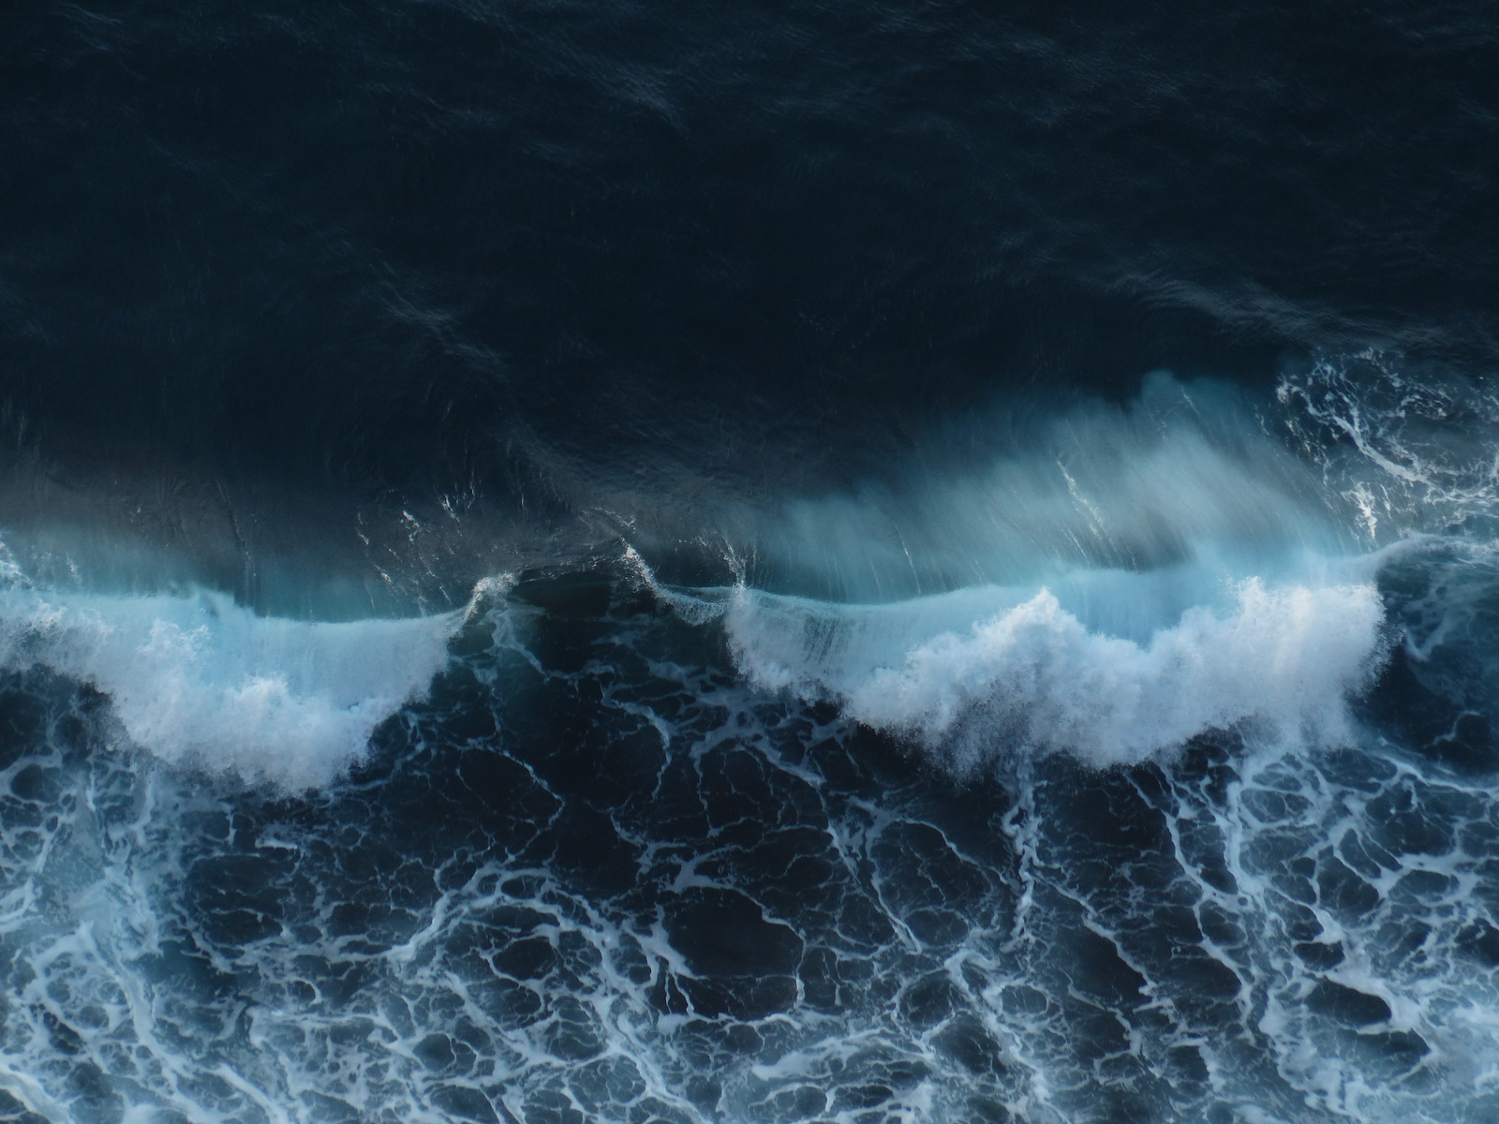
IMPACTS
Because of climate change, the UK is experiencing:
  Hotter, drier summers
  Warmer, wetter winters
  Larger storms
  Flooding
  Drought
All of this contributes towards a loss of habitat for nature!

Slide 17
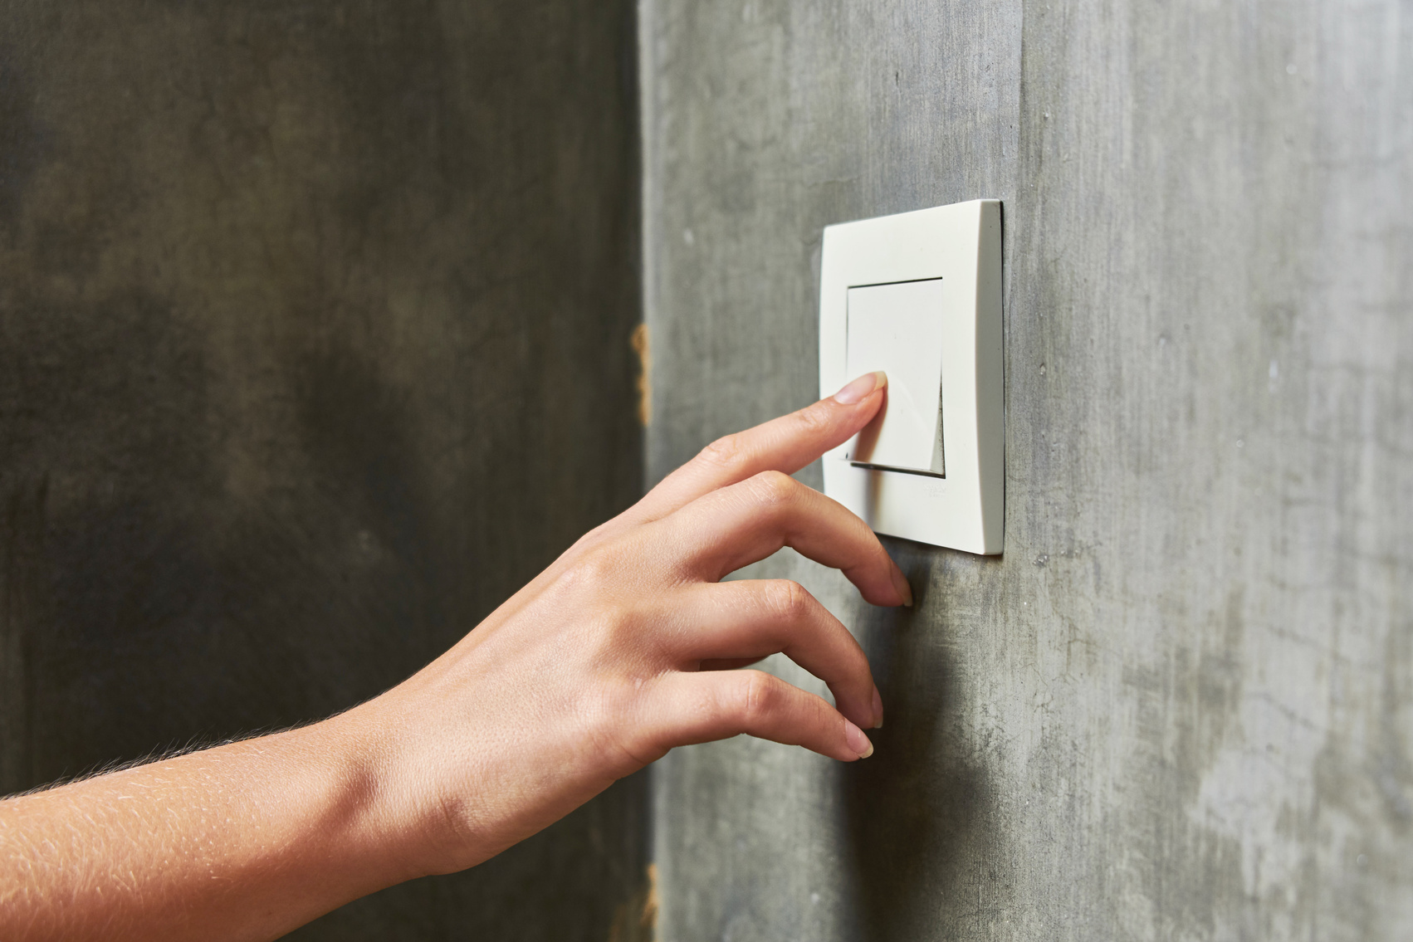
WHAT CAN WE DO?
Some impacts are already fixed in, and will happen even if we stopped creating any more greenhouse gases today, however, we can also work to reduce any further impacts!

Slide 18
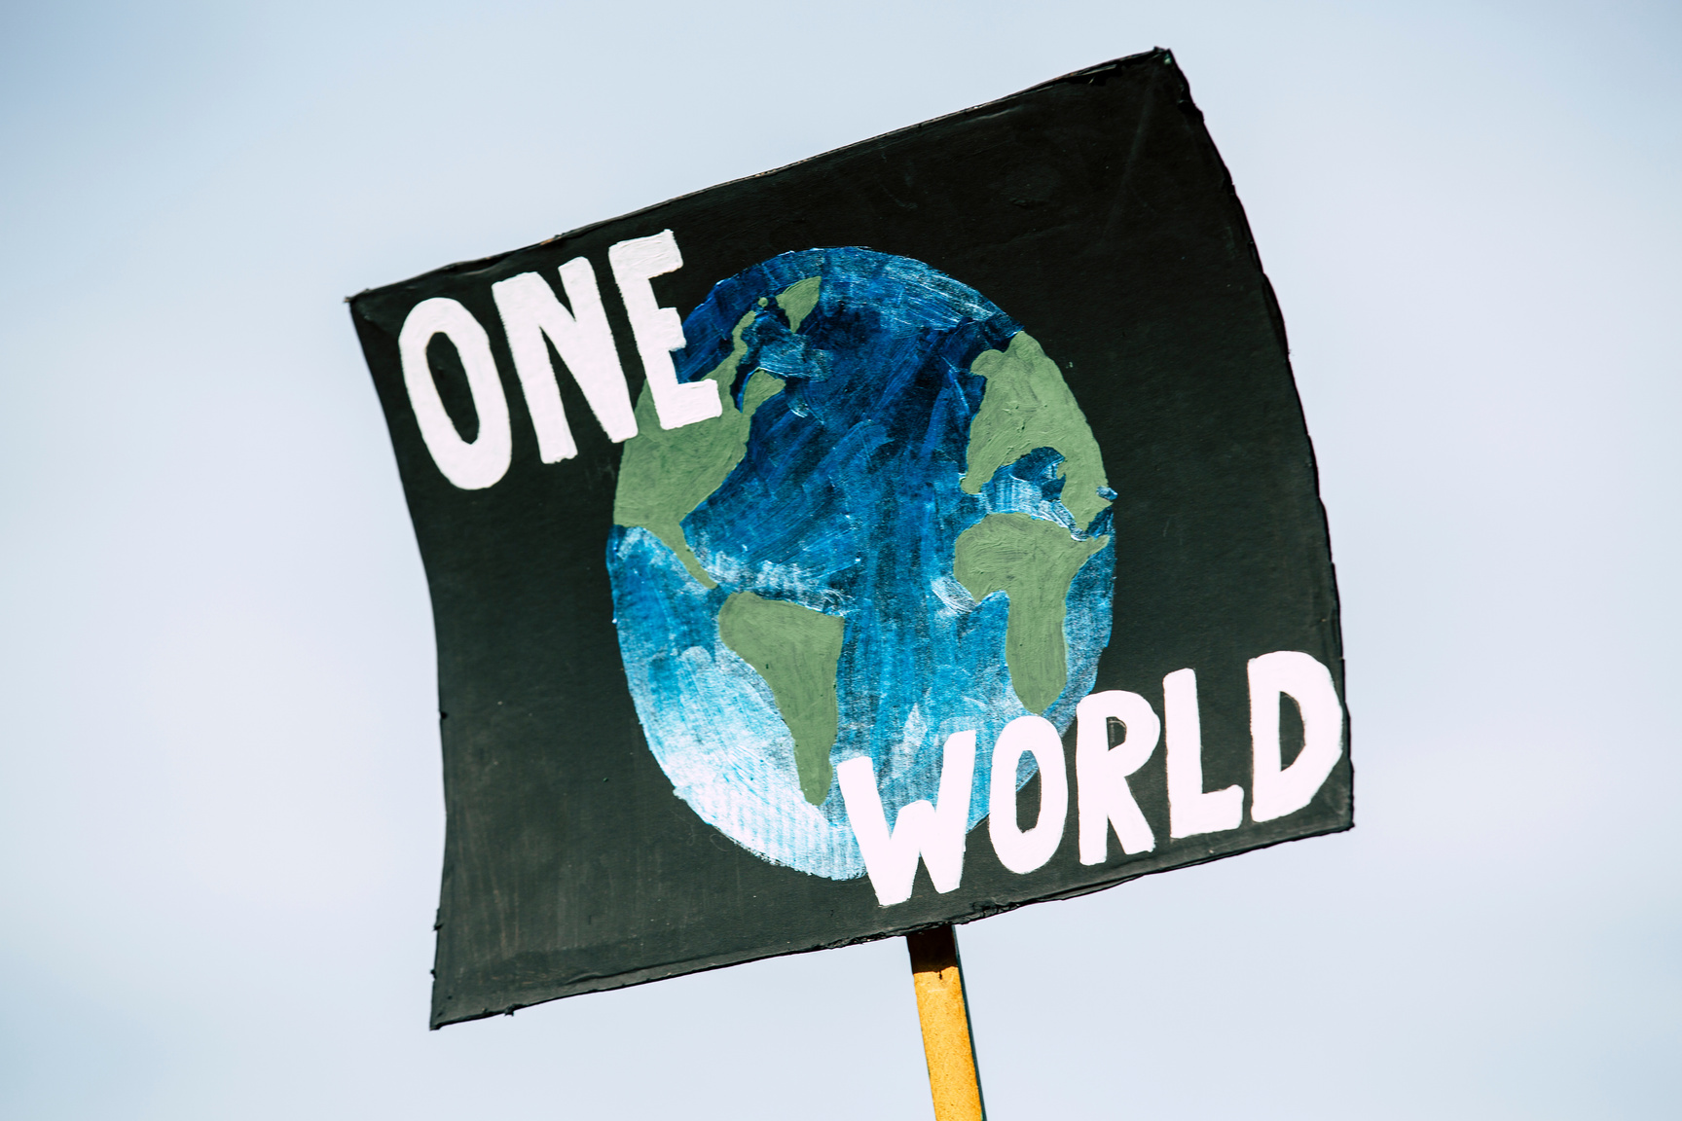
WHAT CAN WE DO?
Earlier in the presentation we saw where greenhouse gases came from, have a discussion and think about ways that we can reduce greenhouse gases from these sources.

Slide 19
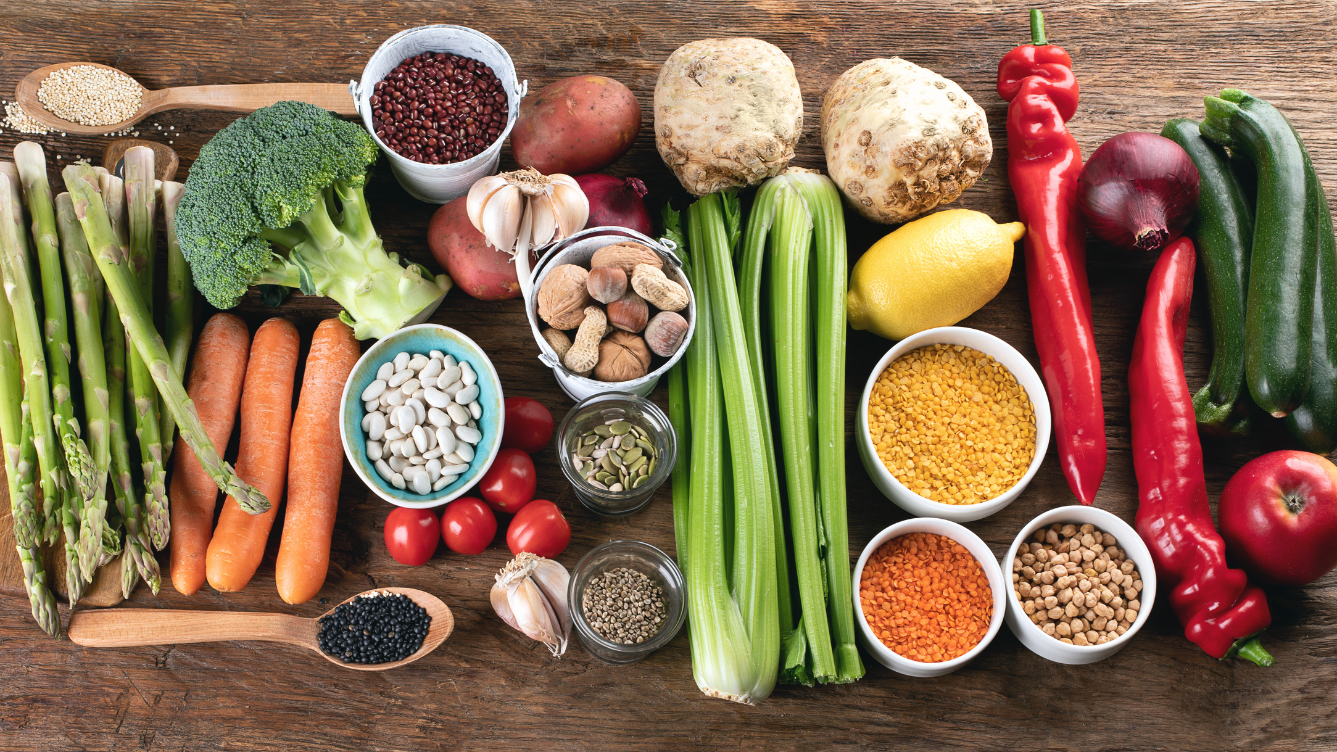
WHAT CAN WE DO?
To reduce greenhouse gases, we personally could:
  Eat less meat
  Walk or cycle when we can instead of using cars
  Lower our heating by a degree or two and wear a jumper

Slide 20
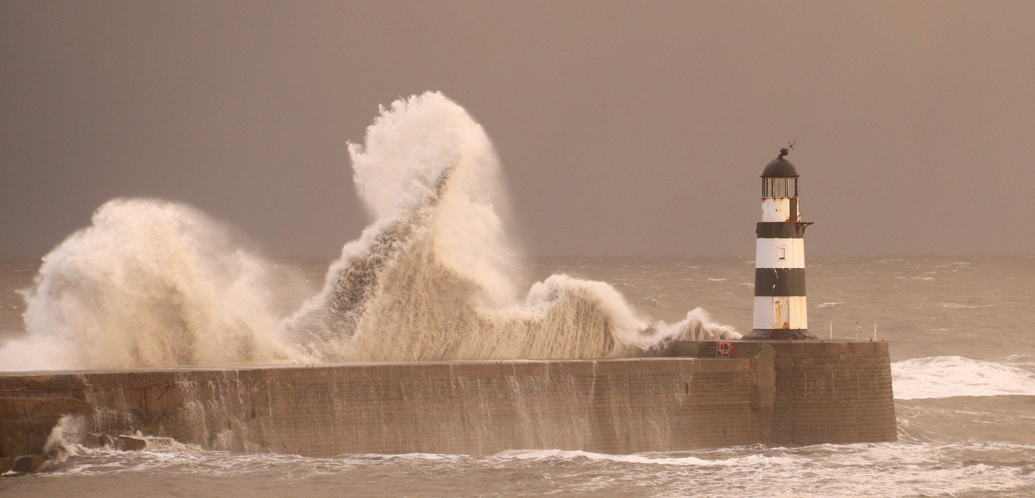
WHAT CAN WE DO?
To reduce impacts from climate change on a large scale we must:
  Use our voices to have governments commit to limiting the amount of greenhouse gases countries are allowed to produce
  Stop drilling for new oil
  Increase our use of renewable energy
  Keep exploring new ways to combat climate change through science

Slide 21
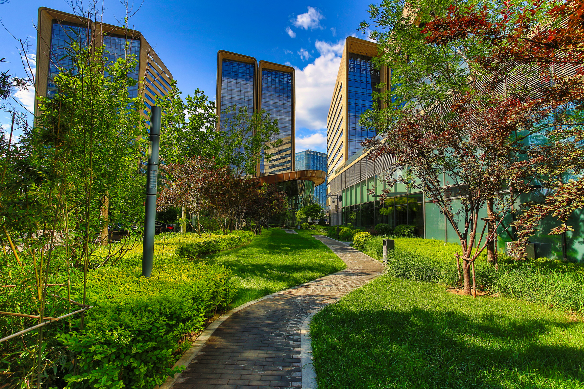
WHAT CAN WE DO?
To reduce impacts from climate change that we cannot avoid:
  Create coastal ‘hard engineering’ barriers
  Plant native plant species that can help reduce flooding
  Re-meander rivers to reduce flooding
  Create ‘cool’ spaces in cities, with concrete holding on to the most

Slide 22

GAME TIME
You will need: 5x blankets or jumpers.
Choose 1 person to be the Earth.
Call out 5 sources of greenhouse gases - every correct answer ‘Earth’ has to wear a blanket or jumper - it’s heating up!
Next, call out 5 ways to reduce greenhouse gases, every correct answer ‘Earth’ can remove a layer - we’re reducing our greenhouse gas emissions!

Slide 23
ANSWERS
Sources:
  Transport
  Home/ food waste
  Electricity production
  Industry
  Agriculture
Reducing greenhouse gases:
Walking instead of driving; eating less meat, not wasting food, turning off electrical appliances when not in use, reusing items and not buying things we don’t need; cycling; calling on businesses and governments to do more...

Slide 24
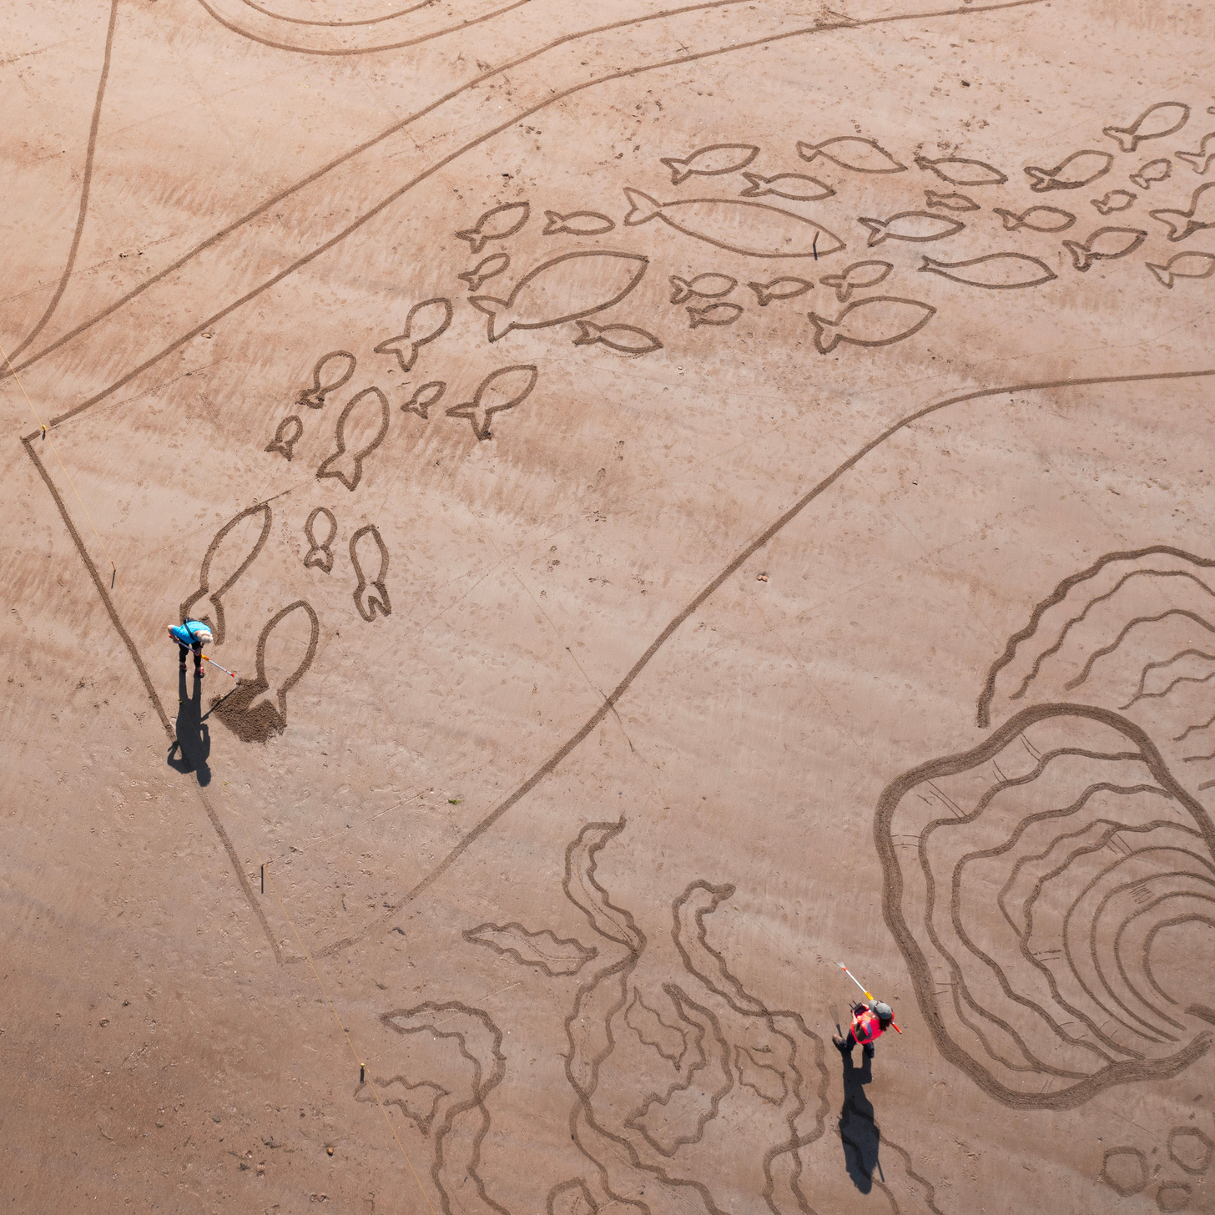


ACTIVITY TIME
In this section you can now complete the associated quiz, and can do the activity in the accompanying pdf!

