Slide 1



QUIZ TIME!
CLIMATE CHANGE

Slide 2

WHAT IS THE MAIN ELEMENT THAT MAKES UP OUR ATMOSPHERE ALONGSIDE OXYGEN?

Slide 3
WHAT IS THE MAIN ELEMENT THAT CONSTITUTES OUR ATMOSPHERE?
NITROGEN

Slide 4

WHAT ELEMENTS MAKE UP CARBON DIOXIDE, AND HOW MANY OF EACH ATOM ARE THERE?

Slide 5
WHAT ELEMENTS MAKE UP CARBON DIOXIDE, AND HOW MANY OF EACH ATOM ARE THERE?
TWO OXYGEN & ONE CARBON

Slide 6

WHAT SOURCE OF GREENHOUSE GASES IS THE LARGEST CONTRIBUTOR?
A) ELECTRICITY & HEAT PRODUCTION
B) TRANSPORT
C) AGRICULTURE
D) FORESTRY
E) MANUFACTURING

Slide 7
WHAT SOURCE OF GREENHOUSE GASES IS THE LARGEST CONTRIBUTOR?
A) ELECTRICITY & HEAT PRODUCTION

Slide 8
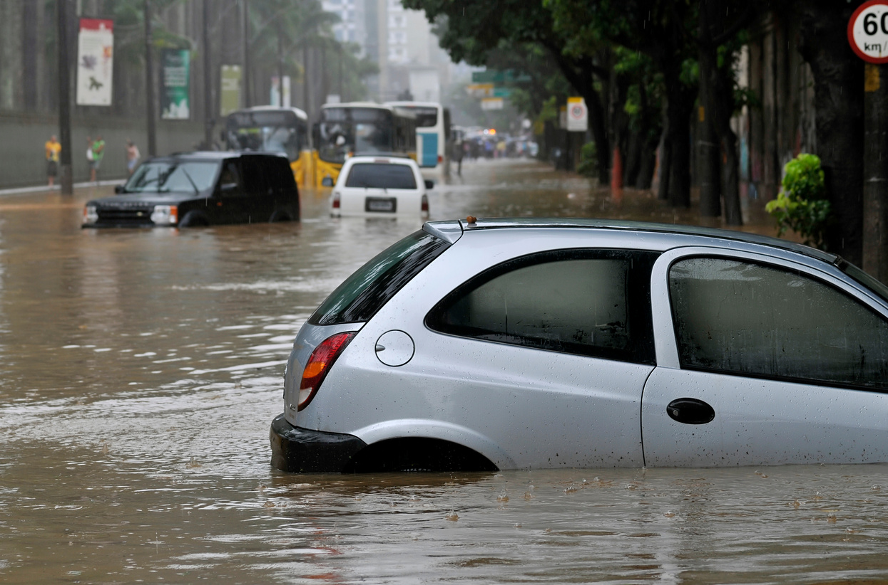
LIST A WAY WE CAN REDUCE IMPACTS FROM CLIMATE CHANGE THAT WE CAN NOT AVOID:

Slide 9
LIST A WAY WE CAN REDUCE IMPACTS FROM CLIMATE CHANGE THAT WE CAN NOT AVOID:
  CREATE COASTAL ‘HARD ENGINEERING’ BARRIERS
  PLANT NATIVE PLANT SPECIES THAT CAN HELP REDUCE FLOODING
  RE-MEANDER RIVERS TO REDUCE FLOODING
  CREATE ‘COOL’ SPACES IN CITIES, WITH CONCRETE HOLDING ON TO THE MOST

Slide 10

IN THE VIDEO, WHAT WAS SAID TO STORE HEAT TO A MUCH GREATER DEGREE THAN AIR?

Slide 11
IN THE VIDEO, WHAT WAS SAID TO STORE HEAT TO A MUCH GREATER DEGREE THAN AIR?
WATER

Slide 12
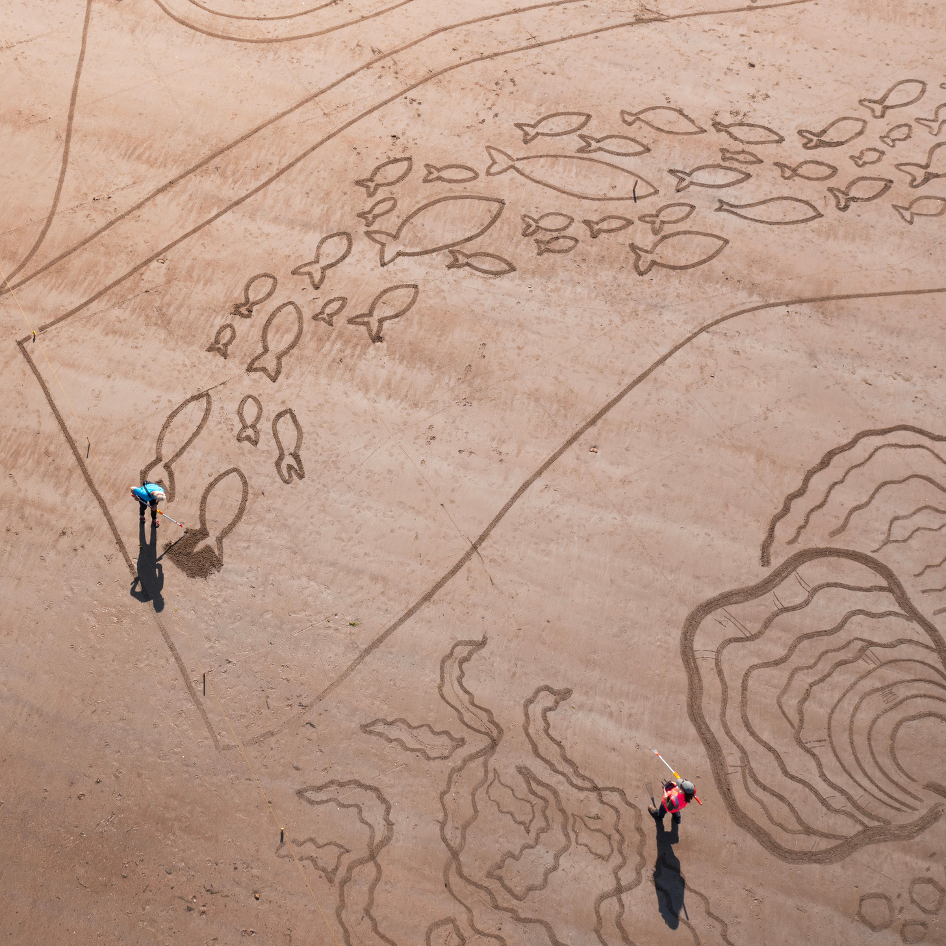
WHAT CAN WE DO COLLECTIVELY TO REDUCE GREENHOUSE GAS EMISSIONS?

Slide 13
WHAT CAN WE DO COLLECTIVELY TO REDUCE GREENHOUSE GAS EMISSIONS?
Move to renewable energy
Expand our use of public transport
Promote meat and dairy alternatives
Properly insulate homes
Innovating: scientists are always researching new ways to reduce our reliance on fossil fuels!

Slide 14



To find out more about Stronger Shores follow the link in the QR code to visit our StoryMap, or go to:
https://storymaps.arcgis.com/stories/7da0c07ee3d245c9b273c6538bf0e1db

