Slide 1

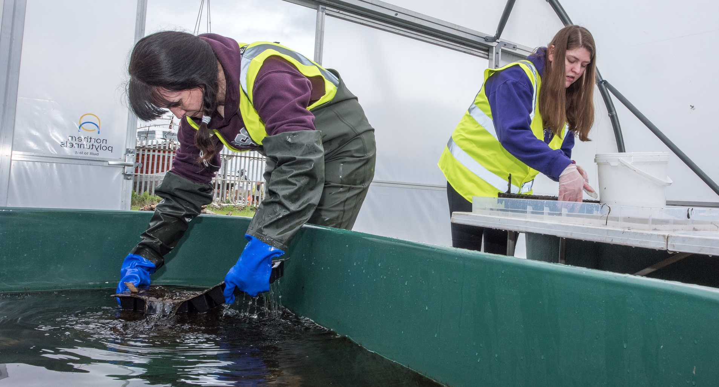

CAREERS
Explore the careers available in conservation!

Slide 2
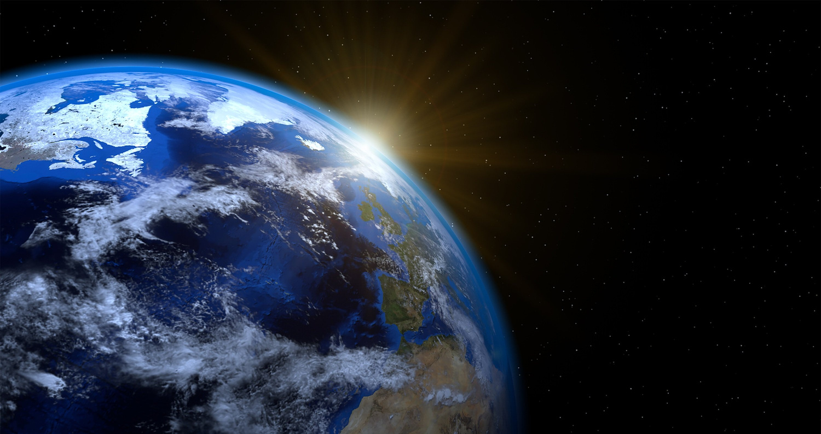
LEARNING OUTCOMES
By the end of this presentation you will have learned:
  Why conservation work is important.
  What types of jobs there are in conservation work.
  Why we need lots of different types of people to make a project successful.
  What working in conservation is like.

Slide 3
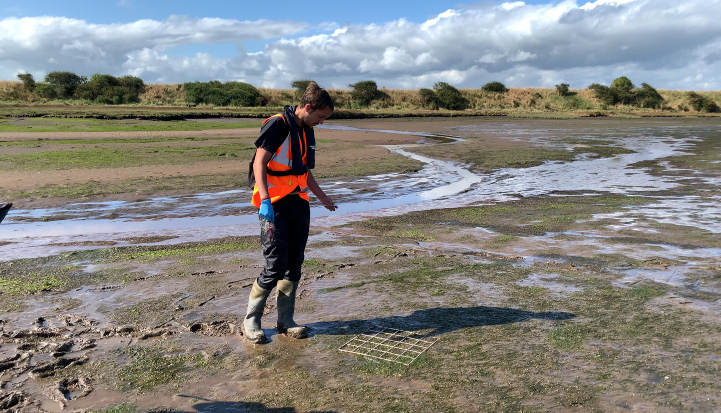
WHY DO PEOPLE WORK IN CONSERVATION?
Conservation work is really rewarding, and there are so many ways that people can get involved in helping to protect our natural world!

Slide 4
WHO CAN WORK IN CONSERVATION?
Anyone! Having a wide variety of different people is brilliant in any workplace, but especially in conservation! We need people with different ideas, different skills, and different ways of thinking to help us come up with creative ways to succeed...

Slide 5
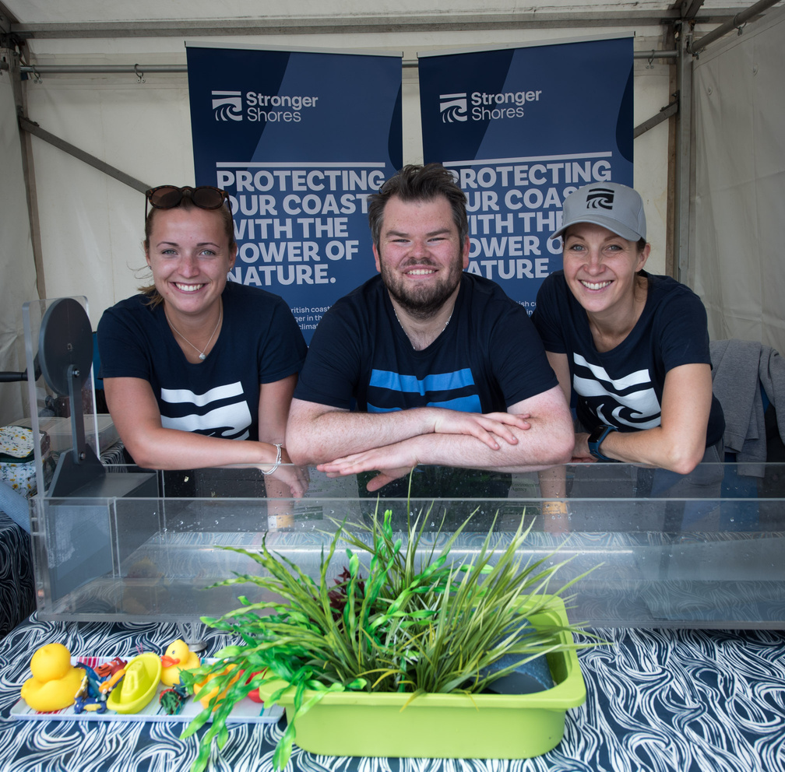
WHAT TYPES OF JOBS ARE THERE IN CONSERVATION?
We’ve met some of the team in Stronger Shores in the ‘careers’ video, so let’s delve a little deeper into the different types of jobs!

Slide 6
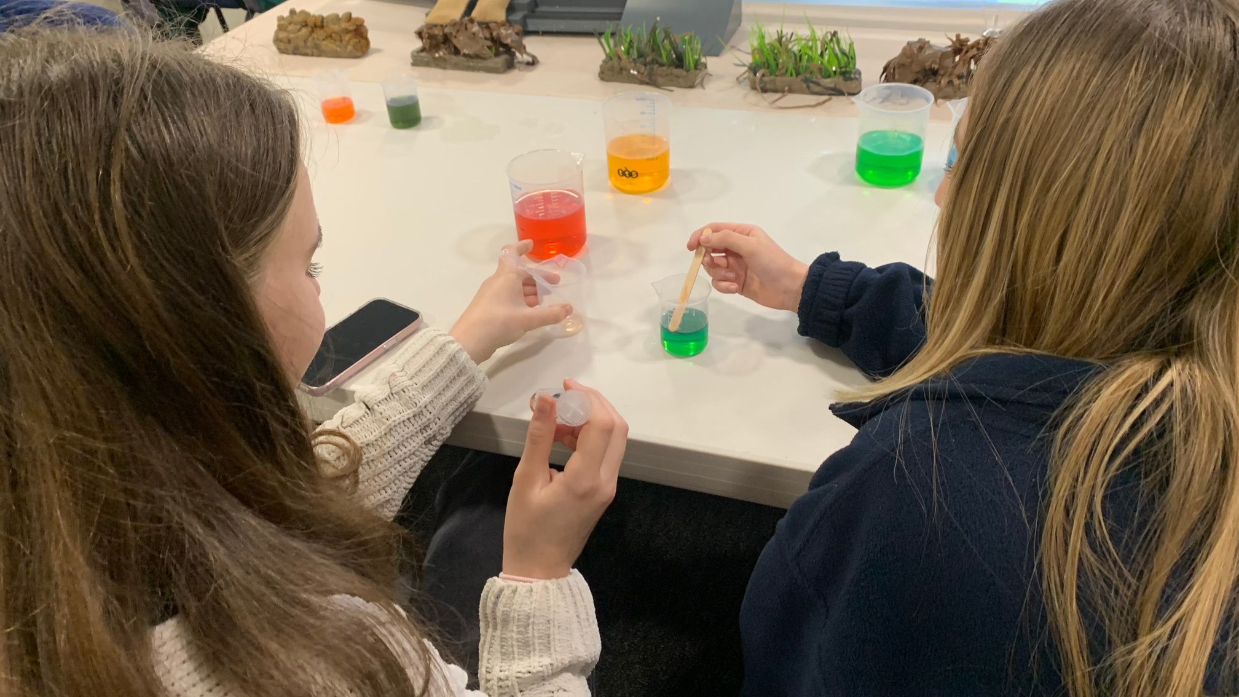
RESEARCHER
Researchers, also known as scientists, answer questions about the world around them. No question is too big or too small! They then have to figure out a way to answer that question while gathering proof to support their answer...

Slide 7
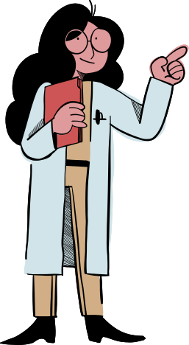
RESEARCHER
Researchers first find out what questions need answers: Do they want to understand how to slow down erosion? Do they want to explore how many oysters it would take to clean the water at a certain location?

Slide 8
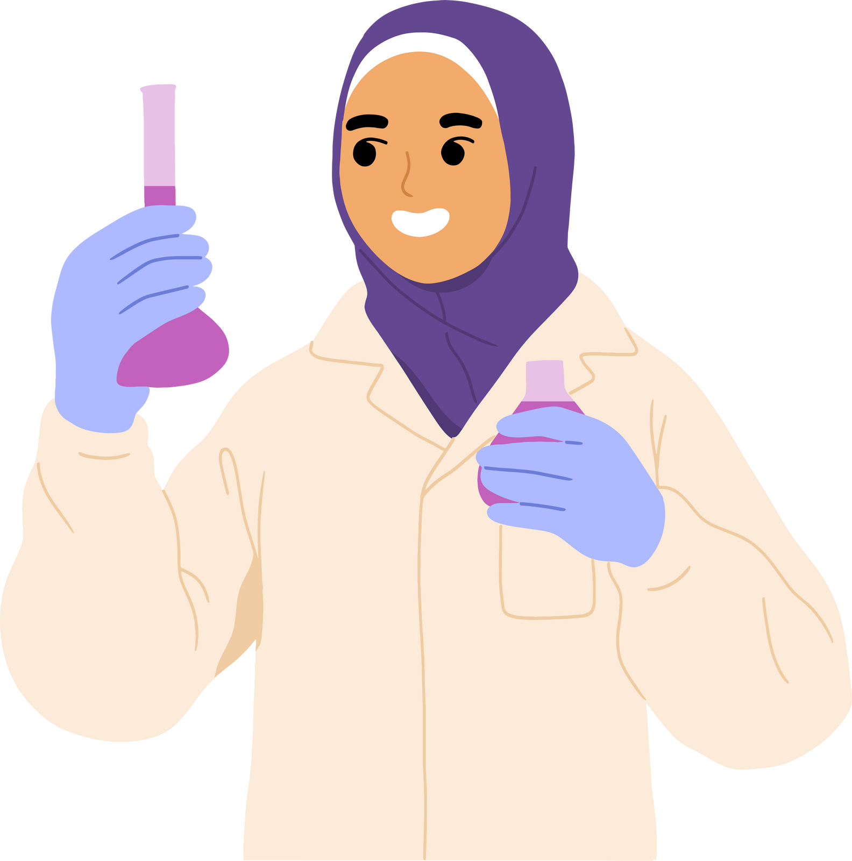
RESEARCHER
They must then suggest what they think the answer is - this is called a hypothesis!
Once they have done this, they must figure out how to test whether their ‘hypothesis’ is correct - they figure out what they need to do an experiment - almost like writing out a recipe!

Slide 9
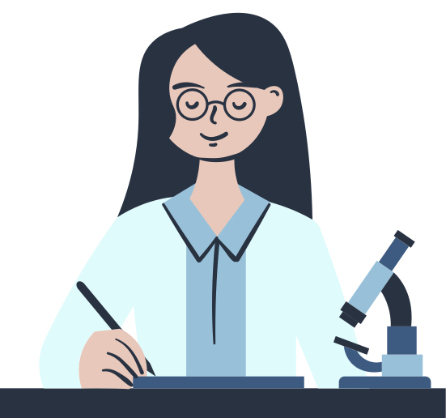
RESEARCHER
Once they do their experiment, they record what they find, the results, and they investigate what that tells them, for example, if they found water with oysters in it was always cleaner than water without, that would suggest the oysters are cleaning the water!

Slide 10
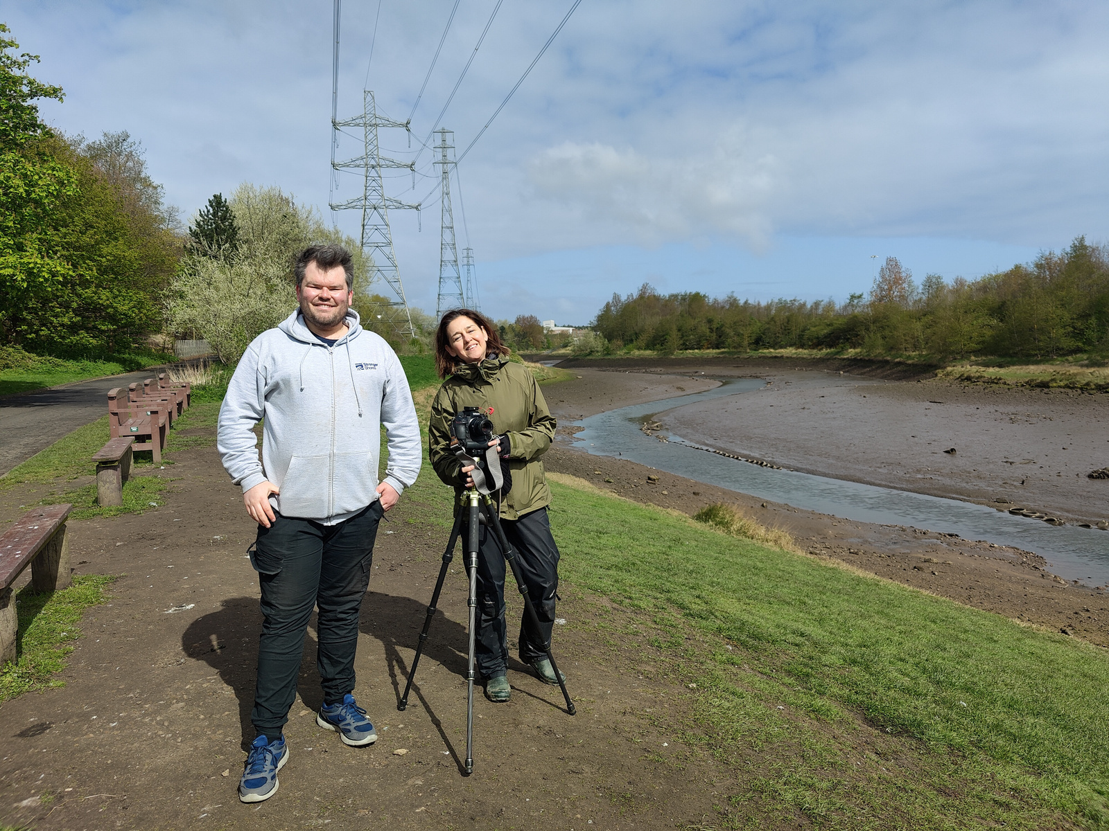
COMMUNICATOR
Science is incredibly important, but so is telling people about it! How else could we use the information that we discover? Science communicators are people who love science, and can find ways to tell people about it creatively, to help others understand. They can do this in so many ways, for example through films, art, writing, and even games!

Slide 11
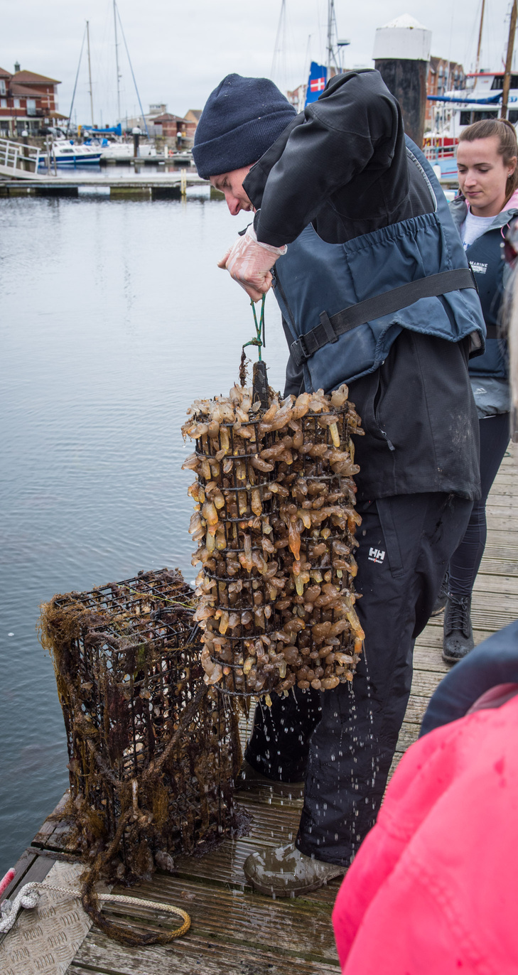
CONSERVATIONIST
Conservationists are scientists, but more often they put the science into action as well, using what science tells us to inform how best to protect, and even restore our natural world! From trudging through mud to snorkelling, from heading out on the boat to sitting at the desk and looking at maps, it’s a varied and fun job!

Slide 12
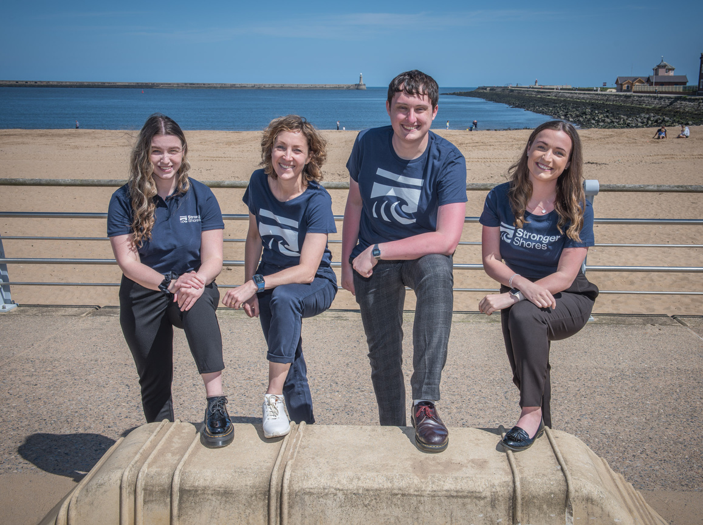
PROJECT TEAM
All of these roles are important, but to bring them together and make use of these roles and their skills requires a project team, people to oversee the job, to take charge, and oversee spending money.

Slide 13
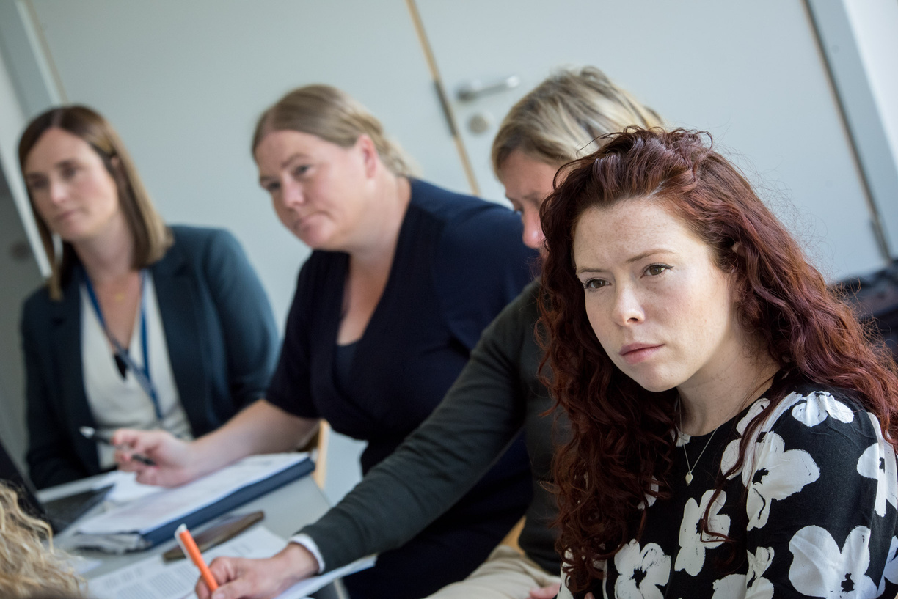
PROJECT TEAM
Project management should be able to reach out and build relationships between the scientists, conservationists and communicators, so everyone can work well together.

Slide 14
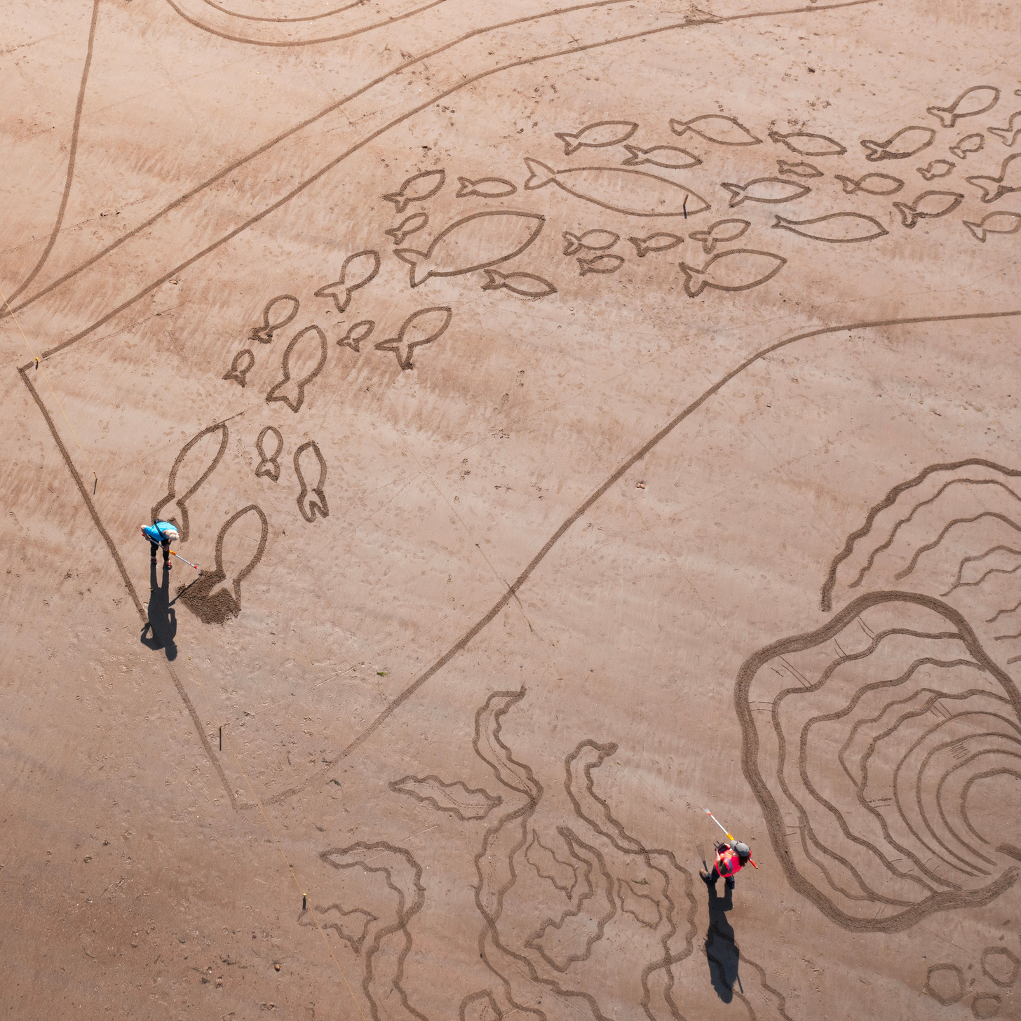
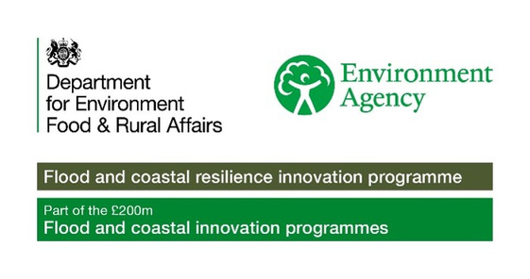

ACTIVITY TIME
In this section you can now complete the associated quiz, and can do the activity in the accompanying pdf!

