Slide 1

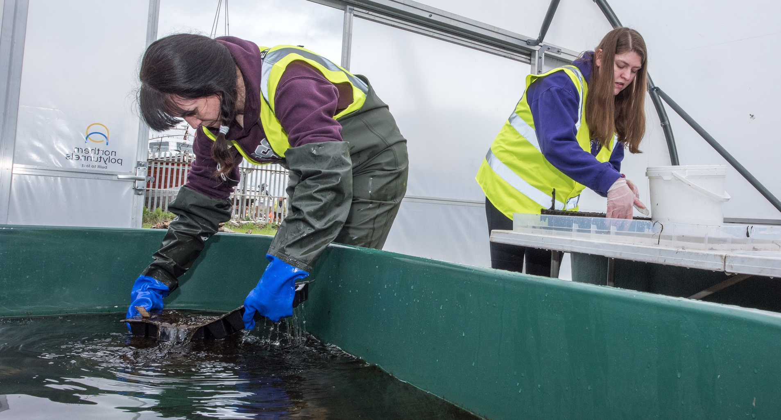

QUIZ TIME!
CAREERS

Slide 2

ACCORDING TO UCAS, WHAT IS THE ESTIMATED AVERAGE SALARY FOR SOMEONE IN CONSERVATION?
A)£18,000
B)£25,500
C)£31,320
D)£45,890

Slide 3
ACCORDING TO UCAS, WHAT IS THE ESTIMATED AVERAGE SALARY FOR SOMEONE IN CONSERVATION?
C)31,320

Slide 4
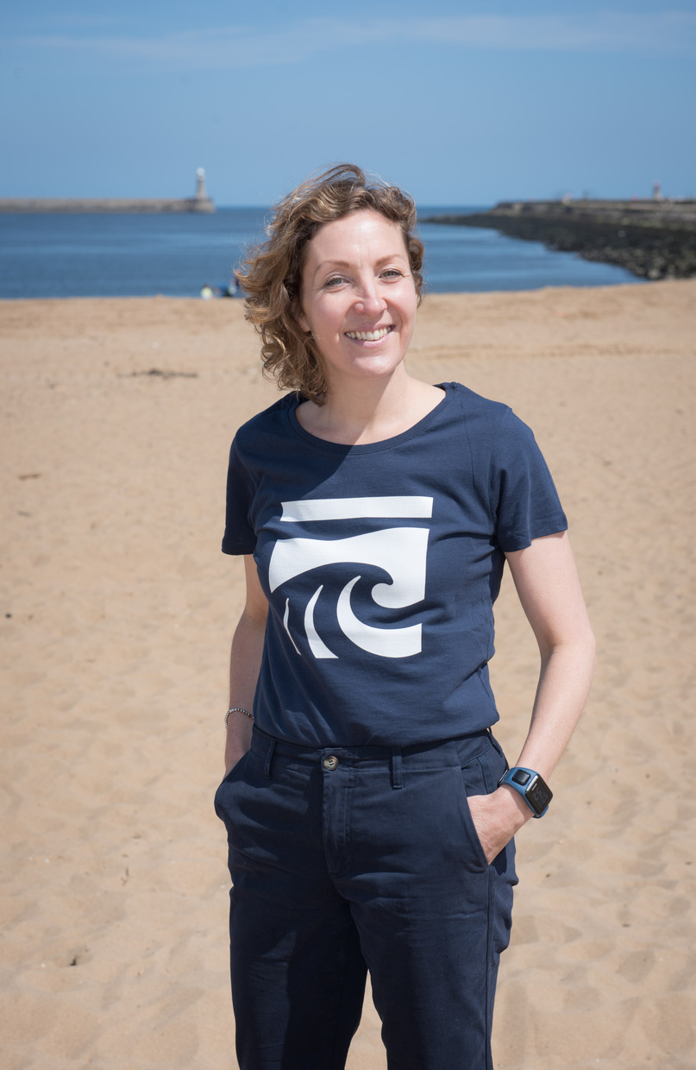
AS A PROJECT MANAGER, WHAT DID KAREN DAGLISH INSIST WAS IMPORTANT IN HER ROLE?
a) Organisational skills
b) People skills
c) Appetite for learning
d) All of the above

Slide 5
AS A PROJECT MANAGER, WHAT DID KAREN DAGLISH INSIST WAS IMPORTANT IN HER ROLE?
D) ALL OF THE ABOVE

Slide 6

WHY IS DIVERSITY IMPORTANT?

Slide 7
WHY IS DIVERSITY IMPORTANT?
Diversity ensures that a range of different ideas are put forth, informed by people’s different life experiences, which makes for a more successful project.

Slide 8

PUT THE PROCESS OF RESEARCH INTO THE CORRECT ORDER:
  COME UP WITH A QUESTION
  MEASURE RESULTS
  CONCLUSION
  UNDERTAKE YOUR METHODOLOGY
  FORM A HYHPOTHESIS

Slide 9
PUT THE STEPS OF RESEARCH INTO THE CORRECT ORDER:
  COME UP WITH A QUESTION
  FORM A HYHPOTHESIS
  UNDERTAKE YOUR METHODOLOGY
  MEASURE RESULTS
  CONCLUSION

Slide 10
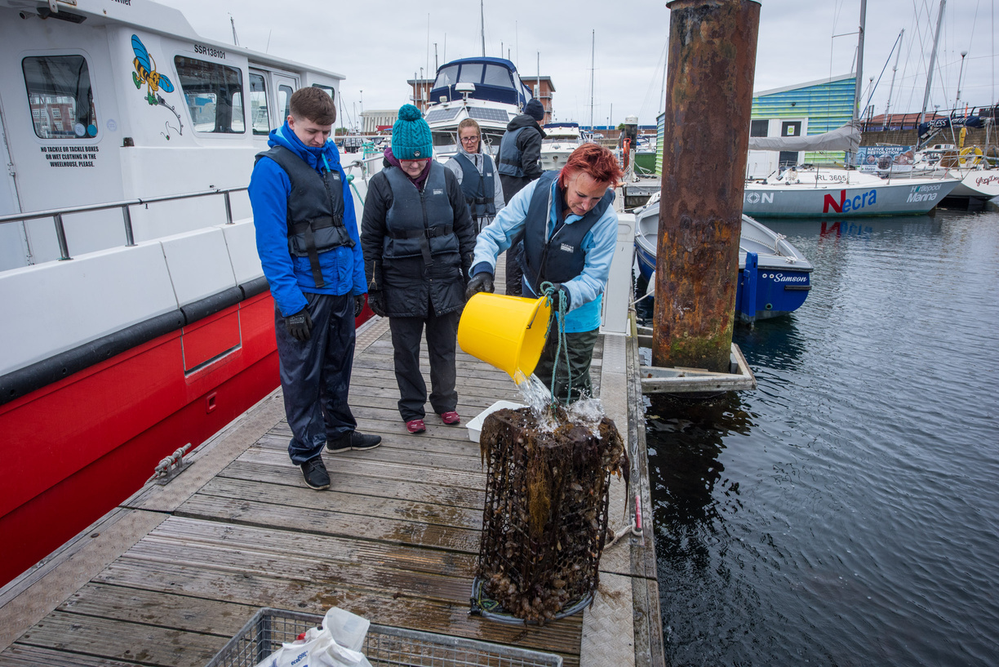
COMMUNICATION IS IMPORTANT FOR A CONSERVATION PROJECT TO BUILD:
A) FEAR
B) RESENTMENT
C)TRUST
D)ANGER

Slide 11
COMMUNICATION IS IMPORTANT FOR A CONSERVATION PROJECT TO BUILD:
C)TRUST

Slide 12



To find out more about Stronger Shores follow the link in the QR code to visit our StoryMap, or go to:
https://storymaps.arcgis.com/stories/7da0c07ee3d245c9b273c6538bf0e1db

