Slide 1

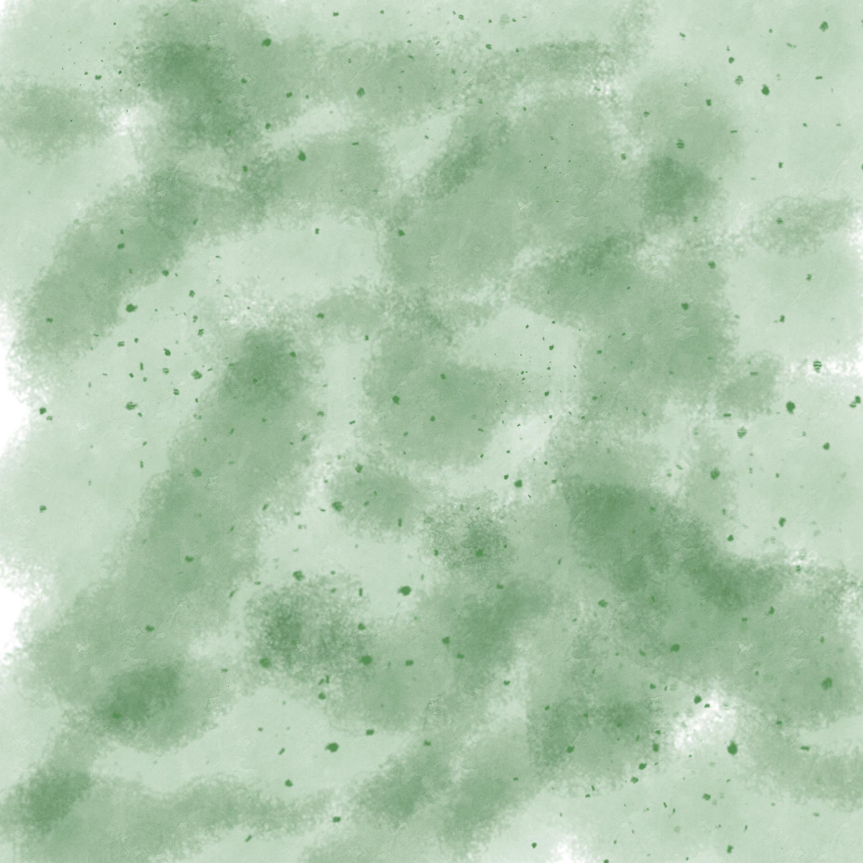


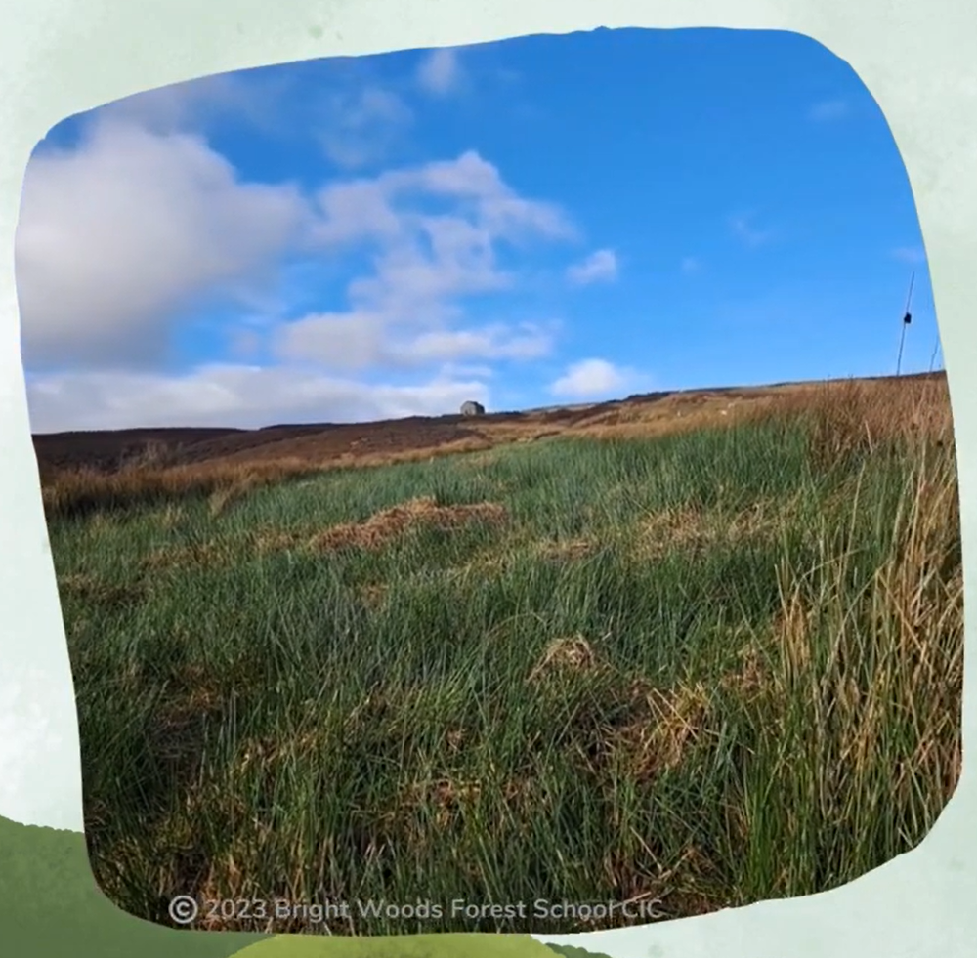
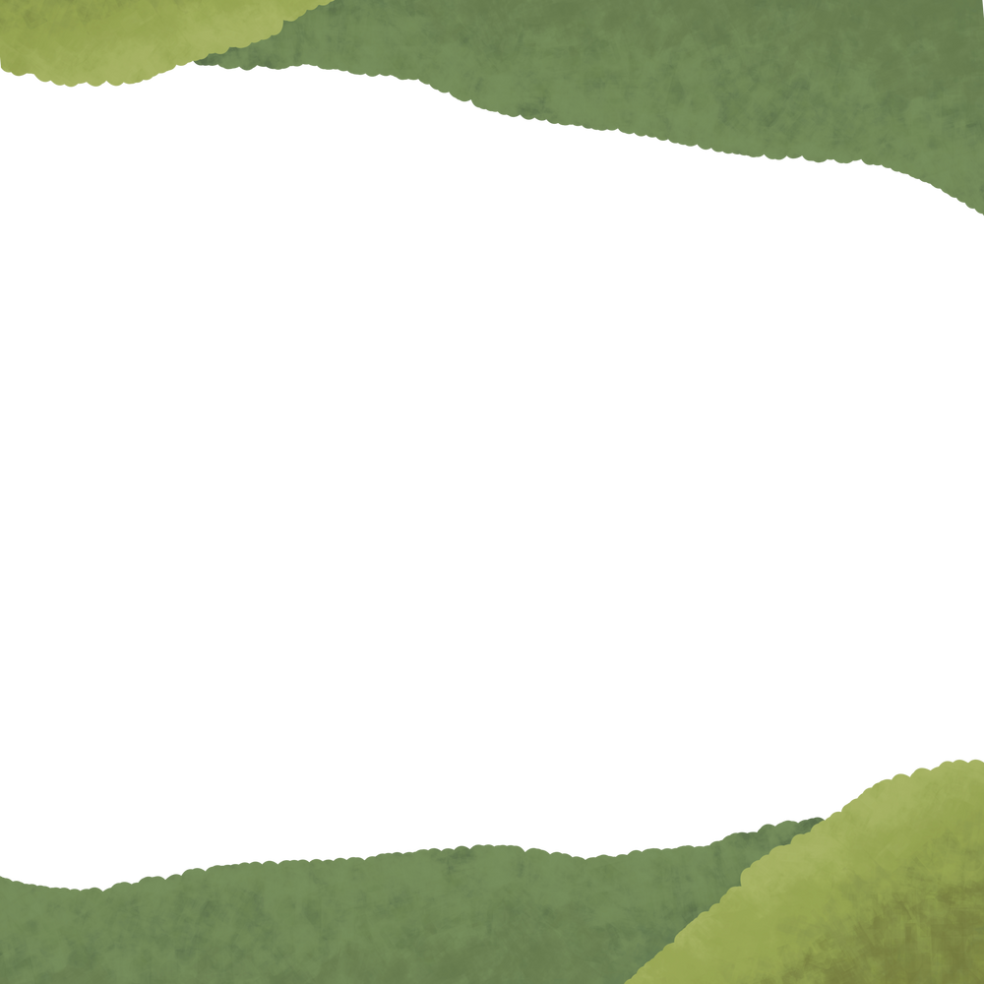
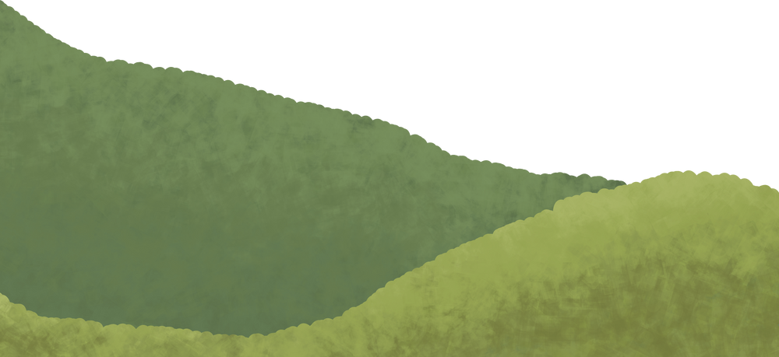

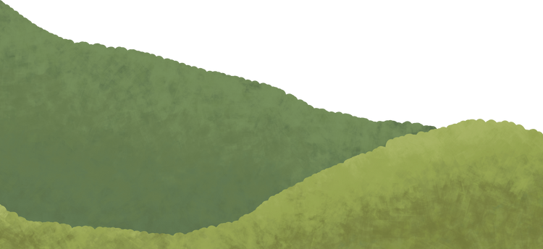

Cuthbert's Moor
An area of upland peatland in the Durham Dales
2023 Bright Woods Forest School CIC

Slide 2

2023 Bright Woods Forest School CIC

Slide 3

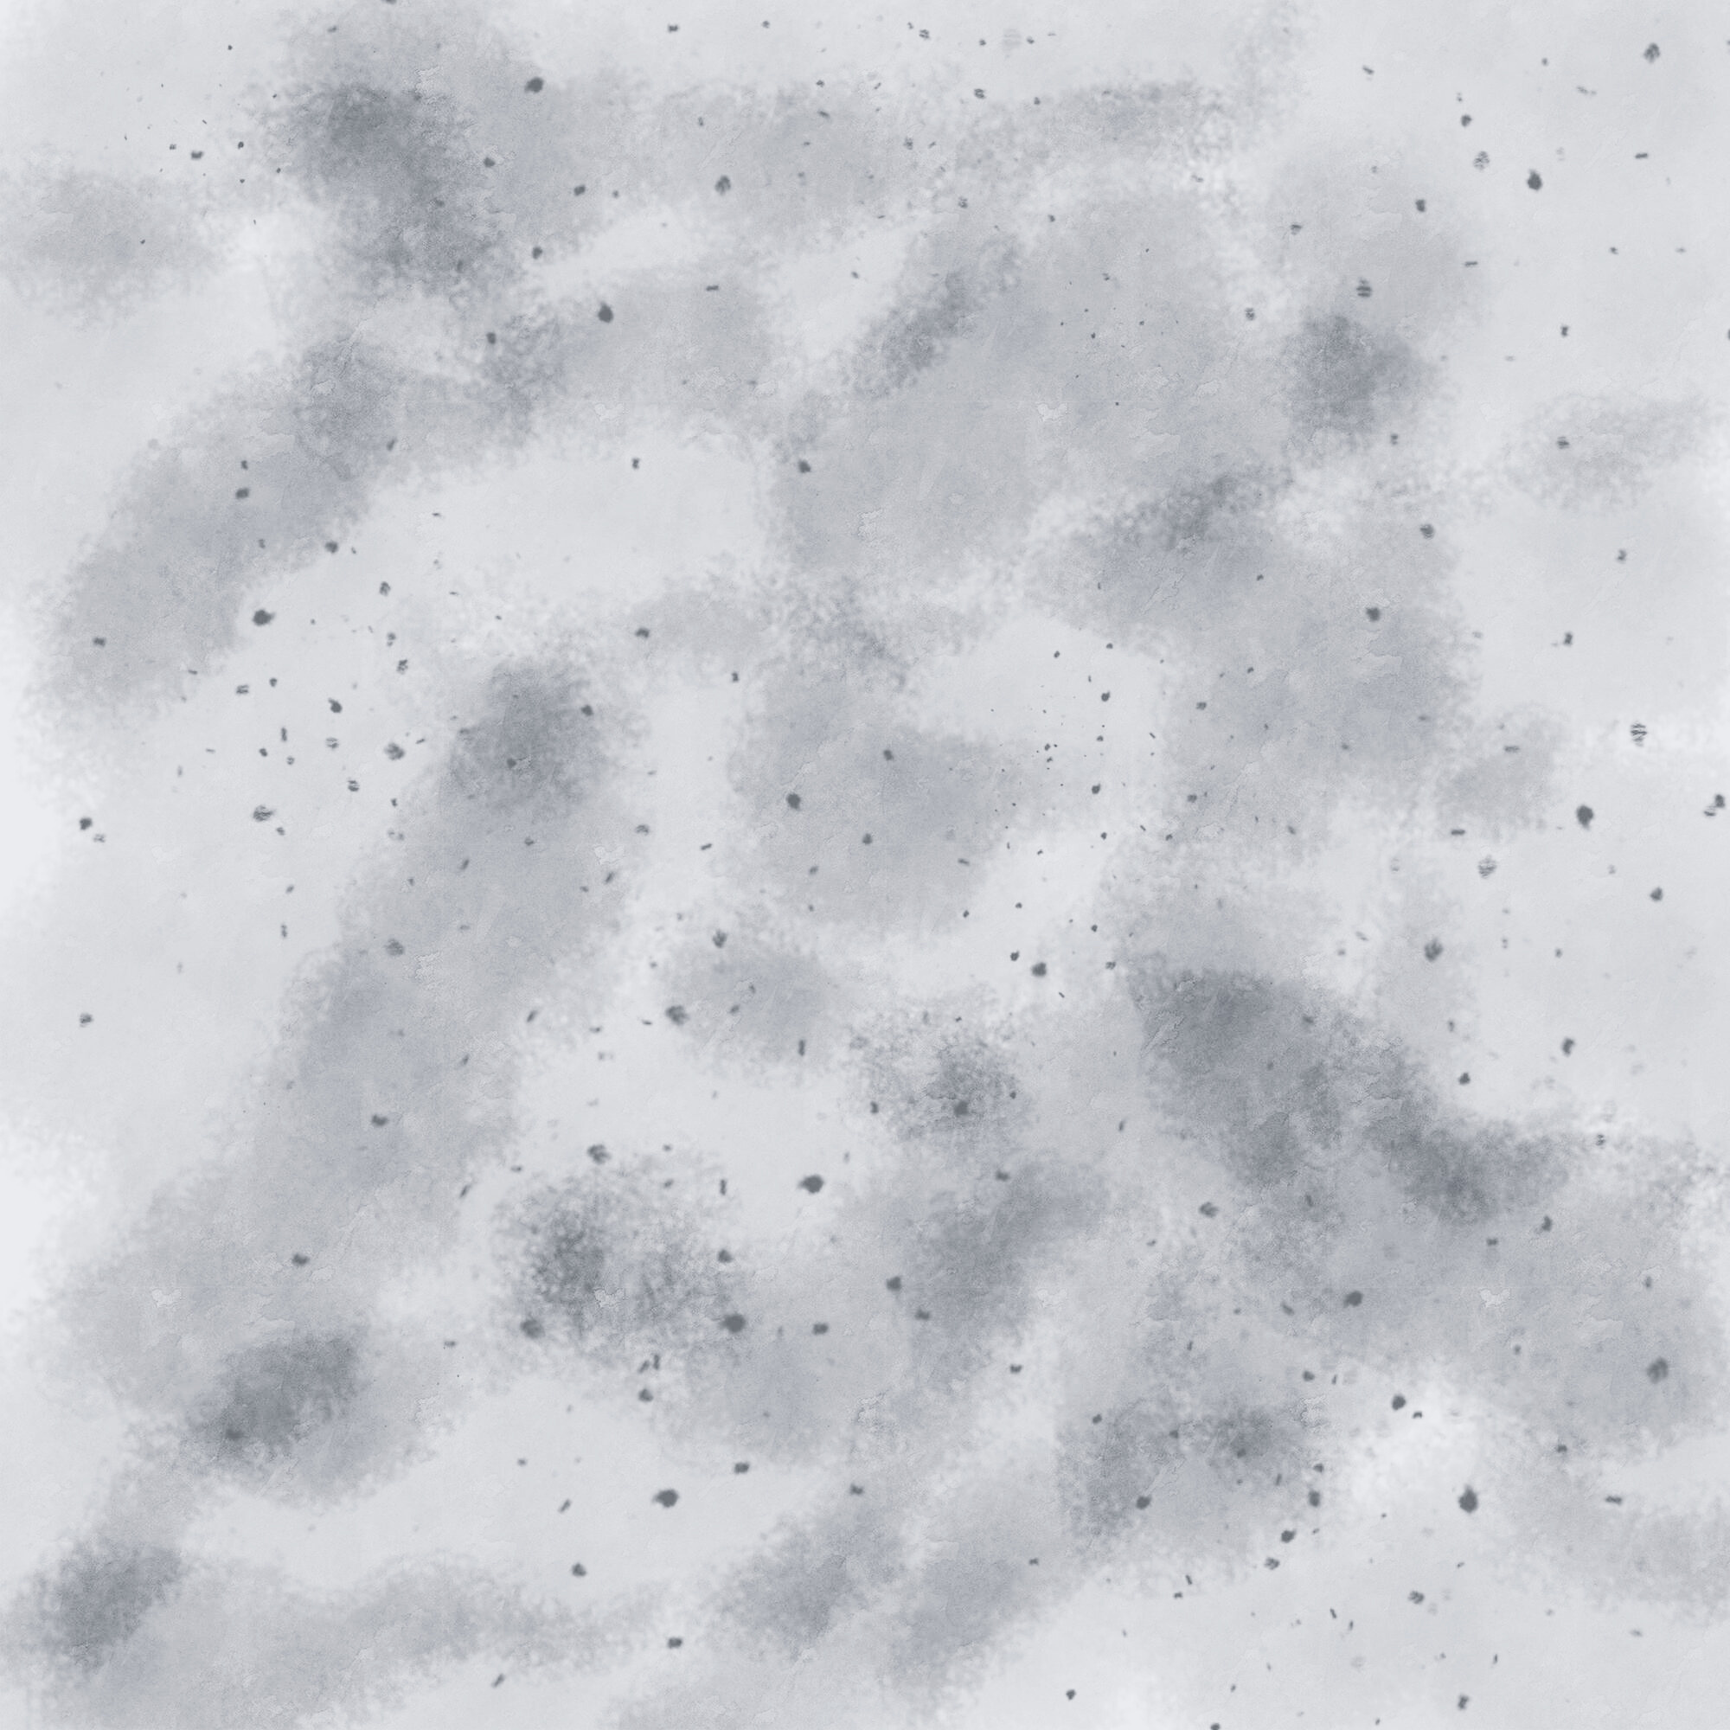





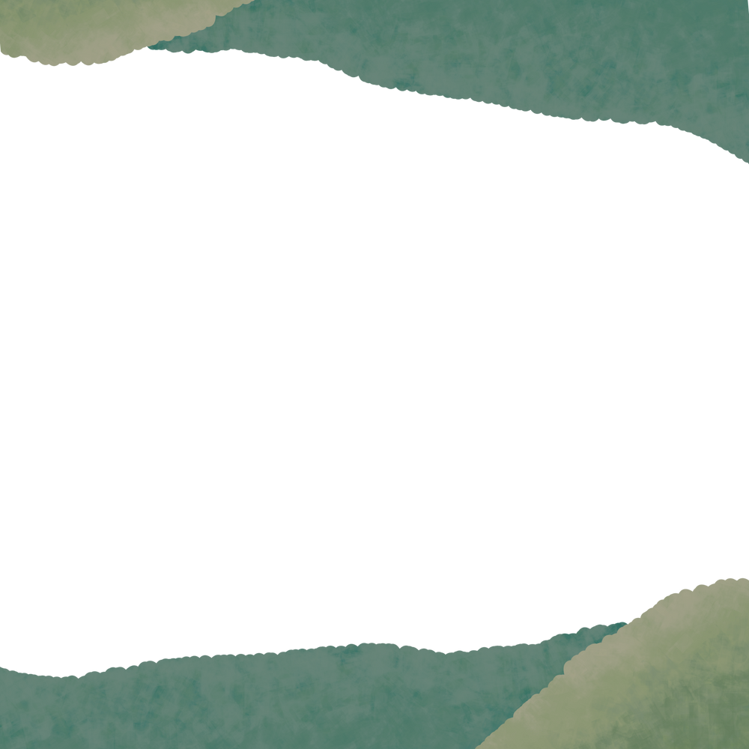

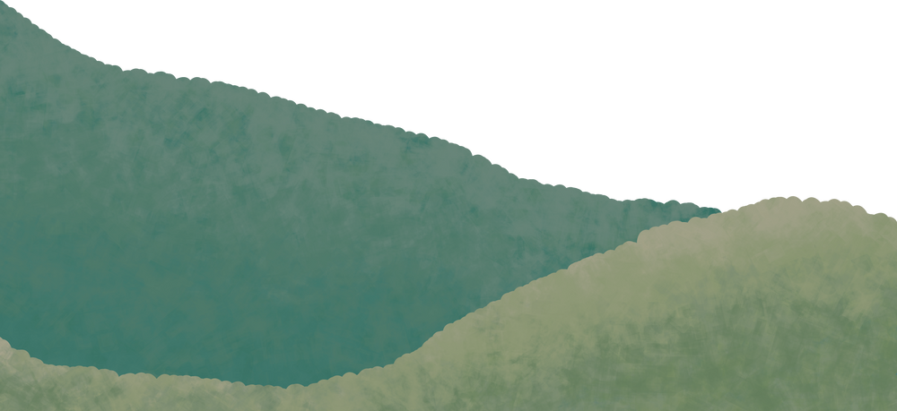

What do you already know about peatland?
Where are they?
What do they look, sound or feel like?
You might not know anything!
What might you find there?
Do they do anything important?
What is peatland?

Slide 4

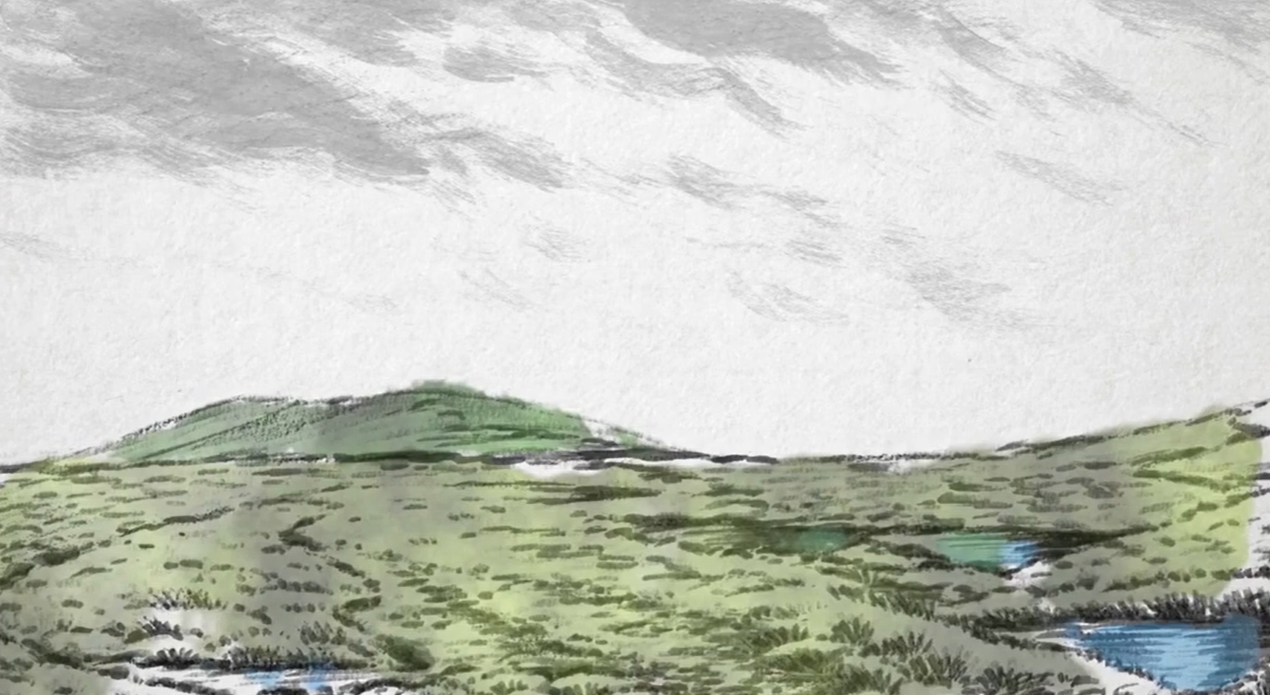
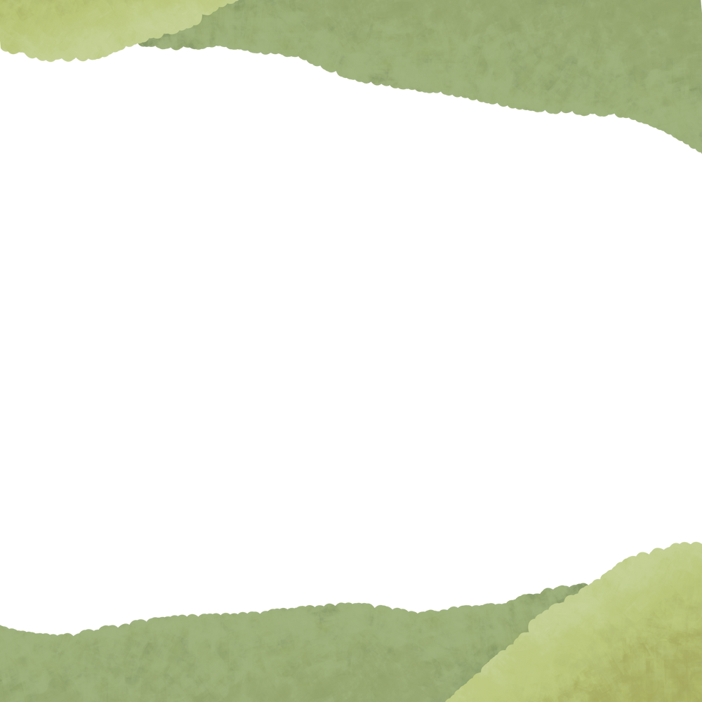

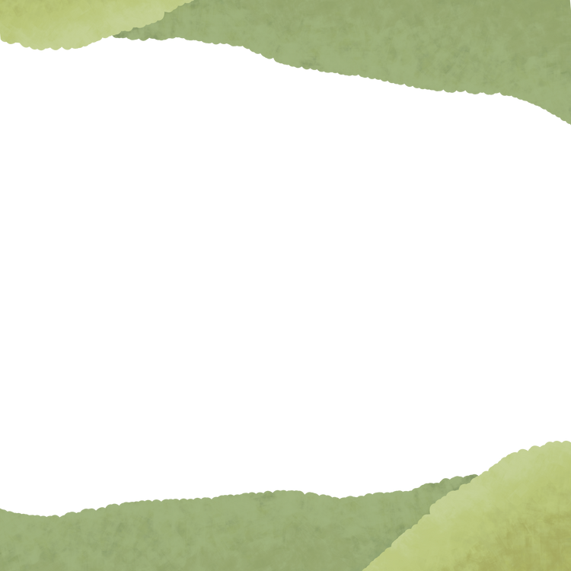
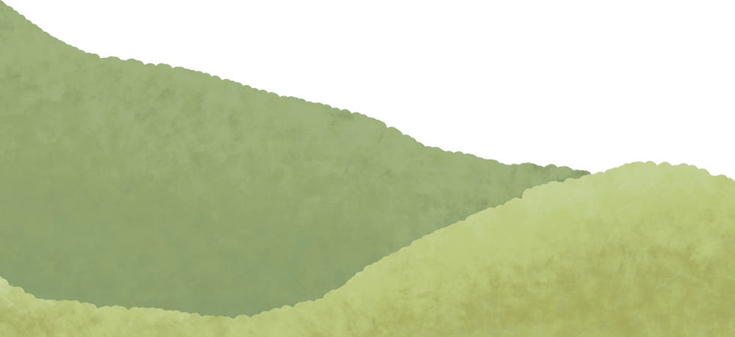
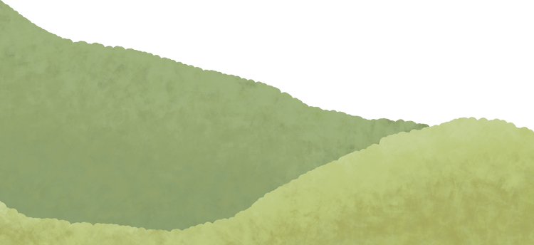
What’s special about peatlands?

Slide 6
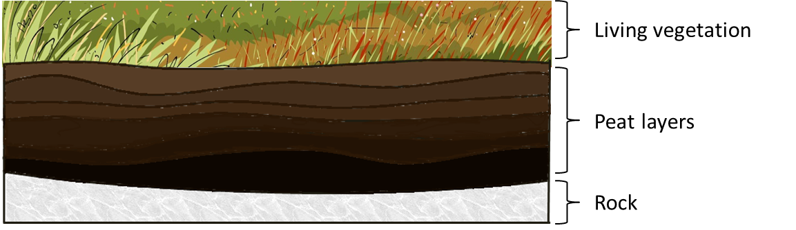
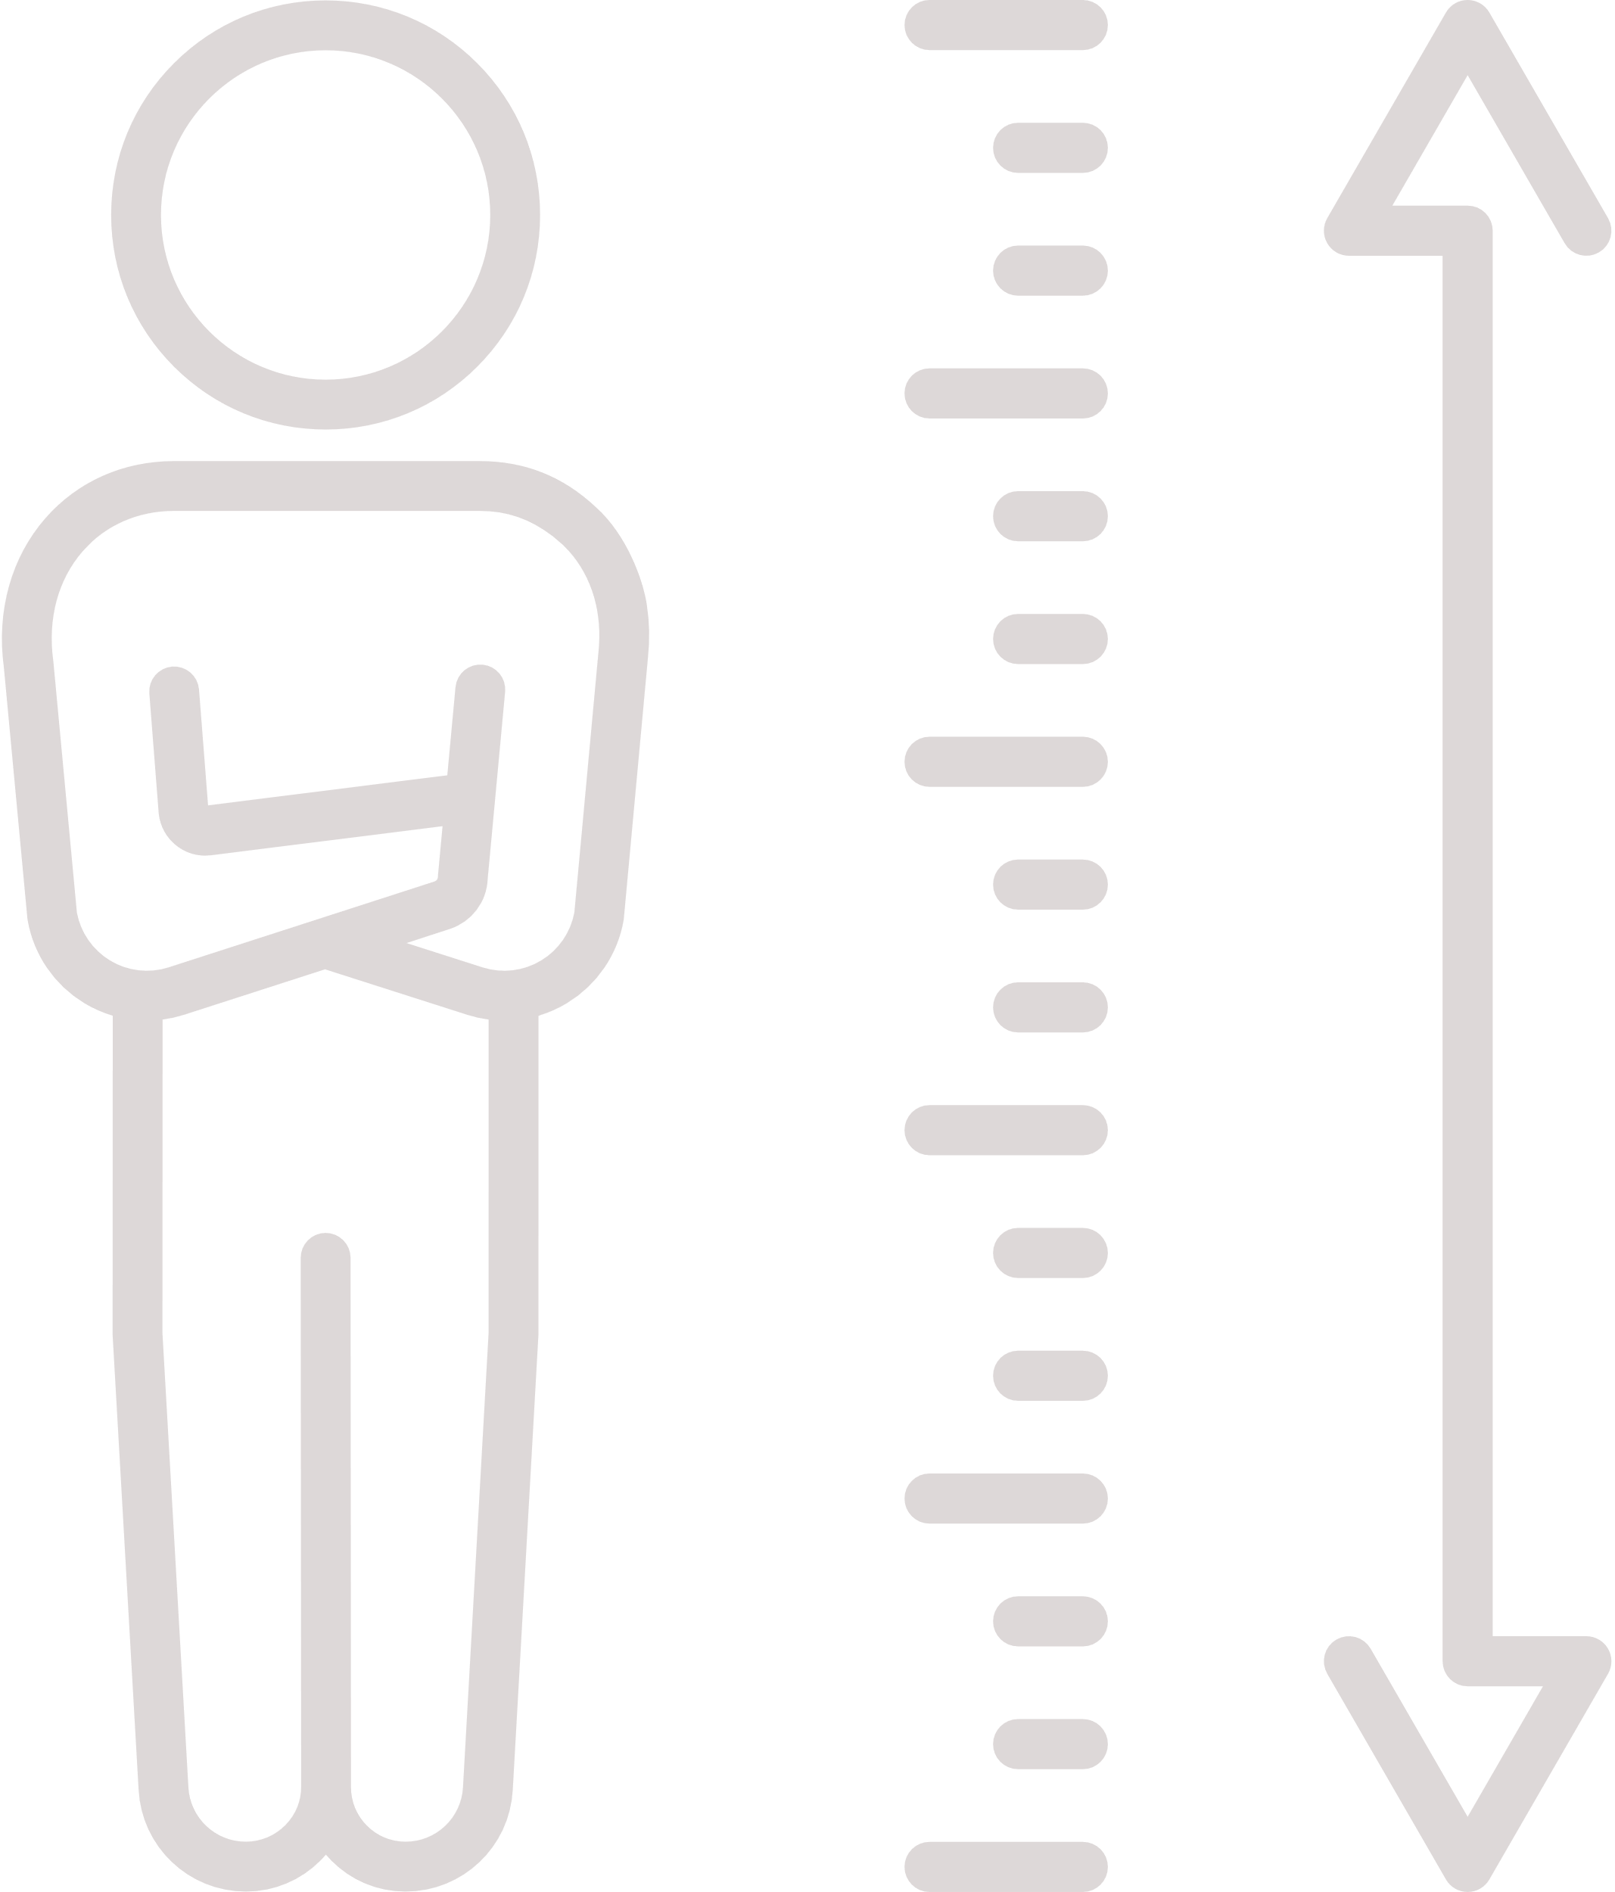
What is peatland?
Living Plants
Peat Layer
at least 30cm deep
Rock
Martin-Ortega, J., Glenk, K., & Byg, A. (2017). Online Peatland Learning Module. Peatland Action, Scottish Natural Heritage.
What is peatland?

Slide 7

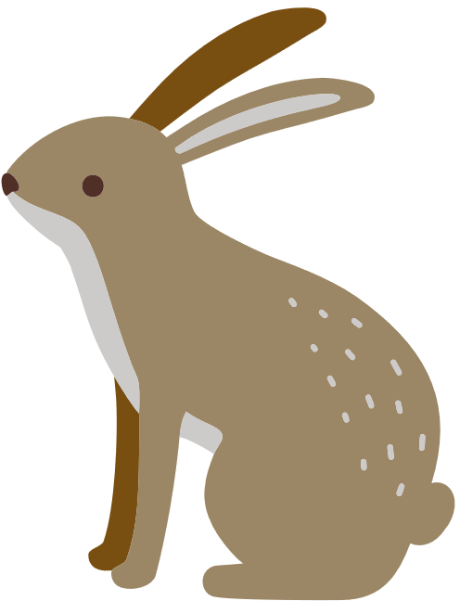

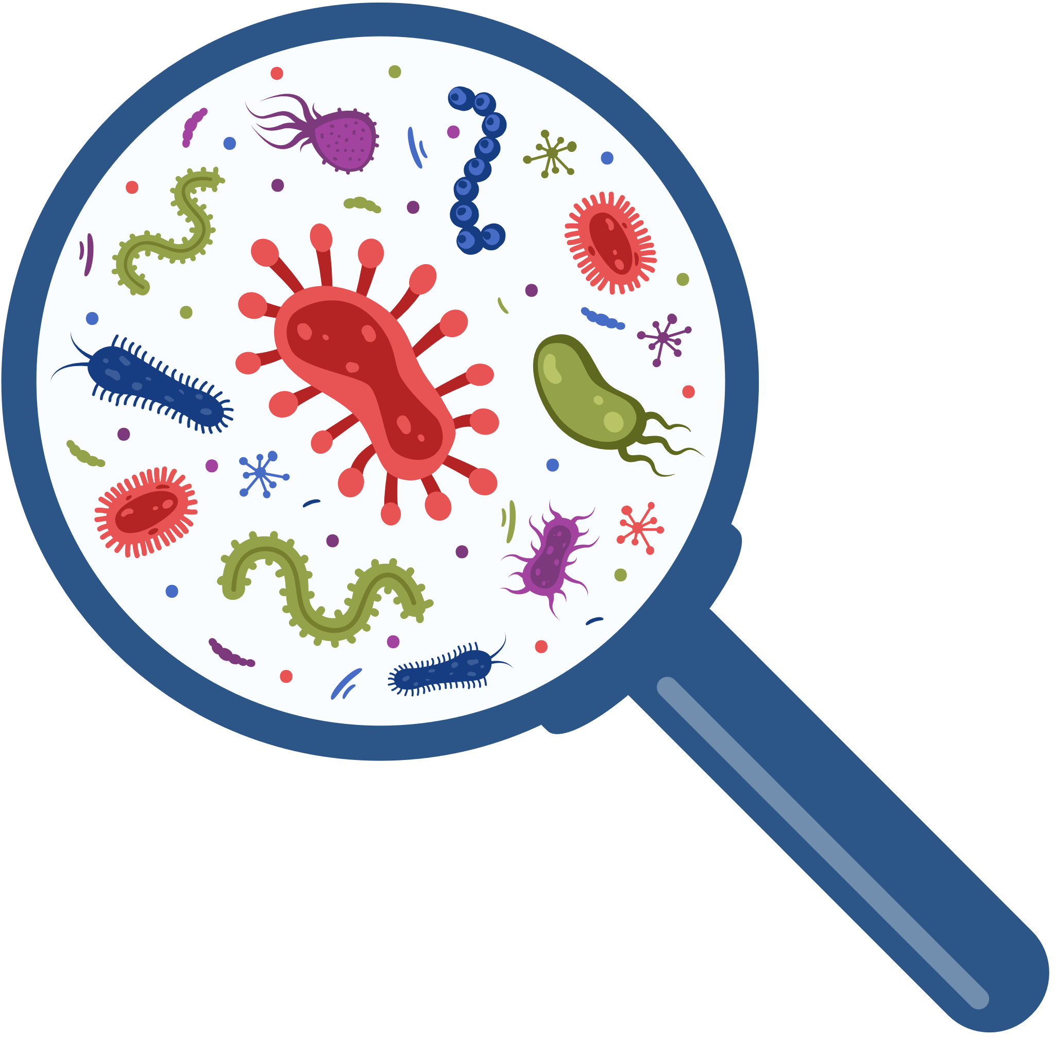



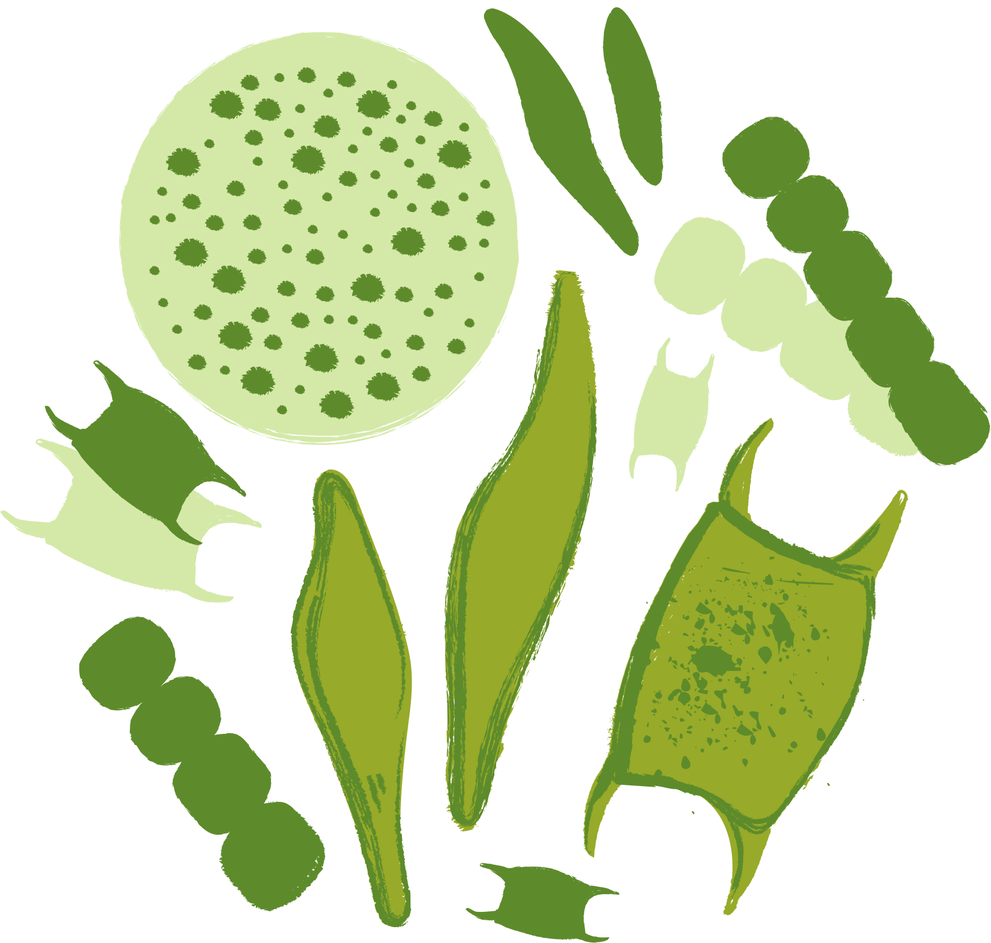
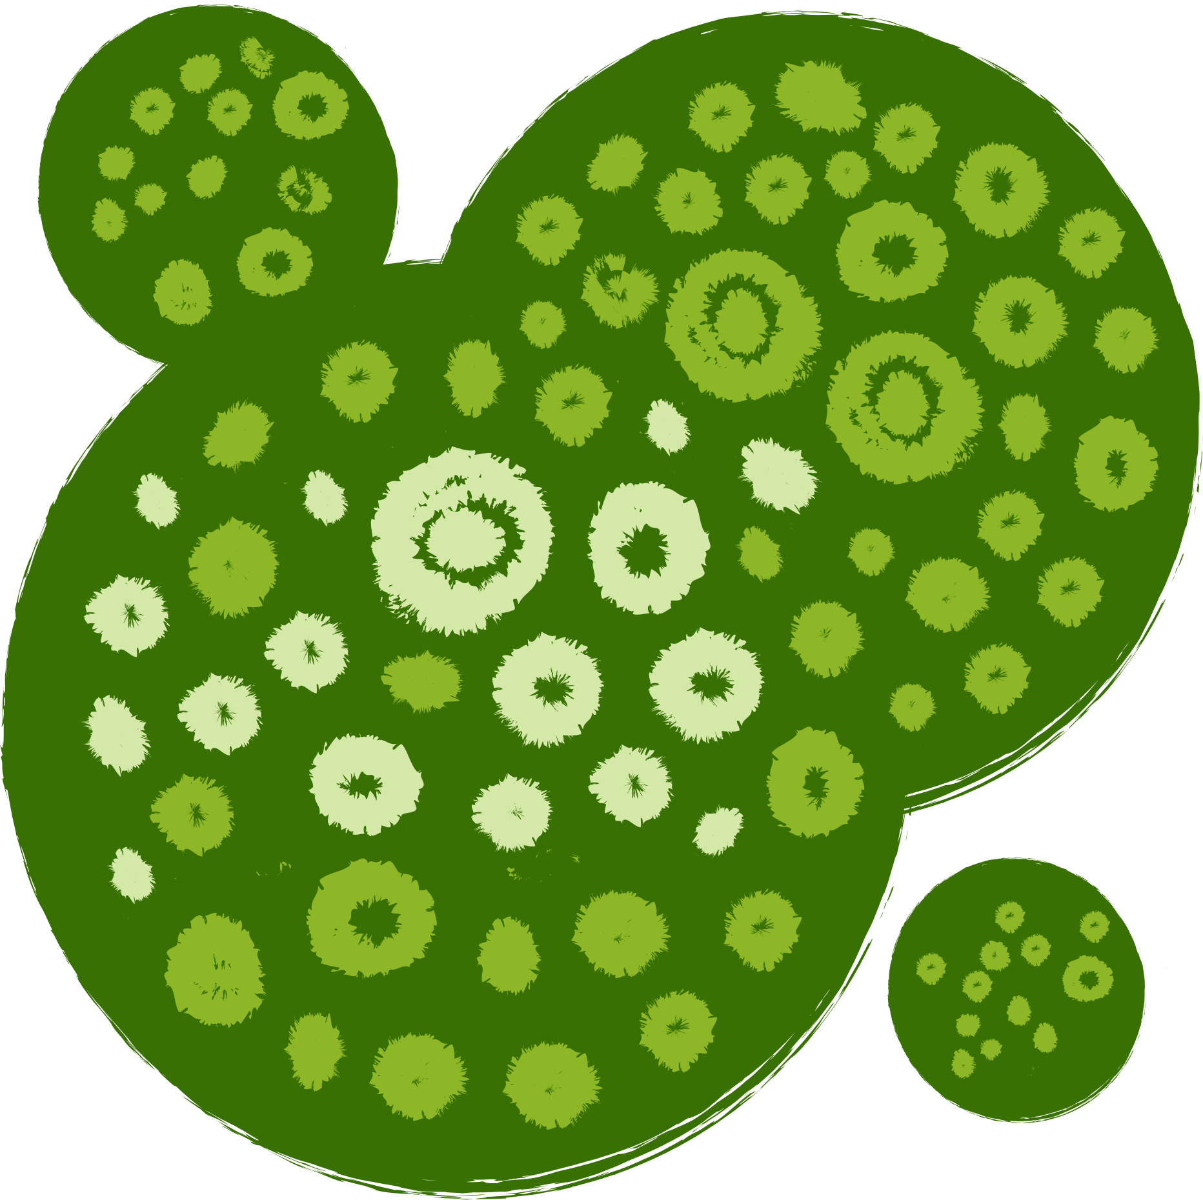
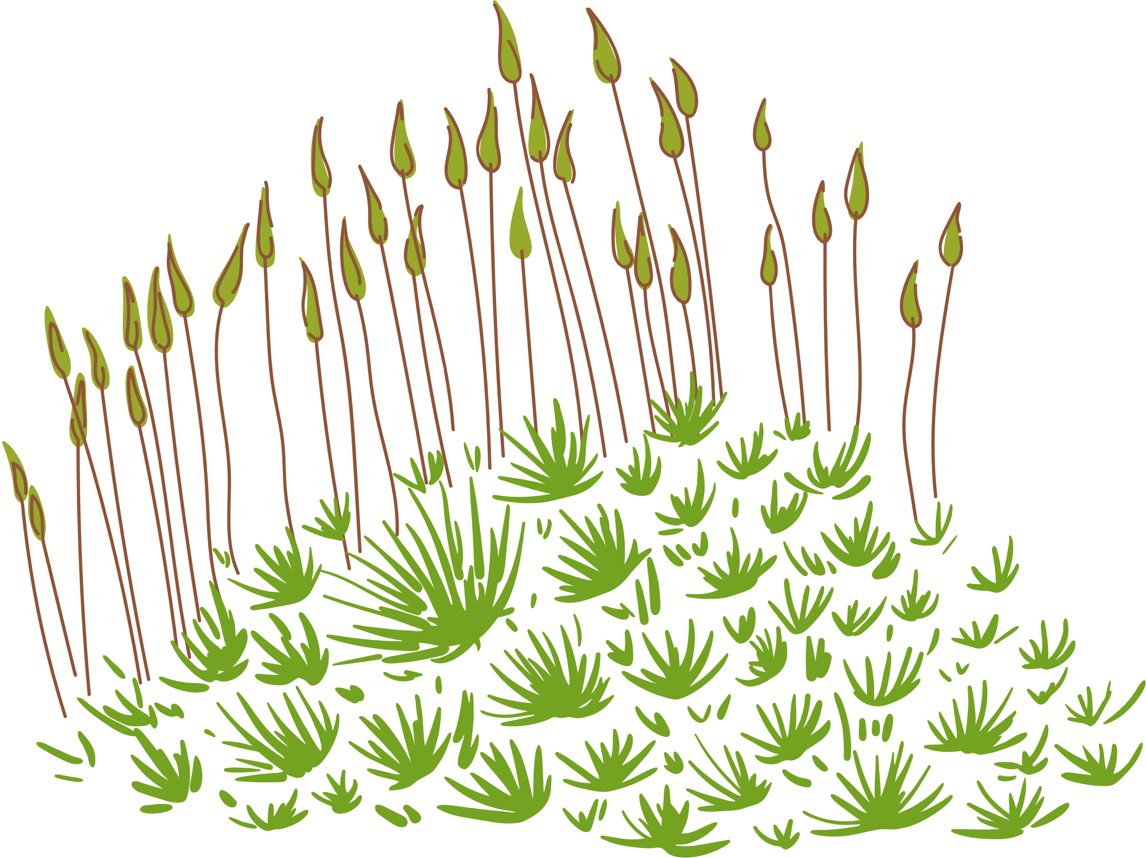
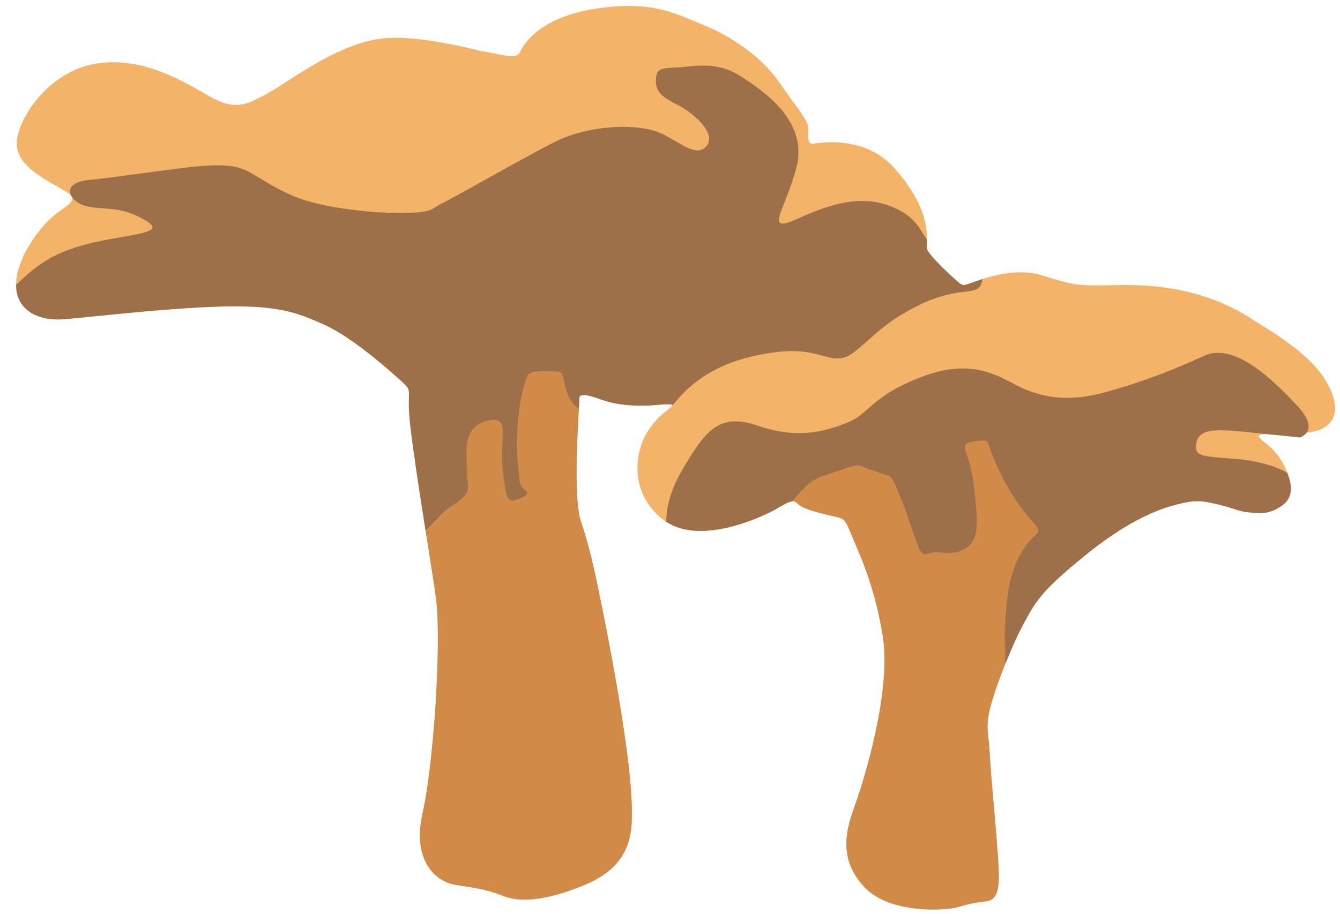


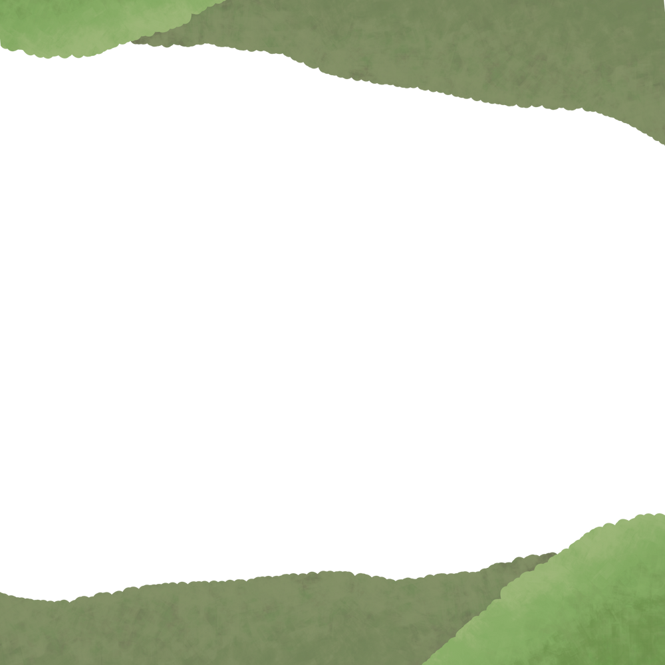
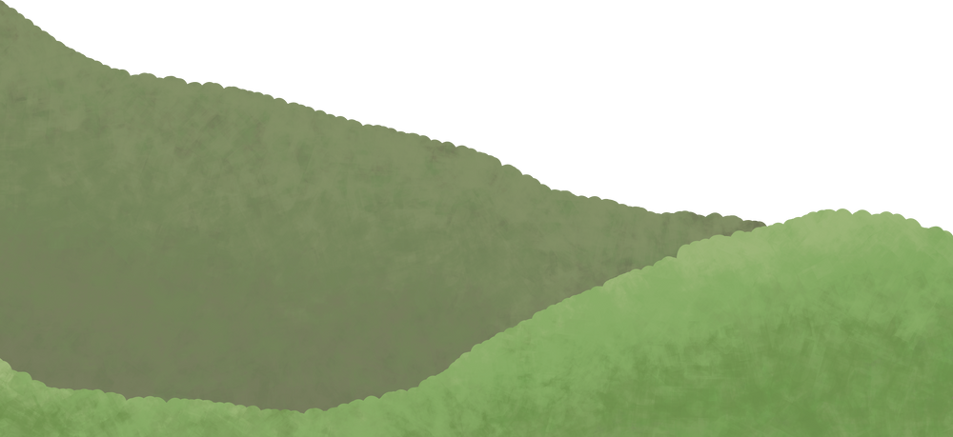


Peatland as an ecosystem
Living Things
Non-living Things
Animals
Bacteria
Sunlight
Air
Algae
Soil
Rocks
Water
Plants
Fungi

Slide 8
Why do we classify animals?
There are millions of different animal species on earth and they are all related to each other in some way.
Classification groups different species together that have similar features.
This makes it easier to study animals by knowing which species are closely related to each other.

Slide 9
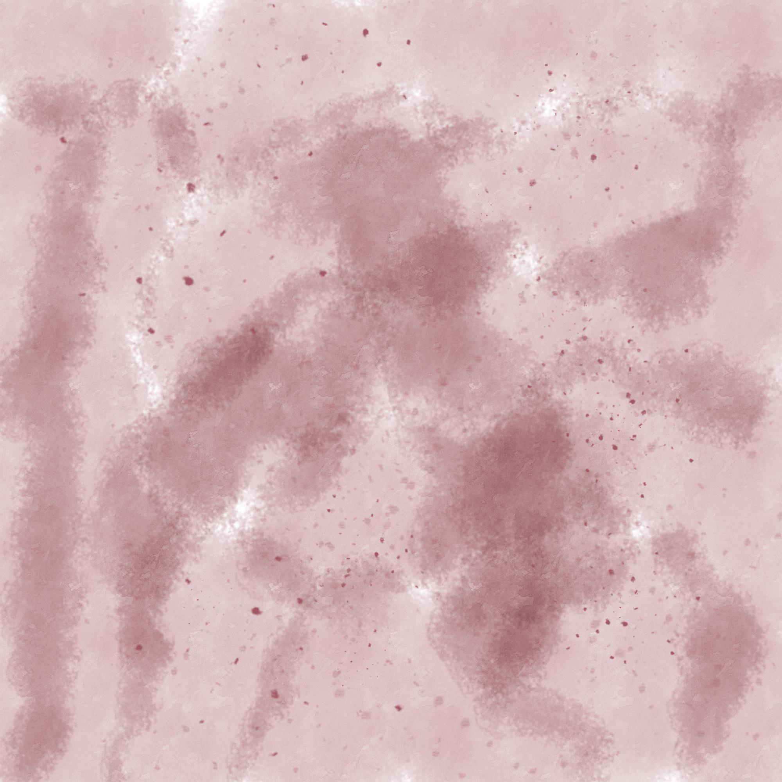


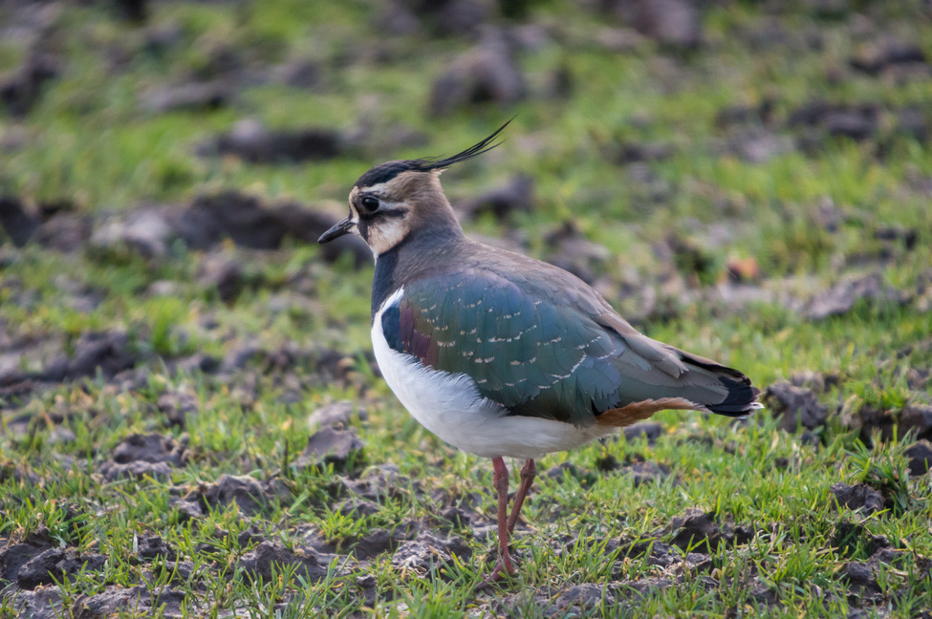
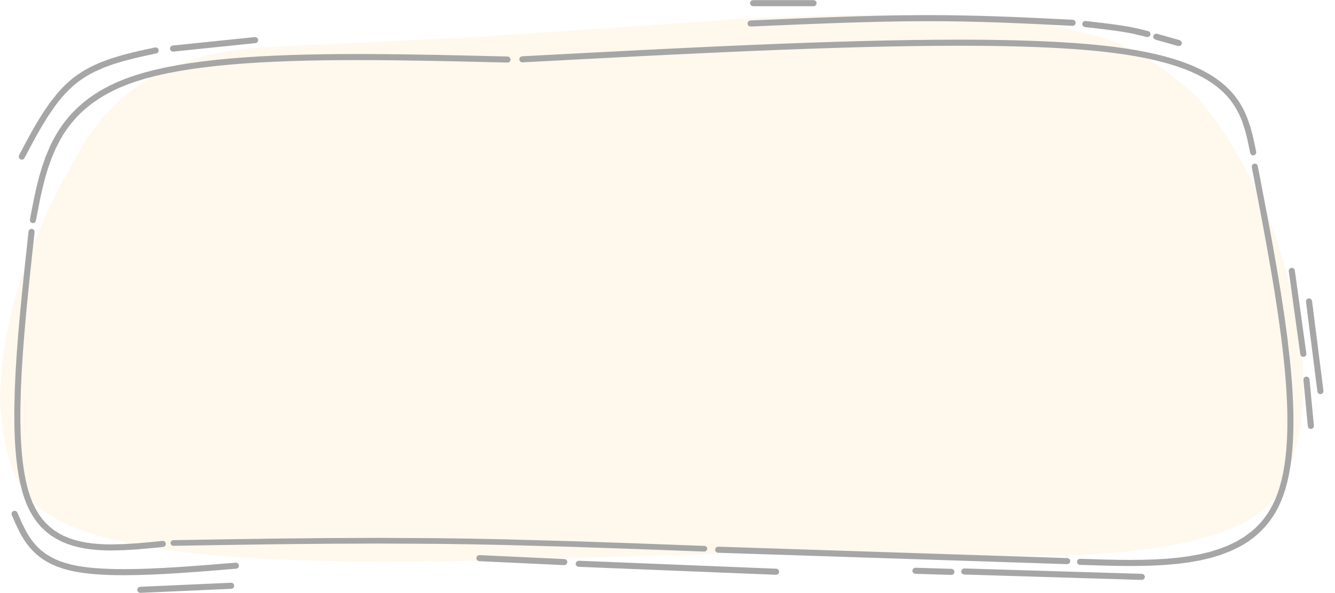
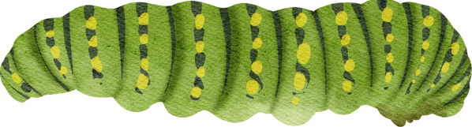
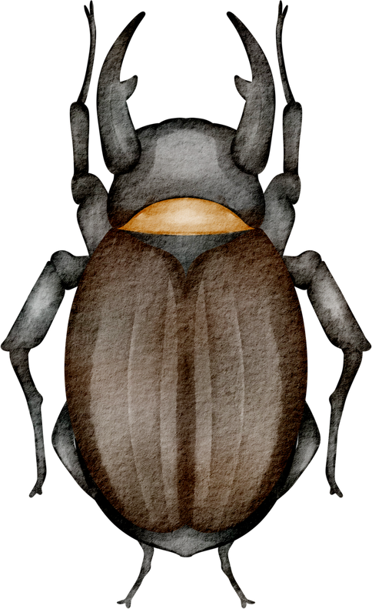
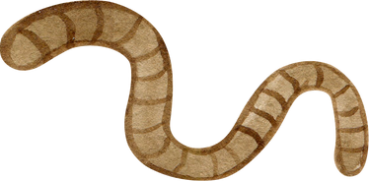
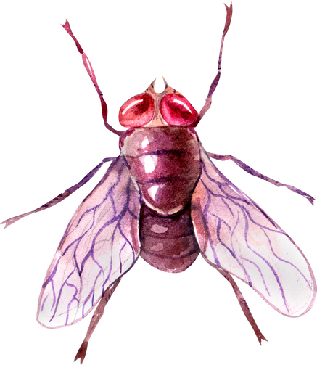

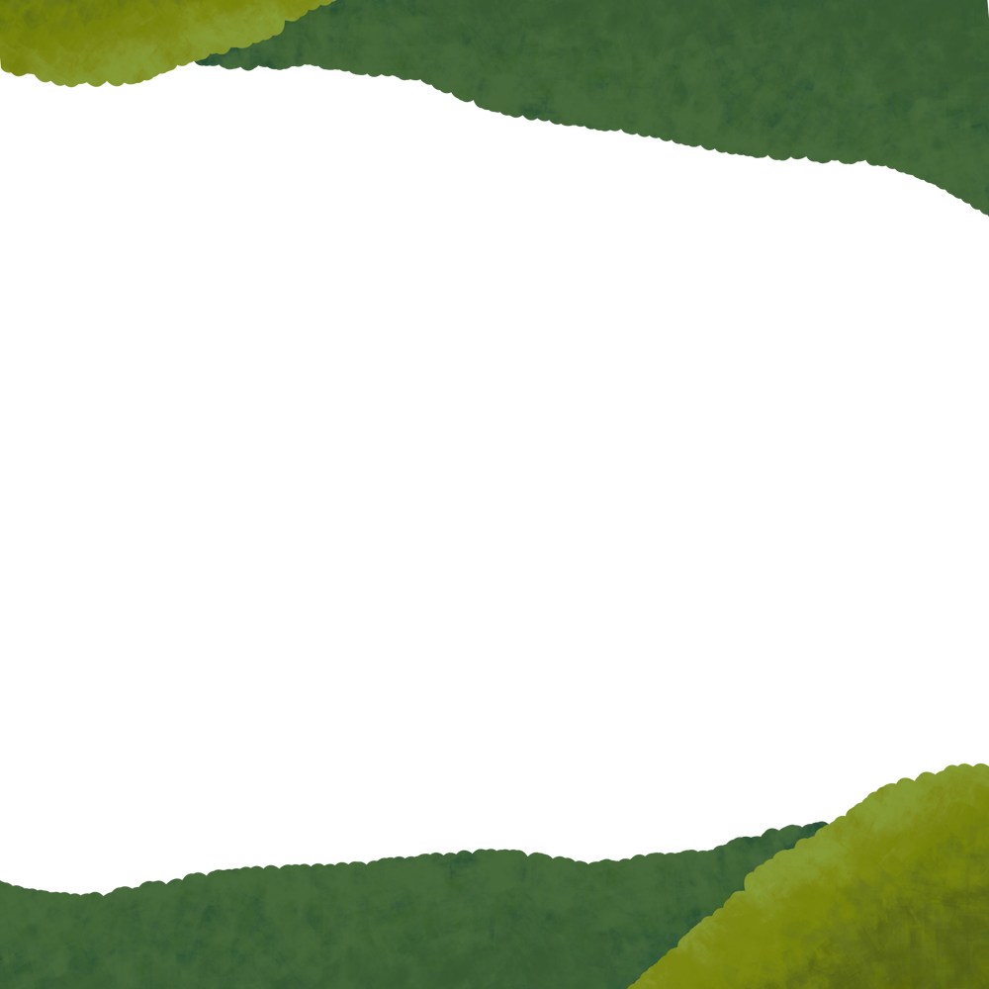
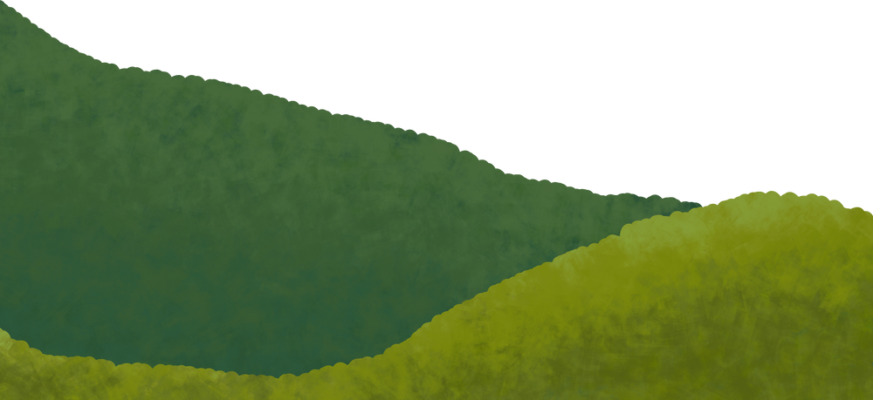

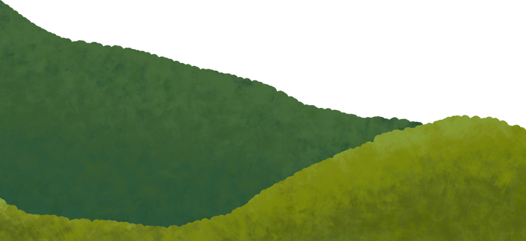
Activity - Classifying Species
In your group, look at the Species Cards and see if you can think of a way to sort them into groups.
Lapwing
Gets its food from
Caterpillars
Beetles
Worms
Flies
There is not a right or wrong answer for this task you just need a reason for your groups.

Slide 10

Classifying animals
Animals are divided into two main groups. Do you know what they are?
These two groups are then subdivided. Do you know any of the names of these groups?

Slide 11
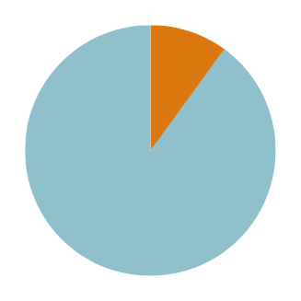

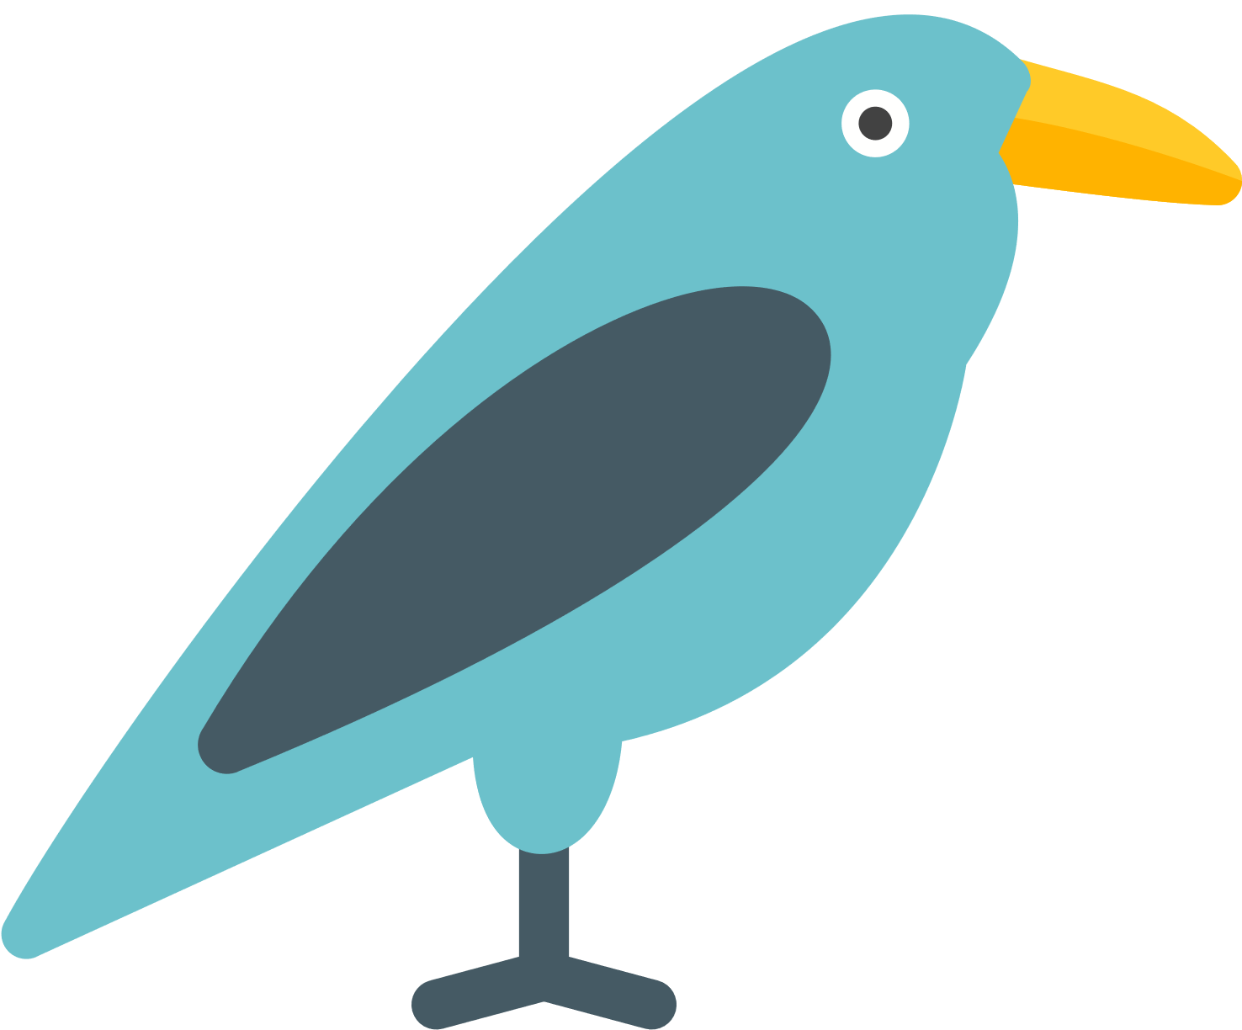
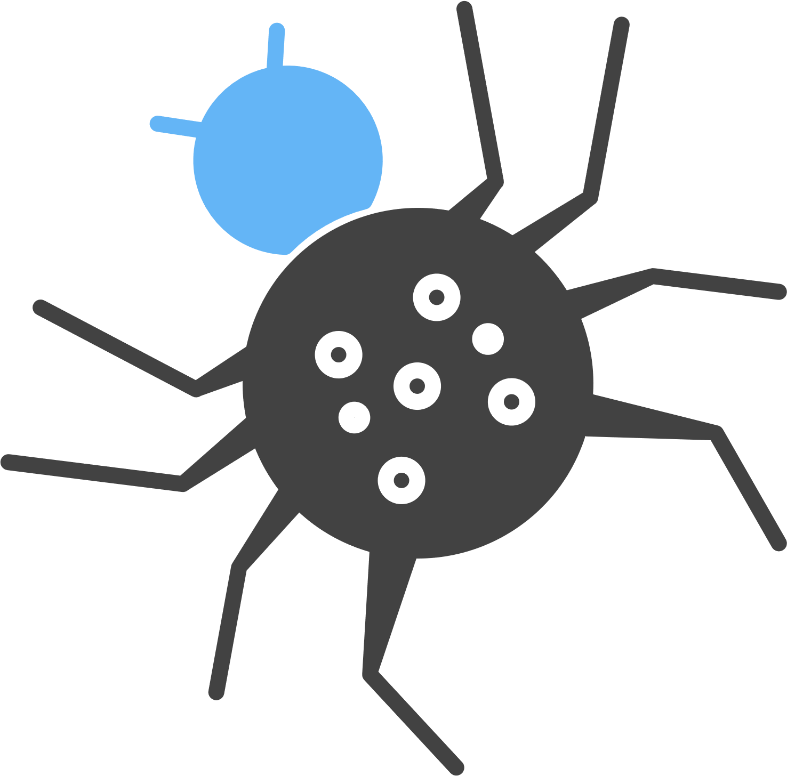
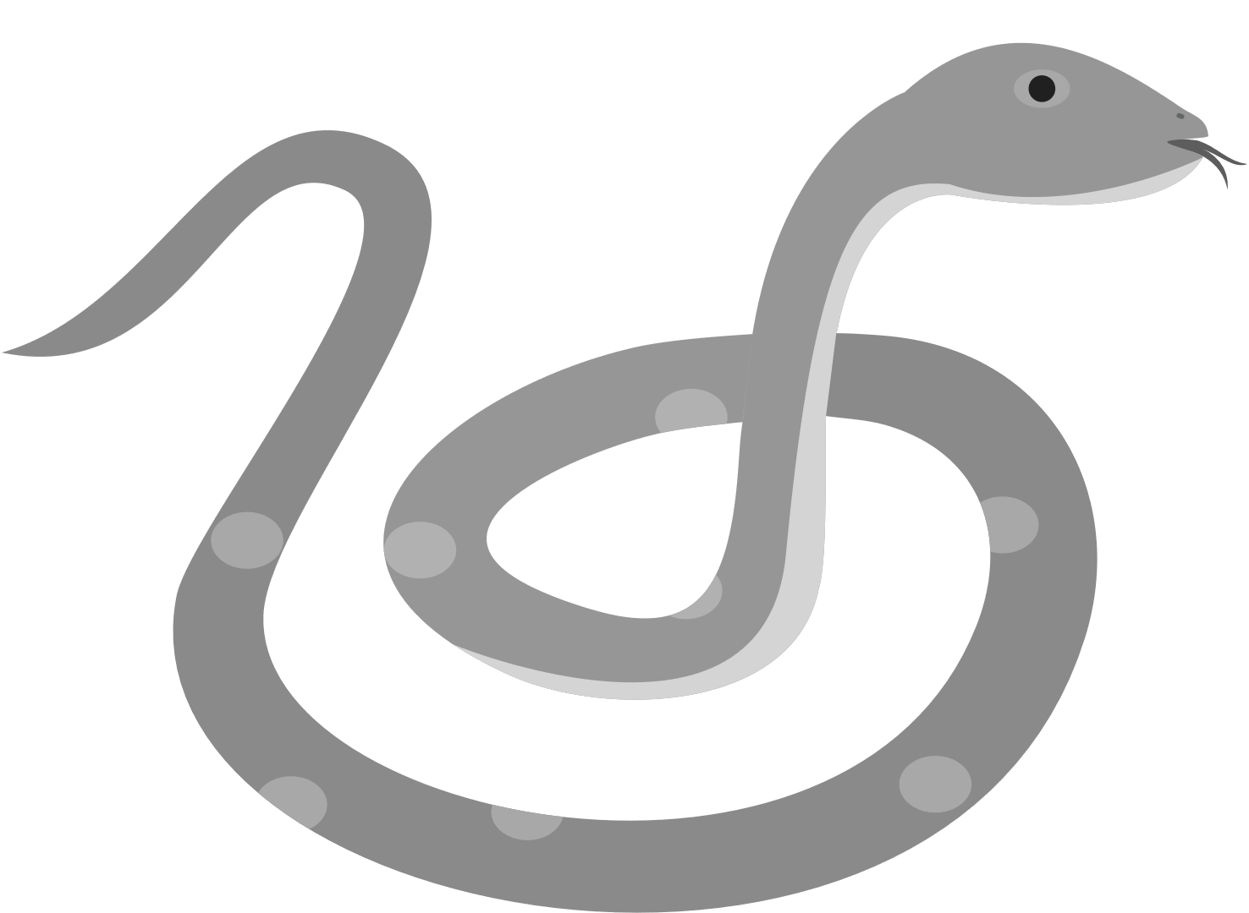
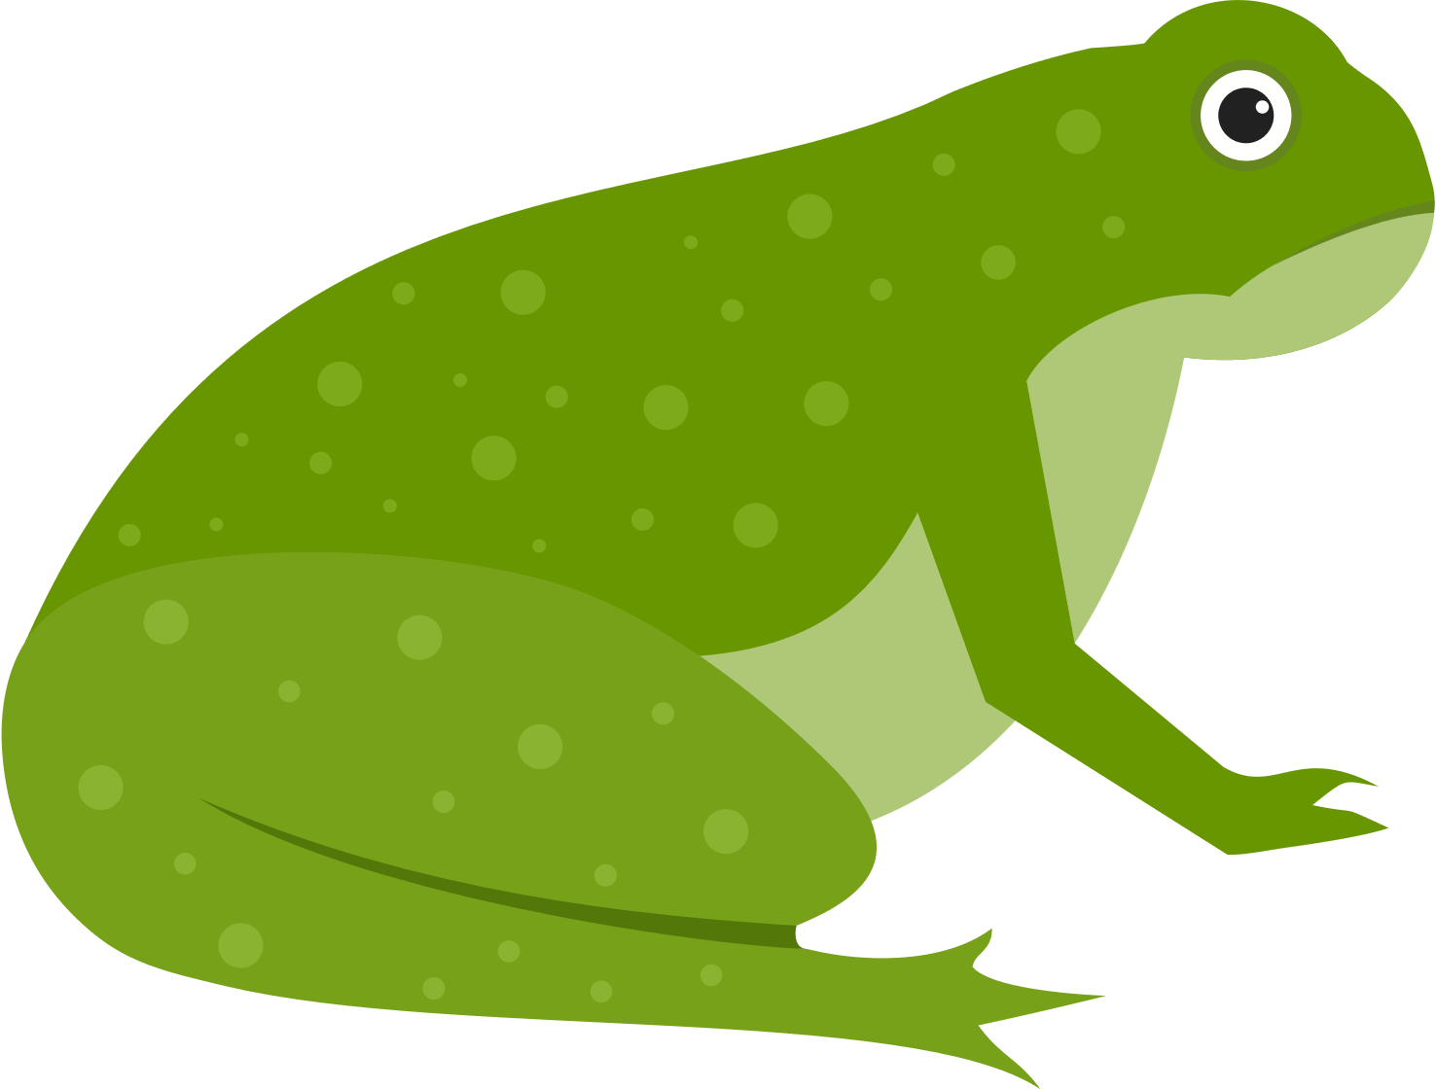
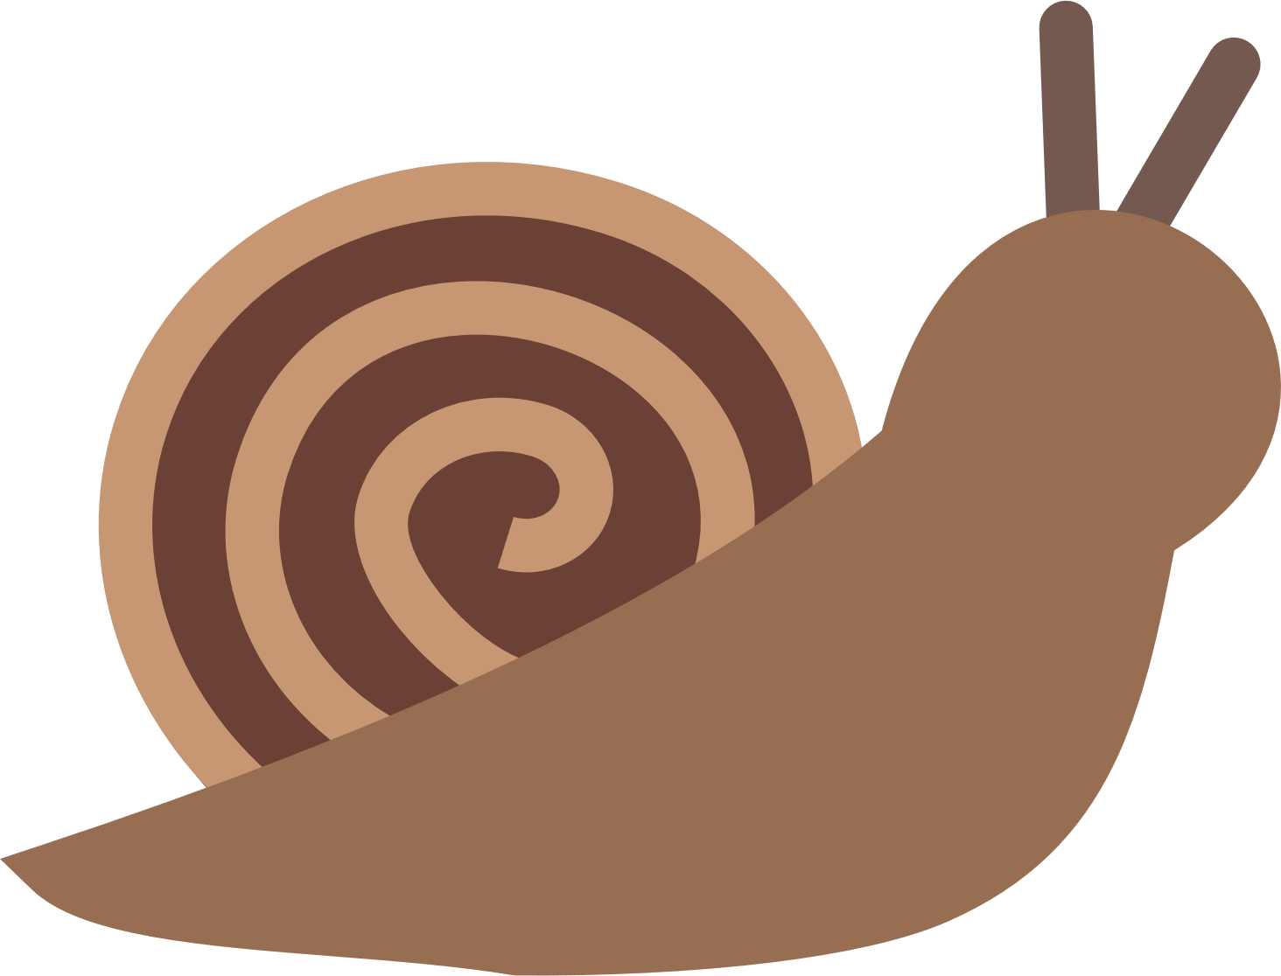

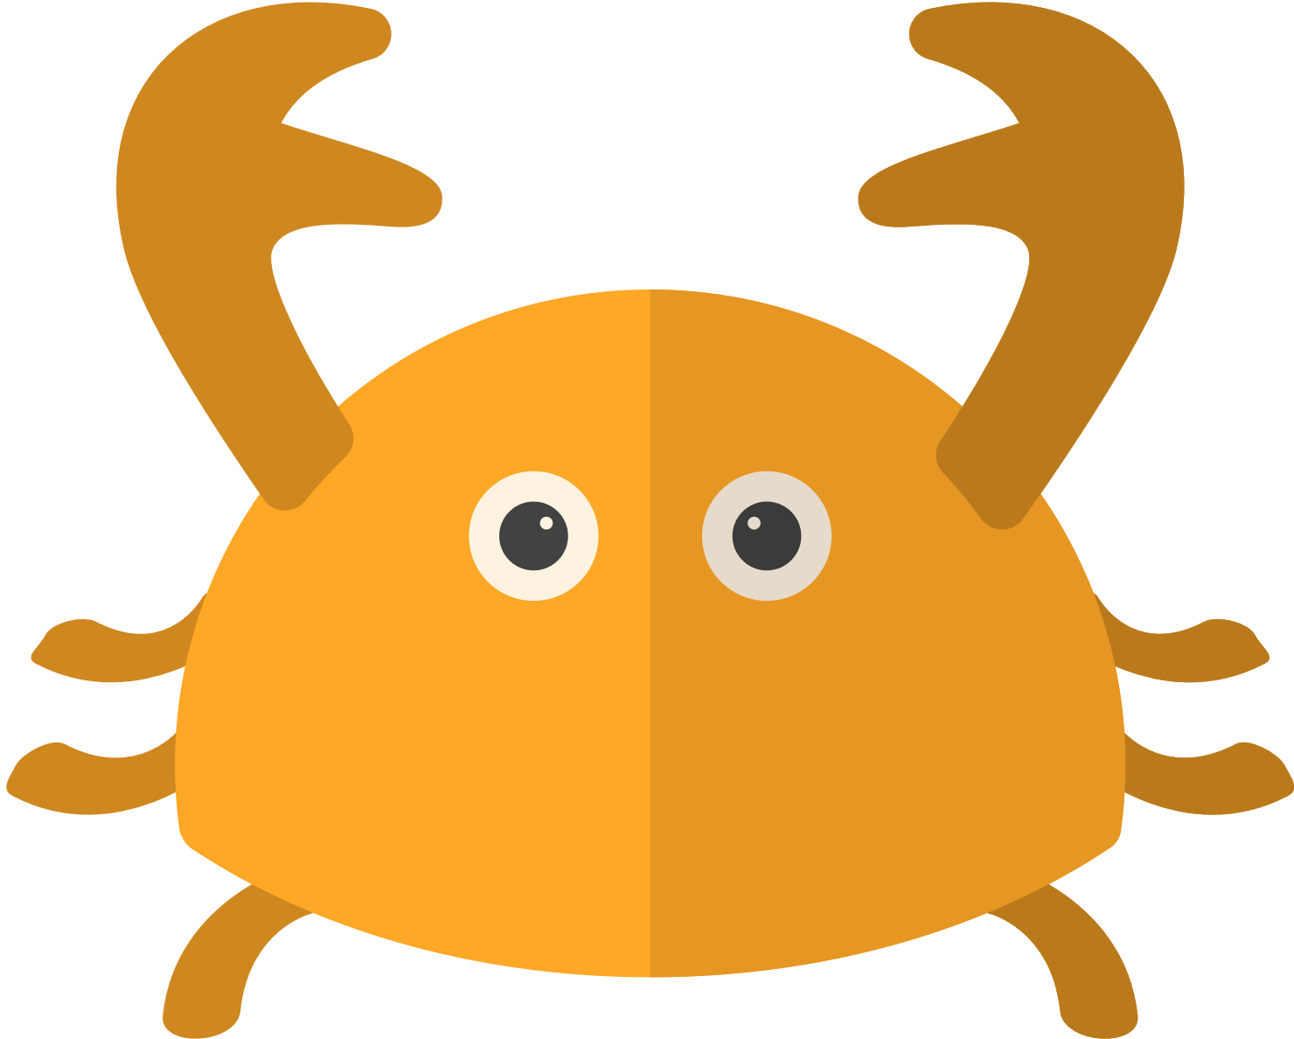

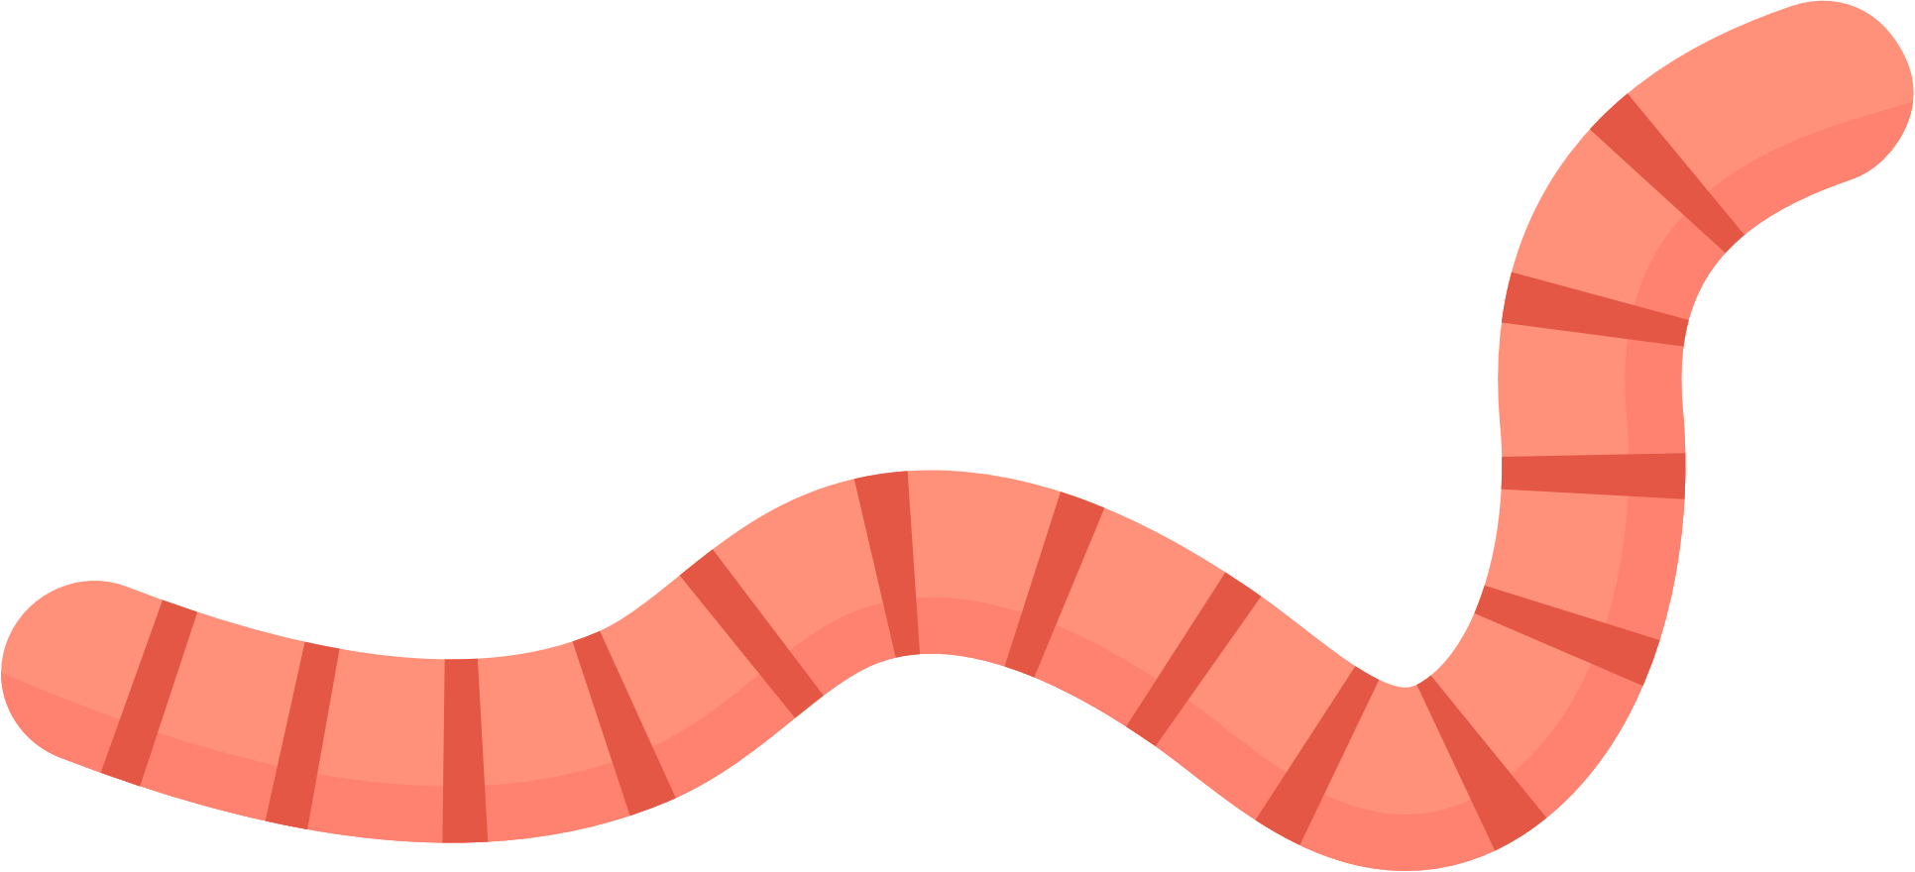
Classifying animals
Vertebrates - less than 10%
Invertebrates - over 90%
Mammals
Birds
Reptiles
Amphibians
Fish
Worms
Molluscs
Insects
Spiders
Crustaceans
Vertebrates
Invertebrates

Slide 12
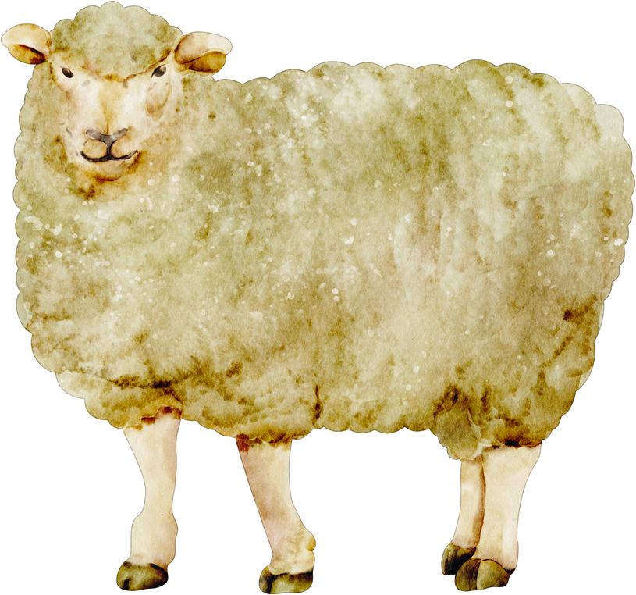
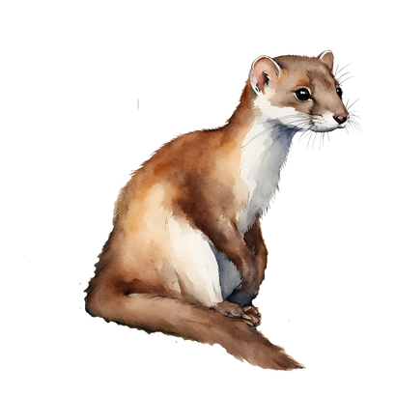
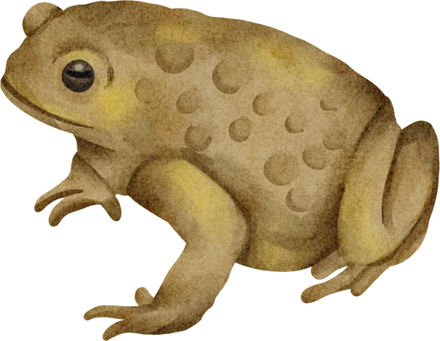
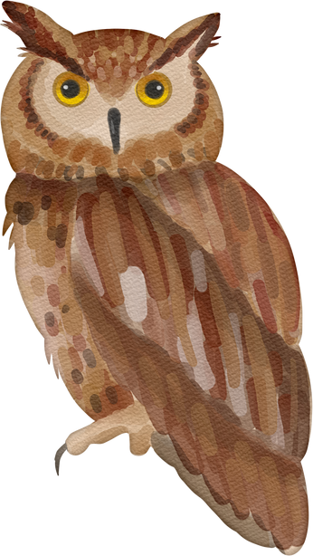
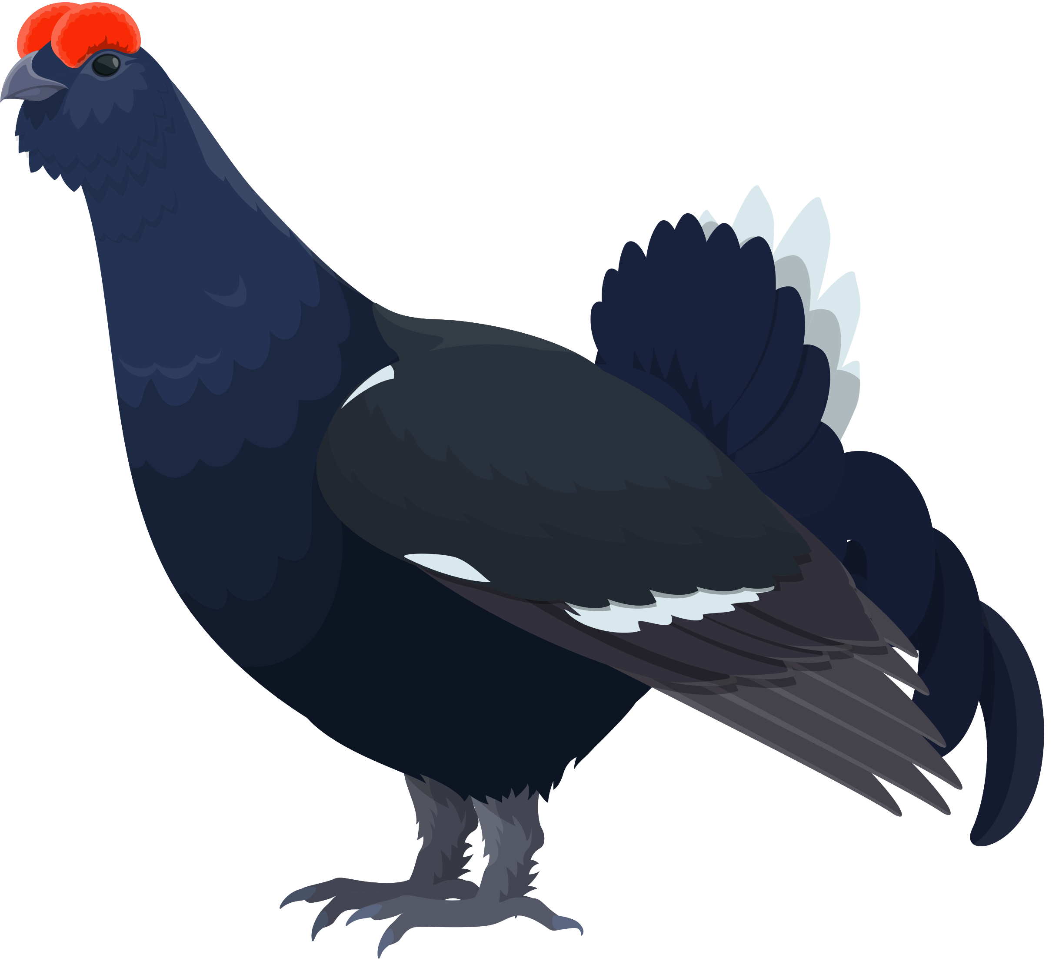
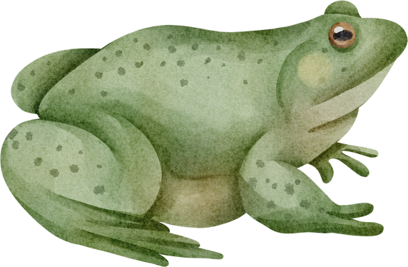
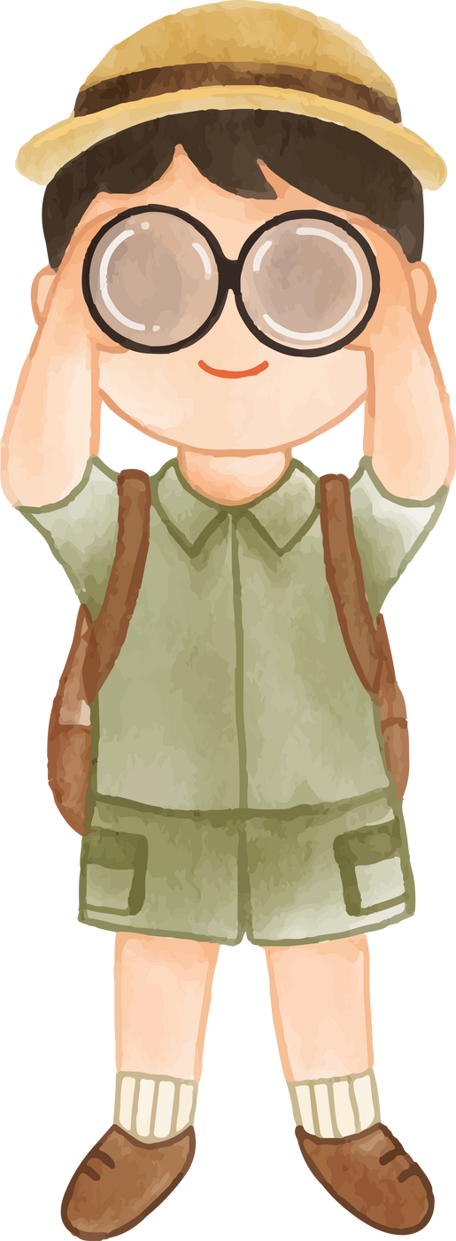
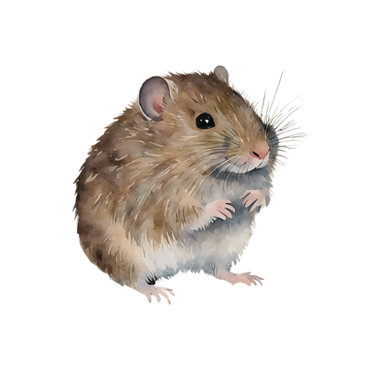
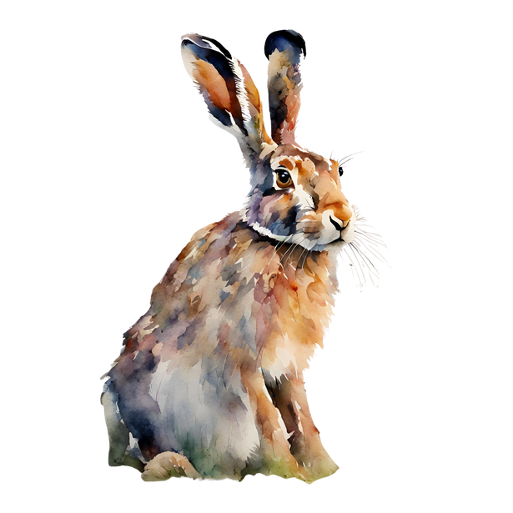











Let’s Take a Closer Look at the Animals We Might Find

Slide 13
Let’s Take a Closer Look at the Animals We Might Find
Amphibians
Mammals
Birds
Invertebrates
Reptiles

Slide 14


Time to get scientific
Why is it important to know what species are on the moor?
Where do we start looking?
Quadrats - these are one way to focus on a small area to find what is there.

Slide 15





You will need:
Lapwing
Gets its food from
Caterpillars
Beetles
Worms
Flies
A view of Cuthbert’s Moor
Species Cards
Recording Sheets
Whiteboard Pen
Quadrat

Slide 16
Activity - Using Quadrats
Animal Recording Sheet - record the number of each animal species that you find in your quadrat. It will be easier if you circle them when you spot any.
Plant Recording Sheet - record how many squares each plant species is growing in. It will be easier to count one species at a time.

Slide 17



Recording your results
You can show your results on a Bar Graph to make it easier for people to understand.
In this example there were 7 quadrat squares that contained Sphagnum Moss.

Slide 18



Credits
Lapwing, Curlew and Black Grouse sound recordings by Simon Elliott
‘The Day We Found The Bog’ Video
Peatland Structure Diagram - Martin-Ortega, J., Glenk, K., & Byg, A. (2017). Online Peatland Learning Module. Peatland Action, Scottish Natural Heritage.
Thanks to funding provided by

